Slide 1

A System to Distinguish Native and Nonnative Written English

Slide 2
Goals
Develop classifiers to distinguish native written English from that written by L1-Spanish speakers.
Focus on advanced learner English (i.e., don’t rely on detecting errors).
Design the classifier such that it could be used as the basis of a learning tool.

Slide 3
Resources Used
Corpora of native and nonnative English
Stanford Parser
Weka Machine Learning Tools

Slide 4
Corpora
Corpus | Tokens Native | Tokens Nonnative
BROWN | 57,809 | 0
ICE-HK | 59,674 | 0
MICUSP | 163,218 | 29,897
MSUELI | 0 | 538
OANC | 84,052 | 0
SPICLE | 0 | 216,879
SULEC | 0 | 39,254
WRICLE | 0 | 96,247
ICE-CAN | 25,225 | 2,070
Total | 389,978 | 384,885
321 Native Samples and 321 Nonnative Samples

Slide 5
Stanford Parser
Probabilistic parser
Developed by Stanford
Generates parse trees and dependency relationship.

Slide 6
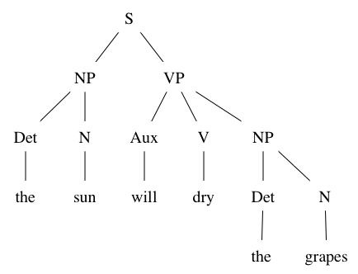
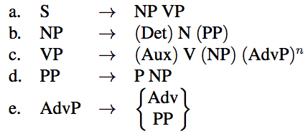
Parse Trees

Slide 7
Dependencies
conj
nsubj
dobj
advmod
det
You do things and do things and nobody really has a clue.

Slide 8
Weka
Machine Learning
  Attributes/Values
  Training Cases
  Testing Cases

Slide 9
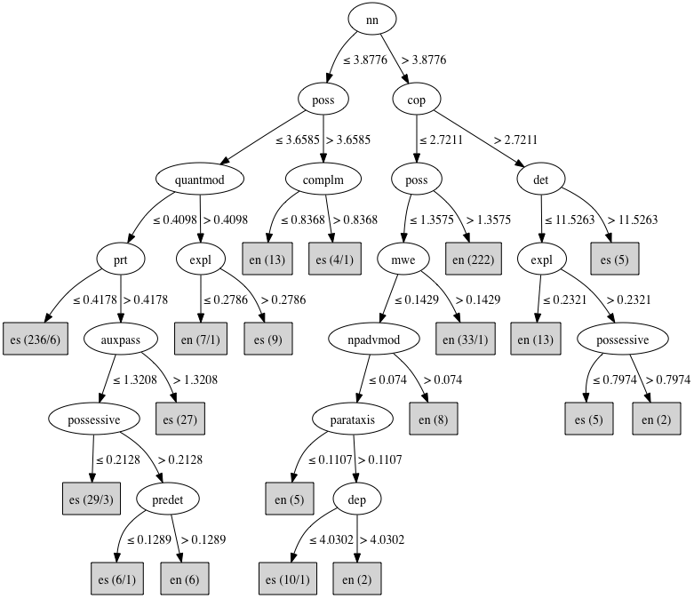
Decision Tree

Slide 10
Dependency Experiment
Relative frequency of dependencies
One attribute for each dependency
Value associated with each dependency is the number of occurrences of that dependency divided by the number of occurrences of all dependencies.

Slide 11
Dependency Experiment
Results
Overall accuracy of between 90% and 94%.
Errors tend to come from classifying native as nonnative.

Slide 12
Verbal Argument Experiment
Verbal argument roles:
  Subject, object, indirect object, subject complement, patient, etc.
  Derivable from dependency graphs
An argument can either be a pronoun or a lexical noun
From this a number of features can be derived

Slide 13
Verbal Argument Experiment
Results
Overall accuracy of between 67% and 74%.
Again, errors tend to come from classifying native as nonnative.

Slide 14
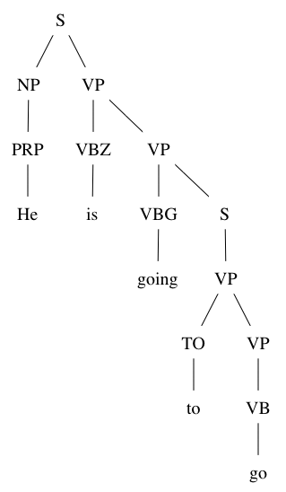
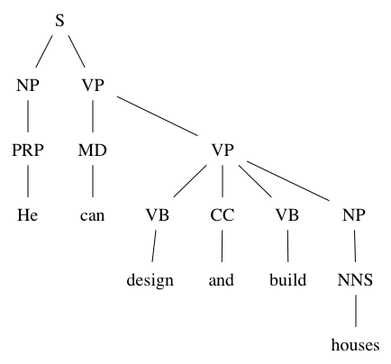
Verb Form Experiment
Determine verbal forms from parse trees.
Phrasal Modal
Core Modal with Two Main Verbs

Slide 15
Verb Form Experiment
Identifies the following features:
  Tense, aspect, voice, core modals, phrasal modals, the helping verbs be, get, have, do, and the negative particle not

Slide 16
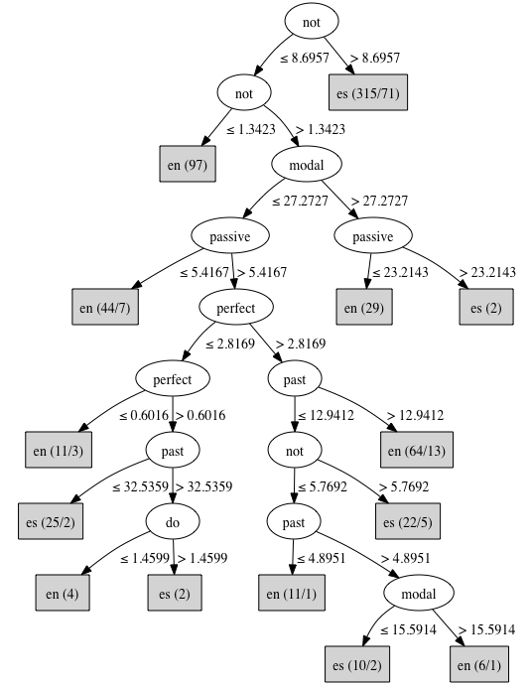
Verb Form Experiment

Slide 17
Verb Form Experiment
Results
Overall accuracy of between 85% and 90%.
Again, errors tend to come from classifying native as nonnative.

Slide 18
Other Possible Attributes
Syntactic complexity (parse tree depth, phrase nesting, etc.)
Types of phrases
Vocabulary (of structural words in particular)
etc.

Slide 19
Learning Tool
Use classifiers to determine if text is identifiably nonnative.
Inform user which features were responsible for classification as nonnative.
Show user which parts of the text exhibit these features.
User edits and reevaluates until text is classified as native.

Slide 20
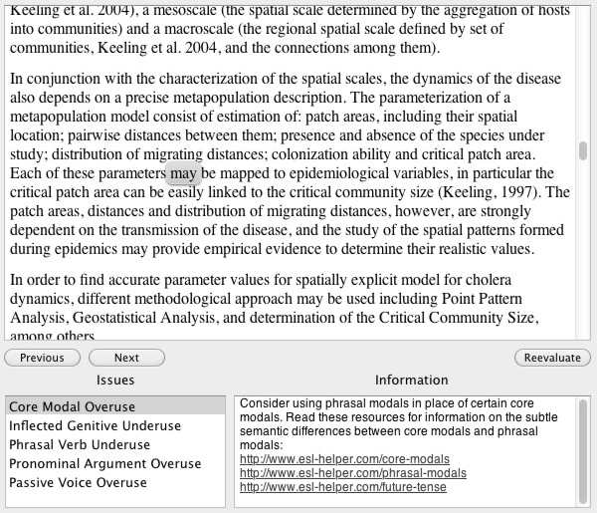
Learner Tool Mock-up

Slide 21
Other Possible Applications
Identifying plagiarism among ESL student.
Determining first language of the writer of a text sample (forensics?).

