Slide 1

A System to Distinguish Between Native and Nonnative Written English

Slide 2
Goals
Develop classifiers to distinguish native written English from that written by L1-Spanish speakers.
Focus on advanced learner English (i.e., don’t rely on detecting errors).
Design the classifier such that it could be used as the basis of a learning tool.

Slide 3
Resources Used
Corpora of native and nonnative English
Stanford Parser
Weka Machine Learning Tools

Slide 4
Corpora
Corpus | Tokens Native | Tokens Nonnative
BROWN | 57,809 | 0
ICE-HK | 59,674 | 0
MICUSP | 163,218 | 29,897
MSUELI | 0 | 538
OANC | 84,052 | 0
SPICLE | 0 | 216,879
SULEC | 0 | 39,254
WRICLE | 0 | 96,247
ICE-CAN | 25,225 | 2,070
Total | 389,978 | 384,885
321 Native Samples and 321 Nonnative Samples

Slide 5
Stanford Parser
Probabilistic parser
Developed by Stanford
Generates parse trees and dependency relationship.

Slide 6
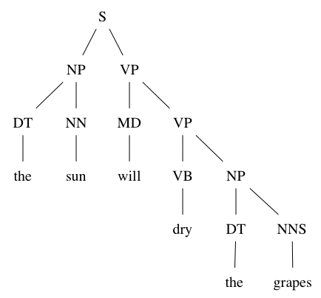
Parse Trees

Slide 7
Weka
Machine Learning
  Attributes/Values
  Training Cases
  Testing Cases

Slide 8
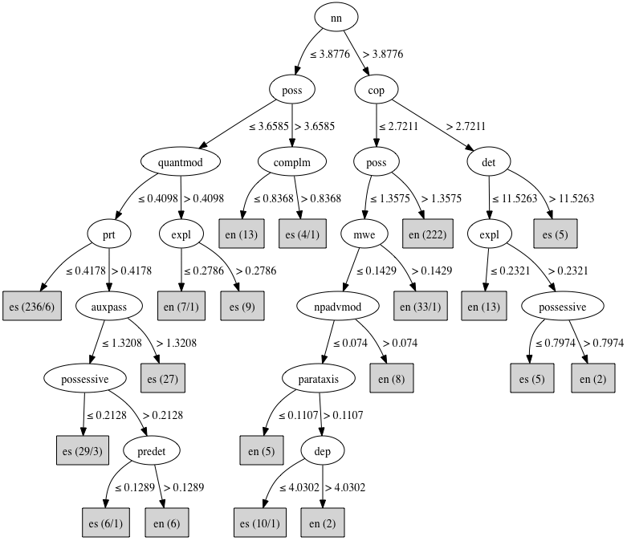
Example Decision Tree

Slide 9
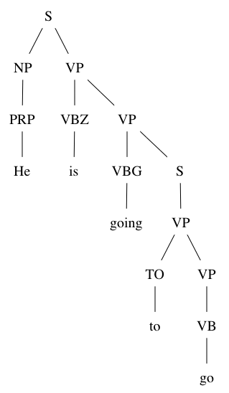
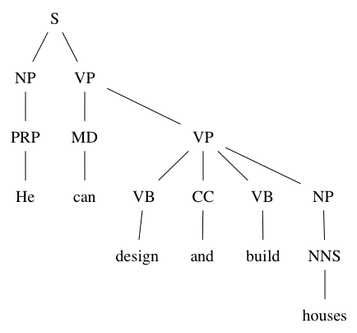
Verb Form Experiment
Determine verbal forms from parse trees.
Phrasal Modal
Core Modal with Two Main Verbs

Slide 10
Verb Form Experiment
Attempt to classify text based on verb usage.
Attribute sets based on the following features:
  Tense, aspect, voice, core modals, phrasal modals, the helping verbs be, get, have, do, and the negative particle not

Slide 11
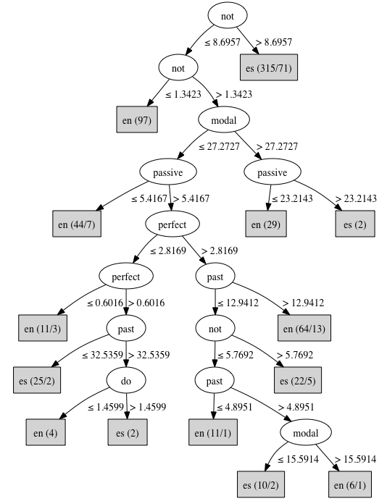
Simplified Decision Tree

Slide 12
Verb Form Experiment
Results
Overall accuracy of between 85% and 90%.
Errors tend to come from classifying native as nonnative.

Slide 13
Learning Tool
Use classifiers to determine if text is identifiably nonnative.
Inform user which features were responsible for classification as nonnative.
Show user which parts of the text exhibit these features.
User edits and reevaluates until text is classified as native.

Slide 14
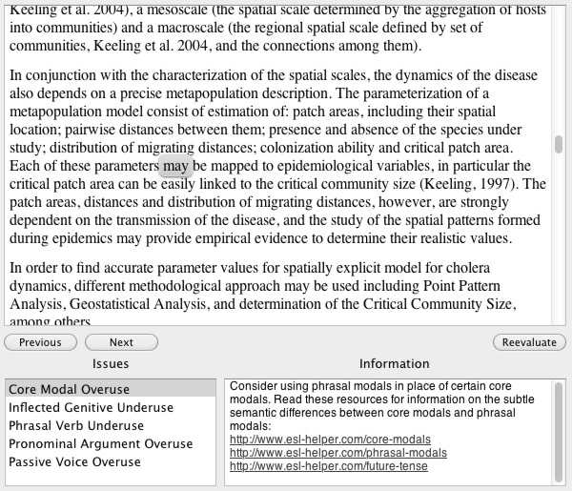
Learner Tool Mock-up

Slide 15
Other Possible Applications
Identifying plagiarism among ESL student.
Determining first language of the writer of a text sample (forensics?).

