Slide 1
BIOS0030 Final Session Info
Week 8 (this week): Complete assessed coursework 2 hand in 10am Friday
Week 9:
Practical – Reserved for working on Assessed Project
(Write-up due after Xmas break)
Lecture – Working with biological networks
Week 10:
Practical – Assessed Test on Dec 13th
Starts at 2:15pm (or 4:30pm for students with clashes)
Alternative arrangements will be put in place for students with EC
Lecture – will be an extra session in a computer room to give you
more time to work on project activities

Slide 2
BIOS0030 Project Options
Option 1: Use Python to run disease simulations to explore the behaviour of diseases under different conditions (e.g. levels of vaccination/resistance, and lockdown strategies).
Option 2: Use Python to analyse the heart rate variability of recordings in the Fantasia heartbeat dataset and present the analysis results.

Slide 3
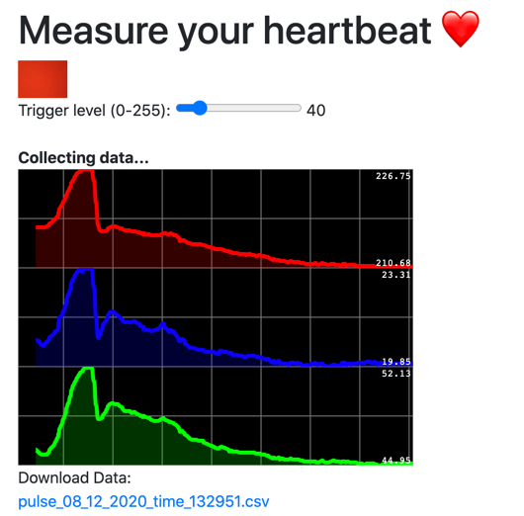
Collecting your own heart rate data
https://sysmic.ac.uk/pulse

Slide 4
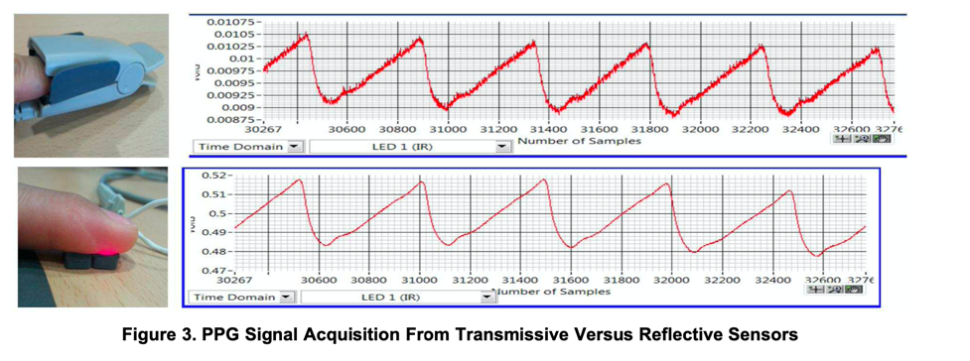
Collecting your own heart rate data
https://sysmic.ac.uk/pulse

Slide 5
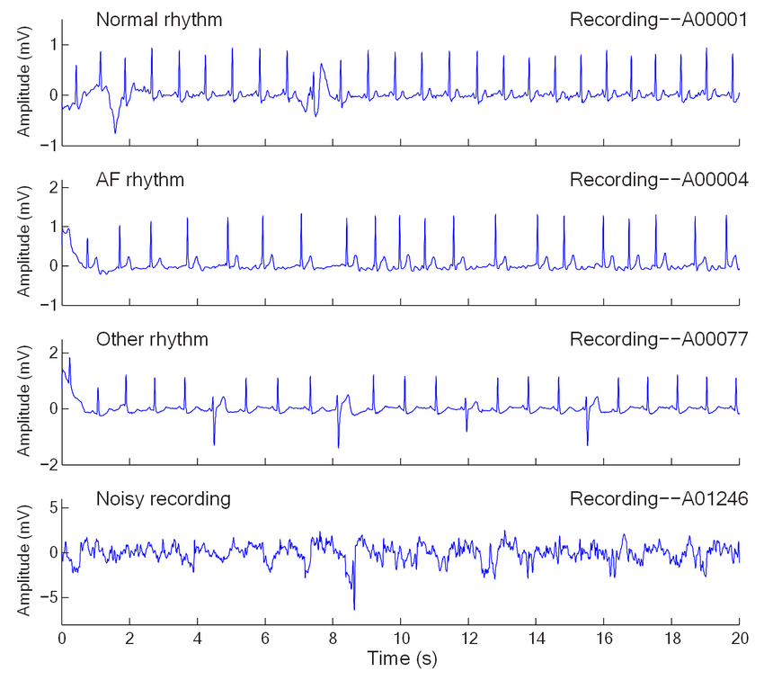
Examples of ECG data

Slide 6
Working with ECG data
ECG file

Slide 7
Working with ECG data
ECG file
Annotate
peaks

Slide 8
Working with ECG data
ECG file
Annotate
peaks
Annotation data
peaks (ms) | 180 | 980 | 1749 | 2517 | 3307 | 4105 | 4893 | 5669 | 6441 | 7281 | 8092

Slide 9
Working with ECG data
ECG file
Annotate
peaks
Annotation data
peaks (ms) | 180 | 980 | 1749 | 2517 | 3307 | 4105 | 4893 | 5669 | 6441 | 7281 | 8092
Interval between peaks
nn (ms) | 800 | 769 | 768 | 790 | 798 | 788 | 776 | 772 | 840 | 811

Slide 10
Working with ECG data
ECG file
Annotate
peaks
Annotation data
peaks (ms) | 180 | 980 | 1749 | 2517 | 3307 | 4105 | 4893 | 5669 | 6441 | 7281 | 8092
Interval between peaks
nn (ms) | 800 | 769 | 768 | 790 | 798 | 788 | 776 | 772 | 840 | 811
Differences between consecutive intervals
diff | 30 | 1 | -22 | -8 | 11 | 12 | 4 | -68 | 29

Slide 11
Working with ECG data
You can find definitions for the different measurements in the following papers:
Heart Rate Variability
Circulation. 1996;93:1043–1065
https://www.ahajournals.org/doi/full/10.1161/01.cir.93.5.1043
An Overview of Heart Rate Variability Metrics and Norms
Frontiers in Public Health. 2017; 5: 258.
https://www.ncbi.nlm.nih.gov/pmc/articles/PMC5624990/

Slide 12
Working with ECG data

