Slide 1




Next Generation Secure Computing Base - Overview and Drilldown
Session Code: ARC341
Keith Kaplan, Senior Security Developer
Ellen Cram, Lead Program Manager
Microsoft Corporation

Slide 2
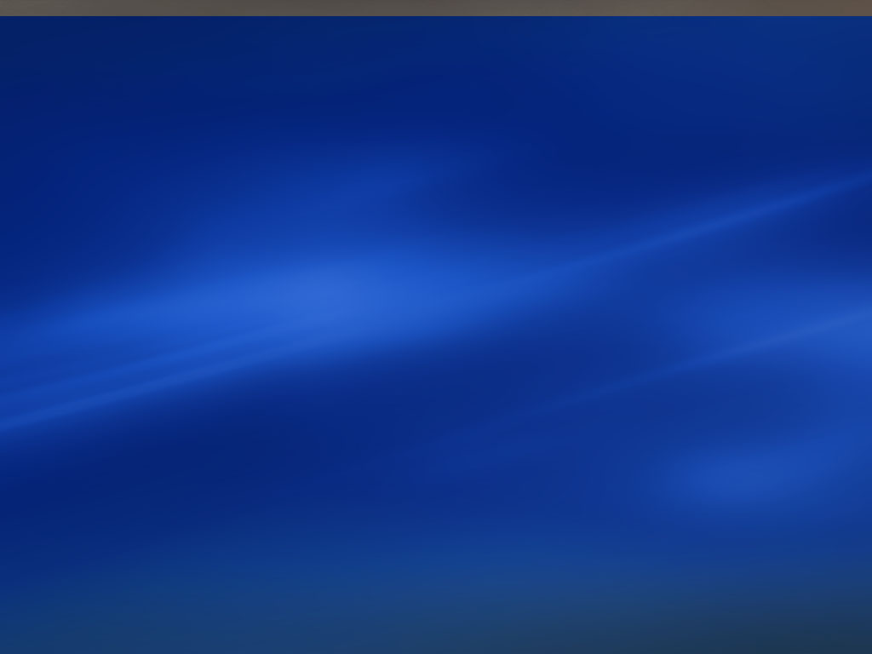
Agenda
NGSCB overview
Nexus fundamentals
Writing an NGSCB agent
Summary
Q & A

Slide 3

Next Generation Secure Computing Base Defined
Microsoft’s Next-Generation Secure Computing Base (NGSCB) is a new security technology for the Microsoft Windows platform
  Uses both hardware and software to protect data
  Offers new kinds of security and privacy protections in an interconnected world

Slide 4
Threats Mitigated in V1
Tampering with Data
  Strong process isolation prevents rogue applications from changing our data or code while it is running
  Sealed storage verifies the integrity of data when unsealing it
Information Disclosure
  Sealed storage prevents rogue applications from getting at your encrypted data
Repudiation
  Attestation enables you to verify that you are dealing with an application and machine configuration you trust
Spoofing Identity
  Secure path enables you to be sure that you’re dealing with the real user, not an application spoofing the user

Slide 5
Version 1 Details
Fully aligned with Longhorn
  Ships as part of Longhorn
  Betas and other releases in synch with and delivered with Longhorn’s
Focused on enterprise applications
Example opportunities:
  Document signing
  Secure IM
  Internal applications for viewing secure data
  Secure email plug-in

Slide 6
NGSCB
Standard-Mode (“std-mode” / LHS)
Nexus-Mode (RHS)
Nexus-Mode
Agent
Agent
Agent
Agent
Agent
Agent
User
Trusted UI
Engine (TUE)
Trusted UI
Engine (TUE)
User Apps.
TSP
TSP
TSP
TSP
TSP
TSP
NCA Runtime Library
NCA Runtime Library
Main OS
Nexus
Nexus
Kernel
USB
Driver
NexusMgr.sys
NAL
NAL
HAL
Hardware
Secure Input
Secure Video
TPM 1.2
CPU
Chipset

Slide 7
Best of Both Worlds
RHS = Security
  In the presence of adversarial LHS code the system must not leak secrets
    → The RHS must NOT rely on the LHS
    for security
LHS = Richness and Compatibility
  In the absence of LHS cooperation NGSCB does not run
    → The RHS MUST rely on the LHS for stability and services

Slide 8
What Runs on the LHS
Windows as you know it today
Applications and drivers still run
Viruses too
Any software, with minor exceptions
  The new hardware won’t allow certain “bad” behaviors, e.g., code that:
    Copies all of memory from one location to
    the next
    Puts the CPU in real mode

Slide 9
Nexus Mode Environment
Basic Operating System Functions
  Process and Thread Loader/Manager
  Memory Manager
  I/O Manager
  Security Reference Monitor
  Interrupt handling/Hardware abstraction
But not a complete Operating System
  No File System
  No Networking
  No Kernel Mode/Privileged Device Drivers
  No Direct X
  No Scheduling
  No…
Kernel mode has no pluggables
  All of the kernel loaded at boot and in the PCR

Slide 10

NGSCB Features
All NGSCB-enabled application capabilities build off of four key features
  Strong process isolation
  Sealed storage
  Secure path
  Attestation
The first three are needed to protect against malicious code
Attestation breaks new ground in distributed computing
  “Subjects” (software, machines, services) can be securely authenticated
  This is separate from user authentication

Slide 11

Strong Process Isolation
Agents run in curtained memory
  Not accessible by other agents
  Not accessible by the standard
  Windows kernel
  Not accessible by hardware DMA
Enforced by NGSCB hardware
and software
  Hardware notifies Nexus of certain operations
  Nexus arbitrates page tables, control registers, etc.

Slide 12

Secure Path
Secure input
  Secure session between device and Nexus
  Protects both keyboard and mouse
  USB for desktops, integrated input
  for laptops
Secure output
  Secure channel between graphics adaptor and Nexus

Slide 13

Sealed Storage
Provides a method for encrypting data with a key rooted in the hardware
  Sealed data can only be accessed by
  authenticated entities
  Each Nexus generates a random keyset on first load
  TPM chip on motherboard protects the Nexus keyset
  Agents use Nexus facilities to seal (encrypt and sign) private data
  The Nexus protects the key from any other agent/application, and the hardware prevents any other Nexus from gaining access to the key

Slide 14

Attestation
When requested, the Nexus can prepare a chain
that authenticates:
  Agent by digest, signed by the Nexus
  Nexus by digest, signed by the TPM
  TPM by public key, signed by OEM or IT department
The machine owner sets policy to control which forms of attestation each NCA or group of NCAs can use
Secure communications agent provides higher-level services to agent developers
  Open a secure channel to a service using a secure session key
  Respond to an attestation challenge from the service based
  on user policy

Slide 15
“Booting” the Nexus
The Nexus is like a kernel
A kernel has to boot sometime
The Nexus can boot any time
It can shut down when it’s not needed (and restart later)

Slide 16
Shadow Process and Threads
The Nexus has no scheduler
LHS threads to call the right to load and run a RHS thread
These LHS threads are part of the Agent’s LHS shadow process
Not getting scheduled again does not leak a secret
Safe RHS synchronization primitives

Slide 17
Summary
NGSCB ships as part of Longhorn
NGSCB is a combination of
  New hardware which creates a secure environment for…
  …A new kernel, called the Nexus, which…
  …Will run agents in a secure memory partition, and which…
  …Will provide these agents with security services so that they can…
  …Provide users with trustworthy computing
Remember that:
  When the Nexus is turned off, literally everything runs just like before
  When the Nexus is on, the LHS runs very close to everything that ever ran
  The Nexus makes no claims about what runs on the LHS
  The hardware should run any Nexus, and give full function to any Nexus (with, at most, an admin step by the user)
  The Nexus will run any software the user tells it to

Slide 18
Writing An Agent
Ellen Cram
Program Manager
Microsoft

Slide 19
Writing NGSCB Agents
Agents may be written in C or C++, using any compiler
  Agents can be instantiated from managed or unmanaged code
Once we have a RHS CLR, agents will be able to be written in any .Net language
  The RHS CLR is planned to ship subsequently

Slide 20
Writing NGSCB Agents
Two classes of RHS functions:
  Functions enhanced by NGSCB
    We use the hardware and protected environment to make these calls safer than they would be on standard Windows
  Functions not protected by NGSCB
    Indicated by a specific prefix
    These functions are not any safer than an equivalent function in standard Windows
      Developers must interact with these intelligently, such as encrypting data using sealed storage before writing it to disk
    Our goal is to enhance these functions with NGSCB in future version

Slide 21
Types of Agents
Application agents - stand-alone applications
  The entire application runs on the RHS
  Application agents are good for clients in multi-tier applications
  Example: online banking client
Component agents - components of a larger application
  Most of the app runs on the LHS
    Agents are used for specific trusted operations
  A LHS proxy translates between COM or .Net and NGSCB IPC
  Good for adding trusted features to existing Windows apps
  Example: document signing component of a word processor

Slide 22
Agent Manifest
Provides the information about an application that a machine user uses to determine if the app should run
Signed XML document that defines:
  Agent components
  Agent properties
    System requirements
      Enforced by NGSCB
      E.g. Debuggable = FALSE
    Descriptive properties
      Not interpreted nor enforced by the system
      E.g. Version = 1.1.2.2
  Agent policy requests
    E.g. access to trusted output, write access to a counter, etc.
XML schema is an NGSCB-specific extension to the standard Longhorn manifest
Policy requests are not binding
  Machine owner policy overrides manifest policy requests

Slide 23
System Policy
Set by the machine owner
  The owner may allow users the ability to override or extend
  The owner may choose to delegate policy and trust decisions
  to a 3rd party
    “Use Foo Org’s policies for any agent signed by Bar”
    “Use my IT department’s policies for all agents”
Expressed using signed XrML policy certificates
Resources controlled by system policy include
  Running an agent
  Responding to an attestation challenge
  Accessing a specific secret
  Accessing NGSCB API sets (such as the network API)
  Creating a child process
  Accessing the TUE
Policy is checked at run-time for every request
  Some policy decisions are cached in the Nexus for performance reasons

Slide 24
Factoring Agents
Agents are monolithic - no DLLs
  Code can be shared using statically-linked libraries
Composition of agents is based on IPC
  IPC is blocking and message-oriented
  Agents and LHS processes can both use IPC
    Agents can communicate with other agents
    LHS applications can communicate with agents they start
  Access to IPC is controlled by policy

Slide 25
Standard Windows (LHS)
NGSCB (RHS)
NGSCB
Agent 2
User Mode
Standard
Application
NGSCB
Agent 1
Agent 1 puts a size and byte array into a user mode buffer
Standard
Windows
Kernel
NGSCB Nexus
Kernel Mode

Slide 26
Standard Windows (LHS)
NGSCB (RHS)
NGSCB
Agent 2
User Mode
Standard
Application
NGSCB
Agent 1
Agent 1 puts a size and byte array into a user mode buffer
Standard
Windows
Kernel
NGSCB Nexus
The Nexus copies the data into a kernel mode buffer
Kernel Mode

Slide 27
Standard Windows (LHS)
NGSCB (RHS)
NGSCB
Agent 2
User Mode
Standard
Application
NGSCB
Agent 1
The Nexus copies the data into a user mode buffer
Agent 1 puts a size and byte array into a user mode buffer
Standard
Windows
Kernel
NGSCB Nexus
The Nexus copies the data into a kernel mode buffer
Kernel Mode

Slide 28
Standard Windows (LHS)
NGSCB (RHS)
NGSCB
Agent 2
User Mode
Standard
Application
NGSCB
Agent 1
Agent 1 puts a size and byte array into a user mode buffer
Standard
Windows
Kernel
NGSCB Nexus
Kernel Mode

Slide 29
Standard Windows (LHS)
NGSCB (RHS)
NGSCB
Agent 2
User Mode
Standard
Application
NGSCB
Agent 1
Agent 1 puts a size and byte array into a user mode buffer
Standard
Windows
Kernel
NGSCB Nexus
The Nexus copies the data into a kernel mode buffer
Kernel Mode

Slide 30
Standard Windows (LHS)
NGSCB (RHS)
NGSCB
Agent 2
User Mode
Standard
Application
NGSCB
Agent 1
Agent 1 puts a size and byte array into a user mode buffer
Standard
Windows
Kernel
Windows copies the data into a kernel mode buffer
NGSCB Nexus
The Nexus copies the data into a kernel mode buffer
Kernel Mode

Slide 31
Standard Windows (LHS)
NGSCB (RHS)
NGSCB
Agent 2
User Mode
Standard
Application
NGSCB
Agent 1
Windows copies the data into a user mode buffer
Agent 1 puts a size and byte array into a user mode buffer
Standard
Windows
Kernel
Windows copies the data into a kernel mode buffer
NGSCB Nexus
The Nexus copies the data into a kernel mode buffer
Kernel Mode

Slide 32
User Mode Debugging
Agents are only debuggable if set in the manifest
  Changing the manifest to enable debugging changes the agent’s code identity
  This change is reflected by attestation
Debugging an agent really means debugging via LHS shadow process
  We’ve redirected the functions to Get and Set Thread Context and Read and Write Process Memory
  We’ve redirected RHS debug events to the LHS process
  Thread control “just works”
All well behaved debuggers that work with LHS processes will also with agents

Slide 33
What You Can Do Today
The Longhorn release you receive here at PDC contains NGSCB developer preview
  The Longhorn SDK also contains APIs for NGSCB
The developer preview SDK is provided so that developers can understand the features and APIs we are providing
  It does not demonstrate the security of NGSCB
The NGSCB developer preview will enable you to prototype most applications you might write on
NGSCB V1
  The SDK may change before we RTM
The developer preview includes a software emulator which simulates the NGSCB environment
  You do not need new hardware to run it

Slide 34
NGSCB Developer Preview
The developer preview supports
  Creating an agent in Visual Studio
    Debugging must be done on the command line at this point
  Simulated Sealed Storage
  Simulated Attestation
  IPC
  Standard Windows and CRT style APIs
The developer preview does not provide
  Secure Path
  Strong Process Isolation

Slide 35
Summary
NGSCB is made up of four key features
  Strong process isolation
  Sealed storage
  Secure path
  Attestation
These features can be utilized either through stand-alone or componentized applications
The NGSCB development environment is similar, although more constrained, than the standard
Windows environment
  Agents are monolithic - no DLLs
  Composition of agents is based on IPC
You can start experimenting with NGSCB APIs as part of the Longhorn SDK

Slide 36
Resources/Next Steps
Go to our Hands On Lab here at PDC
  NGSCB developers, testers and program managers
  are ready to answer your questions
Study the SDK you received here at PDC
  NGSCB is part of the Longhorn SDK
Ask your hardware and software vendors what NGSCB-enabled components they will provide
Visit our site and read the white papers and specs
  http://www.microsoft.com/ngscb
Send questions to our Q&A alias
  ngscb_qa@microsoft.com
Sign up for e-mail updates
  Subscribe to the NGSCB information newsletter for ongoing updates. Send blank e-mail to:
    wtpiinfo-subscribe@pens.tm500.com

Slide 37
© 2003-2004 Microsoft Corporation. All rights reserved.
This presentation is for informational purposes only. Microsoft makes no warranties, express or implied, in this summary.
Notes:
<footer>© 2003-2004 Microsoft Corporation. All rights reserved.
This presentation is for informational purposes only. Microsoft makes no warranties, express or implied, in this summary.

