Slide 1


Solutions for Service Oriented Architectures
Session Code: ARCSYM03
Keith Short
Architect, Enterprise Tools, Visual Studio
Microsoft Corporation
keithsh@microsoft.com

Slide 2


Summary
Building Service Oriented Applications is a complex undertaking
We can improve the underlying frameworks and languages to help
But modeling languages and tools have an important role to play
We can build effective modeling tools if we follow some simple rules

Slide 3
New Business Requirements
  Automate business processes
  Value chains with partners
  Customer and supplier self service
  Improve ROI of IT
  Lower operating costs
  Cut time to market

Slide 4
New Application Architecture
  Automate business processes
  Improve ROI of IT
  Lower operating costs
  Cut time to market
  Value chains with partners
  Customer and supplier self service
  Service oriented architecture
  Web Services, messaging, contracts
  Security
  Caching and state management
  Deployment policies & constraints
  Heterogeneous platforms

Slide 5
Evolving Platform Technology
  Automate business processes
  Improve ROI of IT
  Lower operating costs
  Cut time to market
  Value chains with partners
  Customer and supplier self service
  Application Servers and standards
  Schemas and databases
  Code and attributes
  Configuration files
  Project structures
  Physical server configurations
  Service oriented architecture
  Messaging and protocols
  Security
  Caching and state management
  Deployment policies & constraints
  Heterogeneous platforms

Slide 6
Complexity
?
  Automate business processes
  Value chains with partners
  Customer and supplier self service
  Improve ROI of IT
  Lower operating costs
  Cut time to market
  Service oriented architecture
  Web Services, messaging, contracts
  Security
  Caching and state management
  Deployment policies & constraints
  Heterogeneous platforms
  Application servers & standards
  Schemas and databases
  Code and attributes
  Configuration files
  Project structures
  Physical server configurations

Slide 7
Where Does Complexity Arise?
«entity»
0..1
«entity»
Credit Card
1
User
+ accountNumber : String
+ address : String
+ cardType : String
+ city : String
+ expirationDate : Long
+ country : String
+ nameOnCard : String
+ email : String
+ uid : String
+ groupId : String
+ userUid : String
+ password : String
1..*
+ secretNumber : Integer
+ setValues ( )
+ state : String
+ getValues ( )
+ status : String
1
+ uid : String
«derived»
+ userId : String
High Level Concepts
«entity»
+ zip : String
«entity»
Seller
Buyer
1
1...
«entity»
«entity»
Auction
Bid
+ categoryUid : String
+ amount : Float
+ creditCardAccount : String
+ auctionUid : String
0..1
+ creditCardExpiration : Long
+ buyerUid : String
+ creditCardName : String
+ cancelExplanation : String
+ creditCardType : String
+ date : Long
+ endTime : Long
+ status : String
+ itemUid : String
+ uid : String
+ minimumBidIncrement : Float
+ sellerUid : String
+ startingPrice : Float
+ startTime : Long
+ status : String
+ timezoneUid : String
+ uid : String
+ setValues ( )
+ getValues ( )
?
Low-level Implementation languages
package com.microsoftpearlcircle.auction.auctionmanager.business.auctionmanager;
import java.rmi.RemoteException;
import java.util.Vector;

Slide 8
Abstraction Reduces Complexity
Domain Specific Abstractions
C#, Java, etc
General Purpose Abstractions
Assembler, Pcode,
CLR IL
Bytecode or machine languages

Slide 9
Frameworks Reduce Translation Complexity
Domain Specific Abstractions
Frameworks
E.g. ASP.Net
Domain Specific Frameworks
C#, Java, etc
General Purpose Abstractions
Assembler, Pcode,
CLR IL
Bytecode or machine languages

Slide 10

Domain Specific Modeling Language
Domain Specific Abstractions
Narrow Scope
Graphical
Highly Expressive
Coarse-grained abstractions
May be translated into
  General purpose programming languages
  Specific framework completion
  Other modeling languages

Slide 11
Understanding Web Services
Activities <-> Web services
Messages
Sequences
Security
Reuse
Services and Components
Wire-level protocols
etc

Slide 12
Where Does Complexity Arise?
«entity»
0..1
«entity»
High Level Concepts
  Activities
  Messages
  Security
  Reuse
  Components
  Protocols
Credit Card
1
User
+ accountNumber : String
+ address : String
+ cardType : String
+ city : String
+ expirationDate : Long
+ country : String
+ nameOnCard : String
+ email : String
+ uid : String
+ groupId : String
+ userUid : String
+ password : String
1..*
+ secretNumber : Integer
+ setValues ( )
+ state : String
+ getValues ( )
+ status : String
1
+ uid : String
«derived»
+ userId : String
«entity»
+ zip : String
«entity»
Seller
Buyer
1
1...
«entity»
«entity»
Auction
Bid
+ categoryUid : String
+ amount : Float
+ creditCardAccount : String
+ auctionUid : String
0..1
+ creditCardExpiration : Long
+ buyerUid : String
+ creditCardName : String
+ cancelExplanation : String
+ creditCardType : String
+ date : Long
+ endTime : Long
+ status : String
+ itemUid : String
+ uid : String
+ minimumBidIncrement : Float
+ sellerUid : String
+ startingPrice : Float
+ startTime : Long
+ status : String
+ timezoneUid : String
+ uid : String
+ setValues ( )
+ getValues ( )
?
package com.microsoftpearlcircle.auction.auctionmanager.business.auctionmanager;
import java.rmi.RemoteException;
import java.util.Vector;
Low-level Implementation languages

Slide 13
Scattered Concepts …
«entity»
0..1
«entity»
Credit Card
1
User
+ accountNumber : String
+ address : String
+ cardType : String
+ city : String
+ expirationDate : Long
+ country : String
+ nameOnCard : String
+ email : String
+ uid : String
+ groupId : String
+ userUid : String
+ password : String
1..*
+ secretNumber : Integer
+ setValues ( )
+ state : String
+ getValues ( )
+ status : String
1
+ uid : String
«derived»
+ userId : String
«entity»
+ zip : String
«entity»
Seller
Buyer
1
1...
«entity»
«entity»
Auction
Bid
+ categoryUid : String
+ amount : Float
+ creditCardAccount : String
+ auctionUid : String
0..1
+ creditCardExpiration : Long
+ buyerUid : String
+ creditCardName : String
+ cancelExplanation : String
+ creditCardType : String
+ date : Long
+ endTime : Long
+ status : String
+ itemUid : String
+ uid : String
+ minimumBidIncrement : Float
+ sellerUid : String
+ startingPrice : Float
+ startTime : Long
+ status : String
+ timezoneUid : String
+ uid : String
+ setValues ( )
+ getValues ( )
?
Deployment Policies
And Packages
Project Files and
templates
.asmx files
.asmx code behinds
source code
Statements and
attributes
XML Configuration
Files and schemas
(e.g. WSDL files)

Slide 14
…Replaced By A Holistic View
Web Service Interaction DSL
Deployment Policies
And Packages
Project Files and
templates
.asmx files
.asmx code behinds
source code
Statements and
attributes
XML Configuration
Files and schemas
(e.g. WSDL files)

Slide 15

Need A Designer Infrastructure
For a specific aspect of overall development
  Define a metamodel for the abstractions
  Define a graphical notation
  Define a synchronization engine

Slide 16
Complexity
?
  Automate business processes
  Value chains with partners
  Customer and supplier self service
  Improve ROI of IT
  Lower operating costs
  Cut time to market
  Service oriented architecture
  Web Services, messaging, contracts
  Security
  Caching and state management
  Deployment policies & constraints
  Heterogeneous platforms
  Application servers & standards
  Schemas and databases
  Code and attributes
  Configuration files
  Project structures
  Physical server configurations

Slide 17
Simplify Using DSLs
Assess
Plan
Design
Implement
Run
Strategic
Objectives
Manual Procedures
Business
Business Processes
and Entities
Mappings are defined between modeling languages
Each work product can be a separate modeling language
Services, Messages,
Contracts, Schedules
XML, Database, Classes,
Code
Technology
Architecture
Logical
Data Center
Physical servers
and segments
IT

Slide 18
What’s Inside A Viewpoint?
DSLs
Patterns
Processes
Frameworks
Components
Aspects
Transforms
Constraints
May address data or application
Between or within
Assess
Plan
Design
Implement
Run
Strategic
Objectives
Manual Procedures
Business
Business Processes
and Entities
Services, Messages,
Contracts, Schedules
XML, Database, Classes,
Code
Technology
Architecture
Logical
Data Center
Physical servers
and segments
IT

Slide 19
What’s Inside A Viewpoint?
Assess
Plan
Design
Implement
Run
Strategic
Objectives
Manual Procedures
Business
Business Processes
and Entities
Services, Messages,
Contracts, Schedules
XML, Database, Classes,
Code
Technology
Architecture
Logical
Data Center
Physical servers
and segments
IT

Slide 20
Example 1
Assess
Plan
Design
Implement
Run
Strategic
Objectives
Manual Procedures
Business
Business Processes
and Entities
Services, Messages,
Contracts, Schedules
XML, Database, Classes,
Code
Technology
Architecture
Logical
Data Center
Physical servers
and segments
IT

Slide 21
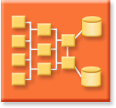
Dynamic Systems Initiative (DSI)
Applications
System
Definition
Model
Application
Hosts
Network Topology
& Operating Systems
Hardware

Slide 22
Whidbey Solutions…
An application designer
System
Definition
Model
Applications
A system hosting designer
A logical data center designer
Application
Hosts

Slide 23
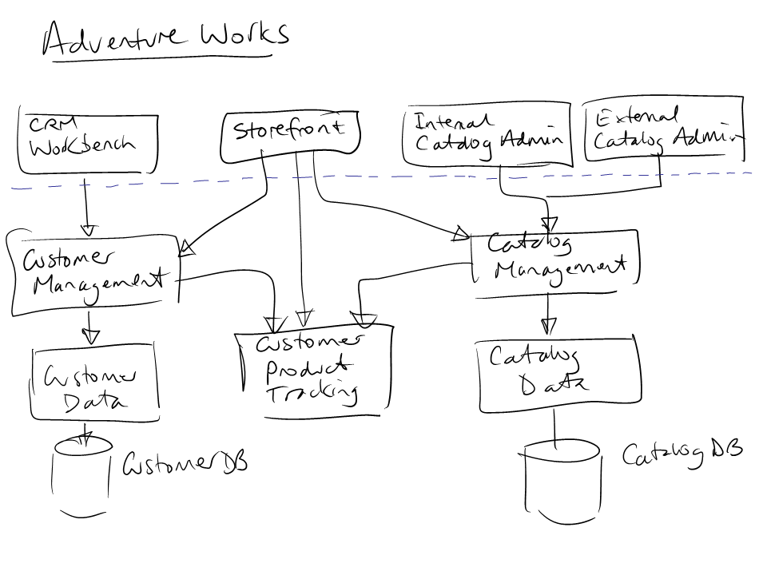
A DSL in Use Today

Slide 24
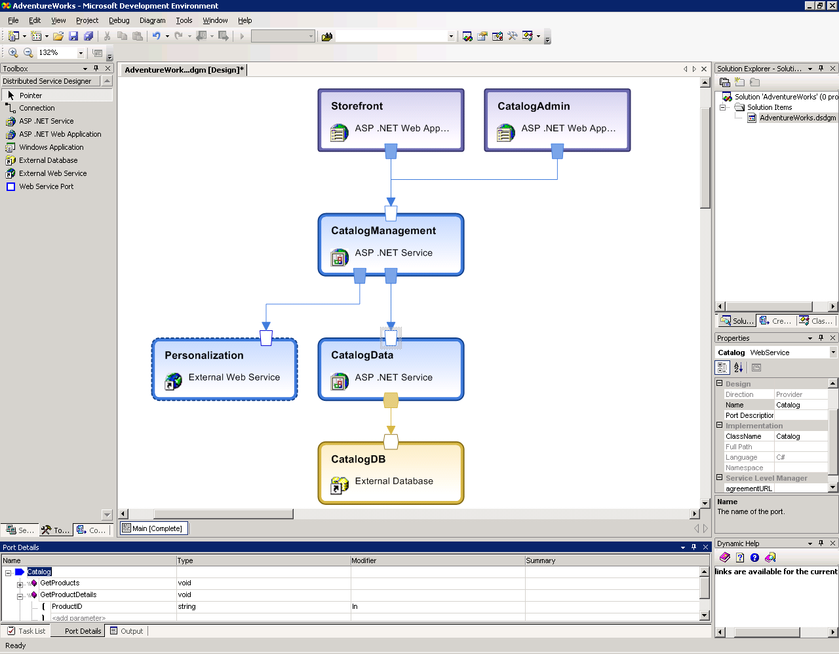

Slide 25
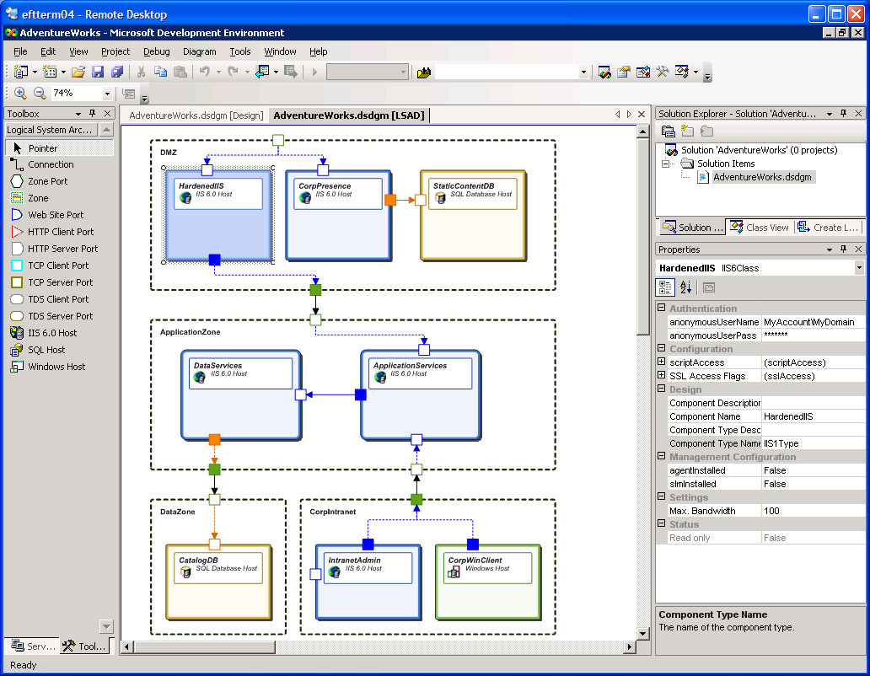

Slide 26
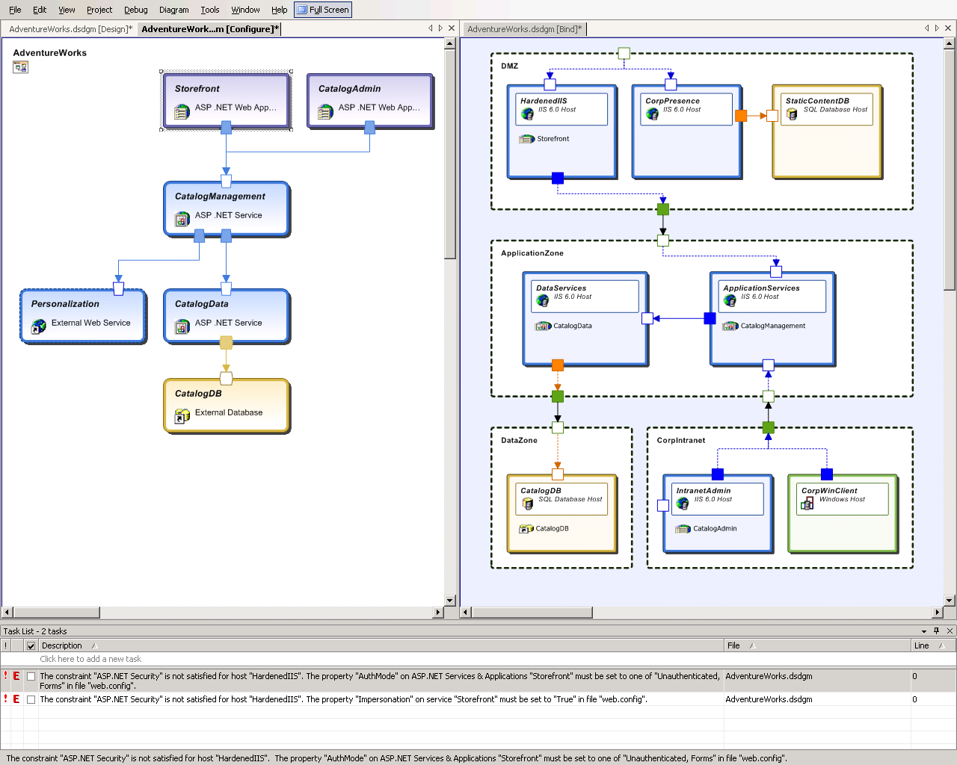

Slide 27


Patterns, Aspects And Transforms
Web Interaction Patterns
  Service Interface
  Gateway
  Façade
Logical System Architecture Patterns
  MSA Patterns
    IDC, EDC
  Layered Architecture Patterns
Aspects
  Transactions
  Security
Transformations
  Validate against deployment infrastructure
  Transform into implementation artifacts

Slide 28

Applying A Service Façade Pattern
Service Facade Pattern
Service
Facade
Project Structures
References
Default XSD schemas
Security Policy
Access Policy
Pass-thru Logic & Filters
Policy Management
Messages
Selected
Messages
Customer Management
Customer Mgmt Facade
Customer Self-Service

Slide 29
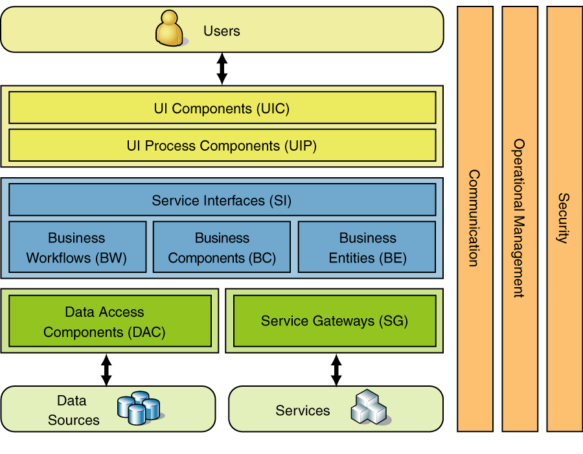
Three Layered Services Application
Discussion Points
  Presentation layer
  Business layer
  Data layer
  Foundation services
Benefits
  Separation of concerns
  Minimal layers
Liabilities
  Complex business logic may require more business layers
  Complex UI apps may require additional UI layers

Slide 30
Aspect Weaving – Instrumentation
Instrumentation Aspect
Pointcut
Aspect
Framework
Policy Management
Pointcut
Call Structure
Code
Pointcut
Customer Management
Aspect
Pointcut
Pointcut
Customer Self-Service
Pointcut
Aspect

Slide 31
Example 2
Assess
Plan
Design
Implement
Run
Strategic
Objectives
Manual Procedures
Business
Business Processes
and Entities
Services, Messages,
Contracts, Schedules
XML, Database, Classes,
Code
Technology
Architecture
Logical
Data Center
Physical servers
and segments
IT

Slide 32
DSLs And Tools
Business Process DSL
  Activities
  Business Event
  Dependencies
  Business Entities
  Documents

Slide 33
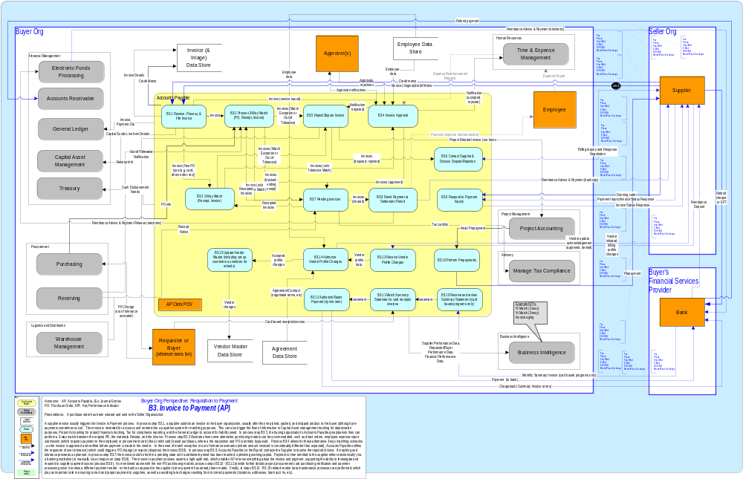
Invoice To Payment

Slide 34
Patterns And Transforms
Process Patterns
  User Process
  Scheduled Process
  Case Process
  Rules Process
Transformations
  Transform into web service collaborations

Slide 35
Build One Business Process DSL?
Assess
Plan
Design
Implement
Run
Strategic
Objectives
Manual Procedures
Business
Huge Variation
Business Processes
and Entities
Services, Messages,
Contracts, Schedules
XML, Database, Classes,
Code
Few Platforms
Technology
Architecture
Logical
Data Center
Physical servers
and segments
IT

Slide 36
Building Applications With DSLs
Choose a specific aspect of overall development
Define a metamodel for the abstractions
  OR extend an existing one
Define a graphical notation
Define a synchronization engine
Build Patterns
Define Aspects

Slide 37
Making Use Of Metadata
Metadata collected in DSLs can be made available across the life cycle
Source control systems
Debuggers
Testing Tools
Compilers and language editors

Slide 38
Enterprise Design Tools
Goal: Simplify design and deployment of SOA’s
Build an initial set of model-driven development tools supporting DSLs
  Focused on specific development tasks
  With hi-fidelity, continuously synchronized mappings to code or other models
Expand and integrate model data throughout life cycle tools
Productize and promote underlying tool-building frameworks and tools

Slide 39
DSL’s Supported
Rich support for designing and constructing connected applications from Web services
Designing WS for operational deployment
  Logical infrastructure requirements considered early – inform and constrain developers
  Verify application settings against logical infrastructure

Slide 40
Review
Modeling languages can help reduce complexity
  Domain-specific abstractions
  Holistic view of scattered concepts
Extensibility is very important
Implementing DSLs can be made effective with the right underlying engine
Microsoft is working to improve Web service design and deployment scenarios

Slide 41
Further Information
Whitepapers on MSDN, Visual Studio Enterprise
http://msdn.microsoft.com/vstudio/enterprise

Slide 42

© 2003-2004 Microsoft Corporation. All rights reserved.
This presentation is for informational purposes only. Microsoft makes no warranties, express or implied, in this summary.

Slide 43
