Slide 1





Tablet PC Platform Roadmap
Session Code: CLI350
David Jones
Lead Program Manager
Tablet PC Platform
davejo@microsoft.com

Slide 2

Agenda
Tablet PC Business update
Tablet PC Platform overview
Microsoft Windows XP Tablet PC Edition Development Kit 1.7
Plans for Longhorn
Q & A

Slide 3

Tablet PC Business Update
Industry Commitment
  OEMs: 40 shipping, 10 in development; 6 multinationals
  2nd, 3rd generation hardware in the pipeline
  130+ Tablet PC ISV’s and growing; Support for Ink in Office 2003, OneNote, Visio, InfoPath, MSN Messenger
Customer Momentum
  Broad corporate evaluation; LOB application testing and development. Customers include: 7-Eleven, Safeco, US Bank
  Verticals quickest to deploy. Healthcare, Education, Insurance
  Strong enthusiast excitement; 8 active community websites
Press, Analyst Support
  Gartner, IDC increasing forecast; tone: “..when, not if..”
  77% reviews recommend purchase
  Tablet hardware and software winning industry awards

Slide 4
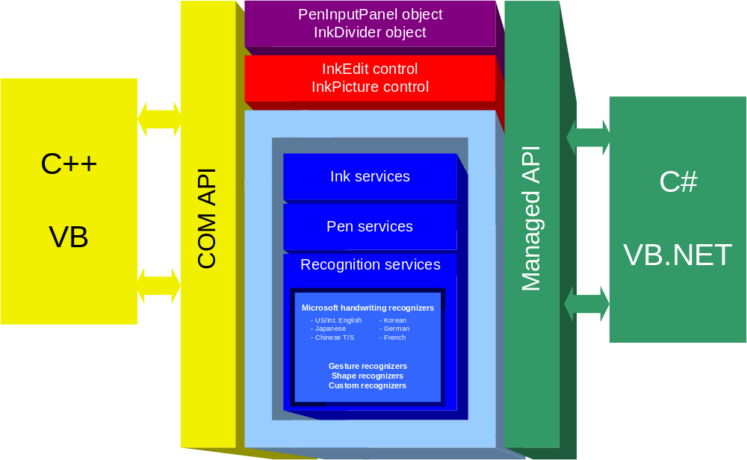
Tablet PC Platform Overview
Tablet PC OS is a superset of Windows XP Professional

Slide 5
Tablet Platform V1.7 SDK
Goal: Address top developer requests
Features
  Web support
  Improved access to real-time pen input data
  Handwriting Recognition improvements via support for context
  Enhanced documentation

Slide 6

Web Support
Microsoft.Ink.dll accepts calls from partially trusted callers
  assemblies running in the internet application domain
Usage scenarios
  Ink controls on web pages
  .Net “No-Touch” deployment
Application examples
  Form filling– inventory management, expense reporting, claim handling, etc.
  Collaboration– shared whiteboard, shared ink annotations, etc.

Slide 7

Web Support

Slide 8
Real Time Stylus
Real Time Stylus (RTS) framework provides complete control over pen input data
  Synchronous and asynchronous access to data
  Simplified threading model
Scenarios enabled
  Non-inkable regions
  Custom dynamic rendering
  Custom gesture detection

Slide 9
RTS Architecture
New object
New Interface
Dynamic Renderer
Existing object
System Gestures
RealTimeEventSink
…
RealTimeStylus
Ink Collecting
Object
queue
Pen
Service
storage
InkCollector
“Inking” Thread
UI Thread

Slide 10
Real Time Stylus

Slide 11
Support for Context
Context = Factoid and/or Wordlist for a given field of text input
  can offer improved recognition results
  can be customized via regular expressions
Common examples:
  Phone Number
  Email address
  URL
  Date
  Word Lists (e.g. list of countries or states)

Slide 12
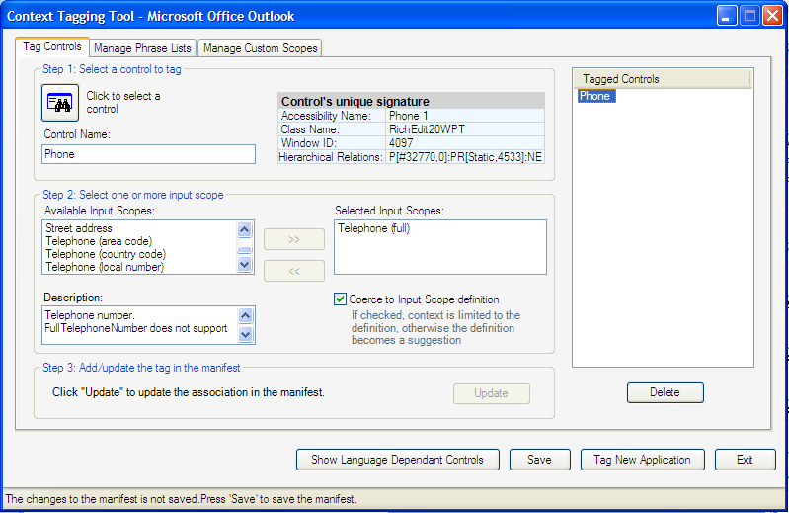
Context Tagging Tool
Allows you to define context for most existing applications without modifying binaries
Stores context data in an XML file
File is read by the system TIP

Slide 13
SDK Doc Improvements
New content for Web support, Real Time Stylus, use of Context
Advanced topics on working with recognition
Separate reference documentation for managed and unmanaged libraries
Enhanced Design Guidelines
More samples

Slide 14
What else do I need to know?
Availability
  Alpha: Nov ’03. Swipe card in Tablet PC booth to get a copy.
  Beta: Q1’04
  RTM: Q2 ’04
Install/redist configuration
  Windows 2000 SP4
  Windows XP RTM, SP1 (non-Tablet)
  Windows XP Tablet PC Edition
  Windows 2003 Server
  CLR1.0 or higher for managed code
Recognizer Pack for Development
  under development, will be released after new SDK

Slide 15
Tablet PC Platform
Plans for Longhorn

Slide 16
Tablet Goals for Longhorn
Avalon support for Pen Input and Ink
  Stylus is a 1st Class Input Device
  System controls are pen-aware
  Any Avalon element can support ink
1st Class WinFX API
  simplified object model
  managed implementation
Improved Ink Recognition
  Personalization
  Ink Analysis
  Support for more languages

Slide 17















Tools
Client Application Model
Web & Service Application Model
Data Systems Application Model
Mobile PC & Devices Application Model
Command Line
Avalon
Windows Forms
ASP.NET / Indigo
Win FS
Yukon
Compact Framework
Mobile PC Optimized
System.Console
System.Windows
System.Windows.Forms
System.Web
System.Storage
System.Data.SqlServer
System.Windows.Forms
System.Windows
NT Service
System.Windows.Input
System.ServiceProcess
Presentation
Data
Communication
System.Windows
System.Search
System.Data
System.Messaging
System.
Discovery
System.Collaboration
UI Element
Explorer
Media
Annotations
SqlClient
DataSet
System.DirectoryServices
Active
Directory
RealTimeEndpoint
Documents
Controls
Animation
Monitoring
SqlTypes
Mapping
System.Remoting
TransientDataSession
Text Element
Dialogs
Controls
Logging
SqlXML
ObjectSpaces
System.Runtime.Remoting
Uddi
SignalingSession
Shapes
SideBar
Control
Relevance
OdbcClient
ObjectSpace
Media
Shape
Notification
Panel
OleDbClient
Query
Activities
Ink
Navigation
Design
OracleClient
Schema
System.Web.Services
System.MessageBus
System.Storage
Web.Service
Transport
Queue
System.Windows.Forms
System.Web.UI
Item
Core
Description
Port
PubSub
Forms
Page
WebControls
Relationship
Contact
Discovery
Channel
Router
Control
Control
Adaptors
Media
Location
Protocols
Service
Policy
Print Dialog
HtmlControls
Design
Audio
Message
Peer Group
Design
MobileControls
Video
Document
Images
Event
System.Web
System.Net
System.Help
System.Speech
Personalization
HttpWebRequest
NetworkInformation
System.Drawing
Recognition
Synthesis
System.Xml
Caching
FtpWebListener
Sockets
System.NaturalLanguageServices
Schema
Xpath
SessionState
SslClientStream
Cache
Serialization
Query
WebClient
Fundamentals
Base & Application Services
Security
Configuration
Deployment/Management
System.Timers
System.Text
System.Collections
System.Windows.
TrustManagement
System.Security
System.Web.Configuration
System.Web
System.Globalization
System.Design
Generic
System.Web.
Security
Authorization
Permissions
System.MessageBus.Configuration
Administration
System.Serialization
System.IO
System.ComponentModel
AccessControl
Policy
System.Configuration
Management
System.Threading
Ports
System.CodeDom
System.Message
Bus.Security
Credentials
Principal
System.Resources
System.Management
System.Runtime
System.Reflection
Cryptography
Token
System.Deployment
Serialization
InteropServices
System.EnterpriseServices
System.Diagnostics
CompilerServices
System.Transactions

Slide 18
Client Application Model
Avalon
Windows Forms
System.Windows
System.Windows.Forms
System.Windows.Input
Presentation
System.Windows
UI Element
Explorer
Media
Documents
Controls
Animation
Text Element
Dialogs
Controls
Shapes
SideBar
Control
Shape
Notification
Panel
Ink
Navigation
Design
System.Windows.Forms
System.Web.UI
Forms
Page
WebControls
Control
Control
Adaptors
Print Dialog
HtmlControls
Design
Design
MobileControls

Slide 19
Stylus (Pen) Input
Native Avalon Input Device
  Tightly Integrated into Avalon Input Manager and Events system
  Rich Stylus Events
High fidelity data
  Low Latency/High Frequency
  Rich pen packet properties (pressure, tilt, etc.)
Unified input stream for Stylus and Mouse
  Stylus emulates mouse
  Containment for promoted events in Avalon apps

Slide 20
Input Architecture
Pen service
  Generates Pen packets
  System gesture detection
  Emulates mouse
Mouse/Stylus Devices
  maintain state
  abstract lower layers
Input Manager
  generates input events
  guarantees event containment
Avalon Input Manager
Mouse Device
Stylus Device
Win32
Pen Service
HID Interface
Mouse Driver
Pen Driver

Slide 21
Code Sample
Different control behaviour for Stylus
  void OnStylusEnter(object o, ClickEventArgs args)
  {
  Control.Size.x +=10;
  Control.Size.y +=10;
  Control.Background = RED;
  }
  void OnStylusLeave(object o, ClickEventArgs args)
  {
  Control.Size.x -=10;
  Control.Size.y -=10;
  Control.Background = BLACK;
  }

Slide 22
InkCanvas Element
Inherits from Avalon Canvas element and adds support for
  Ink Rendering
  Ink Collection
  Ink Editing (including rich Events)
Exposes recognition results
Can ink enable any Avalon element

Slide 23
Example
Want to enable inking on an Image?
Simply wrap it in an InkCanvas
  <InkCanvas id=“myInkCanvas”>
  <Image Source=“picture.jpg"/>
  </InkCanvas>

Slide 24
Ink Canvas

Slide 25
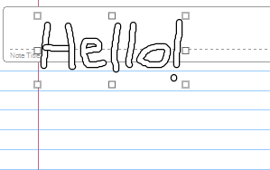

Ink Editing
Setting editing mode on an InkCanvas
myInkCanvas.EditingMode
= EditingMode.Select;
Modes supported
  Ink
  Erase
  Select
    Move
    Resize
    Rotate

Slide 26
Recognition
Enabled by setting AnalysisEnabled=true
Ink Canvas exposes an AnalysisContext object, which contains recognition results
<InkCanvas id=“ic1” AnalysisEnabled = “true”/>
...
RecoText =
ic1.AnalysisContext.TopString;

Slide 27
Ink Analysis
Expands V1 Recognition API beyond handwriting recognition
Determines semantic meaning of ink
  Writing vs Drawing
  Paragraphs, lists, lines, words
  Handwriting recognition
  Shapes, connectors, containers
  Annotations (underlines, callouts, etc)
  Relationships (containment, anchoring)

Slide 28
Ink Analysis

Slide 29
Scenarios
Smarter conversion of free-form handwritten ink to text
  angled writing
  late strokes
  basic layout (e.g. lists)
Smarter searching of free-form handwritten ink to text
Smarter ink editing operations
  word-based selection
  reflow
  list and diagram manipulation
Anchoring of ink annotations on text

Slide 30
Key Components
Ink Analyzer
Analysis Context
  caches document state
  contains analysis results
Classification Engines
Recognizers
Application
Non-Ink
Content
+
Ink
InkAnalyzer
Analysis
Context
Classification
Engines
Language
Based
Recognizers

Slide 31
Code Sample
Getting top recognition string
  InkAnalyzer myInkAnalyzer = new InkAnalyzer();
  myInkAnalyzer.AddStrokes(InkCanvas.Strokes);
  myInkAnalyzer.Analyze();
  String myString = myInkAnalyzer.TopString;
Analysis
Context
Paragraph
Line
Ink
Word
Ink
Word
Hello
World

Slide 32
Code Sample
Recursively visit each node in the tree and draw rotated bounding box around word nodes
    ...
    DrawBoundingBox(g, myInkAnalyzer.AnalysisContext);
    ...
    public DrawBoundingBox(Graphics g, ContextNode cn)
    {
    foreach(ContextNode node in cn.ChildNodes())
    {
    if (node.type == ContextNodeType.Word)
    g.DrawLine(myPen, node.GetRotatedPoints);
    else
    DrawBoundingBox(g, node);
    }

Slide 33
Additional Features
Designed for analyzing ink in real-time
Support for multiple languages
Support for Context (Factoids, word lists)
Explicit classification/user corrections
Persistence of analysis results

Slide 34
Survey Builder

Slide 35
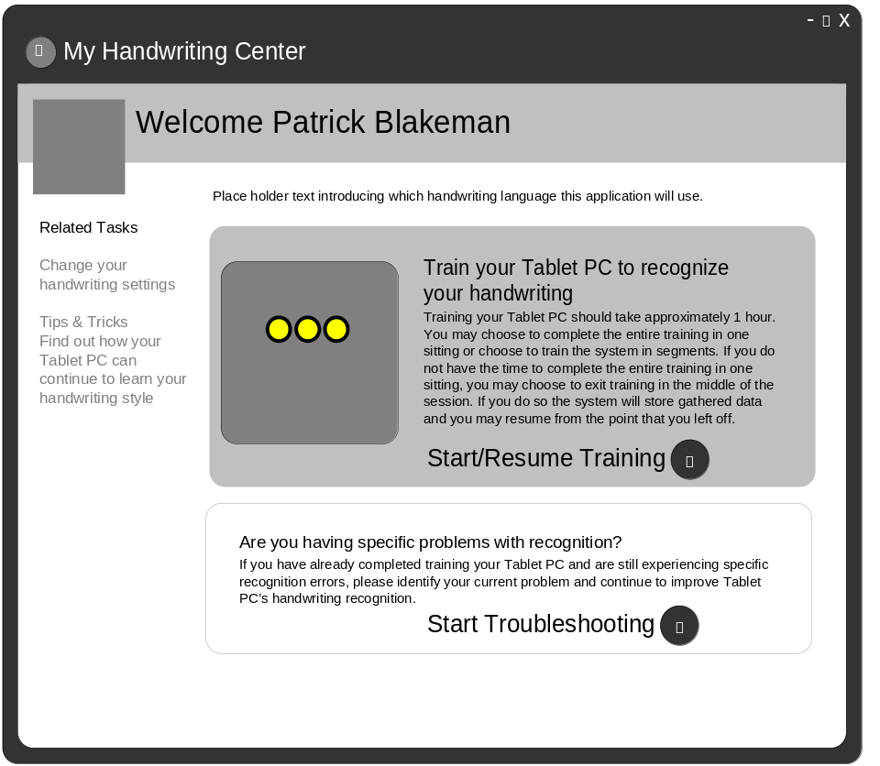
Handwriting Recognition Improvements
Explicit personalization
  fixed script training
  user-specific problems
Harvesting
  personalized dictionary based on documents, email

Slide 36
Handwriting Recognition Improvements
Enhanced support for block print
Language model improvements
Support for new languages
  Italian, World-wide Spanish, Dutch, Brazilian Portuguese
Basic Print Recognizer
  Swedish, Danish, Norwegian, Finnish

Slide 37
Medical Records App

Slide 38
Call to Action
Mobile PCs are taking off - make sure your applications run well on a Tablet!
Remember:
  You can develop Tablet PC applications on your desktop
  The Tablet PC OS is a superset of Windows XP Professional
  Swipe your card at the TabletPC booth to receive and Alpha of our new SDK

Slide 39
Community Resources
Get Your Questions Answered!
Client Lounge: middle of the Exhibit Hall
  Connect with Microsoft client product teams, and PDC 2003 Speakers
Check out the Tablet PC booth
Visit the Tablet PC Hands on Lab (HOL-204)
Ask The Experts: Tues, 7pm–9pm, Hall G,H
Newsgroups:
  microsoft.public.windows.tabletpc.developer
  www.tabletpcdeveloper.com
PDC Weblogs:
  http://pdcbloggers.net

Slide 40

Calling all Developers!
Win $15,000 Cash
Microsoft and PC Magazine invite you to develop the best PowerToy and win one of four fabulous prizes.
Learn how you can win: www.doesyourcodethinkinink.com
Get a free t-shirt and 64mb USB drive at the Tablet PC booth. Limited quantity available so don’t miss this exciting opportunity.

Slide 41
Tablet PC Platform Roadmap

Slide 42























Tablet PC OEM Partners

Slide 43



























Tablet PC Software Partners

Slide 44
© 2003-2004 Microsoft Corporation. All rights reserved.
This presentation is for informational purposes only. Microsoft makes no warranties, express or implied, in this summary.

Slide 45


