Slide 1





Developing Applications Using the Microsoft Business Framework: Overview
Session Code: DAT340
Tim Brookins
Architect
Microsoft Corporation
tbrookin@microsoft.com
Dan Brown
Group Program Manager
Microsoft Corporation
danbr@microsoft.com

Slide 2

Introduction: The MBF Basics
What:
The Microsoft Business Framework (MBF) provides programming abstractions and a prescriptive architecture suitable for the development and deployment of business applications based on a distributed, service oriented architecture.
Who:
The MBF team is composed of Great Plains, Navision, Daamgard, Solomon, Microsoft, and other industry members, with deep experience in building business application platform \ frameworks.
When:
The Microsoft Business Framework is being delivered across two Visual Studio releases.
  The Whidbey version of MBF focuses on establishing key abstractions, along with a programming model and tooling to manipulate those abstractions.
  The Orcas version of MBF adds additional services to support those abstractions including comprehensive UI, reporting, and process \ workflow support.
Where:
The MBF team is part of the Visual Studio division, and MBF is delivered independently from any Microsoft Business Solutions products.

Slide 3


Business application characteristics
Business applications can be huge
  Typical middle market ERP applications have 1000+ forms, 600+ tables, Millions of LOC
Business applications are full of patterns
  UI: Setup, Data Entry, Query \ Report, Process Initiation
  Business Logic Micro Patterns:
    Data types (ala Currency and Qty)
  Business Logic Low Level Patterns:
    Defaulting, Validation, Calculated Values, Get Next Number
  Business Logic High Level Patterns:
    Business Logic symmetry. (A purchase order is somebody else’s sales order)
These business application specific characteristics motivate business specific abstractions!

Slide 4
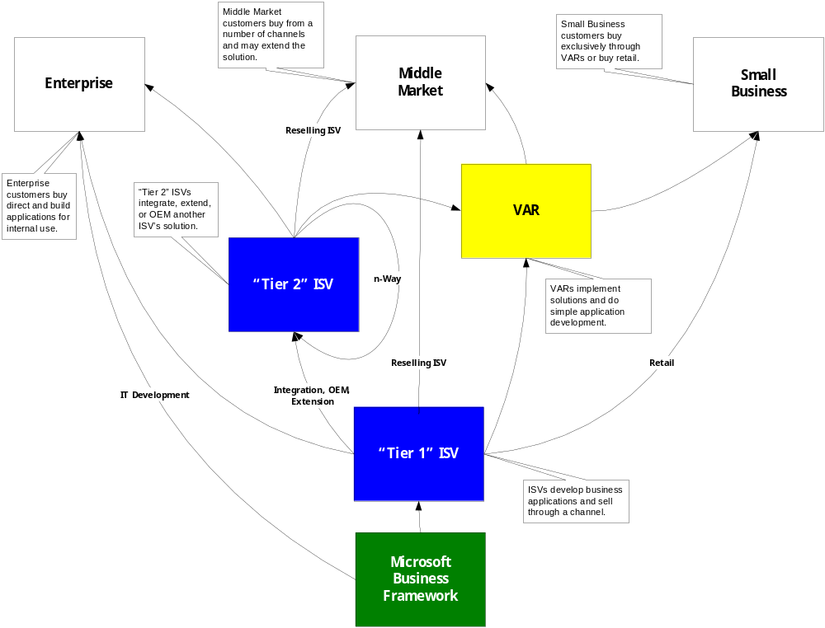
The Biz App creation value chain is complex
Upgradeable customization is essential for business applications

Slide 5

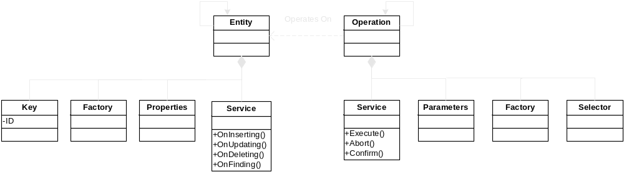
Microsoft Business Framework
A model driven architecture for business apps
Entities compose via Associations and Compositions, forming complex graphs
Operations compose Operations for complex business logic chains
Persistent Data
Abstraction
Handles Defaulting, Validation, and Calculated Values
Business Logic
Abstraction
Handles complex Transaction and Customization scenarios
Entities have identity
Operations support multiple services; dynamically selected at runtime
Entity services allow validation of incoming data modification messages
Operation services support WS-Transaction style long running transactions

Slide 6
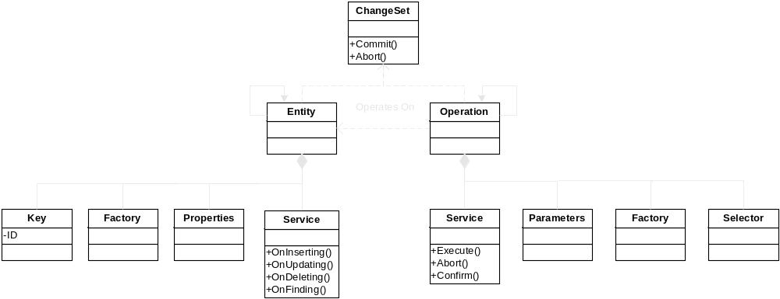
Microsoft Business Framework
A model driven architecture for business apps
Transaction
Abstraction
Persistent Data
Abstraction
Handles Defaulting, Validation, and Calculated Values
Business Logic
Abstraction
Handles complex Transaction and Customization scenarios

Slide 7
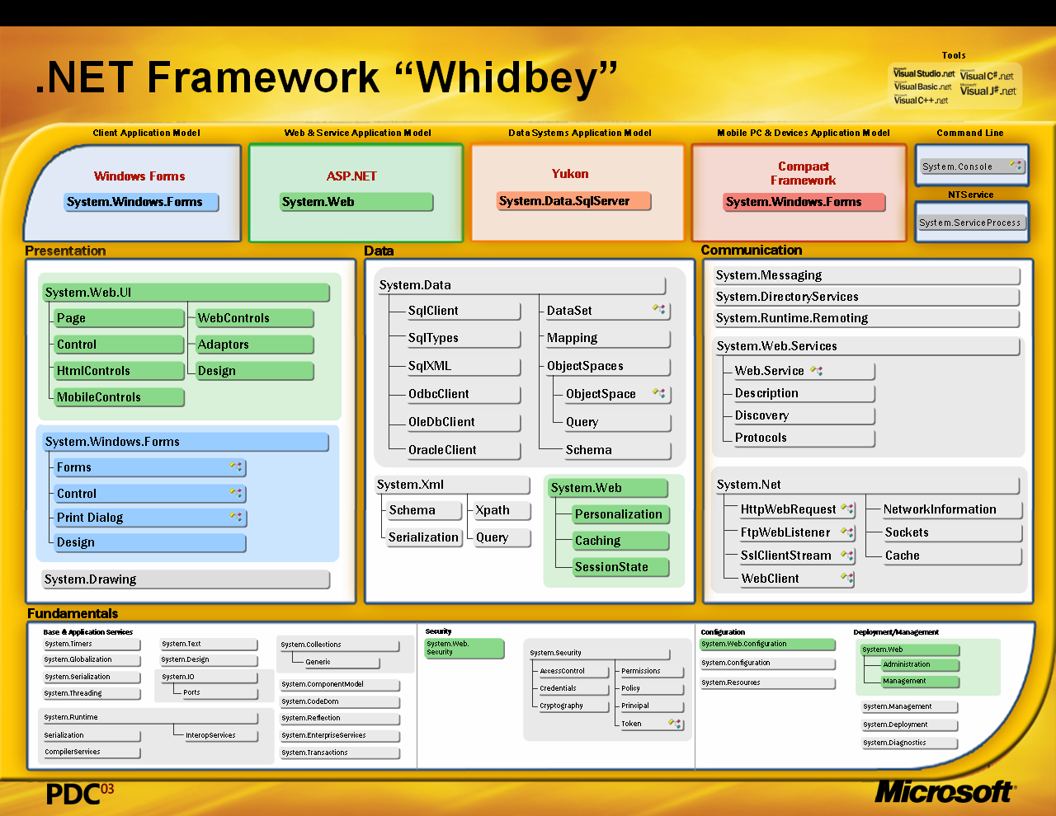
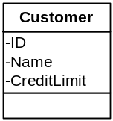
Framework implements abstractions
Great tools support for defining abstractions
Entities and Operations support agent \ service
Entities can be persisted via ObjectSpaces
Entities can be serialized to\from XML streams
Operations can be exposed as Web Services
Operations build on ServicedComponent for complex transaction support
Entities and Operations are securable via Permissions
Abstraction
Implementation

Slide 8
MBF Developer Experience
Creating a project and model

Slide 9
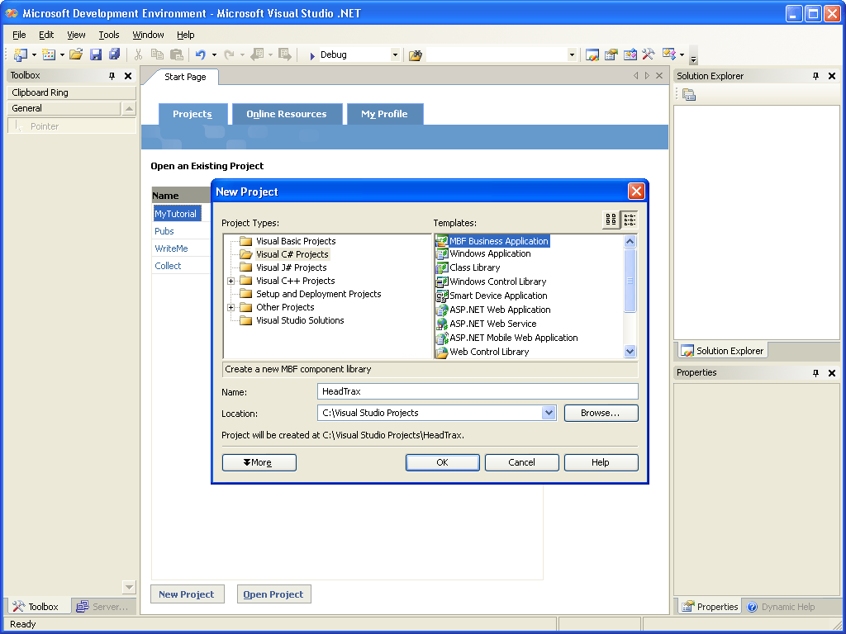

Slide 10
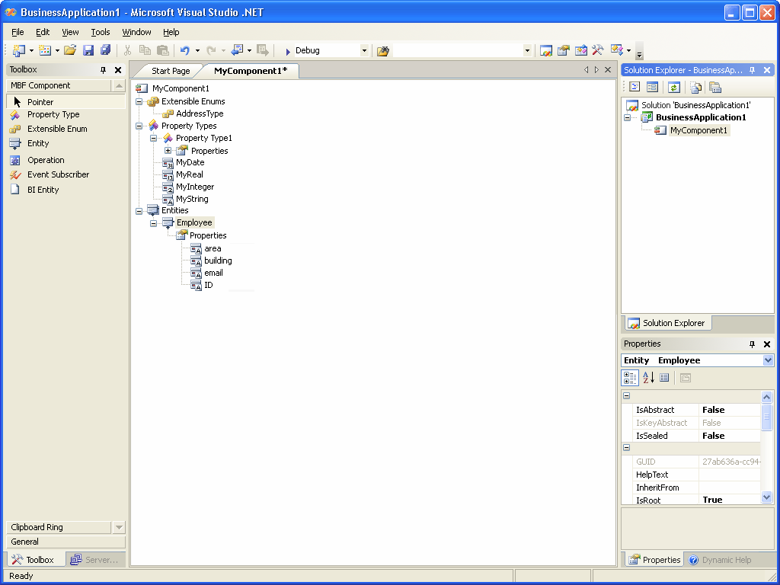

Slide 11
Entities

Slide 12
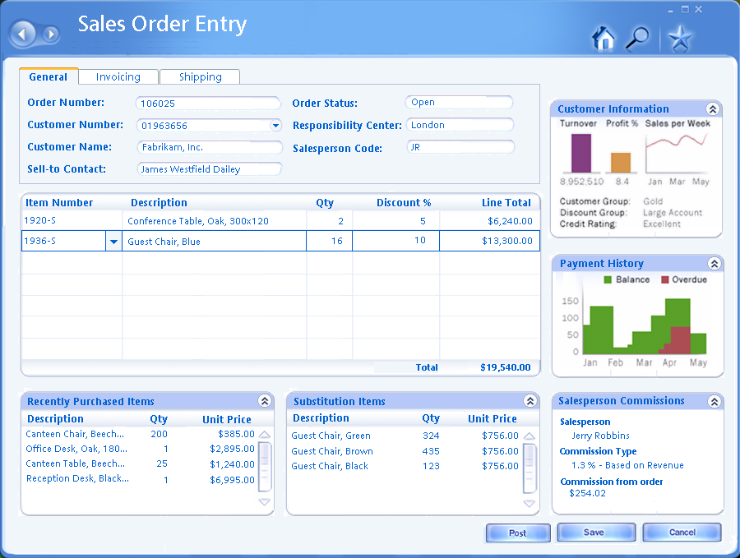
MBF Entity Support
A Sales Order is a complex object which represents data stored in multiple tables
This complex graph of objects must be persisted in and out of the data base as a unit
Developers are more productive when working with the complete object
Complex object graphs are very common in business applications

Slide 13
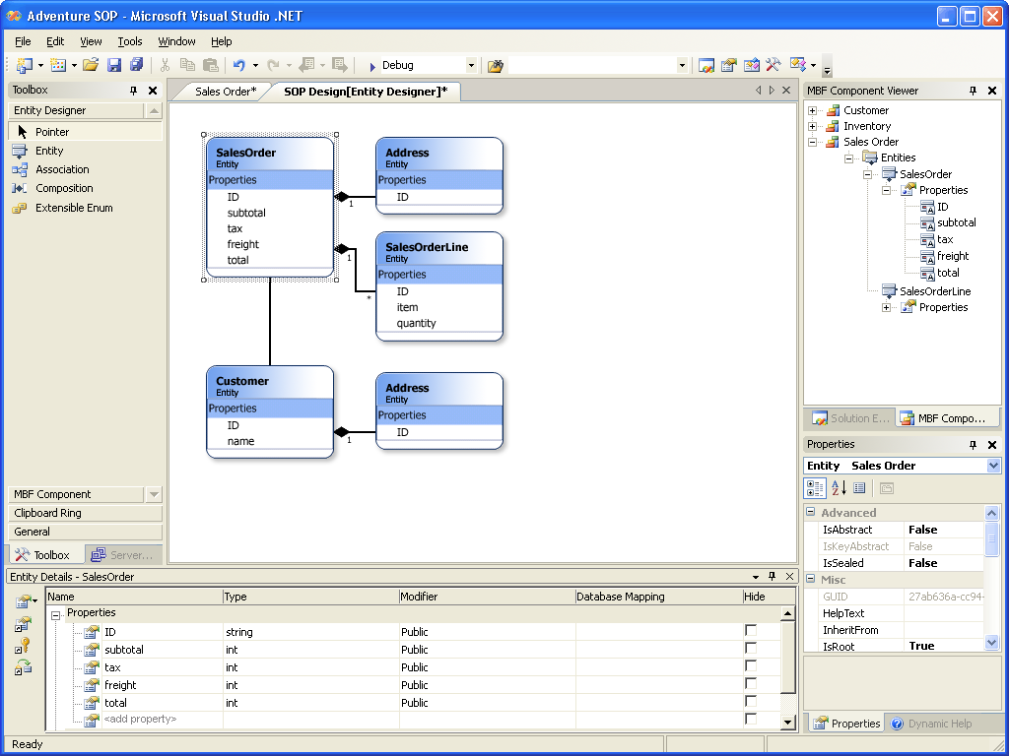

Slide 14
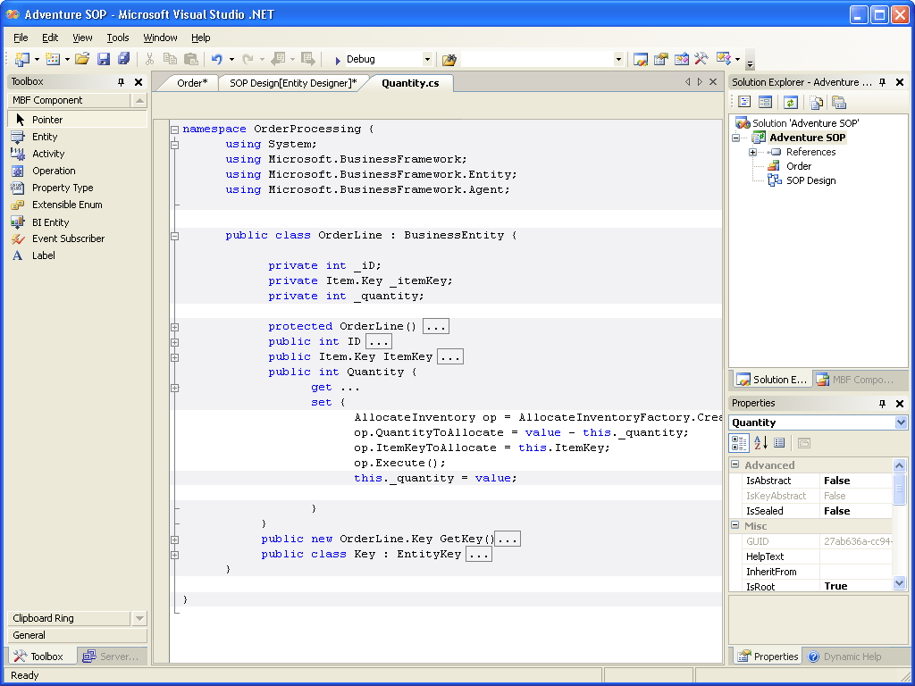

Slide 15
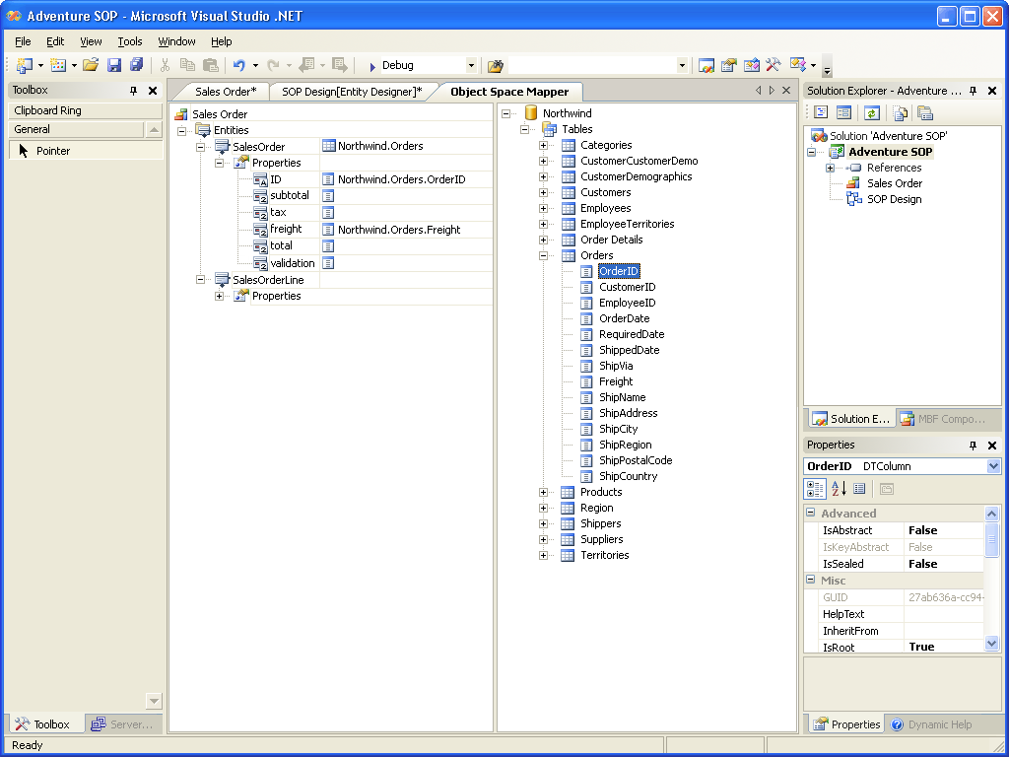

Slide 16
MBF Consumer Experience
Create a context, create a new order
Associate a customer with the order
Save the order + customer
Private Sub OrderForm_Load(ByVal sender As System.Object,ByVal e As System.EventArgs) Handles MyBase.Load
myContext = New EntityContext
order = OrderFactory.Create(myContext)
End Sub
Private Sub CustomerID_Changed(ByVal sender As System.Object,ByVal e As System.EventArgs)
Dim options as EntityQueryOptions
Dim cust as Customer
options = New EntityQueryOptions()
options("Customer“)("Address“).RetrieveOption = QueryRetrieveOptions.LoadOnDemand
options.DynamicViewKey = DynamicViewManager.GetDV(typeof(Customer),”Salesperson”)
cust = CustomerFactory.FindByID(CustomerID.Text, options, myContext)
order.Customer = cust
End Sub
Private Sub SaveButton_Click(ByVal sender As System.Object, ByVal e As System.EventArgs)
orderContext.ChangeSet.Commit()
End Sub

Slide 17
Operations

Slide 18
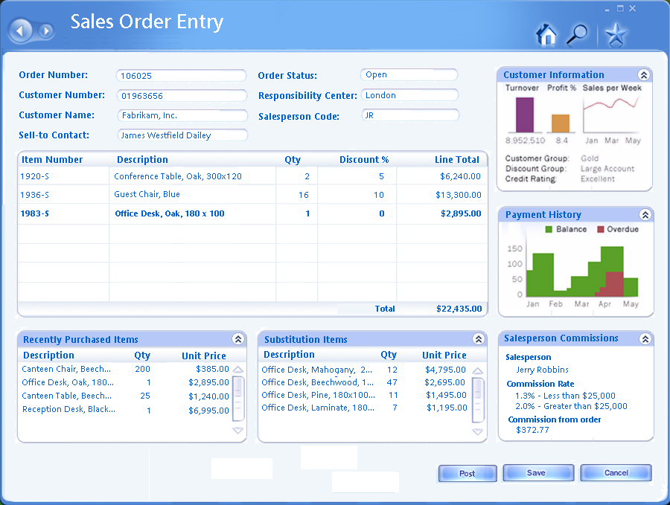
Complex transactional patterns
MBF Reversible Operations support a compensation model
Rich user interfaces often interact with multiple services in a conversational fashion.
These services may not all be read only. For example, each line item calls a service to allocate inventory.
These allocations must be rolled back if the user cancels, or confirmed if saved.
Operations have built-in support for compensation, ala WS-Transactions.

Slide 19
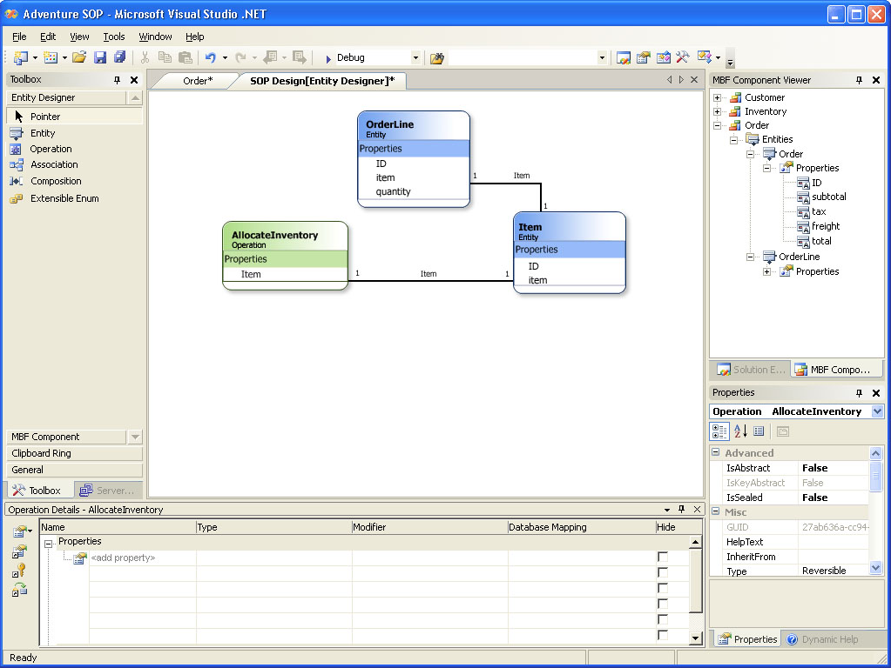

Slide 20
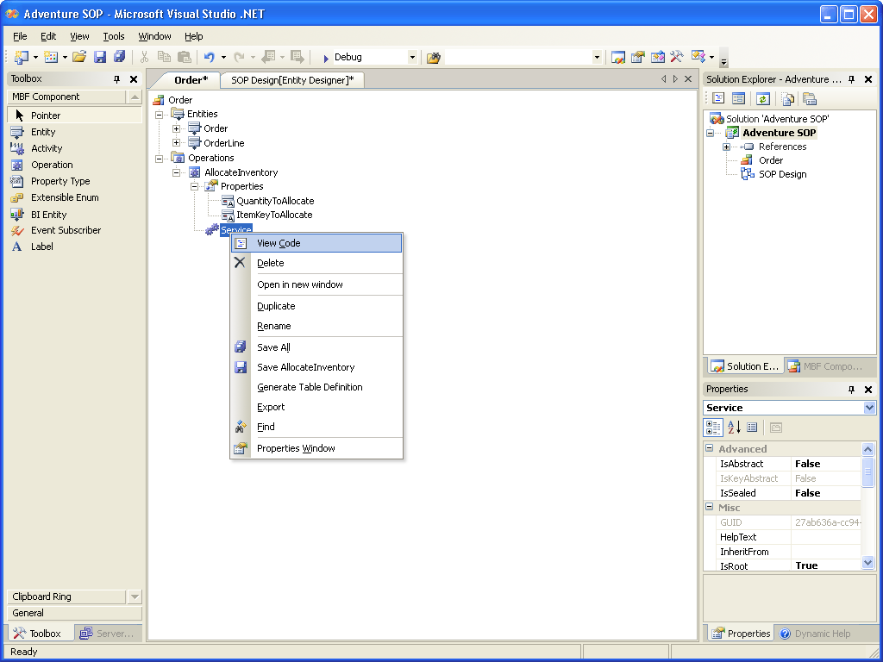

Slide 21
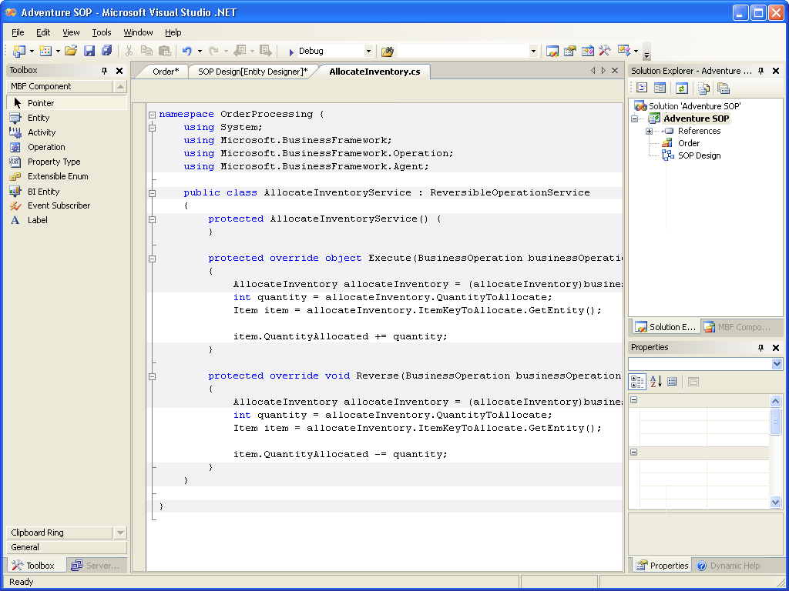

Slide 23
Complex transactional patterns
Restartable Operations provide guaranteed “forward only” execution
Many batch oriented tasks are simply too large to write compensation logic, yet need multiple database transactions.
Integrity is ensured by restarting execution until completed.
Restartable operations must be idempotent.
Building our own infrastructure for Whidbey, replace with Indigo where appropriate for Orcas.

Slide 24
Selectable Services
Operations support multiple services in a pluggable model
Some application logic is regularly changed for every customer of the biz application (e.g. commissions)
Sometimes multiple algorithms are known ahead of time but are applied based on context
Both the service and the service selection mechanism must be extended
Needs to be based on a pluggable model

Slide 25
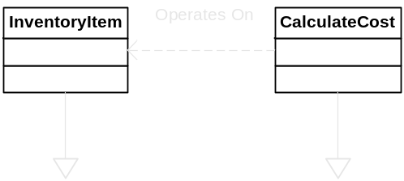
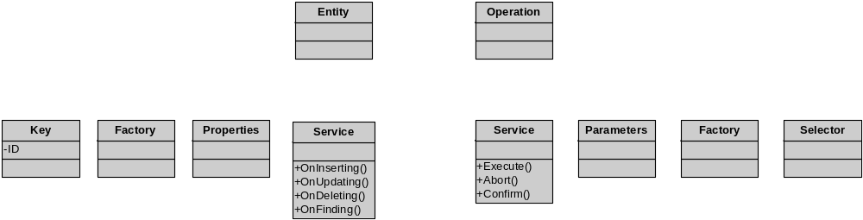
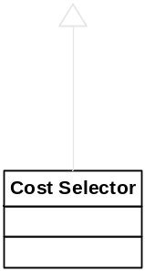
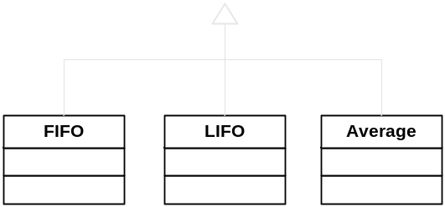
Pluggable Services Example
Inventory costing

Slide 26
EntityCubes

Slide 27
Analytics is an afterthought
It’s slow and complicated to create it and very difficult to maintain
BI is desired when the user is working, not just when they are analyzing information
BI is derived from data model, not the application entity model
The data is stale and inconsistent with the transactional information
There is not a consistent programming model for transactional data and analytical data

Slide 28
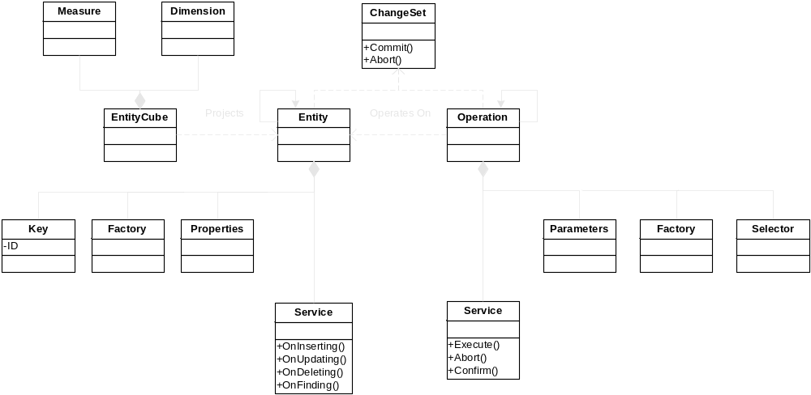
Microsoft Business Framework
A model driven architecture for business apps

Slide 29
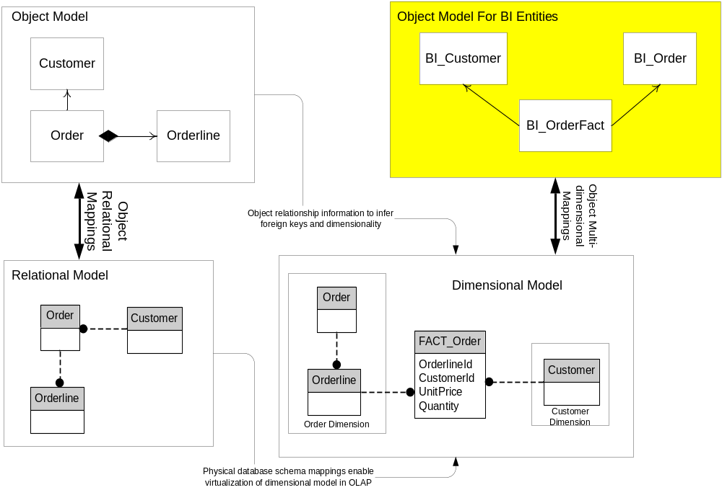
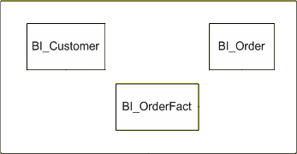
Model Relationships
Dimensional model derived from Entity model
Entity Object Model
EntityCube Object Model

Slide 30
Getting data from the cube
Intellisense is enabled by the BI Entity so that developers can easily use managed code languages to access the OLAP data.
Criteria c = new Criteria(typeof(SalesBI));
c.rows = new Set.LastPeriod(6,
new Member(SalesBI.Time.Calendar.Quarter.currentPeriod());
c.Columns = .Add(
new Set(SalesBI.Profit, SalesBI.OrderQuantity, SalesBI.TotalRevenue));
c.Slice =
new Tuple(SalesBI.Customer.CustomerName.IS(thisCustomerName));

Slide 31
Future Releases

Slide 32
Whidbey delivers programming model
Orcas completes the picture
Consumers
Tools
UI which “auto-binds” to MBF abstractions
(Longhorn-based)
Workflow
Reporting
Integration
System Admin
Process Designer
Customization
Query
Navigation
UI
Portal
Report Designer
Rosetta-based business reporting (OLTP & OLAP)
Form Designer
Programming Model
“n-way” Entity Extension
Component
Explorer
Components
Security
Business Class Library
Process
Entity
Operation
Agent / Service
EntityCube
Activity
Business Entity
Designer
Higher Level Business Patterns
Service Infrastructure
Entity to Database Mapper
Object Spaces
Event Broker
Metadata Services
Deployment Packager
.NET Enterprise Servers & Visual Studio .NET Tools

Slide 33

















MBF Adopters
A Core Component of Visual Studio
Technology Adoption Program Starting
Microsoft’s next generation business solution (codename “Green”) is also an MBF customer

Slide 34
Questions
Come see us at “Ask The Experts”, Tuesday night

Slide 35

© 2003-2004 Microsoft Corporation. All rights reserved.
This presentation is for informational purposes only. Microsoft makes no warranties, express or implied, in this summary.

Slide 36
