Slide 1






NET Framework: Developing Applications Using ADO.Net ObjectSpaces
D410
Luca Bolognese (lucabol@microsoft.com)
Program Manager
Microsoft Corporation

Slide 2







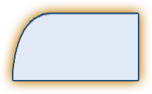
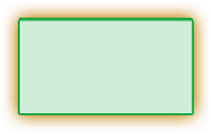
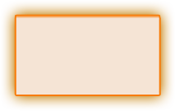
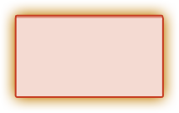



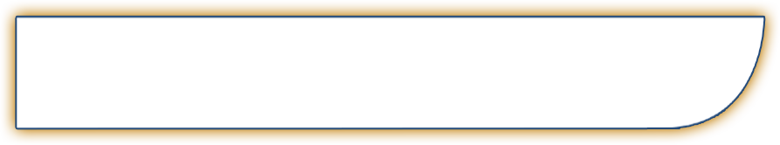

Tools
Client Application Model
Web & Service Application Model
Data Systems Application Model
Mobile PC & Devices Application Model
Command Line
Avalon
Windows Forms
ASP.NET / Indigo
Win FS
Yukon
Compact Framework
Mobile PC Optimized
System.Console
System.Windows
System.Windows.Forms
System.Web
System.Storage
System.Data.SqlServer
System.Windows.Forms
System.Windows
NT Service
System.ServiceProcess
Presentation
Data
Communication
System.Windows
System.Search
System.Data
System.Messaging
System.
Discovery
System.Collaboration
UI Element
Explorer
Media
Annotations
SqlClient
DataSet
System.DirectoryServices
Active
Directory
RealTimeEndpoint
Documents
Controls
Animation
Monitoring
SqlTypes
Mapping
System.Remoting
TransientDataSession
Text Element
Dialogs
Controls
Logging
SqlXML
ObjectSpaces
System.Runtime.Remoting
Uddi
SignalingSession
Shapes
SideBar
Control
Relevance
OdbcClient
ObjectSpace
Media
Shape
Notification
Panel
OleDbClient
Query
Activities
Ink
Navigation
Design
OracleClient
Schema
System.Web.Services
System.MessageBus
System.Storage
Web.Service
Transport
Queue
System.Windows.Forms
System.Web.UI
Item
Core
Description
Port
PubSub
Forms
Page
WebControls
Relationship
Contact
Discovery
Channel
Router
Control
Control
Adaptors
Media
Location
Protocols
Service
Policy
Print Dialog
HtmlControls
Design
Audio
Message
Peer Group
Design
MobileControls
Video
Document
Images
Event
System.Web
System.Net
System.Help
System.Speech
Personalization
HttpWebRequest
NetworkInformation
System.Drawing
Recognition
Synthesis
System.Xml
Caching
FtpWebListener
Sockets
System.NaturalLanguageServices
Schema
Xpath
SessionState
SslClientStream
Cache
Serialization
Query
WebClient
Fundamentals
Base & Application Services
Security
Configuration
Deployment/Management
System.Timers
System.Text
System.Collections
System.Windows.
TrustManagement
System.Security
System.Web.Configuration
System.Web
System.Globalization
System.Design
Generic
System.Web.
Security
Authorization
Permissions
System.MessageBus.Configuration
Administration
System.Serialization
System.IO
System.ComponentModel
AccessControl
Policy
System.Configuration
Management
System.Threading
Ports
System.CodeDom
System.Message
Bus.Security
Credentials
Principal
System.Resources
System.Management
System.Runtime
System.Reflection
Cryptography
Token
System.Deployment
Serialization
InteropServices
System.EnterpriseServices
System.Diagnostics
CompilerServices
System.Transactions

Slide 3


What Is It?
Accessing and manipulating data in terms of domain objects: Customer, Order, Address
Declarative mapping between these objects and relational tables
Binary separation between business logic and data access logic
Higher level layer on top of ADO.NET
When does it make sense?
  When you have a strong business logic layer

Slide 4
ADO.NET Data Access Support
Data is relational is objects is XML is Data
Technology Strengths Use if…
DataSet and
DataReader
in ADO.NET
Relational (tabular) model
Highest performance
Explicit control
Fully exposes database functionality
You are comfortable with the relational model
You require maximum control/performance/functionality
You are using UI bound controls
Business level objects
Relational mapping via metadata
Decoupled from database schema
Smaller working set than other object abstractions
You need a strong business object layer
You know the shape of the results you want to work with
ObjectSpaces in ADO.NET
Interoperability. Format for the Web – B2B, A2A
Sparse (semi-structured) data
XML Services e.g. XQuery, XSD
Relational mapping via metadata
Decoupled from database schema
You need to query data from XML data sources e.g. XML Web Services
You use vertical industry XML schemas for content publishing e.g. XBRL, RIXML, FinXML
You need to load XML documents into database tables
You are using UI bound controls for XML
SQLXML in
ADO.NET

Slide 5
How Does It Work?
Updates
Query
Query Results
Uses the mapping files to translate from an object query/update to a SQL query/update
ObjectSpace
Map Files
Map Files
Map Files
Database

Slide 6

How To Write Your Object Model And Initialization
Luca Bolognese
Program Manager
Webdata

Slide 7
How To Write Objects
Goal: to be as transparent as possible
  Like NFL referees…
Normal CLR objects
  Inheritance
  1-1, 1-many, many-many, methods etc…
Current limitations
  Need of an empty constructor (can be private)
  ObjectList/ObjectHolder to achieve delay loading
Initializing the database
  Easier with the ObjectPersistence sample…

Slide 8
OPath: How To Query For Objects
Luca Bolognese
Program Manager
Webdata

Slide 9
OPath
Defined over the exposed object model
Natural for the programmer
Able to express complex queries
  Relationships Navigation
  Set Restriction Based navigation
Examples querying for Customer
  Orders.Details.Quantity > 50
  Orders[ShippedDate > RequiredDate]
  Orders[Freight > 1000].Details.Quantity > 30

Slide 10
Span And Delay Load
Luca Bolognese
Program Manager
Webdata

Slide 11
Span And Delay Load
How to materialize your object model
  Direct query: multiple explicit queries for the right objects
  Span: materializing connected objects when the primary ones are loaded
  Delay loading: materializing connected objects just when they are accessed

Slide 12
Updates, Transactions And Optimistic Concurrency
Luca Bolognese
Program Manager
Webdata

Slide 13
Updates, Transactions And Optimistic Concurrency
Updates
  Modify your object model
  Call PersistentChanges
Transactions
  Wrap your code in BeginTransaction…CommitTransaction
Optimistic concurrency: throw an exception if the data has changed in the data store. Alternatives:
  Checking all the columns
  Checking a subset of the columns
  Using a timestamp field

Slide 14
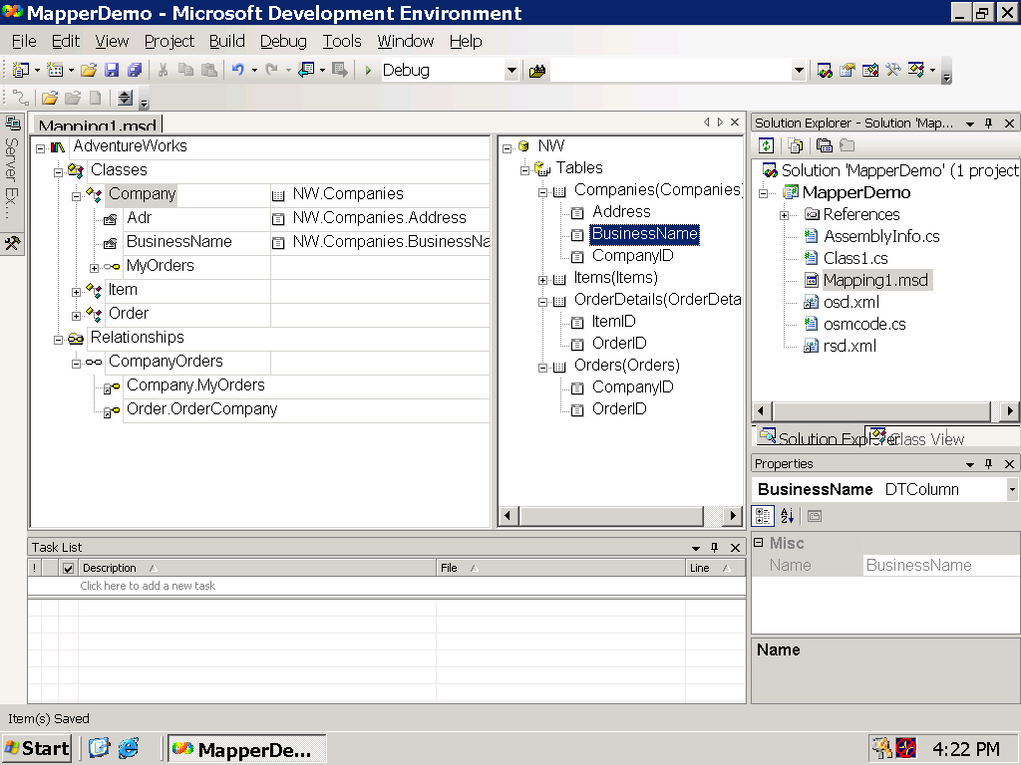
Visual Studio designer
DB Tables
Class property to
DB.Table.column
Relationship Mapping

Slide 15
Sample Mapping Tool
Luca Bolognese
Program Manager
Webdata

Slide 16
ADO.NET Interoperability
Luca Bolognese
Program Manager
Webdata

Slide 17
What I Haven’t Shown You…
Complex mappings
  Inheritance
  Many to many, one object to multiple table etc…
ObjectEngine: the low level interface
Implicit management of primary key
And much more…

Slide 18
Future: Using Generics
ObjectQuery<Customer> query =
new ObjectQuery<Customer>(“State = ‘WA’”, “Orders”);
ObjectReader<Customer> or =
objectspace.GetObjectReader(query);
or.Read();
Customer custumer = or.Current;
Dim query As New _
ObjectQuery(Of Customer)(“State = ‘WA’”, “Orders”)
Dim or As ObjectReader(Of Customer) = _ objectspace.GetObjectReader(query)
or.Read()
Dim cust As Customer = or.Current

Slide 19
A Look Into The Future…
Using generics in the framework
  Pointer to generics talk
Enhancing OPath
  New operators and functions in the language
A report query language
  How to get just some properties of your object
DML Delete
  How to delete some objects without retrieving them first
Simplifying the mapping format

Slide 20
Conclusions
Everything in my demo works with
your bits!!!
It is especially useful when you have a lot of business logic in your application
It is not intrusive for the object model
It is not prescriptive for the
programming model
It is included in the next version of
Visual Studio

Slide 21
Community Resources
Get Your Questions Answered!
Newsgroups:
  microsoft.public.objectspaces
Webdata booth
  connect with Microsoft product teams, and PDC 2003 Speakers
Ask The Experts:
  Tuesday 7 pm – 9 pm in Hall G,H
Email:
  osfdbck@microsoft.com

Slide 22
© 2003-2004 Microsoft Corporation. All rights reserved.
This presentation is for informational purposes only. Microsoft makes no warranties, express or implied, in this summary.

