Slide 1

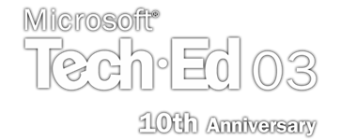
DEV340
.NET Framework Security Best Practices
Sebastian Lange
Program Manager
Common Language Runtime
Microsoft Corporation

Slide 2

Agenda
Quick Code Access Security (CAS) Review
Building a Secure Shared Library
  Using Verifiable Code
  Allowing Partially-trusted Callers
  Proper use of Assert()
  Protecting Exposed Resources
  Sealing Access to Methods
Common security programming mistakes

Slide 3
CAS Review
A New Paradigm
Goal: Enable “Partial Trust”
Primary Security Identity:
  Code (Assembly)
Authentication:
  Information collected about code (Evidence)
Authorization:
  Code identity based policy system grants rights to access resources
Enforcement:
  Verification, Validation, Stackwalks

Slide 4

CAS Review
Infrastructure
Validation
  Ensures correctness of file format
Verification
  Ensures Type Safety
Policy System
  Set of admin-defined rules that assign trust to assemblies
  Input: Evidence
  Output: Granted Permissions
Enforcement
  Developers protect access to resources with Permissions
  CLR enforces protection through stack walks

Slide 5
Creating Secure Libraries
Categorize your Library
Decide on your general approach up front
  Unsafe: Cannot be called in semi-trusted scenarios
  Security Neutral: Does not need any special permissions to run
  Uses Native Resources: Uses COM interop or PInvoke internally
  Exposes Security Relevant Resources
Be aware of “Secure Coding Guidelines”
  Link provided on “Resources” slide

Slide 6
Creating Secure Libraries
Exposing Security Relevant Resources
Exposes a Resource an Admin may want to control
  Examples: File system, speakers, screen, network
Most common library type
Follow Secure Coding Guidelines
  #1: Use Permissions to protect access to your resources!

Slide 7
Creating Secure Libraries
Write Verifiable Code
Helps to ensure that CLR can enforce security
Helps reduce buffer overruns
Verifiability depends on the language compiler and features used
  Visual Basic® .NET verifiable
  C# verifiable
    Except “unsafe” keyword
  C++ is generally not verifiable
    Addressed in future release

Slide 8

demo
The NoiseMaker Library
Scenario:
Secure library that exposes Sound API’s
Intranet Apps can play Sounds
Internet Apps cannot

Slide 9
Creating Secure Libraries
Allowing Partially-trusted Callers
Default: Code that calls your library must have Full Trust
  Limits use scenarios today, even more in the future
AllowPartiallyTrustedCallersAttribute
  Provides an opt-in mechanism for allowing potentially dangerous code to call library
  Specified per-assembly
Do Security Reviews per Secure Coding Guidelines

Slide 10
demo
Allowing Partially Trusted Callers

Slide 11
Creating Secure Libraries
Using Assert()
Asserts() put the burden on you!
Demands() put the burden on the system
Pairing Asserts() with Demands() reduces your burden
Common pattern
  Note: Demand first, then Assert
  Demand a more constrained permission
  Assert what’s needed to access the resource

Slide 12
demo
Using Assert()

Slide 13
Creating Secure Libraries
Protecting Access to Resources
Resources Protected with “Demand” for a Permission
Consideration: Use existing permission or write a new one?
Leverage existing permission when appropriate
  Feature aligns with philosophy of existing permission
    Don’t overload their use
Define a new permission class if needed
  New Permissions should be sealed

Slide 14

Creating Secure Libraries
Protecting Access to Resources
Consider the Admin Model:
  What must an Admin control?
    Ex: File access to c:\*, speaker access, etc.
  Always allow permission to be turned off completely
  What should be in Default Policy?
    Picture the most conservative Admin

Slide 15
Creating Secure Libraries
Protecting Access to Resources
Prefer full Demands, not Link Demands
  All callers checked every call
Demand only what is required
May be stated either “Declaratively” or “Imperatively”

Slide 16
Creating Secure Libraries
Declarative Demands
Specified using Custom Attributes
  Stored in the assembly’s metadata
Permission State must be known at compile time
Can be viewed with PermView SDK Tool
[FileIOPermission(SecurityAction.Demand, Write = "c:\\temp")]
public void foo() {
// class does something with c:\temp
}

Slide 17
Creating Secure Libraries
Imperative Demands
Allows Security Checks to Vary by Control Flow or Method State
Initiated with call to Demand()
public File(String fileName) {
//Fully qualify the path for the security check
String fullPath =
Directory.GetFullPathInternal(fileName);
new FileIOPermission(FileIOPermissionAccess.Read,
fullPath).Demand();
//The above call will either pass or throw a
//SecurityException
//[…rest of function…]
}

Slide 18
demo
Protecting Resources

Slide 19
Creating Secure Libraries
Sealing Access to Members
Use Link Time Demands
  For cryptographically strong identity
Checks only immediate caller
Checks only the first call
  Occurs when method is JIT’ed
Specified using Custom Attributes
Performs better than a full Demand

Slide 20
Creating Secure Libraries
Sealing Access to Members
Link time demands are great because:
  Seals off access to areas of your library
  Reduces your security exposure
  No stack walk = smaller perf impact
Link time demands are bad because:
  Vulnerable to luring attacks
  JIT uses the static type of the caller, not the runtime type
    Watch out for overrides!

Slide 21
Creating Secure Libraries
Sealing Access to Members
For public sealed classes:
For public classes, abstract classes and interfaces:
[StrongNameIdentity(SecurityAction.LinkDemand,
Name=“A1”, PublicKey=“0x…………”)]
public sealed class Foo {}
[StrongNameIdentity(SecurityAction.InheritanceDemand,
Name=“A1”, PublicKey=“0x…………”)]
[StrongNameIdentity(SecurityAction.LinkDemand,
Name=“A1”, PublicKey=“0x………”)]
public class Foo {}

Slide 22
Security Programming Gotcha’s
Check your arguments
  Code generation bugs
Think about race conditions
Watch out for readonly
Pass Evidence when dynamically generating code

Slide 23
Argument Checking
Ex: Malicious WSDL that uses special characters to insert extra method calls
<soap:address location=
'http://server/proxyinjection.dll?
Handler=Default&#34;&#41;&#59;
SomeClass.SomeMethod&#40;&#34;
Some Params here'/>
base.ConfigureProxy(this.GetType(),
"http://server/proxyinjection.dll?
Handler=Default");
SomeClass.SomeMethod("Some Params here");

Slide 24

Race Conditions
Thread1
public unsafe int ReadByte()
{
if (!_isOpen) __Error.StreamIsClosed();
if (_position >= _length)
return -1;
return _mem[_position++];
}
Thread2
Thread1

Slide 25

Race Conditions
Solution
public unsafe int ReadByte()
{
if (!_isOpen) __Error.StreamIsClosed();
int pos = _position;
if (pos >= _length)
return -1;
_position = pos + 1;
return _mem[pos];
}

Slide 26
When readonly isn’t read only
The readonly keyword applies to locations, not instances
Can be changed using:
Prints: “BooBar”
Never use readonly instances of mutable types
public static readonly StringBuilder Value = new
StringBuilder ("Boo");
MyClass.Value.Append("Bar");
Console.WriteLine(MyClass.Value);

Slide 27
Dynamic Code Generation
Without care, dynamically generated code gets the permissions of YOUR library
Carefully scrutinize all usages of:
  AppDomain.DefineDynamicAssembly
  Assembly.Load(Byte[], …)
Always use the overloads that allow you to pass Evidence
  Pass the minimum Evidence possible

Slide 28

Key Takeaways
CAS is based on code identity
  Augments Windows Security Model
Partial trust scenarios will continue to get more prevalent
Always use Permissions to protect your resources
  Remember the Admin when designing new permissions
Be familiar with:
  Secure Coding Guidelines
  Common Security Programming Mistakes

Slide 29
Additional Resources
“Secure Coding Guidelines”
  http://www.msdn.microsoft.com/security/securecode/bestpractices/default.aspx?pull=/library/en-us/dnnetsec/html/seccodeguide.asp
“.NET Framework Security”, Addison-Wesley
MSDN Security Site
  www.msdn.microsoft.com/security
DEV240 “Fundamentals of Code Access Security”

Slide 30

Community Resources
MS Community Sites
  http://msdn.microsoft.com/netframework/community/
  http://microsoft.com/communities/default.mspx
List of newsgroups
  microsoft.public.dotnet.general
  microsoft.public.dotnet.framework
  microsoft.public.dotnet.clr
  microsoft.public.dotnet.security
  http://microsoft.com/communities/newsgroups/default.mspx
ListServs
  http://discuss.develop.com
    ADVANCED-DOTNET
    DOTNET-CLR
    DOTNET-ROTOR
Attend a free chat or webcast
  http://microsoft.com/communities/chats/default.mspx
  http://microsoft.com/usa/webcasts/default.asp
Locate a local user groups
  http://microsoft.com/communities/usergroups/default.mspx
Community sites
  http://microsoft.com/communities/related/default.mspx

Slide 31
Community Resources
Community Resources
  http://www.microsoft.com/communities/default.mspx
Most Valuable Professional (MVP)
  http://www.mvp.support.microsoft.com/
Newsgroups
  Converse online with Microsoft Newsgroups, including Worldwide
  http://www.microsoft.com/communities/newsgroups/default.mspx
User Groups
  Meet and learn with your peers
  http://www.microsoft.com/communities/usergroups/default.mspx

Slide 32
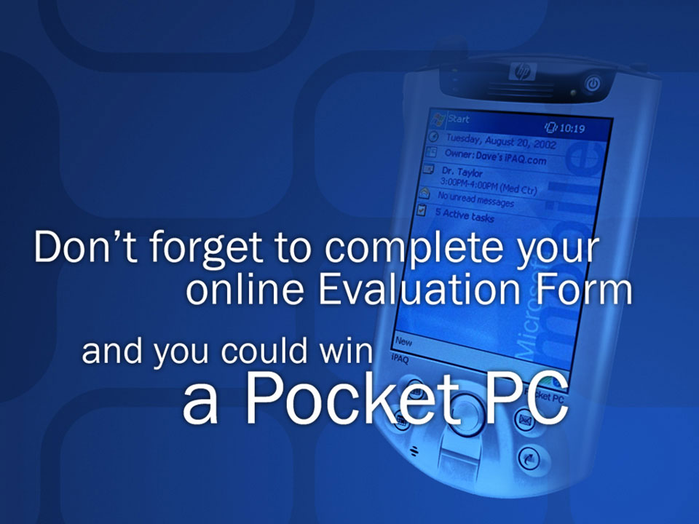
evaluations

Slide 33
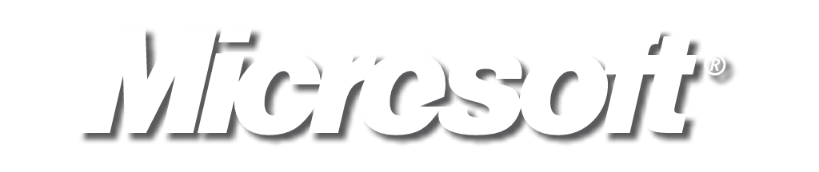
© 2003 Microsoft Corporation. All rights reserved.
This presentation is for informational purposes only. MICROSOFT MAKES NO WARRANTIES, EXPRESS OR IMPLIED, IN THIS SUMMARY.

