Slide 1


Web Services for a Global Gateway Service
Greg Andrews
Hewlett-Packard
Architect, PM
Core E-Commerce Services
Rebecca Dias
Microsoft Corporation
Advanced Web Services PM

Slide 2

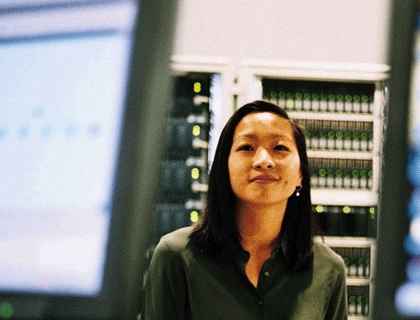
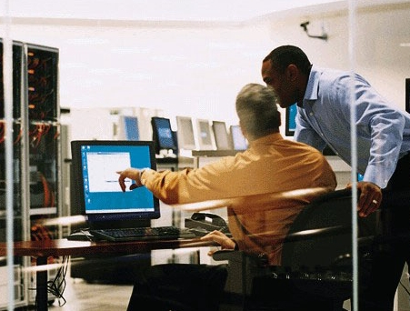
Agenda
Intro by Microsoft on SOAs
HP Global Gateway Services
  Business strategy
  Implementation Details
  Demo
  Benefits
  Lessons learned
Value in Partnering with MS
Next Steps
Where to learn more
Notes:
Intro SOAs, WS, and the process for making srt WS interop a reality
review of the HP Global Gateway Services.
Consolidation of hundreds of one off solutions for payment processing and other financial services for HP’s global storefronts.
Solution greatly impacts both the top line and the bottom line for HP
I will present the business problem and Greg is going to jump in and show what HP did to get the services in place, the benefits in service consolidation, why MS, and lessons learned.
“What are the business benefits for looking at your IT systems holistically and creating a Service Oriented Architecture?”
HP’s success story shows why the MS platform is the strong platform for implementing Web services and how BizTalk can be leveraged for WS orchestration and performing real-time data analytics based on pre-defined business rules.

Slide 3
Service-oriented architecture (SOA)
Web services enable everything to be connected
  People, systems, information and devices
Focus on the service provided not the implementation
  What does it do, not how does it do it!
Shift from infrastructure- to business-level architecture
  Separation of service consumer and provider
SOA is the basis for interoperable business solutions and will become ubiquitous
  Assembly/Composition through calling services, not copying code
Application building blocks will be reusable services performing useful business functions across domains and organizations
  Focus on the contract between the Consumer and Provider
Notes:
Service consolidation, business agility, lowering systems maintenance costs are all hot motivating factors for implementing a SOA. Web services technology is an enabler for making SOAs a reality providing the necessary plumbing for heterogeneous systems.
Creating a SOA allows business folks to make decisions on what non-core IT functions can be outsourced.
Consolidating systems can result in services, robust, implement best practices, provide concrete reporting information can provide the necessary data for real decision making e.g. negotiations

Slide 4

From Tightly Coupled…
…To Service Oriented
You
Your Partner
Programming
Language
Programming
Language
Database
Agreements
Database
Object Model
Object Model
Operating
System
Schema
Operating
System
Application
Application
Complexity
Complexity
Notes:
Services enable you to up level the conversation.
It makes re-use more likely for internal systems and shortens the technology decision making process
Focus on the Semantics of the Message rather than the technology consuming it.

Slide 5
Successful SOA Web Services
Loosely coupled business services
Course-grained, information-rich messages tied to “public” schema
Message-first design
Asynchronous and one-way
Queues
Facades over implementation components
ASP.NET Web Services not Remoting
Document/Literal encoding
Secure
Log messages

Slide 6
WS Architecture Evolution
Secure, Reliable, Transacted
July 2003
WS-Federation
March 2003
WS-ReliableMessaging
WS-Addressing
RM Roadmap
April 2002
WS-Security and Security Roadmap
September 2003
WS-AtomicTransaction
WS-Coordination
SRT WS Whitepaper
December 2002
WS-Policy
WS-Trust
WS-SecureConversation
UDDI
SOAP
WS-I
August 2002
WS-Transaction
WS-Coordination
2000
WSDL
Notes:
Key milestones

Slide 7

Web Services Specifications Process
Specification Published
Feedback and Interop Workshops
Revise spec
Standards Org
WS-I
Participation
Notes:
Publish specs - experts in their corresponding technology domains.
e.g. For Reliable Messaging Tibco and BEA co-authored the specifications with us. Tibco has a marketshare leadership for their reliable messaging infr. in the financial sector.
gather feedback through workshops, demonstrate interoperability, build tools and implementations, take to a standards body
Help provide feedback!!
http://msdn.microsoft.com/webservices/community/workshops/

Slide 8
Interoperability
Events
TBD 2003
WS-Trust
WS-SecureConversation
(workshop)
September 2003 Bill Gates (Microsoft)
Steve Mills (IBM)
December 2002
CDBi - EMEA
October 2003
WS-ReliableMessaging
(workshop)
SOAP
Builders
2002
July 2003
Catalyst
(Burton conference)
September 2003 OASIS
WS-Security
August 2002
XML Web Services One (East)
Notes:
Interoperability demonstrations
XML Web Services One East - August/2002 - WS-Security
CBDi December/2002 – WS-Security, .NET and WebSphere (http://www.cbdiforum.com/bronze/ws_security.php3 is the source)
Catalyst/Burton – July 2003 (7/10) – WS-Security, WS-Federation, WS-Trust (passive and active clients), WS-RM
Gates/Mills – September 2003 – Burton + more RM + WS-Coordination, WS-AtomicTransaction
OASIS – September 2003 - security
Interoperability Workshops
WS-ReliableMessaging (interoperability) – October 2003
WS-SecureConversation and Trust (interoperability) – TBD 2003
Feedback Workshops
WS-Policy and WS-Trust (feedback) – February 2003
WS-Policy and WS-Trust (feedback) - March 2003
WS-ReliableMessaging (feedback) – July 2003
WS-ReliableMessaging (interoperability) – October 2003
WS-SecureConversation and Trust (interoperability) – TBD 2003
WS-Federation (feedback) – TBD 2003

Slide 9
Feedback
Workshops
TBD 2003
WS-Transaction
July 2003
WS-ReliableMessaging
February 2003
WS-Policy and WS-Trust
TBD 2003
WS-Federation
2002
March 2003
WS-Policy and
WS-Trust
Notes:
Upcoming Workshops
WS-Trust/WS-SecureConversation Interoperability Workshop
When: November 18-19, 2003
Where: Mountain View, CA
Host: VeriSign, Inc.
WS-Federation Feedback Workshop
When: November 20, 2003
Where: Mountain View, CA
Host: VeriSign, Inc.

Slide 10
WS-Security demonstrates success with the process
Specification Published
Customer and Industry Feedback
Gathered
Publish Addendum,
Deliver Dev Product
OASIS Standardization
WS-I
Interoperability Profile
April
2002
April - August
2002
August
2002
September
2002
April
2003
Three
Partners
Over 30 Partners
Over 100 Partners

Slide 11
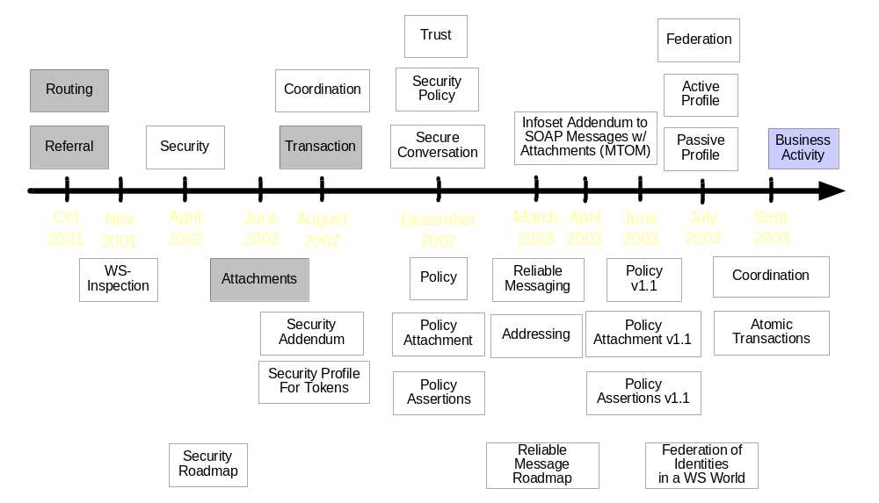
WS-* Specifications Timeline
Notes:
Greyed out - superseded by another spec
Purple - expected

Slide 12
BizTalk Server, XLANGs
Business
Process
New
Order
Exception
Partner
Validation
Loan
Application
Etc.
Office 2003, InfoPath
Business
Documents
Schema 1
Schema 2
Schema 3
Schema 4
Etc.
Common Transport
Visual Studio .NET
Web Services Enhancements (WSE)
Windows Servers
Enterprise Servers
Ubiquitous
Low Cost
Transport
&
Platform
Security
Reliability
Transactions
MetaData
Messaging
XML
Business Value
Notes:
Solving Integration and Business Process flow with Microsoft Products.
BizTalk Technologies
Business Process
Business Rules
Business Activity Monitoring
Bulk Data Load
Data Cleansing

Slide 13


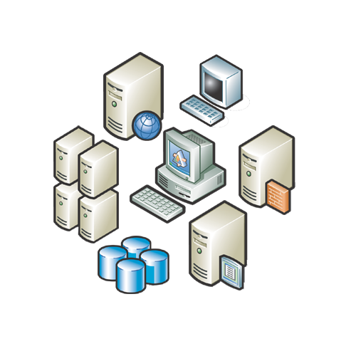




Microsoft .NET
Software to connect information, people, systems and devices
Our vision: provide the platform to
rapidly build and evolve
connected applications
369 CIOs were asked which platform is preferred in building Web services*
Microsoft .NET 46.5%
IBM WebSphere 19%
Sun One 8.2%
Information
Devices
People
Systems
*CIO Magazine Poll Jan 03

Slide 14



Leading the Industry Web Services Effort
Gartner Group Aug 2003:
“Major Vendor Web Services Platform Influence Magic Quadrant”
Challengers
Leaders
IBM
Microsoft
Ability to Execute
BEA
Oracle
SAP
Fujitsu
Sun
HP
CA
Novell
Siebel
Peoplesoft
Niche Players
Visionaries
Completeness of Vision

Slide 15
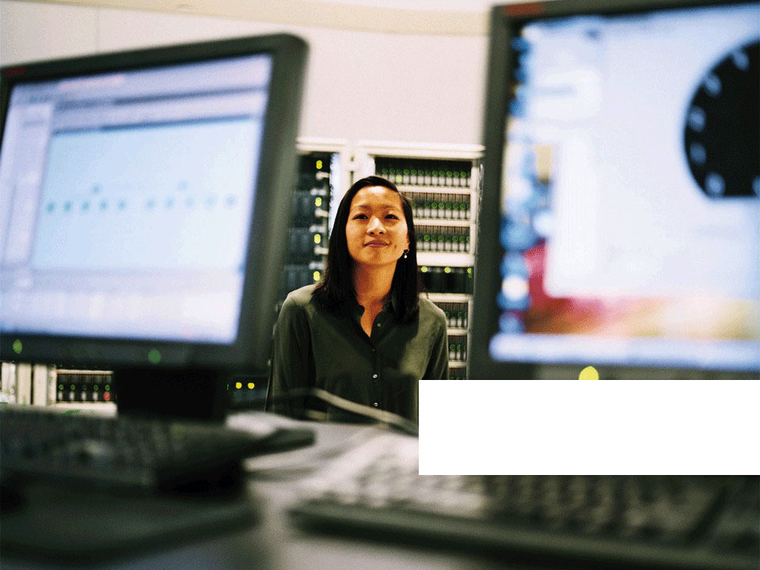
HP Global Gateway Services
Notes:
Using the Gartner Terminology, HP has leveraged the MS Platform to implement a Service Oriented Business Application (SOBA) designed from the ground up as an Event Driven Architecture (EDA)

Slide 16
Business Problem
HP currently has over 200 client applications including 80+ web storefronts that require payment processing services
Each is currently challenged with
  Establishing Banks partnerships for Payment processing
  Understanding US and local government regulations
  Implementation of Fraud analysis
Fraud order case management
  Disparate systems makes fraud analysis more difficult and limited in scope
  Each high risk order that is out-sorted costs more than 15x a low risk order to process due to manual order case management and decision processes!!
  Bad debt write-off
NEED: Common infrastructure for payment processing and fraud screening based on best practices!!!
Notes:
Fraud is expensive! Cost that is not realized

Slide 17
Requirements
Must be Secure
Global in scope
Easy to integrate HP IT environments
  Must be interoperable
  Satisfy technology needs for heterogeneous systems
Cost effective (beyond ROI)
Business visibility
Needs to grow with the business
  Transaction scaling is potentially exponential
Notes:
SECURE:
• From External Threats
• From Internal Threats
– Last numbers – ~20% of fraud was because of internal security breaches
ROI:
• Business process improvement
• Speed and accuracy of the system (human error and judgement)
• Agility to change with the trends
– 6mo > minutes
Business Visibility – PGS is not in finance; however PGS is creating IT systems that normally would be provided by a financial department

Slide 18
Microsoft Technologies in Production Today
.NET tools and technologies
  Visual Studio .NET 2003
  .NET Framework v1.1
  WS-I compliant Web services
Web Service Enhancements for Microsoft .NETv1.0
  Digital Signing and Encryption with x509 certificates
BizTalk Server 2002 Enterprise Edition
  business process management
Windows 2000 Advanced Server
SQL Server 2000 Enterprise Edition
UDDI (Windows Server 2003)
Notes:
.NET Suite
WS-I Compliant
WSE 1.0
• Username Token and X.509 certificates (internally)

Slide 19
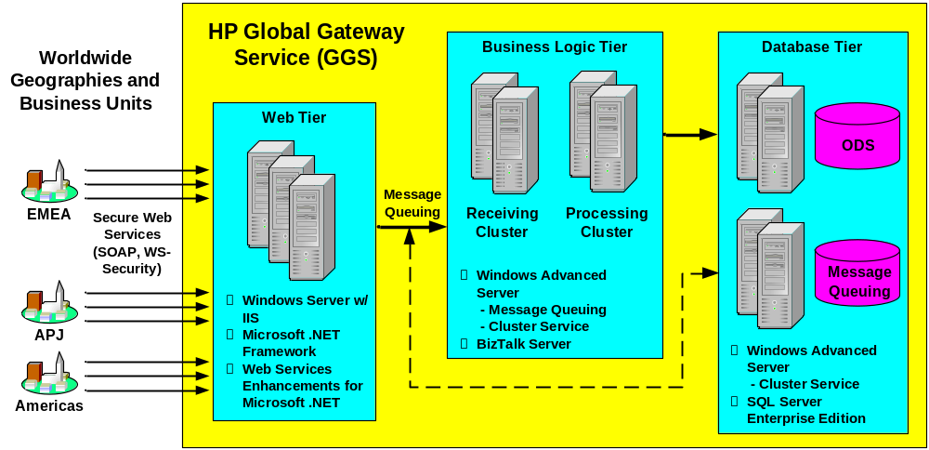
Global Gateway Services Solution
Notes:
FRONT END:
• Handle the frontend processing of the WS
• Scalable high or wide to meet needs
– Processor / System utilization requirements
MIDDLE TIER:
• Automated Business Processes
DATABASES:
• Secure storage of the transactional data
2nd and 3rd Tiers combined:
• The business process management allowed us to do Programmatic data analysis.

Slide 20
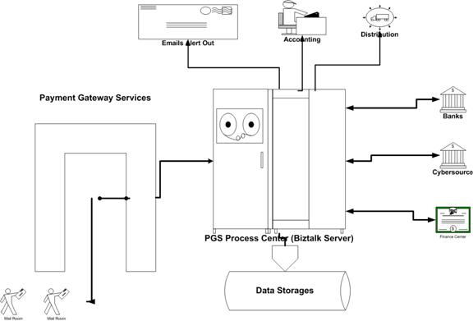
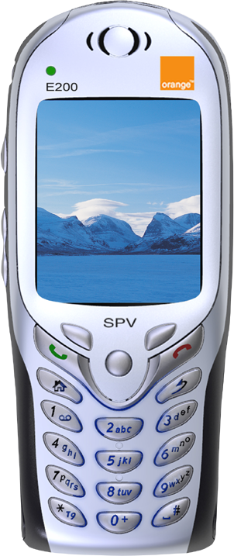
Process Flow
Notes:
• Process flow into and out of the “Black Box”
• Interaction with systems
– Versions of SAP
– Java apps
– And of course.NET
• Reporting

Slide 21
Global Gateway Services
DEMO

Slide 22
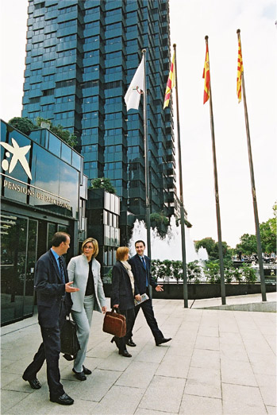

Business impact
Fee rate decreased by 30%
Standardization of financial systems and processes
Fraud rate decreased to < 1%
Revenue enablement
Notes:
• FEES: economies of scale through volume aggregation
• PROCESS: Many to 1, Best Practices Utilization
• FRAUD: Industry average of ~6%
• REVENUE: Automation of the customer to cash cycle
– Faster and more accurate recognition of the full $$ TX lifecycle

Slide 23
Fraud business benefits
Reduce chargebacks and bad debt due to fraud
Automate manual look ups and decision process steps
Scale to increased order volumes
Reduce order review and processing time
Increase operating efficiency and customer satisfaction
Reduce IT maintenance and enhancement costs
Scale process to meet peak capacity demands
Notes:
• Ability to see chargebacks and use the data
• Business process Automation
• Scalable
– TX volume
– Reliability

Slide 24

Fraud business benefits
Bottom line
In NA HP has achieved significant annual cost reductions and can scale to triple order capacity with
no increased cost
In addition, more orders
are approved, faster
Furthermore, with minimal additional development, we can roll out to other stores in the AP and EMEA regions
Business visibility to fraud
Notes:
? WHO is interested in saving money, but not cutting budgets ?
~1Mil / Yr for one business team alone
• Bus.Proc.Automation means order acceptance rate is higher, while tightening down on fraud trends
• REPEATABLE
– AP ~23 financial integrations > 1
– EMEA 11 countries online in 2 months
? Can your business truly see where its bleeding ?
• Full Cycle deltas and reports

Slide 25
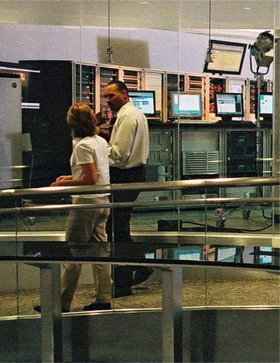
IT benefits
Bottom line
Flexibility, faster time to market and rapid development
  Easily incorporate new systems with standardized fraud detection service
  Two developers built solution in six weeks
Security, reliability and availability with advanced Web services
Notes:
• Easily built with the .Net suite of products
• WS-I compliant WS makes the deliverable reusable and repeatable
• ALWAYS keep STDs in mind
– Rosettanet, ISO 8583, etc.
• 2 dev – 6wks
• ALWAYS keep security and your InfoSec teams in the loop

Slide 26
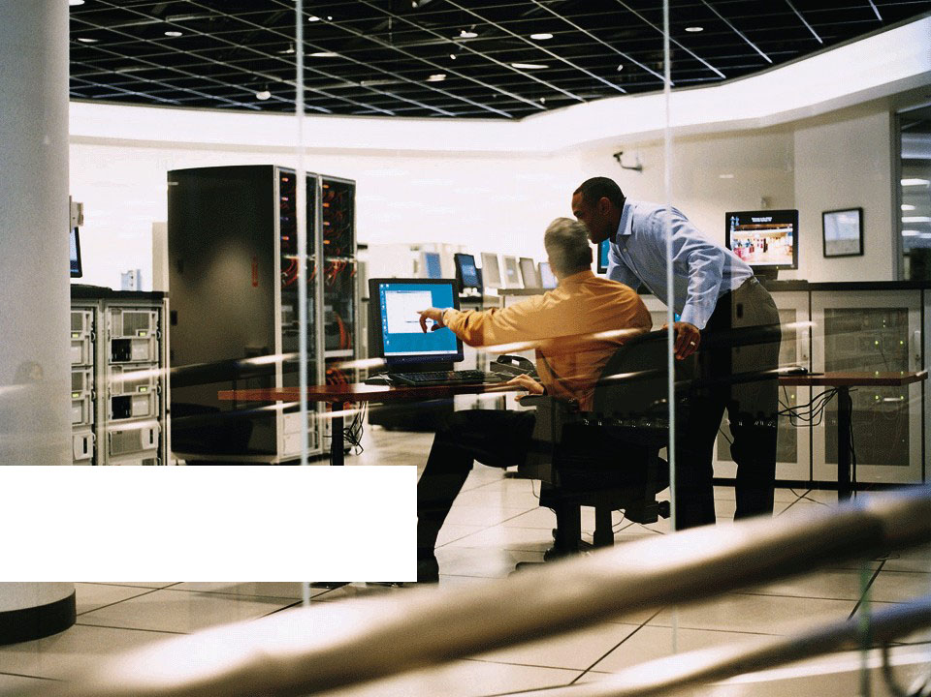
Lessons learned

Slide 27
Lessons learned
First evaluate how a Service Oriented Architecture can improve IT Operations
Select tools, platforms and technologies that support advanced Web services
Focus on ease of development, flexibility of infrastructure, and maintenance costs
Reliable, secure, scalable Web service solutions are real today
Notes:
• IT Ops doesn’t have to deal with 100’s of 1-Offs
• There is no Silver Bullet, use the tools that match your needs.
– No tech. for technologies sake
• Flexibility in terms of for enhancements

Slide 28
Benefits of Partnering with Microsoft
Strong understanding of customer needs and requirements for secure and reliable Web services solutions
Visionary and leader in Web services industry
Windows platform proven to deeply support Web services
  Strong history of Microsoft tools and technologies supporting standard and emerging Web services specifications
Proven interoperability with competing platforms
Windows Server System: rapid development, security and management with integrated platform
Notes:
• Get the right people involved in your vision
• MS Resources are there if you ask
• Native support of WS without addons
• Truly interoperable (Java/Unix, SAP, etc)
• Security

Slide 29
GGS Short Term Next Steps
Continued support and adoption of advanced Web services
  Moving from MS Web services enhancements 1.1 to 2.0
    WS-Security, WS-Addressing, WS-Policy
Enhanced Business Process Management: BizTalk Server 2004
  HP early adopter of BizTalk Server 2004
Order Processing: Commerce Server 2002
  Order processing plug-in will facilitate seamless integration of PGS capabilities into other HP business unit solutions
Reporting Services: InfoPath as smart client view into SQL Server 2000 Reporting Services
  Improved insight for PGS business managers
    Robust fraud and purchase behavior reporting capabilities delivered to the desktop
Windows 2003 Advanced Server
  Scalability and Uptime
  Native Web services integration in platform
  “lots of cool stuff”
Windows SharePoint Services
  Cross team collaboration during the PGS development phase
Notes:
• WS-SEC (security)
• WS-Addressing (routing)
• WS-Policy - configurability
• SQL Enterprise
• Windows 2003 (LOTS OF COOL STUFF)
• Windows Sharepoint Services collaboration
– Across the dev team
– Across the business teams

Slide 30
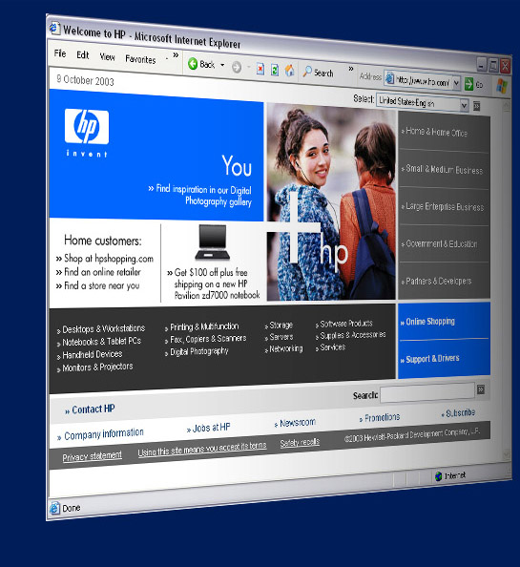
Where to learn more
Contact
greg.andrews@hp.com
rdias@microsoft.com
http://blogs.gotdotnet.com/rdias
Download the BizTalk Server 2004 beta and learn more about BizTalk Server at:
  http://www.microsoft.com/BizTalk
Download WSE and learn more about Web Services at:
  http://msdn.microsoft.com/webservices

