Slide 1






Under the Covers: Windows Mobile Device Platform Futures
MBL317
Ori Amiga
Lead Program Manager
Mobile Devices Product Group
Microsoft Corporation

Slide 2

Agenda
Platform Evolution
Demo: Flight Service (C#)
  Notifications Broker
  Managed access to Calendar
Demo: Contacts and SMS (C#)
  Managed access to Contacts database and data-binding
  Sending an SMS message
Demo: Making a Phone Call (C#)
  Making a call using new Telephony namespace
Demo: Email and Camera (C#)
  Creating an Email form
  Using the Camera API to attach a photo
Demo: Configuration System (C#)
  Access the Windows Mobile XML configuration system
Demo: Location-Based Services (C#)
  Using the Location platform APIs to retrieve current device location
  Leveraging live Web Services in your application
Demo: DirectX Mobile
  Quick n’ dirty application using Direct3D Mobile

Slide 3
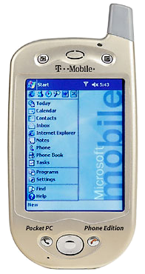
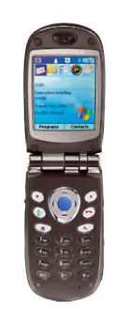

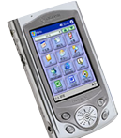
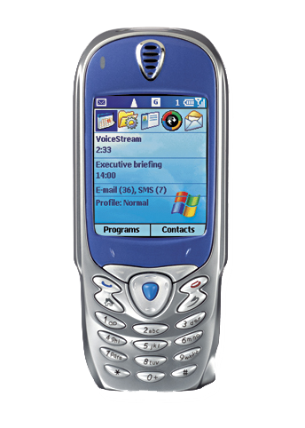


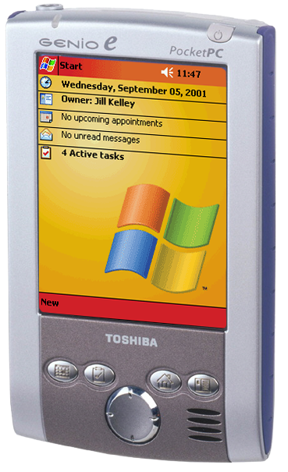






A Brief History of Time...
eVC 3 (C++)
eVB 3 (VB)
eVC 3 (C++)
eVB 3 (VB)
eVC 3 (C++)
eVC 4 (C++)
VS.NET 2003 (C#, VB.NET)
VS Whidbey
(C#, VB.NET, C++)
Tools
Devices
PPC 2000
PPC + PE v Next
VGA, Landscape, Square, Standard, SP v Next, QVGA
Standard
PPC = Pocket PC
PPC PE = Pocket PC Phone Edition
SP = Smartphone
PPC + PE 2002
SP 2002
PPC +PE 2003
SP 2003
Platforms
+ .NET Compact Framework,
Bluetooth,
SMS
+ .NET CF Whidbey,
New native runtimes,
New device class libraries,
Notification Broker, DirectX, Location APIs, Dr. Watson
APIs
Win32,
POOM
+ MFC,
Connection Manager
CE OS
3.0
3.0
4.2
Macallan

Slide 4

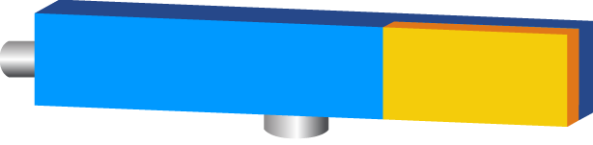





Future Windows Mobile Platform
3rd-Party ISV Applications
Gaming and Multimedia
Rich Client Apps
Web Services
Enterprise LOB
Native Framework
Managed Framework
Configuration System
Telephony
.PocketOutlook | .Telephony
Notifications Broker
Pocket Outlook
.NotificationsBroker
ActiveSync and RAPI
Shell, Internet Explorer
.Configuration | .Multimedia
Native Platform
.NET Compact Framework
Networking | Security
Multimedia
Web Services, Data
eDB | Core OS
Win32 | ATL | MFC
WinForms | Multimedia

Slide 5
Notifications Broker
“Notifications-driven” code is a key programming paradigm of Pocket PC and Smartphone applications.
Key benefits:
  Improved context-sensitive functionality
  Tighter integration with system services
  Efficient use of CPU, memory, power, bandwidth
  Extensible by OEMs and ISVs
Today:
  Limited notifications support
  Multiple different models for different components
  Limited/no support for .NET applications notifications and activation.
Tomorrow: notify via:
  Window Messages
  CE Message Queues
  Application Activation
  .NET Event Delegates
Unified notifications on:
  Networking state
  SMS / Email
  Synchronization state
  Telephony events
  Device state changes
  3rd-Party-defined events
  And more.

Slide 6

Notifications Broker

Slide 7

Pocket Outlook Object Model
Today: separate unique native APIs for each core area
  Native POOM
  Native MAPI
  Native SMS API
  Native SMS intercept
Tomorrow: unified .NET programming model
  Mail
  SMS
  Contacts
  Calendar
  Tasks
Supporting (common):
  Creation/Deletion
  Enumeration
  Sort/Search/Restrict
  Copy/Compare
  Data binding

Slide 8
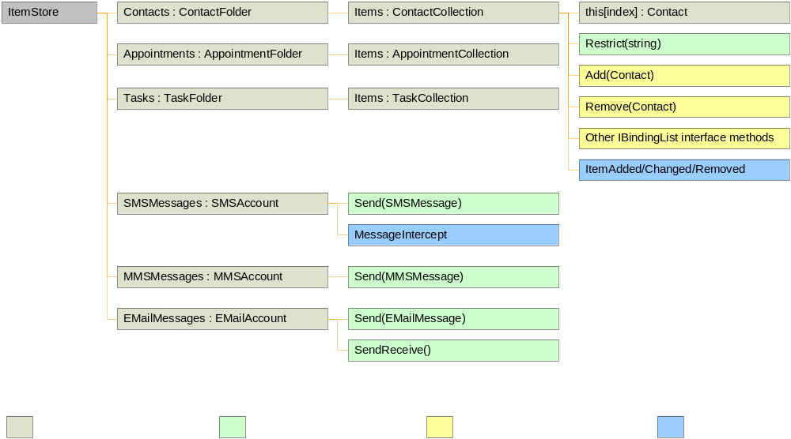
Pocket Outlook Object Model

Slide 9
Contacts and SMS

Slide 10
Telephony Object Model
Today: separate unique native APIs for
  TAPI
  ExTAPI
  Assisted TAPI
  Phone API
  Call Log
Tomorrow: unified .NET programming model
  Phone control
  Call log access
Supporting:
  Access telephony UI
  Make / end calls
  Determine phone state
  Access call log
  Notifications

Slide 11
Making a Phone Call

Slide 12
eDB
Future Generation eMbedded Database
eDB is the replacement data store for CEDB
New features:
  ACID transactions
  Significantly better performance with large data sets
  Larger databases
  Support for more indexes
Replacing the PIM data store
CEDB-like API, not 100% compatible
Supports a secure file system
(i.e. encryption at the file level with password)

Slide 13
Mail and Picture Control

Slide 14
Configuration System
Config Manager
  Single point of configuration
  Brokers requests to CSPs
  All operations transacted
  Consistent security role
  across transactions
Provisioning Supported Via:
  WAP Push (OTA)
  CAB-Based Provisioning (.CPF)
  DMProcessConfigXML API
  .MobileDevices.Configuration
  RapiConfig.exe from Dekstop
3rd-Party Apps
User Interface
Control Panel
WSP Source
SMS Router
Configuration Manager
Configuration Service Providers (CSPs)
Homescreen
Profiles
Sounds
Browser
Locale
Telephony
Email
ActiveSync
Clock
Installer
Bootstrap
File System
Registry
Device Info
Security

Slide 15
Configuration System Access

Slide 16
Platform Evolution: Hardware
Displays
  Pocket PC Portrait/Landscape support
  Pocket PC Square Screen
  Pocket PC VGA
  Smartphone QVGA
Form Factors
  Hybrid devices
  Pocket PC softkey support
Multiple-Radios
  GSM/GPRS CDMA/1xRTT
  WiFi (802.1x)
  Bluetooth
  Location Services

Slide 17


Location Services
Issues and challenges:
    No single point of control for:
      Global changes of location information for all applications
      Securing and controlling access to location information
    No schema exists that:
      Encapsulates all sources of location information
      Is understood across all applications
    No existing source of location information meets all application needs
Future generation Windows Mobile platform offers a location service that:
    Aggregates all location information
    Supports an extensible location schema
    Supports an extensible plug-in model for new sources of location information
    Subset the Longhorn Location APIs

Slide 18
Location Service Architecture
Location Data API
  Applications register for location notifications
  Applications retrieve
  location reports
Management API
  Applications manage subsystems of service
Provider API
  Feed location information into the service
Resolver API
  Receive location reports from the service
  Resolve and push back new reports
Location-Aware
Applications
Location Data API
Active
Directory
Management API
MapPoint
Resolver API
Location Service
3rd-Party
Resolver
Provider API
802.11
GPS
3rd-Party

Slide 19
Location and Web Services

Slide 20
Platform Components
Updated Web Server (HTTPD) w/ ASP support
Native MSMQ libraries, as well as managed support for System.Messaging
SOAP Toolkit to consumption of web-services in native code
UPnP
P2P
Updated version of MSXML

Slide 21
Pocket Watson
Testing catches a large number of bugs but conditions in the field are difficult to emulate
Top ~1% of bugs cause ~50% of the user-encountered crashes
Pinpoint problem areas that users are actually experiencing “in the field”
Report crash data with the option of including other logs
Leverages existing Desktop Watson reporting infrastructure
Complies with US and EU principals on collection and use of personal data
Reported directly from device
Report primarily via non-cellular data connections (avoid charges)
ISV’s who participate in Mobile2Market can access their crash data via the Windows Error Reporting Program (WERPA)
The hyperbola is your friend!
# of incidents
Bug ID

Slide 22

Multimedia
Direct3D Mobile
  Proper subset of desktop Direct3D 8 API (COM based)
  Designed from ground up targeting devices
  (small code-size and footprint)
  Flexible Architecture (SW/HW/Hybrid)
  Support for both native (Win32) and managed (.NETCF) on Pocket PC and Smartphone
DirectDraw
DirectShow (camera and video image capture)
Windows Media Player
  Pluggable Codecs
  OCX control

Slide 23
Quick n’ Dirty: D3DM

Slide 24
Visual Studio Whidbey
Managed and Native development in same IDE
First class development experience
  WinForms and Data Designers for Managed
  Resource Editor for Native
  Accurate Intellisense, integrated Help
  New device cross-compilers for Native
  Updated Connectivity technology, native and managed remote debuggers
Whidbey Native Runtimes
  ATL, MFC, CSL/STL for native development
  Bringing device runtimes to desktop 8.0 code base
  Merging ATL and MFC common functionality
  Improved security, performance, robustness
  See MBL315 on PDC DVD for additional info.

Slide 25
.NET Compact Framework Whidbey
Performance
Extensibility
  P/invoke
  COM interop
  Hosting Interface
Class Library evolution
  More GUI controls and drawing
  Designer support for multiple resolutions
  More XML (xpath, schemas)
  MSMQ, Authentication and IPV6 for networking
  SQL CE result set (fast!)
  Other: crypto, registry, generics, serial port

Slide 26
Windows Mobile
Call to action
Develop Windows Mobile applications today (Tools available on Longhorn DVD)
Visit www.microsoft.com/windowsmobile/developer
Join Windows Mobile developer beta programs
  Mail to : wmdevbet@microsoft.com
  Subject : Windows Mobile Future Gen

Slide 27
Windows Mobile
What to do at PDC
Visit the Product Pavilion
  See the latest devices and get your questions answered
Take a Hands on Lab – Pocket PC, Smartphone, MapPoint, .NET Compact Framework
Visit the Mobile Planet store
  Buy a Smartphone 2003 Developer Kit
  Buy a Pocket PC and accessories
Visit the Mobile PC and devices lounge
  Comfortable connectivity with experts on hand

Slide 28
© 2003-2004 Microsoft Corporation. All rights reserved.
This presentation is for informational purposes only. Microsoft makes no warranties, express or implied, in this summary.
Notes:
<footer>© 2003-2004 Microsoft Corporation. All rights reserved.
This presentation is for informational purposes only. Microsoft makes no warranties, express or implied, in this summary.

Slide 29
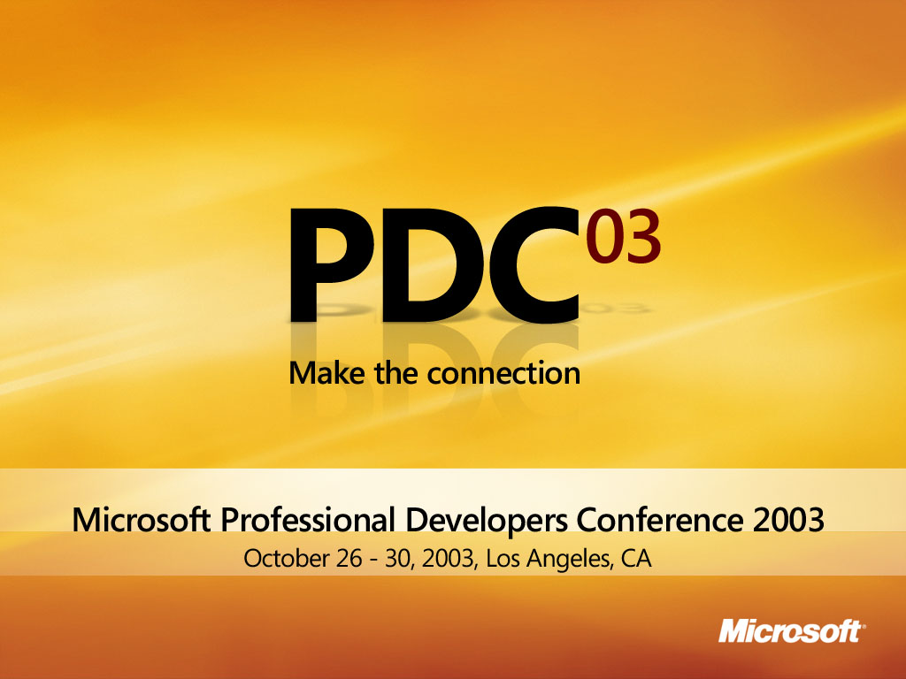

Slide 30
Appendix

Slide 31
Windows Mobile
Resources – On the web
Windows Mobile Developer Portal
  www.microsoft.com/windowsmobile/developer
Mobility Developer Center
  www.msdn.com/mobility
Mobile2Market
  www.microsoft.com/windowsmobile/mobile2market
Windows Mobile Community
  www.microsoft.com/windowsmobile/resources/
  communities/developer
Smartphone Developer Kit
  www.microsoft.com/windowsmobile/information/
  devprograms/smartphonedevkit

Slide 32
Windows Mobile Sessions
MBL210 | Overview: Developing for Windows Mobile Devices | Mon 1:30-2:45 | 404AB | James Pratt
MBL314 | Developing Data Applications for Devices with SQL Server CE 3.0 | Mon 3:00-4:15 | 404AB | Kevin Collins
MBL315 | Developing for Devices Using Native C++ with Visual Studio | Mon 4:45-6:00 | 402AB | Nishan Jebanasam Rich Hanbidge
MBL319 | Building Mobile Location Based Applications with MapPoint Technologies | Tue 2:00-3:15 | 402AB | Steve Lombardi
MBL317 | Under the Covers: Windows Mobile Device Platform Futures (Pocket PC and Smartphone) | Tue 2:00-3:15 | 511ABC | Ori Amiga
MBL312 | Developing Smartphone Applications Using the .NET Compact Framework | Tue 5:15-6:30 | 402AB | Jamie de Guerre Scott Smith
MBL210R | Overview: Developing for Windows Mobile Devices (Pocket PC and Smartphone) | Wed 3:30-4:45 | 404AB | James Pratt
MBL311 | Exploring New Features in .NET Compact Framework "Whidbey" Release | Wed 3:30-4:45 | 501ABC | Bruce E. Johnson Seth Demsey
MBL316 | Architecting Applications for Smartphone in Native Code | Wed 5:00-6:15 | 402AB | Greg Burgess

