Slide 1

Microsoft® SharePoint™ Products
and Technologies Developer Tour
EMEA 2004

Slide 2
Search Extensibility with
Microsoft® Office SharePoint™ Portal Server 2003

Slide 3



Search Technology Comparison
Microsoft® Windows® SharePoint™ Services for Microsoft® Window® Server 2003 | Microsoft® Office SharePoint™ Portal Server 2003
Uses Microsoft® SQL Server Full-Text Search Not available with WMSDE | Uses SharePoint Portal Server-specific Search Richer UI Multiple Scopes
Limited to a single site | Aggregator of multiple sites, portals, external sources
Alerts are scoped to a site Focused on list items Add/modify/delete events Email delivery only | Alerts are more focused on areas and personal sites Many configuration options Email and Web Part delivery
 | Shared Services
Notes:
Windows SharePoint Services
Uses SQL FTS – which is 2 generations ‘less advanced’ than SharePoint Portal Server 2003 search.
It is only available when Windows SharePoint Services is installed with SQL – with SQL, however, it is automatically turned on.
It is slower, doesn’t have the advanced features of SharePoint Portal Server 2003 search (aggregation, scoping, etc.).
Fewer language and document format capabilities
Advanced administration via SQL vs. in the Windows SharePoint Services UI
Limited to a single site – it has no cross site capabilities
Alerts – uses the SQL alerting mechanism, so is limited to the site. Can only use email as a notification medium.
SharePoint Portal Server
Uses SharePoint Portal Server Search – Microsoft’s flagship search technology – thus has all the advantages covered in the rest of this slide deck.

Slide 4
Search Extensibility
Using SharePoint Portal Server Search from Other Applications
  SharePoint Portal Server Query Web service
  Research Library Task Pane
Extending SharePoint Portal Server Search to Index Other Content
  IFilter, IProtocolHandler, IWordbreaker, IStemmer
Modifying the Built-in Default User Interface
  Custom query components
  Search results Web Part
    Already used around the Portal (My Documents)
    Customize search results page
Notes:
Query web service: We have changed the custom query experience so that the developer only needs to understand and write to a single query interface – the query web service. The query language is a defined part of the SQL Query language – Full Text Extensions for the SQL Query Language. The SharePoint Portal Server 2001 SDK covers this in great detail and has many pieces of sample code.
All Portal Search UI are Web Parts
This means you can easily customize the queries – through changing web part properties or changing the web part code.
The search results are also a web part – so can also be easily customized. There are multiple places throughout the portal which use the search results page to display data (i.e. My Recent Documents).
IFilter, IProtocolHandler, IWordbreaker, and IStemmer
The IFilter, IWordbreaker and IStemmer interfaces are fully documented in the Windows Platform SDK
IProtocolHandler is fully documented in the SharePoint Portal Server 2001 SDK

Slide 5
SharePoint Portal Server Query Service
Functions
Query
  Accepts Query XML
    Defined by the urn:Microsoft.Search.Query namespace
  Returns Response XML
    Defined by the urn:Microsoft.Search.Response namespace
QueryEx
  Accepts Query XML
    Defined by the urn:Microsoft.Search.Query namespace
  Returns search results as DataSet for the specified query string.

Slide 6

SharePoint Portal Server Query Service
Functions
Registration
  Defined by the urn:Microsoft.Search.Registration namespaces
  Returns the name of a portal site.
SPSGetPortalSearchInfo
  Returns a list of search and catalog scopes.
Status
  Returns a success code to indicate that the search provider is available

Slide 7
SharePoint Portal Server Query Service
Functions
Add Web Reference
  Service found at http://<portal>/_vti_bin/search.asmx
Authenticate
Formulate and send a query

Slide 8

Using the Search Query Service from ASP.NET
Notes:
Time: 2-3 minutes
Objective: Demonstrate using the SharePoint Portal Server Search Web Service
Setup:
Single box SharePoint Portal Server 2003 configuration

Slide 9
SharePoint Portal Server Query Service
SharePoint Portal Server Search SQL Syntax
Syntax Help
  Microsoft SharePoint Portal Server 2001 SDK
  Manage Properties of Indexed Content
  Manage Content Sources
  SPSGetPortalSearchInfo()
  SPSQueryServiceConst Class
    Templates for SELECT, WHERE, CONTAINS
  View Source on search.aspx

Slide 10
SharePoint Portal Server Query Service
SharePoint Portal Server Search SQL Syntax
QueryText Pointers
  QueryText type='STRING‘
    Returns results with some Research Task Pane intelligent formatting
  QueryText type='MSSQLFT‘
    Query() returns 2 columns regardless of query
      DAV:DisplayName, DAV:href
    SELECT must contain urn:schemas.microsoft.com:fulltextqueryinfo:sdid

Slide 11
Building an SharePoint Portal Server Query Service Test Client
Notes:
Time: 2-3 minutes
Objective: Demonstrate using the SharePoint Portal Server Search Web Service
Setup:
Single box SharePoint Portal Server 2003 configuration

Slide 12
Research and Reference Task Pane
Overview
Task Pane in Microsoft® Office System apps
Allows user to search information sources
A platform content providers can build on
It supports rich content and forms
SharePoint Portal Server is compatible!

Slide 13
Research and Reference Task Pane
SharePoint Portal Server Query Service Compatibility
Registration Function
Query Function
Response XML

Slide 14
Extending SharePoint Portal Server to Index More Content
Architecture overview
Tools to be Built
  Protocol Handlers
  Filters
  Word Breakers

Slide 15
Search Characteristics
Enterprise Scalability
  From ~ 5 M Docs to ~ 20 M Docs
  Cross catalog querying, load balanced queries
  Very Significant for Enterprise Search Scenarios
Shared Portal Services
Content Aggregation
Probablistic Relevance Ranking
Notifications/Alerts, Topic Assistant
Adaptive Crawling
Common Search Technology across Microsoft Product Offerings

Slide 16
Protocol Handlers and IFilters
SharePoint Portal Server indexing capability is extensible via the development of Protocol Handlers and IFilters
  Protocol Handlers are used for extending the indexing capability of SharePoint Portal Server to other content sources
  IFilters are generally used for indexing specific types of files.
    Called by Protocol Handler, and thus
    Can be skipped if the Protocol Handler is willing to do all the work
This is low-level technology; you’ll still need to use COM
  You must write a COM component, your end result will be a .dll
  Can use VC.NET to develop these components – attributed C++ is an advantage, but the code is not managed

Slide 17
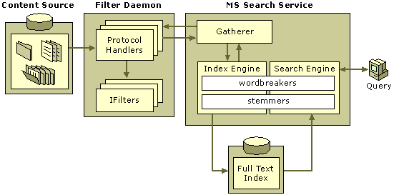
Search Structure

Slide 18
Protocol Handler General Features
Registers with gatherer
Connects to external content source
Collects data from external content source
Binds to content in external content source & streams back to gatherer
Obtains metadata and security information on external content source and sends back to gatherer
Sends LCID info to gatherer where appropriate.

Slide 19
Protocol Handlers Provided by Microsoft
Microsoft Search Service ships with a number of Protocol out-of-box
  file://
  http://
  Exchange
  Active Directory
  Lotus Notes databases
  SharePoint sites and portals

Slide 20
Before You Begin
Must have solid understanding of your external content source
Must have programmatic access to the external content source backend
Must understand the concepts behind Microsoft Search Service
Must be developed in C++, can be VC.NET

Slide 21
IFilter General Features
Extends the types of files which can be indexed
Also COM based, end result is a .DLL
Extracts internal properties from files as well as body text
IFilters can be used with any Microsoft Search Vehicle, not just SharePoint Portal Server
  Microsoft® Windows®
  SQL Server
  Microsoft® Exchange Server

Slide 22
IFilters Provided by Microsoft
Microsoft Search Service ships with a number of IFilters out-of-box
  All Office System document formats
  TIFF
  XML
Popular 3rd Party IFilters
  PDF
  CAD (.dwg)

Slide 23
Before You Begin
Must have solid understanding of your file format
Must be able to extract body text and property values from within the file format
Must be developed in C++, can be VC .NET

Slide 24
Word Breaker General Features
Decomposition of text into individual text tokens, or words
Extends the locales of data which can be indexed
Also COM based, end result is a .DLL
Wordbreakers can be also used with any Microsoft Search Vehicle, not just SharePoint Portal Server

Slide 25
Word breakers Provided by Microsoft
Many word breakers ship out of box in the Microsoft Search Service
Interface recently published in Microsoft Platform SDK
  http://msdn.microsoft.com/library/default.asp?url=/library/en-us/indexsrv/html/ixrefint_9sfm.asp

Slide 26
Steps to Building a Protocol Handler
Install sample, get it running
  http://msdn.microsoft.com/library/default.asp?url=/library/en-us/spssdk/html/_creating_a_protocol
    _handler_sample.asp
Connect to your content source
Iterate through contents
Extract data & pass to Gatherer
Write metadata mapping code
Write security mapping code
Test

Slide 27
IFilters
Not Just for Document Contents
Typically for parsing file formats
Implement them within a protocol handler to expose …
  Contents of directories (Pretend the directory is a document and the files’ names form a multi-valued property. See sample PH in SDK for example.)
  Properties taken from the document store, not from inside the document itself

Slide 28
The Gatherer Pulls Data
You are reactive to the gatherer – must wait for requests
The gatherer pulls – you can’t push
You must buffer/cache data until asked for it
You must keep more state than you might like
This isn’t rocket science, but it can be a pitfall.

Slide 29
The Gatherer is Multithreaded
Address data locking early in the design process
Think about COM apartments and threading models
The gatherer promises some thread affinity; see the SDK for details
Are your libraries thread safe?

Slide 30
Returning Data
Return File/Folder indicators
Document Body
Relevant Metadata Including
  Standard Metadata
  Custom Metadata
  LCID (if applicable)
Location information (URL)
Security Information

Slide 31
Clickable URLs in Search Results
Search is no good if you can’t get to the document
Default result URL is search URL, but IE probably doesn’t understand your protocol (ie dctm://).
The DAV:href property controls the URL that search renders – you can overwrite with a URL that the browser will like

Slide 32
Security Mapping
Search results contain file names, locations, and excerpts of the contents
Default allows every user to see every file
Search can “trim” results, but you must provide an NT ACL for each file at crawl time … no callback
Mapping users between domains or even OSes can be tricky
Mapping mechanism

Slide 33
Property Mapping
Done through the administrative UI
Maps source document properties (e.g., Author, Subject, Description, etc.) to specific target properties (e.g., Auteur, Onderwerp, Omschrijving)

Slide 34
Customizing the Search UI
Overview
Customization
  Adjusting the Out-of-Box interface
Extensibility
  SearchResults Web Part
  Create a New Advanced Search Web Part
  Create a New Search Menu
Q&A
Notes:
This talk will have focus on how the search web part page can be customized.
We will try to answer questions like:
How does the Search Web Part Page Work?
How can the Search Web Part Page be customized?
How can I extent the search Web Part Page?
Topics:
Search Web Part Page: We will look at the different web parts used on the Search Web part Page and how they work together. The web parts which we will look at are:
Search Menu Web Part – Navigation
Advanced Search Web Part – used for the advanced search options
Search Results web Parts – shows the results of the search
Search Box – The search box in the upper right corner
Customization: We will look at how we can customize the search page . The the dwp file.
Extensibility: If the default possibilities aren’t enough or doesn’t quite suite you needs. We will lastly look at how the different web parts can be extended (the SearchResults Web Part and the Advanced Search Web Part)
Out of Scope:
How to extent the alerts which are shown in the search result -

Slide 35
SharePoint Portal Server’s Search Web Part Page

Slide 36
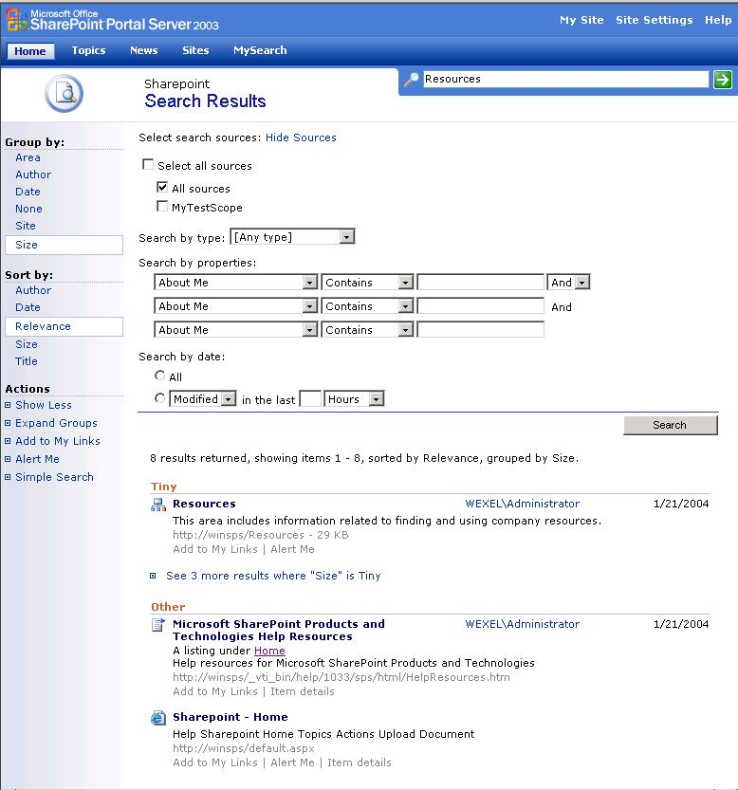
Search Box
Search Menu
Advanced Search
Search Results
Notes:
Show the different Web Parts on the Picture and what they are used for.
Search Box – query term – Note: if used on the search page it will not use the GET Syntax but a hidden fields.
Search Menu – navigation (group by, sort by, shift view, Alert Me, My Links)
Advanced Search Web Part – a) Scopes – b) Properties which are configured to be on the search page c) property groups (hard coded)
Search Result Web Part – The search result web part renders the results of the search

Slide 37
Customizing the Default Search Web Part Page

Slide 38
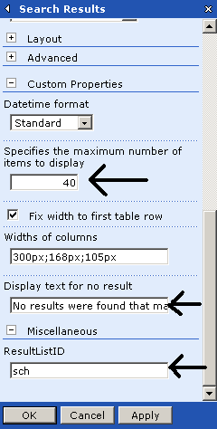
Search Results Web Part
Customize through the Property Sheet
  The number of items returned
  The display text for the “no results” condition
  Widths of columns
Notes:
The main Web parts which control mush of the functionality on the search page is the SearchResults Web Part. The SearchResults web part inherits from QueryResultBase.
The QueryResultBase Web Parts has some properties which can be changed – these properties can also be changed on the SearchResult Web Part through either the property browser or by changing the dwp file.
Fix the HTML tables. If the html tables are fixed the HTML usually renders faster.

Slide 39
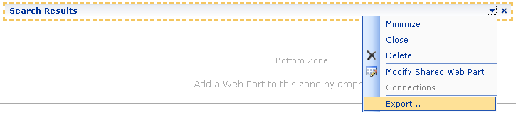
Search Results Web Part
Customize through the DWP file
  Call the search page with http://Localhost/Search.aspx?Mode=Edit&PageView=Shared
  Export the Search Results Web Part
Notes:
To get the dwp file:
http://Localhost/Search.aspx?Mode=Edit&PageView=Shared
Export and open the DWP file.

Slide 40
Search Results Web Part – DWP
Properties
ResultListID
FixLayout
GroupByList
DefaultGroupBy
SortByList
DefaultSortBy
ColumnURIs
ColumnWidths
TextForNoResults
RowNumberForEachItem
EnableQueryLoggingSearch
SupportExpandCollapseAll
EnableSQLCommandLogging
ColumnDisplayNames
OpenNewWindowForMatchingItems
ShowRankForEachItem
MaxMatchingItemsNumber
Notes:
Go through the different properties and explain short what the are used for.

Slide 41
Search Results Web Part - DWP
Important properties for customizing the search query:
  QueryTemplateSelectPart
  QueryTemplateFromPart
  QueryTemplateWherePart
  QueryTemplateOrderByPart
Notes:
We will look at 4 of the properties:
QueryTemplateSelectPart – contains the properties to return from the search
QueryTemplateFromPart – contains the %__scopecatalogs__% macro which will be replaced with the scope catalogs names
QueryTemplateWherePart – the WHERE clause
QueryTemplateOrderByPart – the order by property
%__scopecatalogs__% = Search Catalogs
%__sort_by__% = Which property to sort by
%__keywordinputnoboundaryquote__% =
%__keywordinput__% = Key works from the search box
%__sourcegroups__% = if a source group has be selected (property groups)
%__morewhereCondition__% (the advanced property will go here)
On the SearchResults Class the GenerateQuery replaces the macros and returns QueryTemplateSelectPart + QueryTemplateFromPart + QueryTemplateWherePart + QueryTemplateOrderByPart

Slide 42
How to Add Support for Wildcard Searches
demo
Notes:
In the demo we will look at the Query syntax and use the query tester web part to test some predefined queries.
Make a search from a different page then the Search Page – see the GET Syntax in the URL
Make another search on the search page - see the source of the page. The search query is logged at the bottom of the search page (search for spssSQPH)
Copy the HTML Encoded Search Query and past it in the Query Tester Web Part and Decode the HTML – run the query
Look at the different predefined queries and talk about the differences and possiblities
Lastly work with the DWP file
Change the QueryTemplateWherePart by adding the OR CONTAINS('%__keywordinput__%') to the query.
Show that you can now use Wildcards in the search from the search box.

Slide 43
Extending the Search Page with Custom Components
NOTE: From this point forward, the changes you make may not (and probably will not) be eligible for official support.

Slide 44
Search Web Part Page
Ghosted page
  C:\Program Files\Common Files\Microsoft Shared\web server extensions\60\TEMPLATE\{LCID}\SPS
Controls in the Code Behind file
  RightBodySectionSearchBox
  SearchResultManagement
  EditModeSettingsLink
  And more …
Notes:
The Search Web Part Page is a ghosted page – this mean that the page isn’t stored in the database but on the file system. Ghosted pages have better performance over unghosted pages stored in the database. (10 % performance hit if unghosted – stored in the database).
If you change the page in Front Page the page will get unghosted – this can be a problem if you need to move the search. Aspx page between different environment like from development to test, test to preproduction, from preproduction to production. Therefore the best practice is to change the code behind file – but remember that your changes can be overridden by a Service Pack.
The ghosted Search.aspx page can be fund under the folder:
C:\Program Files\Common Files\Microsoft Shared\web server extensions\60\TEMPLATE\1033\SPS
If we look in the code behind file the RightBodySectionSearchBox (Search Box) and the SearchResultManagement (Search Menu) are added here. We also have the EditModeSettingsLink which makes it possible to shift between edit mode and view mode on the Search Page.
The RightBodySectionSearchBox properties:
CompactMode
ContextSensitiveScopeType
EnableCache
PromptText
SearchBoxTableClass
SearchResultPageURL
SupportThemes
The SearchResultManagement Property:
TargetResultListID: The menu is linked/targeted a web part with the ID value. The search web part has a default ID=sch, therefore to make the SearchResultManagement works together with the Search result web part it has to have TargetResultListID=sch.
Because the page has a EditModeSettingsLink control it can be edit through the web front end like all other web part pages. We will have to put http://Localhost/Search.aspx?Mode=Edit&PageView=Shared into the URL to get the functionality.

Slide 45
Optional DEMO
Show the Code behind file and the different Web controls used

Slide 46
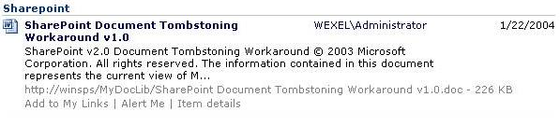
Search Result Web Part
The different Columns can have a heading by overriding the GenerateHtmlForRowColumn function
Column 0
Column 1
Column 2
Column 3
Row 0
Row 1
Row 3
Row 2
Each row can be overridden by using the GenerateHtmlOneRowForOneItem
The Icon can be
overridden with the GenerateHtmlForItemIcon function
Notes:
GenerateHtmlForItemIcon: Generates the HTML that displays the icon for the specified DataRow object in the search result set.
GenerateHtmlForRowColumn: Generates the HTML for the specified column of data for the specified DataRow object in the search result set.
GenerateHtmlOneRowForOneItem: Generates the HTML for the specified column and row of data for the specified DataRow object in the search result set.

Slide 47
Adding a new option to open the
SharePoint list itself, not the list item
demo
Notes:
The code is in the document – just need to put it into a web part

Slide 48
Limits – the Advanced Search Web Part
It isn’t possible to:
  Add new property groups
  Add new controls
  Change the layout
  Add new operations

Slide 49
Working Together
Search Box
Search Menu
Advanced Search
Search Result
JavaScript (Search.js and in HTML)
Hidden Fields
Notes:
The different web parts are working together, so to change the advanced search web part will have an influence on the other web parts.
The Search Menu web part has a property TargetResultListID which is the name (ResultListID) of the Search Result Web Part. The Search Menu disables the menu items when no results are returned in the Search Results Web Part – this is done server side. When in advanced mode the menu items are dynamically read from the “Sort by” and “Group By” properties on the Search Results Web Part.
When shifting between Group By + Sort By JavaScript functions in the Search.js file are called. The view state and the caller (like PageToPrevious, PageToNext, DirectPageTo, GroupBy, SortBy, Advanced, seeFullListLink, Go in the spssWFEH hidden field) is saved to hidden fields before submitting the form.
When clicking on the Search Box arrow or clicking the search button on advanced search page – an embedded javascript function is calls which puts all the names of the form controls into a hidden field and submit the form. The Search Result web part “reads” the hidden field and gets the values for the query. If the Search Box are called from a different page the Search Term is first canonicalized and the search page is called by using the GET syntax.
When changing properties in the drop down box the different possible operations for the type are changed in JavaScript. Every property has a prefixed letter indicating it’s type (S = String, B = Boolean, M=Multivalue, I=Numbers, D=Date)

Slide 50
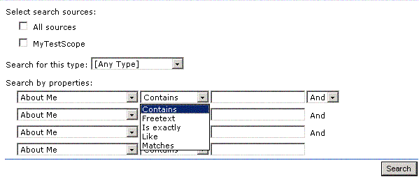
Creating a New Advanced Search Web Part
SearchConstructor
CustomViewState
SearchPageData

Slide 51
Creating a New Advanced Search Web Part - SearchPageData
Get Properties
using Microsoft.SharePoint.Portal.Schema;
PortalContext ctx = PortalContext.Current;
PropertyDefinitionCollection defCol =
new PropertyDefinitionCollection( ctx, false );
foreach(PropertyDefinition def in defCol )
{
…..
}

Slide 52
Creating a New Advanced Search Web Part - SearchPageData
Get Scopes
using Microsoft.SharePoint.Portal.Search.ObjectModel;
SearchScopes PortalSearchScopes = new SearchScopes(ctx);
SearchScope scope;
int i = 0 ;
while(PortalSearchScopes.GetAllScopes().Length>i)
{
scope = PortalSearchScopes.GetSearchScope(
PortalSearchScopes.GetAllScopes()[i].Name);
SearchScopeEntity[] scopeEntities = scope.GetEntities();
for(int ii=0; ii<scopeEntities.Length; ii++)
{
if(scopeEntities[ii].Type == 1)
{
Debug.WriteLine(scopeEntities[ii].Value);
}
}
i += 1;
}

Slide 53
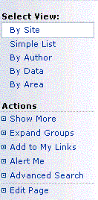
Creating a New Search Menu
JavaScript Functions
  Onshd
  OnToggleAllGroups
  OnPinSearch
  OnSubscribeSearch
  TooleMgmtAdv
Notes:
Onshd - changes between the Show Less/More menu and store the state in a cookie.
OnToggleAllGroups - changes between Collapse/Expand Groups and stores the information both in a hidden field and in a cookie
OnPinSearch- Add the Search page to the My Links
OnSubscribeSearch - Make a subscription for the search
TooleMgmtAdv - Changes between the advanced and simple view.

Slide 54
Creating a New Search Menu
Adding the menu items
//add Show Less / Show More
actionButton = new ToolBarButton();
actionToolbar.Controls.Add(actionButton);
actionButton.ID = TargedID + "_ShowLessMore";
actionButton.AllowScriptInUrl = true;
actionButton.Enabled = IsEnabled();
actionButton.ToolTip = "Show less or more";
actionButton.AccessKey = "m";
actionButton.NavigateUrl = "javascript:Onshd('" + TargedID + "', 'a','" + actionButton.UniqueID + "', 'Show Less', 'Show More');";
actionButton.Text = IsShowMore()?"Show Less":"Show More";

Slide 55
Installing the Custom Search Web Part samples
demo
Notes:
Installing the Custom Search Web Part Samples
When changing the code behind file you may also talk about the other controls (see last in notes)
Open the project in Visual Studio
Look at the SearchPageData and show the Get Scopes and Get Properties
Look at the Custom Menu – Search Results
Note (Out of Scope):
If you look in the code behind file you can also find these controls:
ShowMessageToNonScriptableClients
If the browser doesn’t support script the returned script is run
Returned script in the HTML: <noscript><meta http-equiv="refresh" content="0; url=/_layouts/1033/error.aspx?ErrorText=Your+browser+does+not+support+scripts.+This+page+requires+scripts+in+order+to+display+properly.">
CustomCSSResourceElement
Insert the link to the custom CSS, if the portal is configured to use such. This can been done through the adm pages. The information can also be obtained through the siteInfo class’s function PortalCSSUrl.
LocString
Return the “Search Results”. The SearchResult_PageTitle_Label is an Enum type Microsoft.SharePoint.Portal.WebControls.LocStringId. If the Text property of the web control is set it will overrule the content of the TextLocId and insert the text value as the title.
PageHeader
Renders the header of the page.
CategoryNavigationWebPart
Renders the menu on the search page.
WebProperty
Get the title of the site. In the default this is “Sharepoint”:
LabelLoc
Look up the pages title in the Microsoft.SharePoint.Portal.WebControls.LocStringId
RightBodySectionSearchBox
This is the search box. The Class inherits from Microsoft.SharePoint.Portal.WebControls.SearchBox
EditModeSettingsLink
Make it possible to use the edit functionality of the Web Part Framework.
SearchResultManagement
The menu is linked to the DateSearchResult base class, so the menus link will show up on the right site instead of on the top of the search result. The SearchResultManagement works together with the Search result web part.
PageLevelError
If there should be an error text or an warning showed to the user. You can set the text either by using the ErrorText or the EncodedErrorText properties. The is also an Image property which can be set to either “Error” or “Warning”

Slide 56
Summary
Search is powerful
Search is meant to be used by many clients
Search is extensible with many components
Search is customizable with many options
Get out there and build on it!

Slide 57

© 2003 Microsoft Corporation. All rights reserved.
This presentation is for informational purposes only. Microsoft makes no warranties, express or implied, in this summary.

