Slide 1




Visual C# “Whidbey”
IDE Enhancements For C# Developers
Session Code: TLS321
Scott Wiltamuth
scottwil@microsoft.com
C# Product Unit Manager
Microsoft Corporation
Anson Horton
ansonh@microsoft.com
C# Program Manager
Microsoft Corporation
Notes:
Good afternoon. My name is Scott Wiltamuth, and I’m the Product Unit Manager for C#.
My team is responsible for the C# language and the Visual C# IDE, and I’m here to talk to you about our Whidbey release.
How many of you use C# today? That’s fabulous. I think you’ll really enjoy this talk.

Slide 2





The C# Road To Longhorn
Visual C# “Orcas”
  Avalon, Indigo, WinFS
  Adaptive app support
Visual C# “Whidbey”
  C# generics
  .NET Framework 2.0
  ClickOnce deployment
  Win64, Yukon, Office, Sharepoint
Visual C# .NET 2003
  .NET Framework 1.1 and .NET Compact Fx 1.1
  Windows Server 2003 and PocketPC
Visual C# .NET 2002
  C# language
  .NET Framework 1.0 and Web services
  IntelliSense®, Win and Web designers

Slide 3

Generics
Anson Horton
Program Manager
Visual C#

Slide 4
Generics
Demo recap
  The benefits of strongly typed collections without per-collection hand coding
  Better reuse and less code
  Excellent performance and no code bloat
  IntelliSense®
Staged rollout
  Whidbey – VC#, VB, VC++, and VJ#
  Orcas/Longhorn – generics in CLS

Slide 5
More Info On C# language
C# talks and panels
  TLS320, Visual C# "Whidbey": Language Enhancements, today at 3:45 pm
  Ask the Experts, tonight at 7-9 pm
  PNL10, The Future of .NET Languages, Thursday at 1:45 pm
Other language features
  Iterators
  Anonymous methods
  Partial types
  Property accessors with different accessibility

Slide 6
Productivity
Developer productivity
Write code
Navigate code
Refactor code
Debug code
Team productivity
Source code control
Build code
Migrate code
Visualize code

Slide 7
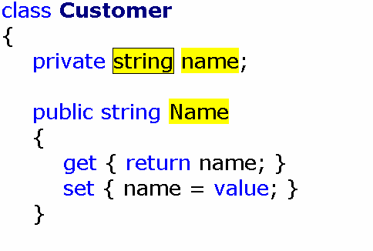
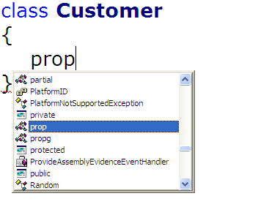
Write Code
Expansions

Slide 8
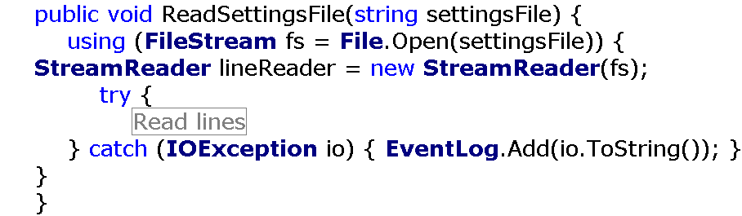
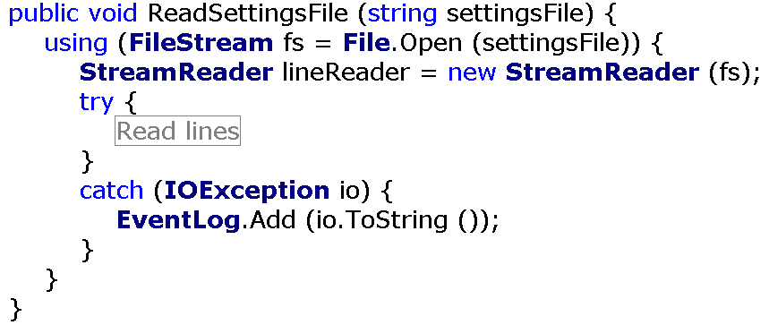
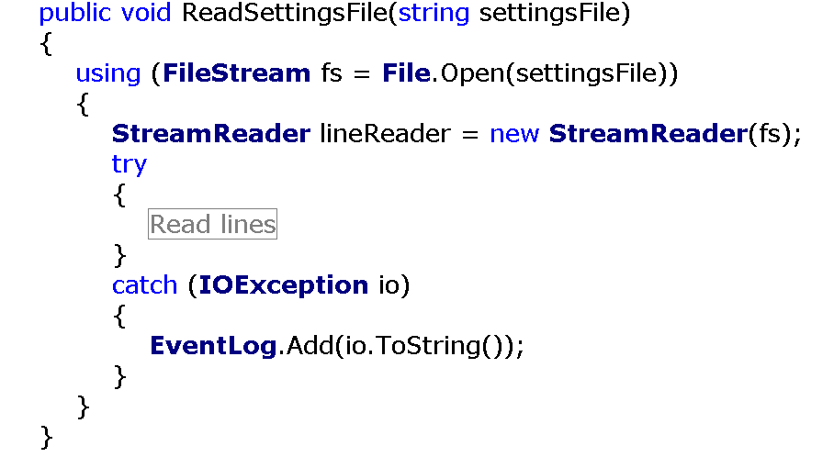
Write Code
Expansions
Code formatting

Slide 9
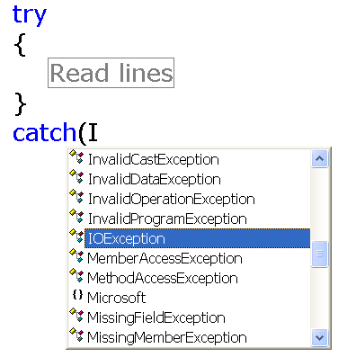
Write Code
Expansions
Code formatting
Filtered completion lists

Slide 10
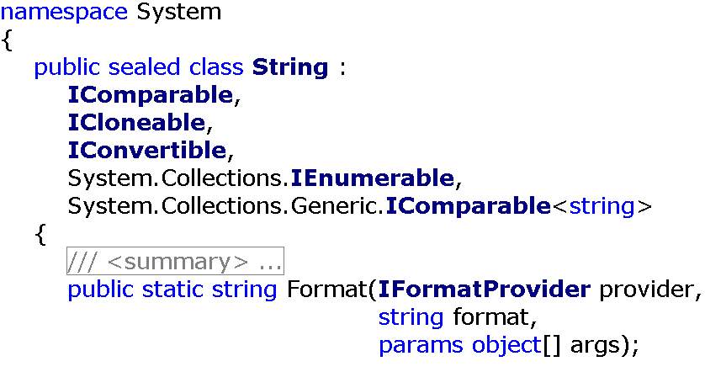
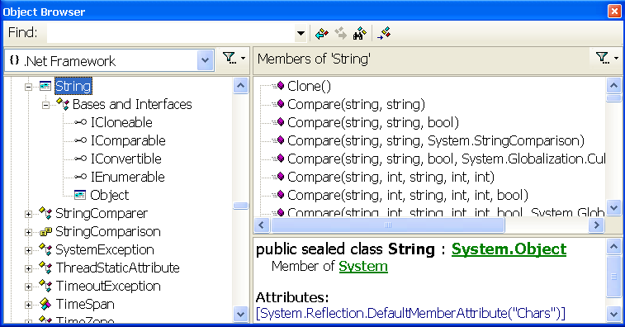
Navigate Code
Browse components

Slide 11
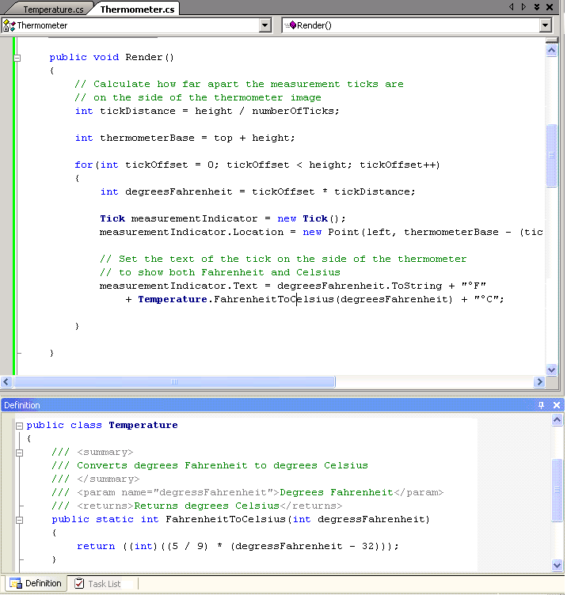
Navigate Code
Browse components
View use and definition

Slide 12
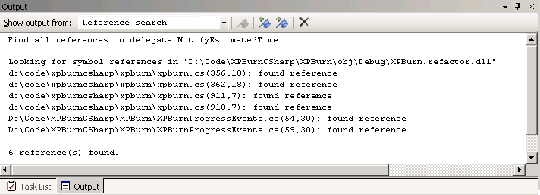
Navigate Code
Browse components
View use and definition
Find all references window

Slide 13
WriTe Code
Navigate Code
Anson Horton
Program Manager
Visual C#

Slide 14
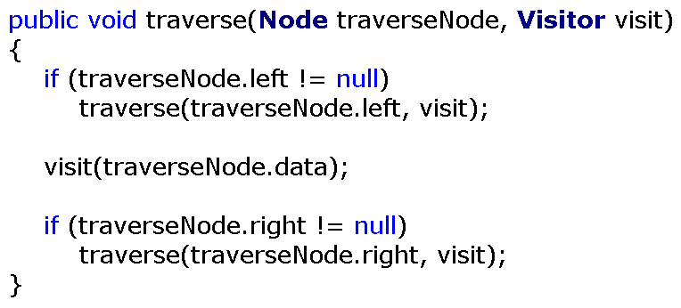
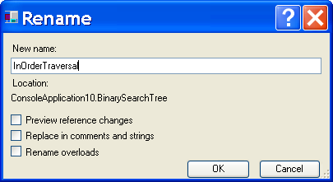
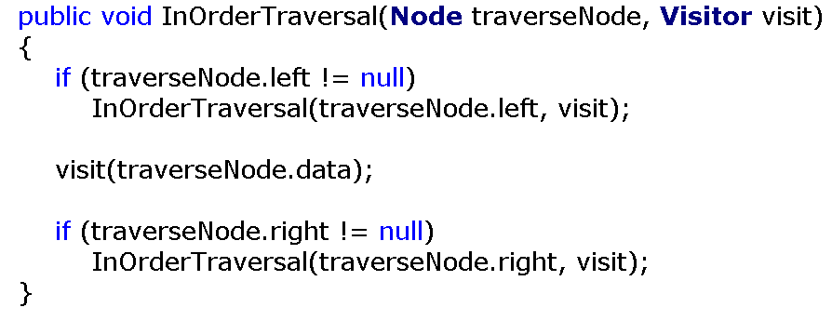
Refactor Code
Rename

Slide 15
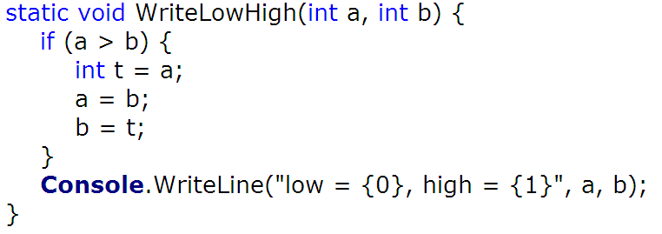
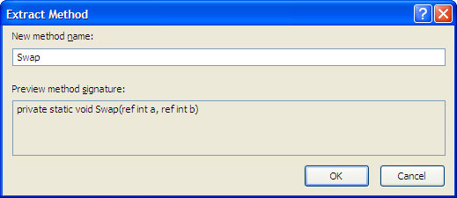
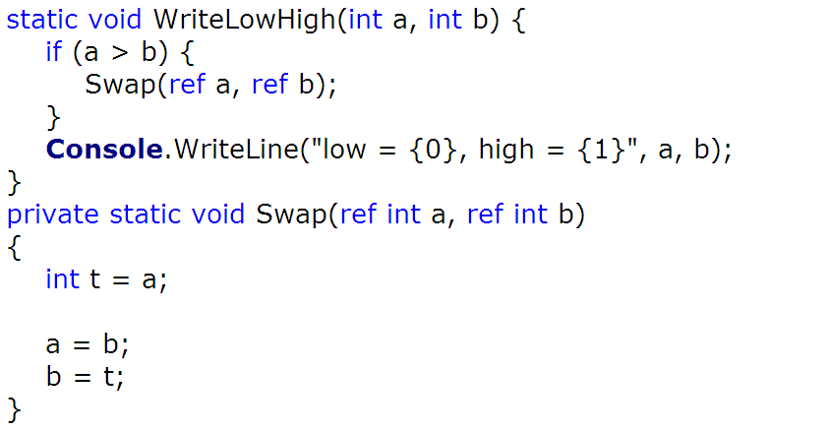
Refactor Code
Rename
Extract method

Slide 16
Refactor Code
Rename
Extract method
Extract interface
Encapsulate field
Reorder parameters
Remove parameter
Add parameter
Promote local to parameter

Slide 17
RefacTor Code
Debug Code
Anson Horton
Program Manager
Visual C#

Slide 18
Debug Code
New C# expression evaluator
Data tips
Data visualizers
“Just my code” debugging
Yukon and Win64
TLS343, Visual Studio "Whidbey": Advanced Debugging Techniques, today at 5:15 pm

Slide 19
Productivity
Developer productivity
Write code
Navigate code
Refactor code
Debug code
Team productivity
Source code control
Build code
Migrate code
Visualize code

Slide 20
Source Code Control
Remote access
Large project performance
Merging

Slide 21

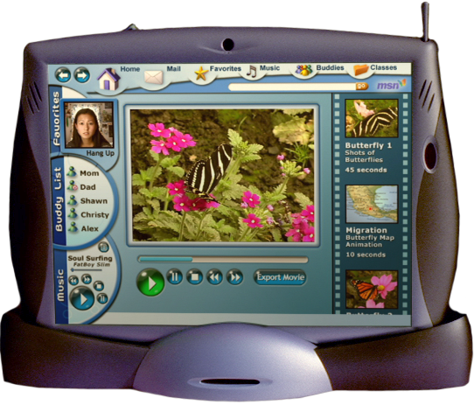
Build Code – Visual C# 2003
VS Build System
Pre build step
0011010101
1110010110
1101100111
0010100111
Post build step
Produces
Authors
Feeds
PROJECT FILE
- $%#^$&%
- @$#%$^#
Final Product

Slide 22

Build Code – Whidbey
MSBuild
Final Product
Produces
PROJECT FILE
<Project>
<Property … />
<Item … />
<Target … />
</Project>
Authors
Authors
Feeds
DEVELOPER

Slide 23
Build Code
Derive a class from Task
Use properties for input/output parameters
Write the Execute method
public class MakeDir : Task {
private string dirLocation;
public string Dir {
get { return dirLocation; }
set { dirLocation = value; }
}
public bool Execute() {
Directory.CreateDirectory(Dir);
}
}
<Task Name=“MakeDir” Dir=“FooDir” />

Slide 24
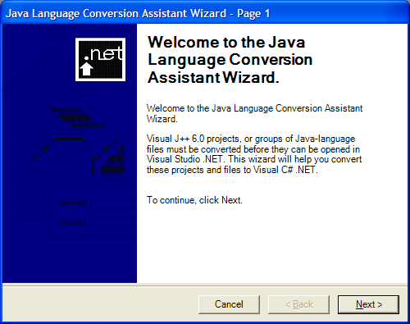
Migrate Code
Easy upgrade from Visual C# 2002/2003
Migrating code from Java and J2EE
  Java Language Conversion Assistant
  TLS330, Migrating Java Applications to the .NET Framework, Wednesday at 3:30 pm

Slide 25
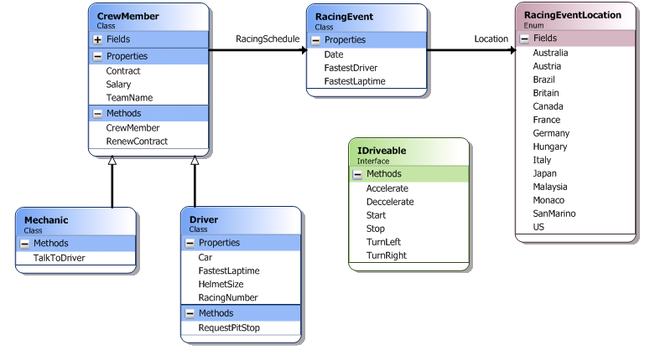
Visualize Code
Understand code
Design code
Refactor code

Slide 26
Demo: Visualize Code
John Stallo
Program Manager
Visual Studio

Slide 27
Productivity
Developer productivity
Write code
Navigate code
Refactor code
Debug code
Team productivity
Source code control
Build code
Migrate code
Visualize code

Slide 28

The C# Road To Longhorn
Adopt Visual C# .NET 2003 and write C# code!
Explore the “Whidbey” alpha!
ISV’s – get ready for Whidbey!
  http://www.vsippartners.com
Participate in the C# community
  http://msdn.microsoft.com/vcsharp
  microsoft.public.dotnet.languages.csharp
Learn more today at PDC
  3:45 pm, C# language enhancements talk, TLS320
  5-7 pm, Tools and Languages Lounge, Room 402AB
  7-9 pm, Ask the Experts

Slide 29
© 2003-2004 Microsoft Corporation. All rights reserved.
This presentation is for informational purposes only. Microsoft makes no warranties, express or implied, in this summary.
Notes:
<footer>© 2003-2004 Microsoft Corporation. All rights reserved.
This presentation is for informational purposes only. Microsoft makes no warranties, express or implied, in this summary.

Slide 30


