Slide 1




Introducing MSBuild:
Build Engine for "Whidbey" and "Longhorn"
TLS347
Alex Kipman
Program Manager
Microsoft Corporation
Insert Email--Recommended
Rajeev Goel
Software Design Engineer
Microsoft Corporation
Insert Email--Recommended
Notes:
We are very excited to be here today. Thank you for joining us!! We are thrilled to see soooo many people interested in MSBuild.
I don’t know about you, but I’ve been frustrated by the fact that you cannot build a VS project on a machine that doesn’t have VS installed.
I’ve been even more frustrated by the fact that I can’t replicate the Visual Studio build process through some other means.
Even worse, I’ve been frustrated by the fact that you can’t extend the Visual Studio build process to fit your own needs.
During the next hour we are going to share with you our strategy to solve all these problems so that by
My name is Alex Kipman and I'm a Program Manager in the VSCore team
and next to me I have Rajeev Goel who is a Software Developer engineer in the VSCore team
So let's get started...

Slide 2

Agenda
MSBuild design goals
Basic file format features
Advanced features & extensibility
Bringing it all together
Summary

Slide 3
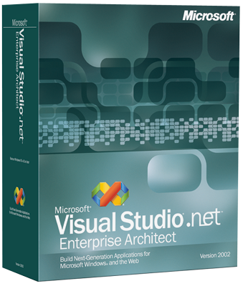
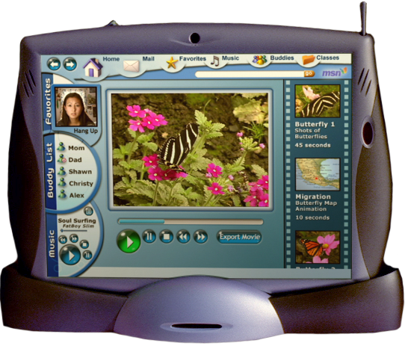
Visual Studio .NET 2002/2003
VS Build System
Pre build step
0011010101
1110010110
1101100111
0010100111
Post build step
Abracadabra
Produces
Authors
Feeds
PROJECT FILE
- $%#^$&%
- @$#%$^#
Final Product

Slide 4
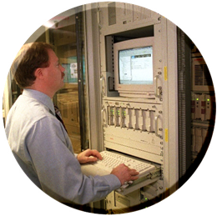
MSBuild Design Goals
MSBuild
Final Product
Produces
PROJECT FILE
<Project>
<Property … />
<Item … />
<Target … />
</Project>
Authors
Authors
Feeds
DEVELOPER

Slide 5

MSBuild File Format

Slide 6
Advanced Features And Extensibility

Slide 7
Bringing It All Together
MSBuild concept of "build"
SCC
Build
Unit Test
Obfuscate
Send E-mail
Build
VS .NET 2002/2003 concept of "build"

Slide 8
Step 1 - Augment VS Build
Add unit testing
Add obfuscation
Developer machine(s)
<Project>
…
ResGen
Compile
UnitTest
Obfuscate
…
</Project>
MSBuild
Sources
*.cs
*.resx

Slide 9
Augmenting VS build

Slide 10
Step 2 – Check Into SCC
Developer machine(s)
SCC Server
<Project>
…
</Project>
<Project>
…
ResGen
Compile
UnitTest
Obfuscate
…
</Project>
<Project>
…
ResGen
Compile
UnitTest
Obfuscate
…
</Project>
<Project>
…
ResGen
Compile
UnitTest
Obfuscate
…
</Project>
<Project>
…
ResGen
Compile
UnitTest
Obfuscate
…
</Project>
Sources
<Project>
…
</Project>
Sources
Sources
*.cs
*.resx
Sources
*.cs
*.resx
Sources
*.cs
*.resx
Sources
*.cs
*.resx
<Project>
…
</Project>
Sources

Slide 11
Step 3 – Create A Build Lab
Write Daemon
Author project file
Author HTML logger
Build lab machine
MSBuildLog.html
Rolling build daemon
<html>
</html>
Build Started.
GetFromScc succeeded.
Every
5 seconds
MSBuild succeeded.
Logged events
SendEmail succeeded.
Build Finished.
Developer machine(s)
SCC Server
<Project>
…
</Project>
Enlistment
<Project>
…
</Project>
MSBuild
<Project>
…
ResGen
Compile
UnitTest
Obfuscate
…
</Project>
Sources
Sources
Builds master project file
<Project>
…
</Project>
<Project>
…
</Project>
Sources
Sources
<Project>
GetFromSCC
MSBuild
SendEmail
</Project>
Sources
*.cs
*.resx
GetFromSCC
<Project>
…
</Project>
<Project>
…
</Project>
MSBuild
SendEmail
Sources
Sources

Slide 12
Rolling Build Server

Slide 13

Summary
With MSBuild you’ll be able to:
  Build a VS project without VS being installed since MSBuild ships with the CLR
  Author a project file with ease since the file format is open and backed up by an XSD
  Customize the build process through our comprehensive task extensibility model
Do all this without losing any of the
RADness you expect from an IDE!

Slide 14
Other Resources
PDC – Ask the experts
  Come see us tomorrow night from
  6:30pm to 9:00pm
Explore MSBuild
  “Whidbey” DVD given to PDC attendees
  Give us feedback via public MSBuild newsgroup
  Longhorn DevCenter website

Slide 15
© 2003-2004 Microsoft Corporation. All rights reserved.
This presentation is for informational purposes only. Microsoft makes no warranties, express or implied, in this summary.
Notes:
<footer>© 2003-2004 Microsoft Corporation. All rights reserved.
This presentation is for informational purposes only. Microsoft makes no warranties, express or implied, in this summary.

Slide 16
