Slide 1





“Indigo”: Services And The Future Of Distributed Applications
Session Code: WSV 201
Don Box
Architect
Microsoft Corporation
http://www.gotdotnet.com/team/dbox
email here – recommended

Slide 2
The Software Ecosystem
The inevitability of connected applications

Slide 3
The Object Ecosystem
One metaphor to rule them all

Slide 4
The Service Ecosystem
Respecting the boundaries of others

Slide 5
The Service-Oriented Model
Services, Clients, Systems

Slide 6
Tenet: Boundaries are Explicit
Developers opt-in to exposing service-based functionality

Slide 7
Tenet: Services are autonomous
Independent deployment, versioning, and security

Slide 8
Tenet: Share Schema, not Class
Integration based on message formats and exchange patterns, not classes and objects

Slide 9
Tenet: Policy-based compatibility
Service compatibility based on policy assertions using stable global names

Slide 10
Services and Microsoft: 2003
You have the tools…

Slide 11
Services and Microsoft: Indigo
…and we’re making them better

Slide 12




Indigo Architecture
Messaging Services
Service Model
Queuing
Instance
Manager
Context
Manager
Service
Methods
Type
Integration
Declarative
Behaviors
Transacted
Methods
Routing
Connector
Channels
(Datagram, Reliable, Peer, …)
Eventing
Policy
Engine
Channel
Security
…
Transport Channels
(IPC, HTTP, TCP…)
Message
Encoder
System Services
Communications Manager (Port)
Transaction
Federation
Hosting Environments
ASP.NET
.container
.exe
NT Service
DllHost
…

Slide 13
Indigo and Service-Orientation
Boundaries come into focus…

Slide 14
Indigo and Unification
Less is more…

Slide 15
Indigo And Unification
ASMX
.NET Remoting
Enterprise Services
Simple Config
Interoperable
Service-Oriented
Broad Vision
Extensibility
Object-Oriented
Attributes
Transactions
Components
Indigo

Slide 16
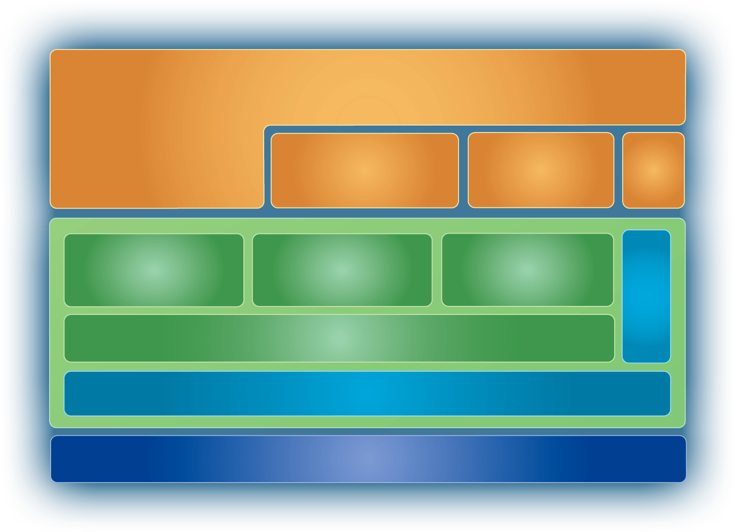
Indigo and Interoperation
Secure and reliable reach…

Slide 17
Indigo and Scale-Invariance
Ubiquity through efficiency…

Slide 18
Indigo: Getting there from here
Future-proofing on .NET V1.x

Slide 19

Preparing For Indigo Today
Build services using ASMX
Use .NET Enterprise Services within your service…
  If you need ES functionality
  If you need fast/secure intra-farm ORPC
Use .NET Remoting within your service…
  If you need lightweight CLR-CLR ORPC

Slide 20
Services: The Next Twenty Years
Wither Objects?

Slide 21
© 2003-2004 Microsoft Corporation. All rights reserved.
This presentation is for informational purposes only. Microsoft makes no warranties, express or implied, in this summary.

Slide 22
