Slide 1





“Indigo”: Connected Application Technology Roadmap
WSV302
Joe Long
Product Unit Manager
Microsoft Corporation
joelong@microsoft.com

Slide 2








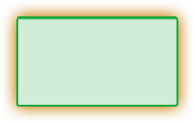
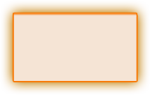
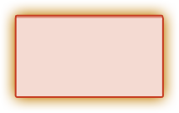





Tools
Client Application Model
Web & Service Application Model
Data Systems Application Model
Mobile PC & Devices Application Model
Command Line
Avalon
Windows Forms
ASP.NET / Indigo
Win FS
Yukon
Compact Framework
Mobile PC Optimized
System.Console
System.Windows
System.Windows.Forms
System.Web
System.Storage
System.Data.SqlServer
System.Windows.Forms
System.Windows
NT Service
System.ServiceProcess
Presentation
Data
Communication
System.Windows
System.Search
System.Data
System.Messaging
System.
Discovery
System.Collaboration
UI Element
Explorer
Media
Annotations
SqlClient
DataSet
System.DirectoryServices
Active
Directory
RealTimeEndpoint
Documents
Controls
Animation
Monitoring
SqlTypes
Mapping
System.ServiceModel
TransientDataSession
Text Element
Dialogs
Controls
Logging
SqlXML
ObjectSpaces
System.Runtime.Remoting
Uddi
SignalingSession
Shapes
SideBar
Control
Relevance
OdbcClient
ObjectSpace
Media
Shape
Notification
Panel
OleDbClient
Query
Activities
Ink
Navigation
Design
OracleClient
Schema
System.Web.Services
System.MessageBus
System.Storage
Web.Service
Transport
Queue
System.Windows.Forms
System.Web.UI
Item
Core
Description
Port
PubSub
Forms
Page
WebControls
Relationship
Contact
Discovery
Channel
Router
Control
Control
Adaptors
Media
Location
Protocols
Service
Policy
Print Dialog
HtmlControls
Design
Audio
Message
Peer Group
Design
MobileControls
Video
Document
Images
Event
System.Web
System.Net
System.Help
System.Speech
Personalization
HttpWebRequest
NetworkInformation
System.Drawing
Recognition
Synthesis
System.Xml
Caching
FtpWebListener
Sockets
System.NaturalLanguageServices
Schema
Xpath
SessionState
SslClientStream
Cache
Serialization
Query
WebClient
Fundamentals
Base & Application Services
Security
Configuration
Deployment/Management
System.Timers
System.Text
System.Collections
System.Windows.
TrustManagement
System.Security
System.Web.Configuration
System.Web
System.Globalization
System.Design
Generic
System.Web.
Security
Authorization
Permissions
System.MessageBus.Configuration
Administration
System.Serialization
System.IO
System.ComponentModel
AccessControl
Policy
System.Configuration
Management
System.Threading
Ports
System.CodeDom
System.Message
Bus.Security
Credentials
Principal
System.Resources
System.Management
System.Runtime
System.Reflection
Cryptography
Token
System.Deployment
Serialization
InteropServices
System.EnterpriseServices
System.Diagnostics
CompilerServices
System.Transactions

Slide 3









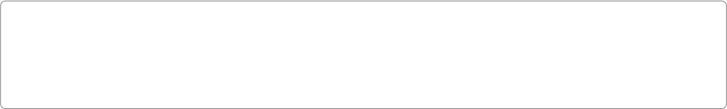






Presentation
Data
Communication
Avalon
Windows Forms
ASP.NET
WinFS
Indigo
Windows Forms
ADO.NET
Collaboration
Document
UI
Media
Object
T/SQL
XML
Service
Models
Desktop
Services
Desktop Window
Manager
Controls Interop
Engine
Adaptive UI
Engine
Services
Schemas
ObjectSpaces
Connectivity
Messaging
Services
People and
Groups
Synchronization
(WinFS, Win32..)
People
Group
Channels
(Datagram, Reliable,
Peer, …)
Policy
Engine
Queuing
Presentation
Object Manager
Desktop
Composition Engine
Application
Services
Page/Site
Composition
Calendar
Media
DataSet
Collaboration
History
Document
…
Channel
Security
Eventing
Media Services
InfoAgent
(PreferenceRules..)
Data Model
SQL XML
Transport Channels
(IPC, HTTP, TCP…)
Message
Encoder
Routing
Real-Time
Activities
Animation and
Composition
Media
Processing
Capture and
Sourcing
Designer
Services
Personalization and
Profiling Services
Items
System Services
Hardware
Rendering
Software Rendering
and Sinks
Controls
Membership and
Security Services
FileSystem Services
(MetaDataHandlers..)
Relationships
Providers
Communications Manager
(Port)
Transaction
Signaling
Framework
Extensions
Federation
Base Operating System Services
CLR
Base Class Libraries
Network Class Library
Application Deployment
Engine
(Click-Once)
Memory Manager
Code Execution
Loader
Security
Serialization
Network Services
Hosting Layer
Demand Activation and Protocol Health
GDI/GDI+
Window
Manager
Global
Audio
Engine
DirectX
Graphics
Transactions
Identity &
Security
System
Storage
Management
PNRP
Native
WiFi
SIP
TCP
Listener
UDP
Listener
IPC
Listener
Graphics drivers
Lightweight
Transactions
Transaction
Coordinator
Backup /
Restore
File Replication
Service
Virtual Disk
Service
Internet Connection Firewall
DDI
Input
Manager
Audio
Drivers
DirectX
Graphics
Mini port
Kernel
Transaction
Manager
Logging
Service
Redirectors
Distributed
File System
Filter
Manager
Cache
Manager
Protocols
Filter
Engine
TPC, UDP
IPV4, IPV6
IPSEC
QOS
HTTP
Listener
Plug and
Play
Memory
Manager
Power
Manager
Config
Manager
Process
Manager
Security
Reference
Monitor
LPC
Facility
Transacted
NTFS
Universal
Data
Format
FAT 16/32
IO Manager
Device Drivers
Kernel
SCSI/FC
802.3
802.11
..
Kernel Mode
Hardware Abstraction Layer
Make the connection

Slide 4
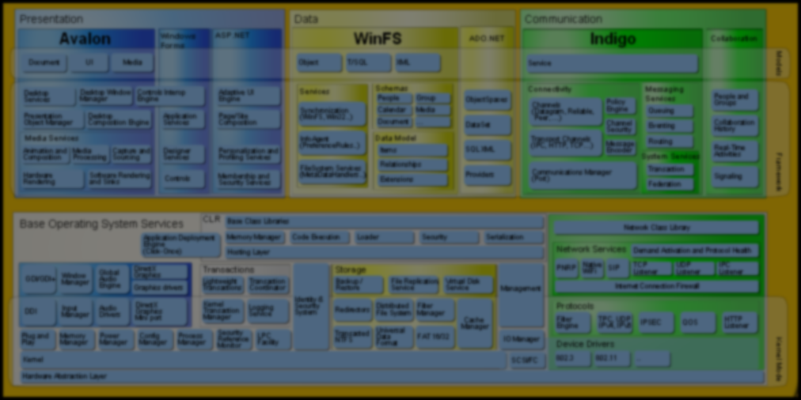
Indigo Architecture
Service Model
Messaging Services
Queuing
Instance
Manager
Context
Manager
Service
Methods
Type
Integration
Declarative
Behaviors
Transacted
Methods
Routing
Connector
Channels
(Datagram, Reliable, Peer, …)
Eventing
Policy
Engine
Channel
Security
…
Transport Channels
(IPC, HTTP, TCP…)
Message
Encoder
System Services
Communications Manager (Port)
Transaction
Federation
Hosting Environments
ASP.NET
.container
.exe
NT Service
DllHost
…

Slide 5

Agenda
I have an application – how do I make the binary work with Indigo?
Now how do I move the code
to Indigo?
If I start writing a new app today, what should I do to best set myself up to move to Indigo?

Slide 6
Using Indigo With Existing Systems
A.k.a., Wire Interop

Slide 7
The Problem
Client
Server
API
API
Infrastructure
Infrastructure
Wire Protocol
Can not recompile or redeploy the client or server application
Need to allow incremental upgrades of clients and/or servers

Slide 8

Solution Space
Teach existing infrastructure new protocols
  Better support for Services
    Build internet scale, secure, reliable, transacted applications that can span trust boundaries
    Expose internal applications to business partners and customers safely
  Ride the Wave
    Better routers, firewalls, tools, etc.
Teach new infrastructure existing protocols
  This becomes a new programming model for building apps using the existing infrastructure
  Will not solve any of the fundamental issues that the existing protocols have (e.g., interoperability, internet scale, etc.)

Slide 9
Architectural Solutions
Client
Server
API
API
Infrastructure
Infrastructure
Infrastructure
Infrastructure
Wire Protocol
New Wire Protocol
New Wire Protocol
New Wire Protocol

Slide 10
Wire Interop Options
Infrastructure
Protocols
Infrastructure
Client
Binaries
Upgraded
Upgraded
Server
Binaries
Upgraded
Upgraded
Upgraded
Existing
Existing
Upgraded
Existing
Existing
Web Service Protocols
Existing Protocols
Upgraded Infrastructure
(LH Client, LH Server)
Existing Infrastructure
(W2K, XP, or W2K03)

Slide 11
Indigo And Existing Technology Binary Interoperability
It Just Works – no changes required
  ASP.NET Web Services (ASMX)
  The latest version of Web Services Enhancements (WSE)
Upgrade to Longhorn required
  COM+ and MSMQ
No Binary Interop
  .NET Remoting
  Older versions of WSE
Existing Protocols (DCOM/MSMQ) will be fully supported in Longhorn

Slide 12
COM+ Binary Interop Drilldown

Slide 13
COM+ Migration Fundamentals
Existing binaries just work; No recompilation required
Focus on bridging service environments; COM+ services will interact seamlessly with Indigo services
COM+ applications can be accessed from Indigo clients
Indigo Web services can be accessed from COM clients

Slide 14
COM+ Wire Interop – ASP App
SQL
IIS
COM+
IIS
COM+
TDS
Load
Balancing
HTTP
Firewall
COM+
IIS
COM+
HTTP
HTTP
IIS
COM+
TDS
HTTP
Cluster
COM+
IIS
COM+
HTTP
IIS
COM+
TDS
SQL
COM+
Expose as a Web Service
Upgraded
Upgraded
Existing
Upgraded

Slide 15
COM+ Scenario: Rich Client
Rich
Client
Server
API
API
COM+
COM+
COM+
COM+
DCOM
Web Services
Expose as a Web Service
Upgraded
Upgraded
Existing
Upgraded

Slide 16
COM+ Binary Migration Details
Requirements
  Use a TLB
  Be installed in COM+
  Declare all co-classes and all interfaces on each co-class in the tlb
  Declare explicit interface types as parameters
Avoid
  Explicit use of COSERVERINFO
    Let config decide where the service lives
  Using interface pointers in custom UCPs
    Marshal-by-value approach works better
  Calling CoSetProxyBlanket after first use of proxy
Will not be supported
  Proxy/stub marshalling

Slide 17
MSMQ Binary Interop Drilldown

Slide 18
MSMQ Server Wire Interop
Client
Server
API
API
MSMQ
MSMQ
MSMQ
MSMQ
MSMQ / SRMP
Web Services
Expose as a Web Service
Upgraded
Upgraded
Existing
Upgraded

Slide 19
MSMQ Binary Migration Details
Requirements
  Upgrade the platform
Avoid
  Nothing: The full set of MSMQ features
  will interop
Will not be supported
  Nothing: The full set of MSMQ features
  will interop

Slide 20
Other Programming Models
ASMX: Indigo V1 will fully support ASMX wire protocol (SOAP 1.1 and
SOAP 1.2)
WSE: The last version of WSE will have wire interop with Indigo V1
.NET Remoting: No binary interop supported
  Stay tuned for a great code migration path!

Slide 21
Why Upgrade Your Infrastructure
Better support for services
  Build internet scale, secure, reliable, transacted applications that can span trust boundaries
  Expose internal applications to business partners and
  customers safely
  Rich client server internet applications enabled
  Application context (e.g., transactions and security) flows
  across boundaries
Ride the Wave
  Better routers
  Better firewalls
  Better tools
  Etc.
Allows new clients to talk to existing servers
Migrate at your own speed

Slide 22
Migrating Existing Code To Indigo

Slide 23
Migrating Managed Code To The Indigo Programming Model
Existing Code Base | Simple and Mechanical
ASMX (ASP.NET Web Services) | 
.NET Remoting | 
Enterprise Services | 
WSE | 
System.Messaging | 
Simple and Mechanical: Read a whitepaper and write a script

Slide 24
Managed Code Migration Details

Slide 25
General Migration
The code “inside the function” will work unmodified
Parameters work unmodified
You can always use Indigo and the existing stacks in the same App Domain
Avoid or abstract existing
extensibility models

Slide 26
ASMX To Indigo Client Code
// using System.Web.Services;
using System.ServiceModel;
using System.Web.Services;
public class Client
{
public static void Main(string[] args)
{
AccountingOperation credit = new
AccountingOperation("Accounts payable", 100);
AccountingOperation debit = new
AccountingOperation("Assets", 100);
accountingService.AddEntry(debit, credit);
}
}
// Accounting accountingService = new Accounting();
Accounting accountingService =
ServiceManager.CreateProxy<Accounting>();
Accounting accountingService = new Accounting();

Slide 27
ASMX To Indigo Server Code
// using System.Web.Services;
using System.Web.Services;
public class AccountingOperation
{
public string AccountName;
public long Amount;
}
public class Accounting : WebService
{
[WebMethod(TransactionOption=TransactionOption.RequiresNew)]
using System.ServiceModel.Compat;
using System.ServiceModel;
[Service]
// [WebMethod(TransactionOption=TransactionOption.RequiresNew)]
public int AddEntry(AccountingOperation debit,
AccountingOperation credit)
{
// Add entry to internal accounting book
// return id.
}
}
[ServiceMethod]
[TransactionScope]

Slide 28
ASMX Code Migration
The code “inside the function” will
work unmodified
Parameters work unmodified
WebMethodAttribute and XML Serialization attributes fully supported
SOAPExtensions will be simple and mechanical to rewrite

Slide 29
ASMX Code Migration – Caveats
HTTP Context object not supported
  The information is available to the developer only when running over HTTP
    No ASP.NET application state support
    No ASP.NET session state that can survive
    process recycles
Indigo will not support the WSDL customization features of ASMX
  But will support the full set of scenarios

Slide 30
.NET Remoting To Indigo Client Code
// using System.Runtime.Remoting;
using System.ServiceModel;
using System.Runtime.Remoting;
public class Client
{
public static void Main(string[] args)
{
RemotingConfiguration.Configure("Client.Config");
Accounting accounting = new Accounting();
// RemotingConfiguration.Configure("Client.Config");
// Accounting accounting = new Accounting();
AccountingOperation credit =
new AccountingOperation("Accounts payable", 100);
AccountingOperation debit =
new AccountingOperation("Assets", 100);
accounting.AddEntry(debit, credit);
}
}
Accounting accountingService =
ServiceManager.CreateProxy<Accounting>();

Slide 31
.NET Remoting To Indigo
Host Code
// using System.Runtime.Remoting;
using System.ServiceModel;
using System.Runtime.Remoting;
public class Host
{
public static void Main(string[] args)
{
RemotingConfiguration.Configure("Server.Config");
// RemotingConfiguration.Configure("Server.Config");
Console.WriteLine("Host is ready to process remote messages.");
Console.ReadLine();
}
}
ServiceManager manager = new ServiceManager("http://pdc-svr");
manager.Services.Add("/Accounting", typeof(Accounting));

Slide 32
.NET Remoting to Indigo Server Object Code
// using System.Runtime.Remoting;
using System.Runtime.Remoting;
public class AccountingOperation
{
public string AccountName;
public long Amount;
}
public class Accounting : MarshalByRefObject
{
public int AddEntry(AccountingOperation debit,
AccountingOperation credit)
{
// Add entry to internal accounting book
// return id.
}
}
using System.ServiceModel;
[RemoteObject]

Slide 33
.NET Remoting Code Migration
The code “inside the function” will work unmodified
Parameters work unmodified
Fully support the transparent remoting programming model
  Except for “new”

Slide 34
.NET Remoting Migration – Caveats
Channels and Sinks are implemented in a new way in Indigo and do not move forward
  Plumbing that was built to support features missing in .NET Remoting (such as security) may be in Indigo and this code can just be thrown away
  Plumbing that was built to support features not in Indigo will have to be rewritten using
  Indigo extensibility
The SynchronizationAttribute is no longer needed nor recognized in Indigo (there is no ContextBoundObject in Indigo)

Slide 35
EnterpriseServices to Indigo (1 of 3)
// using System.EnterpriseServices;
using System.ServiceModel.Compat;
using System.EnterpriseServices;
[ComponentAccessControl]
[SecureMethod]
[Transaction(TransactionOption.Required)]
public class Accounting
{
public void AddCreditEntry(string creditAccount, int creditAmount)
{
}
}
: ServicedComponent

Slide 36
EnterpriseServices to Indigo (2 of 3)
// using System.EntepriseServices;
// [ComponentAccessControl]
// [SecureMethod]
// [Transaction(TransactionOption.Required)]
using System.EnterpriseServices;
[ComponentAccessControl]
[SecureMethod]
[Transaction(TransactionOption.Required)]
using System.ServiceModel;
public class Accounting
{
public void AddCreditEntry(string creditAccount, int creditAmount)
{
}
}
[RemoteObject]
: ServicedComponent
// ServicedComponent
: MarshalByRefObject
[TransactionScope]
[SecurityRole("PostGroup")]

Slide 37
EnterpriseServices to Indigo (3 of 3)
// using System.EntepriseServices;
// [ComponentAccessControl]
// [SecureMethod]
// [Transaction(TransactionOption.Required)]
using System.EnterpriseServices;
[ComponentAccessControl]
[SecureMethod]
[Transaction(TransactionOption.Required)]
using System.ServiceModel;
public class Accounting
{
public void AddCreditEntry(string creditAccount, int creditAmount)
{
}
}
[Service]
: ServicedComponent
//:ServicedComponent
[ServiceMethod]
[TransactionScope]
[SecurityRole("PostGroup")]

Slide 38
Enterprise Services
Code Migration
Most Enterprise Services code is simple and mechanical to migrate
Fully integrated with .NET config and hosting model
Attributes for Transactions, Security, Lifetime management are fully supported

Slide 39
Enterprise Services Code
Migration – Caveats
QC, LCE, and CRM will not be migrated
  All of the scenarios are supported with new programming model
Attributes that configure the COM+ catalog or the COM+ process model will no longer be needed nor recognized
by Indigo

Slide 40
WSE Code Migration
WSE is a vehicle for early adopters to take advantage of leading edge Service Oriented technology
WSE should be used when gaining a first mover advantage is more important than having code portability to the next major revision of
the platform
Migrating WSE code to Indigo may require a non-trivial development investment
We will provide whitepapers on how to migrate WSE code to Indigo

Slide 41
System.Messaging Code Migration
No plan to implement System.Messaging on top of Indigo

Slide 42
Prescriptive Guidance

Slide 43

Application Architectures
Object Orientation
  Assume homogeneous platform and execution environment
  Share types, not schemas
  Assume cheap, transparent communication
  Are linked: Object identity and lifetime maintained by infrastructure
  Typically require deployment of both client and server
  in sync
  Are easy to talk about and become a natural path for customers to follow
  Customers have 20+ years of experience and great intuition about what “object oriented is”
Service Orientation
  Assume heterogeneous platform and execution environment
  Share schemas, not types
  Assume variable cost, explicit communication
  Are autonomous: Security and failure isolation are a must
  Ease “continuous deployment” of client and server separately
  Builds on ideas from component software, distributed objects, and MOM
  Dominant theme is to manage/reduce sharing between services

Slide 44
Application Boundaries
Application boundaries
  Platform
  Deployment
  Trust
Objects are appropriate within boundaries
Services are appropriate across and
within boundaries

Slide 45
Today’s Prescriptive Guidance
Build services using ASMX
  Enhance your ASMX service with WSE if you need the WSE feature set and you can accept the support policy
Use object technology in a service’s implementation
  Use Enterprise Services if
    You need ES rich feature set
    You are communicating between components on the local machine and have performance issues with ASMX or WSE
  Use .NET Remoting if
    You need to integrate with an existing proprietary protocol
    You are communicating in-process, cross app domain
Use System.Messaging if you need the reliable messaging and queuing features in MSMQ

Slide 46
Today’s Caveats
ASMX
  Avoid or abstract using low-level extensibility such as the HTTP Context object
.NET Remoting
  Avoid or abstract using low-level extensibility such as .NET Remoting sinks and channels
Enterprise Services
  Avoid passing object references inside of ES
Do not use COM+ APIs – use System.EnterpriseServices
Do not use MSMQ APIs – use System.Messaging

Slide 47
Customer Migration Summary
We will make Indigo work well with COM+, MSMQ, WSE, and ASMX apps
New Indigo nodes can be easily integrated into existing systems
There is an easy migration path to Indigo from today’s RPC style programming models
Understand and follow the prescriptive guidance for writing distributed applications

Slide 48
Discussion

Slide 49
For More Information
Come see me
  Immediately after this session
  Web/Services Lounge: 309 Foyer
MSDN “Longhorn” DevCenter http://msdn.microsoft.com/longhorn
Newsgroup
  microsoft.public.windows.developer.winfx.indigo
At PDC
  Hands on labs: On-site or download from CommNet
  Ask The Experts: Tuesday 7 P.M. – 9 P.M. Hall G, H
  PDC Weblogs: http://pdcbloggers.net

Slide 50
© 2003-2004 Microsoft Corporation. All rights reserved.
This presentation is for informational purposes only. Microsoft makes no warranties, express or implied, in this summary.

Slide 51
