Slide 1





Programming “Indigo” Part 1:
The Fundamentals
Session Code: WSV 301
Don Box, Architect dbox@microsoft.com
Steve Swartz, Lead Program Manager
stevesw@microsoft.com
Microsoft Corporation

Slide 2








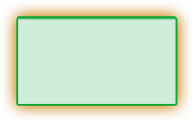
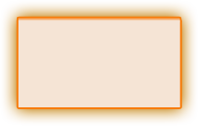
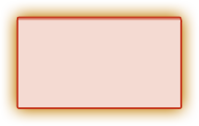





Tools
Client Application Model
Web & Service Application Model
Data Systems Application Model
Mobile PC & Devices Application Model
Command Line
Avalon
Windows Forms
ASP.NET / Indigo
Win FS
Yukon
Compact Framework
Mobile PC Optimized
System.Console
System.Windows
System.Windows.Forms
System.Web
System.Storage
System.Data.SqlServer
System.Windows.Forms
System.Windows
NT Service
System.ServiceProcess
Presentation
Data
Communication
System.Windows
System.Search
System.Data
System.Messaging
System.
Discovery
System.Collaboration
UI Element
Explorer
Media
Annotations
SqlClient
DataSet
System.DirectoryServices
Active
Directory
RealTimeEndpoint
Documents
Controls
Animation
Monitoring
SqlTypes
Mapping
System.ServiceModel
TransientDataSession
Text Element
Dialogs
Controls
Logging
SqlXML
ObjectSpaces
System.Runtime.Remoting
Uddi
SignalingSession
Shapes
SideBar
Control
Relevance
OdbcClient
ObjectSpace
Media
Shape
Notification
Panel
OleDbClient
Query
Activities
Ink
Navigation
Design
OracleClient
Schema
System.Web.Services
System.MessageBus
System.MessageBus
System.Storage
Web.Service
Transport
Queue
System.Windows.Forms
System.Web.UI
Item
Core
Description
Port
PubSub
Forms
Page
WebControls
Relationship
Contact
Discovery
Channel
Router
Control
Control
Adaptors
Media
Location
Protocols
Service
Policy
Print Dialog
HtmlControls
Design
Audio
Message
Peer Group
Design
MobileControls
Video
Document
Images
Event
System.Web
System.Net
System.Help
System.Speech
Personalization
HttpWebRequest
NetworkInformation
System.Drawing
Recognition
Synthesis
System.Xml
Caching
FtpWebListener
Sockets
System.NaturalLanguageServices
Schema
Xpath
SessionState
SslClientStream
Cache
Serialization
Query
WebClient
Fundamentals
Base & Application Services
Security
Configuration
Deployment/Management
System.Timers
System.Text
System.Collections
System.Windows.
TrustManagement
System.Security
System.Web.Configuration
System.Web
System.Globalization
System.Design
Generic
System.Web.
Security
Authorization
Permissions
System.MessageBus.Configuration
Administration
System.Serialization
System.IO
System.ComponentModel
AccessControl
Policy
System.Configuration
Management
System.Threading
Ports
System.CodeDom
System.Message
Bus.Security
Credentials
Principal
System.Resources
System.Management
System.Runtime
System.Reflection
Cryptography
Token
System.Deployment
Serialization
InteropServices
System.EnterpriseServices
System.Diagnostics
CompilerServices
System.Transactions

Slide 3

What Is Indigo?
“Indigo” is a set of .NET technologies for building and managing
service-oriented systems
“Indigo” is scale-invariant
“Indigo” is broadly interoperable
“Indigo” provides a unified programming model and runtime

Slide 4









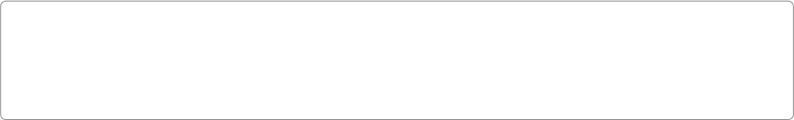






Presentation
Data
Communication
Avalon
Windows Forms
ASP.NET
WinFS
Indigo
Windows Forms
ADO.NET
Collaboration
Document
UI
Media
Object
T/SQL
XML
Service
Models
Desktop
Services
Desktop Window
Manager
Controls Interop
Engine
Adaptive UI
Engine
Services
Schemas
ObjectSpaces
Connectivity
Messaging
Services
People and
Groups
Synchronization
(WinFS, Win32..)
People
Group
Channels
(Datagram, Reliable,
Peer, …)
Policy
Engine
Queuing
Presentation
Object Manager
Desktop
Composition Engine
Application
Services
Page/Site
Composition
Calendar
Media
DataSet
Collaboration
History
Document
…
Channel
Security
Eventing
Media Services
InfoAgent
(PreferenceRules..)
Data Model
SQL XML
Transport Channels
(IPC, HTTP, TCP…)
Message
Encoder
Routing
Real-Time
Activities
Animation and
Composition
Media
Processing
Capture and
Sourcing
Designer
Services
Personalization and
Profiling Services
Items
System Services
Hardware
Rendering
Software Rendering
and Sinks
Controls
Membership and
Security Services
FileSystem Services
(MetaDataHandlers..)
Relationships
Providers
Communications Manager
(Port)
Transaction
Signaling
Framework
Extensions
Federation
Base Operating System Services
CLR
Base Class Libraries
Network Class Library
Application Deployment
Engine
(Click-Once)
Memory Manager
Code Execution
Loader
Security
Serialization
Network Services
Hosting Layer
Demand Activation and Protocol Health
GDI/GDI+
Window
Manager
Global
Audio
Engine
DirectX
Graphics
Transactions
Identity &
Security
System
Storage
Management
PNRP
Native
WiFi
SIP
TCP
Listener
UDP
Listener
IPC
Listener
Graphics drivers
Lightweight
Transactions
Transaction
Coordinator
Backup /
Restore
File Replication
Service
Virtual Disk
Service
Internet Connection Firewall
DDI
Input
Manager
Audio
Drivers
DirectX
Graphics
Mini port
Kernel
Transaction
Manager
Logging
Service
Redirectors
Distributed
File System
Filter
Manager
Cache
Manager
Protocols
Filter
Engine
TPC, UDP
IPV4, IPV6
IPSEC
QOS
HTTP
Listener
Plug and
Play
Memory
Manager
Power
Manager
Config
Manager
Process
Manager
Security
Reference
Monitor
LPC
Facility
Transacted
NTFS
Universal
Data
Format
FAT 16/32
IO Manager
Device Drivers
Kernel
SCSI/FC
802.3
802.11
..
Kernel Mode
Hardware Abstraction Layer
Make the connection

Slide 5
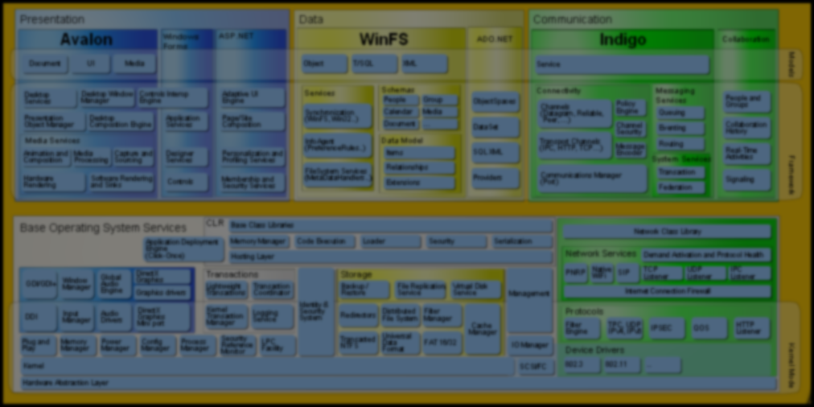
Indigo Architecture
Service Model
Messaging Services
Queuing
Instance
Manager
Context
Manager
Service
Methods
Type
Integration
Declarative
Behaviors
Transacted
Methods
Routing
Connector
Channels
(Datagram, Reliable, Peer, …)
Eventing
Policy
Engine
Channel
Security
…
Transport Channels
(IPC, HTTP, TCP…)
Message
Encoder
System Services
Communications Manager (Port)
Transaction
Federation
Hosting Environments
ASP.NET
.container
.exe
NT Service
DllHost
…

Slide 6

The “Indigo” Connector
The “Indigo” Connector is based on four simple concepts
  Messages are in-memory SOAP envelopes
  Services are targets for message delivery
  Ports are a (named) location in network space
  Channels allow message I/O through a port
All “Indigo” applications rely on these concepts directly or indirectly

Slide 7
Ports, Channels, Services, And Messages
Service
Port
Channel
Service
Message
Channel
Service
Service
Channel

Slide 8
Messages In Indigo
Messages adhere to the SOAP data model
  Distinct header/body separation
  Full support for soap:mustUnderstand et al
Message headers are always buffered
  Needed to enforce SOAP processing model
Message bodies may be streamed
  Can lazily produce body content on demand
Messages support XML-based I/O via System.Xml (includes binary)

Slide 9
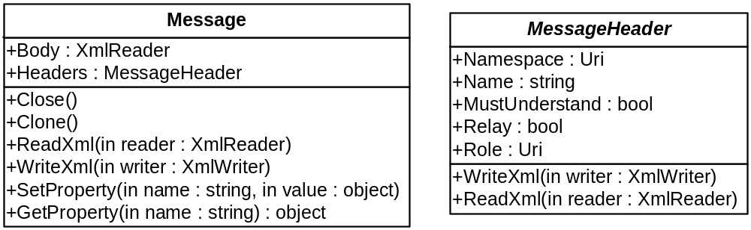
Messages In Indigo

Slide 10

Messages

Slide 11
Ports And Channels
A port is a location in network space
  Resides in a single AppDomain
  Has one or more affiliated transport channels
  Provides a base URI for all addresses
Messages flow through a port
via channels
  Channels impose a message exchange pattern
  Channels may add additional processing code

Slide 12
Port/Channel Architecture
Service
Service
Port A
Port B
Channels
Channels
Transport
Extensions
Extensions

Slide 13
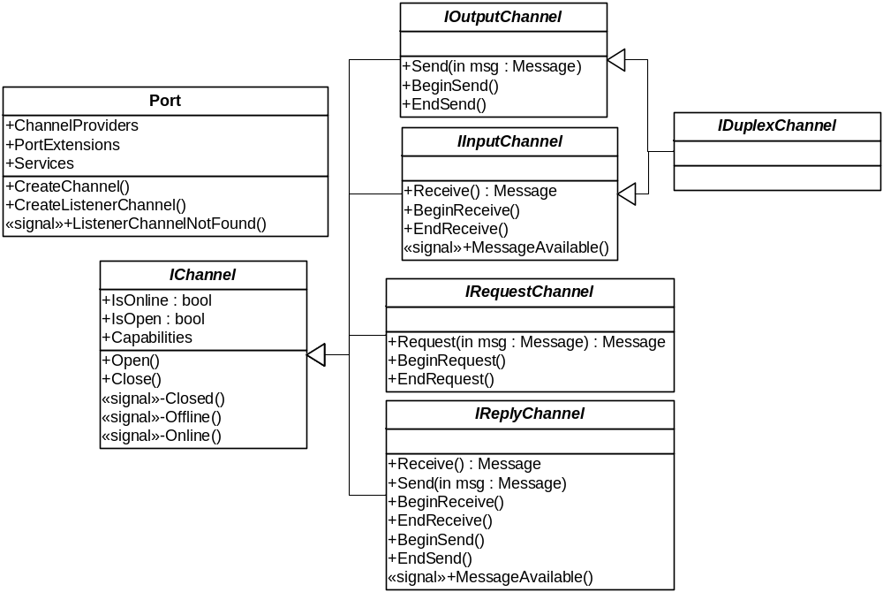
Ports And Channels

Slide 14
Services And Addresses
ServiceReferences are used to identify message recipients
  Absolute URI of service + fixed headers
  Fully interoperable
  ServiceAddress is relative version
“Indigo” uses the IService interface to model message recipients
  Maps ServiceAddress to in-memory object

Slide 15
Ports And Channels

Slide 16
Hosting
Services can be self-hosted or activated on demand via ASP.NET
“Indigo” shares activation with ASP.NET
  Process/AppDomain Startup/Shutdown/Cycle
  Health monitoring
  Management
URI namespace partitioning relies
on metabase
  Independent of transport (HTTP, TCP, etc.)

Slide 17
On-Demand Activation
Admin
Tools
MMC Plugins
Cmd line tools
(adsutil, etc)
Mgmt APIs
Process
Management
Components
Metabase
W3SVC
Listeners
http.sys
TcpListener
Mail Listener
IPC Listener

Slide 18
On-Demand Activation

Slide 19
Service Model
“Indigo” Messaging is for raw message I/O
  Lowest-level access – minimalist model
“Indigo” Service Model is the most likely entry point for developers coming to Indigo
  Integrates with CLR type system
  First-class WSDL support
  Supports both message-based and method-based programming
“Indigo” Service Model unifies the three V1 technologies (ASMX, ES, .NET Remoting)

Slide 20
Service Model
ASMX
.NET Remoting
Enterprise Services
Simple Config
Interoperable
Service-Oriented
Broad Vision
Extensibility
Object-Oriented
Attributes
Transactions
Components
"Indigo" Service Model

Slide 21
Services In Action
Service
Client
Service
Model
Extensions
Service
Model
Extensions
Send()
Receive()
Proxy
Session
Port A
Port B
Channels
Channels
Transport
Extensions
Extensions

Slide 22
[Service]
Service-Oriented Programming Model
Opt-In Contract
Schema-based integration
Broad interop
[Service]
public class Hello
{
[ServiceMethod]
private string Greeting(string name)
{
return String.Format("Hello, {0}!", name);
}
public string Salutation (string name)
{
return String.Format(“Howdy, {0}!”, name);
}
}

Slide 23
[Service]
Channel Type
  Datagram
  Dialog
Call Type
  Message
  Method
Call Contents
  Message
  Parameters
Back Channel
[Service]
public class Hello
{
string name;
[ServiceMethod(OneWay=true)]
public void SendName(string incoming)
{
name = incoming;
}
[ServiceMethod]
public string Greeting(void)
{
return String.Format("Hello, {0}!", name);
}
}

Slide 24
[Service]
[Service]
public class Hello
{
[ServiceMethod]
public Message Greeting(Message msg)
{
XPathDocument doc = new
XPathDocument(msg.Body);
XPathNavigator nav =
doc.CreateNavigator();
return Message.CreateMessage(
String.Format(
"Hello, {0}!",
nav.Select(“//text()”)));
}
}
[Service(
Callback=typeof(IHelloBackChannel))]
public class Hello
{
[ServiceMethod]
public void Greeting(string name)
{
IHelloBackChannel channel =
ServiceModelContext.GetCallback<
IHelloBackChannel>();
channel.Salutation(
String.Format("Hello, {0}!", name));
}
}

Slide 25
[RemoteObject]
Object-Oriented Programming Model
Contract based on public visibility
DLL-based integration
No Interop
Like .NET Remoting, CLR-focused
[RemoteObject]
public class RemObj : MarshalByRefObject
{
public RemObj() {
Console.WriteLine(
"Object {0} has been created.",
this.GetHashCode().ToString());
}
public string Hello(string name) {
return
String.Format("Hello, {0}!”, name);
}
~RemObj() {
Console.WriteLine(
"Object {0} is being torn down.",
this.GetHashCode().ToString());
}
}

Slide 26
Service Code

Slide 27
Preparing For "Indigo" Today
Build services using ASMX
Use .NET Enterprise Services within
your service…
  If you need ES functionality
  If you need fast/secure intra-farm ORPC
Use .NET Remoting within your service…
  If you need lightweight CLR-CLR ORPC

Slide 28
Where Are We?
Core messaging based on messages, ports, and channels
  Low-level connectivity for all AppDomains
Services can be self-hosted or
system-hosted
  Shares infrastructure with ASP.NET and IIS
"Indigo" remoting provides unified programming model based on CLR types and methods
  Melds ASMX/ES/.NET Remoting feature sets

Slide 29
For More Information
Hands on labs
  Try them right here at PDC or download them from CommNet
Web/Services Lounge: 309 Foyer
Ask The Experts
  Tuesday 7 P.M. – 9 P.M. Hall G, H
Longhorn Dev Center
  http://msdn.microsoft.com/longhorn
Newsgroup
  microsoft.public.windows.developer.winfx.indigo
PDC Weblogs
  http://pdcbloggers.net

Slide 30
© 2003-2004 Microsoft Corporation. All rights reserved.
This presentation is for informational purposes only. Microsoft makes no warranties, express or implied, in this summary.

Slide 31
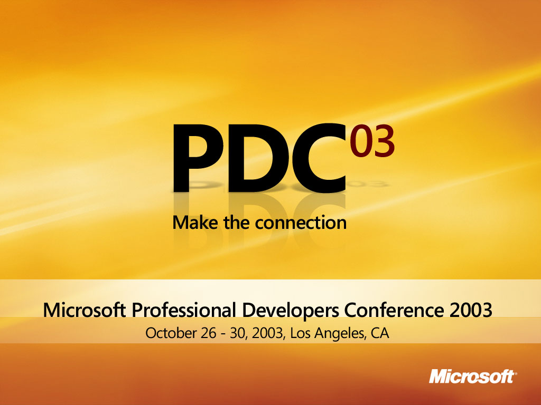

Slide 32
Backup
Notes:
<footer>© 2003-2004 Microsoft Corporation. All rights reserved.
This presentation is for informational purposes only. Microsoft makes no warranties, express or implied, in this summary.

Slide 33
Service Environment (PDC)
“Indigo” configuration is surfaced via the ServiceEnvironment class
Config files may contain multiple named service environments
  /configuration/system.messagebus/service
  Environments/*
Each top-level programming construct may have configuration data
  Port is min-bar for most scenarios
  Security, RM, remoting also configurable

Slide 34
Service Environment (PDC)
public class ServiceEnvironment {
public static ServiceEnvironment Load();
public static ServiceEnvironment Load(string name);
public string Name { get; }
public void Open();
public bool Close();
public object this[Type type] { get; set; }
}
<configuration>
<system.messagebus>
<serviceEnvironments>
<serviceEnvironment name=“envOne">...
<serviceEnvironment name=“envTwo">...
</serviceEnvironments>
</system.messagebus>
</configuration>

Slide 35
Config-Based Services

Slide 36
Moving To “Indigo”
“Indigo” works well with COM+, MSMQ, WSE, and ASMX applications
“Indigo” nodes are easy to integrate into existing systems
Existing applications have an easy migration path to “Indigo”
Follow the prescriptive guidance for writing distributed applications
See WSV203 for more details

Slide 37
For More Information
Come see us
  Immediately after this session
  Web/Services Lounge: 309 Foyer
MSDN “Longhorn” DevCenter http://msdn.microsoft.com/longhorn
Newsgroup
  microsoft.public.windows.developer.winfx.indigo
At PDC
  Hands on labs: On-site or download from CommNet
  Ask The Experts: Tuesday 7 P.M. – 9 P.M. Hall G, H
  PDC Weblogs: http://pdcbloggers.net

