Slide 1





ASP.NET: ASP.NET Web Parts In "Whidbey"
WSV322
Andres Sanabria
Program Manager
Microsoft Corporation
Andress@Microsoft.com

Slide 2


Agenda
Building Dynamic User Interface
ASP.NET Web Part
Windows Sharepoint Services
Core Concepts
  Zone
  Part
  Web Part Manager
  Page Personalization
Web Part Drill Down
Summary

Slide 3

Dynamic User Interface
Developer Challenges:
  A lot of code is required
  Comprehensive Personalization Solution
  Secure and Bullet Proof Customization
  Lack of Rich development support
Web Site End Users Want:
  Flexible Display Options
  Personalized Content
  Reduced Data Entry
  Import and Export settings

Slide 4
ASP.NET WebParts
Provide building blocks for dynamic web sites
Expose core ASP.NET Services
  Personalization, Role Management, Membership, Profile.. etc
Great Visual Studio Designer Experience
Full development flexibility and extensibility
Can be used in any type of Web site
  Portal, content, intranet, internet
  Use Windows or form authentication

Slide 5
Windows SharePoint Services
WSS, SPS v-next will build on top of the ASP.NET Whidbey Web Part
  Microsoft is fully betting on the ASP.NET Whidbey
Current WSS 2.0 Web Part control:
  Will work in WSS v-next
ASP.NET Whidbey Web Part control:
  Will work under ASP.NET Whidbey
  Will work under WSS v-next
  Will work under WSS 2.0 *

Slide 6

Windows SharePoint Server 3.0 “Prototype”

Slide 7
Agenda
Modular User Interface
ASP.NET Web Part
Windows Sharepoint Services
Core Concepts
  Zone
  Part
  Web Part Manager
  Page Personalization
Web Part Drill Down
Summarys

Slide 8
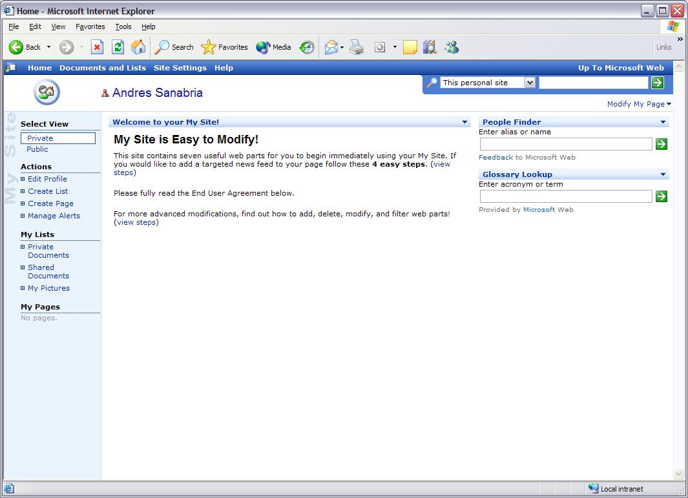
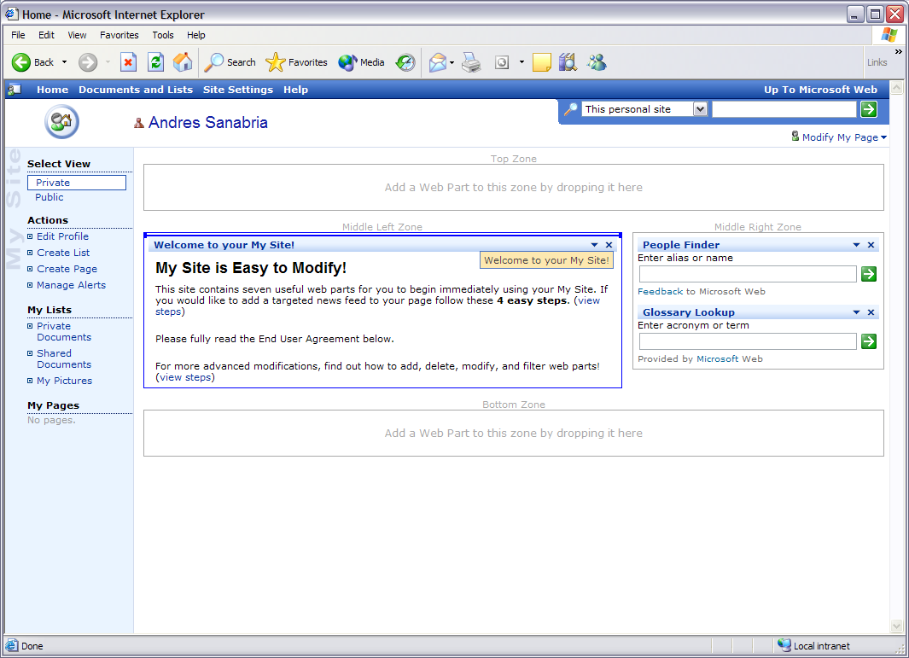
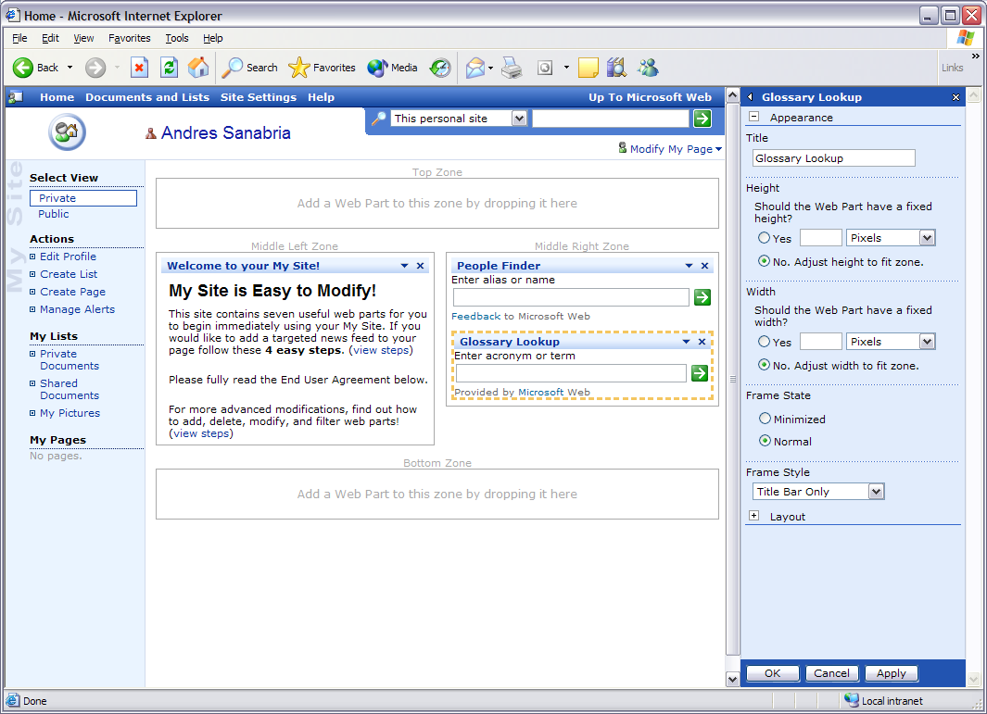
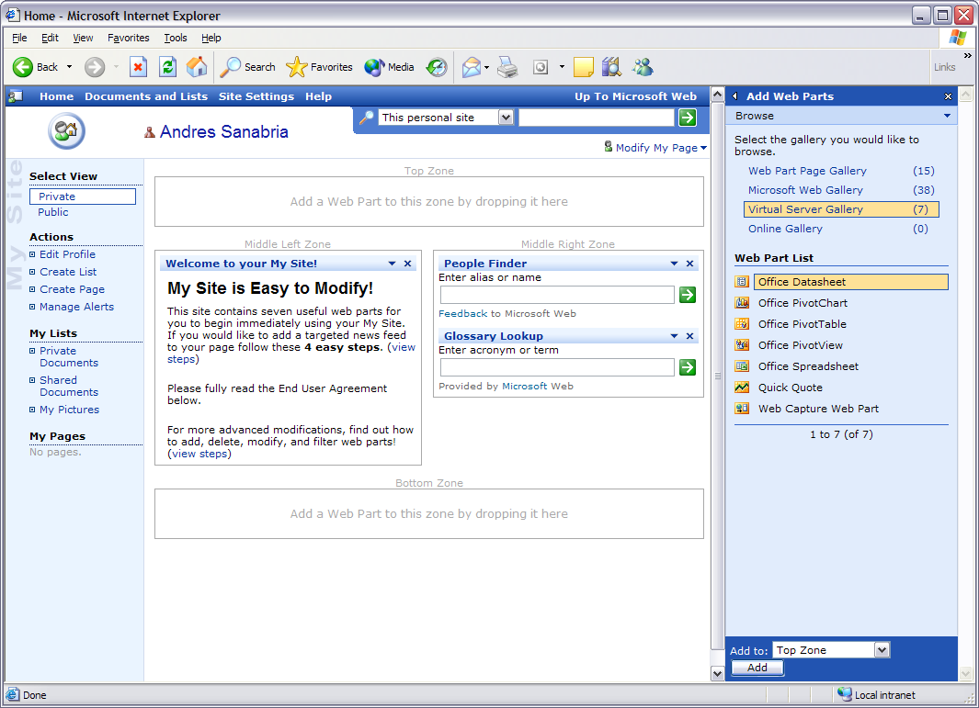
Dynamic Modular Web Sites
Core concepts
  Normal
  Design
  Edit
  Catalog
  Connection

Slide 9

Core Concepts
Zone: layout
Layout managers for ASP.net server side controls
  A Zone can contain one or more Web Parts
  Responsible for rendering user interface
  elements of its
    border, title, and associated WebPartVerb
  Define a section of the UI for part
A page can contain one or more zones
A Zone will depend on the mode that the
page is in

Slide 10
Core Concepts
Zone: layout
<%@ page language="VB"%>
<html>=<body><form id="form1" runat="server"><table width="100%" >
<tr valign=middle align=center>
<td>
<asp:WebPartZone id="LeftZone" runat="server“>
<zonetemplate>
<!– content goes here -->
<zonetemplate>
</asp:WebPartZone>
</td>
<td>
<asp:WebPartZone id=“RightZone" runat="server“>
<zonetemplate>
<!– content goes here -->
<zonetemplate>
</asp:WebPartZone>
</td>
<td>
<asp:EditorZone id="EditingZone" runat=server>
<zonetemplate>
<!– content goes here -->
<zonetemplate>
</asp:EditorZone>
</td>
</tr></table></form></body></html>

Slide 11
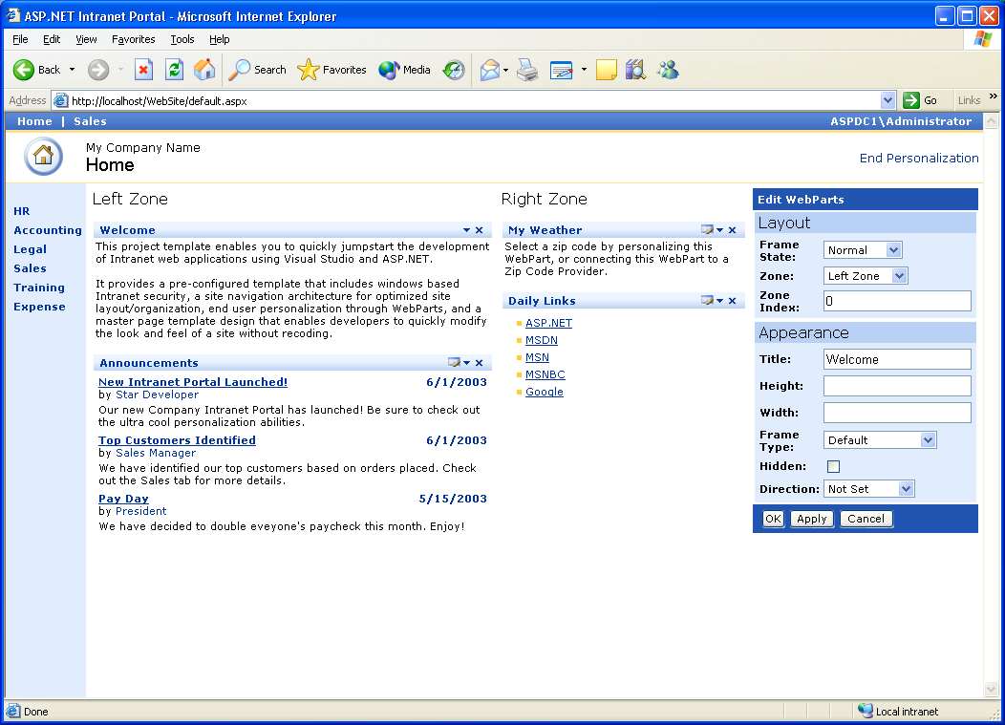
Core Concepts
Zone: layout
EditorZone
WebPartZone

Slide 12
Core Concepts
Zone: layout
Zone*
WebPartZoneBase*
ToolZone*
All modes
Edit mode
Catalog mode
Connection mode
WebPartZone
EditorZone
CatalogZone
ConnectionZone

Slide 13
Core Concepts
Part: content
Built-In part controls to enable functionality
in a zone
  ImportCatalogPart
  PageCatalogPart
  TemplateCatalogPart
  BehaviorEditorPart
  AppearanceEditorPart
  PropertyGridEditorPart
  LayoutEditorPart
Any ASP.net server side control or user control behaves as a Web Part control

Slide 14
Core Concepts
Part: Content
<%@ page language="VB"%>
<%@ register tagprefix="uc1" tagname="UserInformation" src="~/UserInformation.ascx"%>
<html><body><form id="form1" runat="server"><table width="100%">
<tr valign="middle" align="center">
<td>
<asp:webpartzone id="LeftZone" runat="server">
<zonetemplate>
<!– ASP.NET Server Control -->
<asp:calendar id="Calendar1" runat="server"></asp:calendar>
</zonetemplate>
</asp:webpartzone></td>
<td>
<asp:webpartzone id="RightZone" runat="server">
<zonetemplate>
<!– ASP.NET User Control-->
<uc1:userinformation id="UserInformation1" runat="server"></uc1:userinformation>
<!– ASP.NET Part Control-->
<WebPartTest:CustomPartControl id=“PartControl1" runat="server"></uc1:userinformation>
</zonetemplate>
</asp:webpartzone></td>
<td>
<asp:editorzone id="EditingZone" runat="server">
<zonetemplate>
<asp:layouteditorpart runat="server"></asp:layouteditorpart>
</zonetemplate>
</asp:editorzone></td>
</tr>
</table></form></body></html>

Slide 15
Core Concepts
Part: Content
WebPart Control
LayOutEditorPart
Literal
User Control
AppearanceEditorPart

Slide 16
Core Concepts
Part: content
WebPartZone
“All Modes”
Part
EditorZone
“Edit Mode”
WebPart
EditorPart
CatalogZone
“Catalog Mode”
CatalogPart
BehaviorEditorPart
GenericWebPart
ImportCatalogPart
AppearanceEditorPart
PageCatalogPart
PropertyGridEditorPart
TemplateCatalogPart
LayoutEditorPart

Slide 17
Core Concepts
Web part manager
Non-visual control <ASP:WebPartManager>
Manages all Web Parts zone and part controls
  Track which parts are contained in each zone.
  Add/remove web parts
  Set and track the edit state of the page.
    Normal, Catalog connect, Design, edit
  Establish and manage communication between parts
There must be one Web Part Manager per page

Slide 18
Core Concepts
Web part manager
<%@ page language="VB"%>
<%@ register tagprefix="uc1" tagname="UserInformation" src="~/UserInformation.ascx"%>
<html><body><form id="form1" runat="server">
<asp:WebPartManager runat="server" id=WebPartManager1></asp:WebPartManager>
<table width="100%">
<tr valign="middle" align="center">
<td>
<asp:webpartzone id="LeftZone" runat="server">
<zonetemplate>
<!– ASP.NET Server Control -->
<asp:calendar id="Calendar1" runat="server"></asp:calendar>
</zonetemplate>
</asp:webpartzone></td>
<td>
<asp:webpartzone id="CenterZone" runat="server">
<zonetemplate>
<!– ASP.NET User Control-->
<uc1:userinformation id="UserInformation1" runat="server"></uc1:userinformation>
<!– ASP.NET Part Control-->
<WebPartTest:CustomPartControl id=“PartControl1" runat="server"></uc1:userinformation>
</zonetemplate>
</asp:webpartzone></td>
<td>
<asp:editorzone id="EditingZone" runat="server">
<zonetemplate>
<asp:layouteditorpart runat="server"></asp:layouteditorpart>
</zonetemplate>
</asp:editorzone></td>
</tr>
</table></form></body></html>

Slide 19
Core Concepts
Web part manager
Sub LinkButton1_Click(ByVal sender As Object, ByVal e As System.EventArgs)
If WebPartManager1.DisplayMode = WebPartDisplayMode.Normal Then
WebPartManager1.DisplayMode = WebPartDisplayMode.Design
LinkButton1.Text = "Save Personalization"
Else
WebPartManager1.DisplayMode = WebPartDisplayMode.Normal
LinkButton1.Text = "Personalize this page"
End If
End Sub

Slide 20
Core Concepts
Page personalization
Persist per user control settings
Configurable Data store
  Built-In SQL Server and Access support
  Extensible via providers
  Disable by default
Allow per user and all users personalization

Slide 21
Core Concepts
Page personalization
<%@ page language="VB“ enablepersonalization=“true” %>
<%@ register tagprefix="uc1" tagname="UserInformation" src="~/UserInformation.ascx"%>
<html><body><form id="form1" runat="server">
<asp:WebPartManager runat="server" id=WebPartManager1></asp:WebPartManager>
<table width="100%">
<tr valign="middle" align="center">
<td>
<asp:webpartzone id="LeftZone" runat="server">
<zonetemplate>
<!– ASP.NET Server Control -->
<asp:calendar id="Calendar1" runat="server"></asp:calendar>
</zonetemplate>
</asp:webpartzone></td>
<td>
<asp:webpartzone id="CenterZone" runat="server">
<zonetemplate>
<!– ASP.NET User Control-->
<uc1:userinformation id="UserInformation1" runat="server"></uc1:userinformation>
<!– ASP.NET Part Control-->
<WebPartTest:CustomPartControl id=“PartControl1" runat="server"></uc1:userinformation>
</zonetemplate>
</asp:webpartzone></td>
<td>
<asp:editorzone id="EditingZone" runat="server">
<zonetemplate>
<asp:layouteditorpart runat="server"></asp:layouteditorpart>
</zonetemplate>
</asp:editorzone></td>
</tr>
</table></form></body></html>

Slide 22
Building A Dynamic User Interface

Slide 23
Agenda
Modular User Interface
ASP.NET Web Part
Windows Sharepoint Services
Core Concepts
  Zone
  Part
  Web Part Manager
  Page Personalization
Web Part Drill Down
Summary

Slide 24
Web Part - Drill Down
Technical details
Container Control
  Inheritance from <asp:Panel>
  Can include text, markup, and server side controls
  Represent a module in the User Interface
Can be place in anywhere in the page
Any ASP.net Server control or user control act as a web part control at runtime
Can be build as User control or Custom control
Empower user to perform advance task
  Configure
  Manage (Add/Remove)
  Connect to other Web Part

Slide 25
Web Part - Drill Down
Building a web part
Any ASP.net control
  Add it to the zone
  At runtime the control will be wrapped using a GenericWebPart
User control
  Create an ASCX file
  Add it to the zone
  At runtime the user control will be wrapped using a GenericWebPart
Custom Control
  Inheritance from the System.Web.UI.WebPart
  Add new members
  Overriding ChildControlCreated/Render method
  Add it to the zone

Slide 26
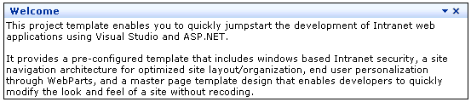
Web Part - Drill Down
UI Elements
WebPart’s UI elements
Verbs
  UI elements that enable users to perform actions
  WebPartZone Provide standard verbs
    Close, Minimize, Restore, Help, Edit, Connect, Export
  WebPart developer can add custom verbs
TitleIcon
Title
Verbs
Content
Chrome

Slide 27
Web Part - Drill Down
UI Elements
Adding a Verb to the web part
public override WebPartVerbCollection Verbs{
get{
WebPartVerb sortVerb =
new WebPartVerb(new WebPartEventHandler(SortLinks));
sortVerb.Description = "When checked, the list of links is sorted.";
sortVerb.Enabled = true;
sortVerb.ImageUrl = "~/images/SortedButton.jpg";
sortVerb.Text = "Sorted";
WebPartVerb[] controlVerbs = new WebPartVerb[] {sortVerb};
m_Verbs = new WebPartVerbCollection(base.Verbs, controlVerbs);
return m_Verbs;
}}

Slide 28
Building A Web Part Control

Slide 29
Web Part - Drill Down
Editing
End user can Personalized web part Property using the Editor Zone
There are four type of EditorPart
  BehaviorEditorPart
  AppearanceEditorPart
  PropertyGridEditorPart
  LayoutEditorPart
WebBrowsable attribute
Personalizable
[Personalizable(true)]
[WebBrowsable(“true")]
public String ZipCode { get {...}; set {...}; }

Slide 30
Personalizing A Property

Slide 31
Web Part - Drill Down
Editing
Web Part could add a custom EditorPart to the EditorZone
  Implement IWebEditable in the webpart
    Return a collection of the editorpart
      EditorPartCollection CreateEditorParts();
  Create an EditorPart
    Create a class that Inheritance from EditorPart
    Override:
      public abstract void SyncChanges();
      protected internal abstract bool ApplyChanges();

Slide 32
Creating A Custom Editor Part

Slide 33
Web Part - Drill Down
Adding parts in a page
Developer or Admin could define approved Web Part in the Catalog
  Catalog provide a UI to add parts to a page
  Parts are added to the catalog when closed
Two Type of catalogs
  PageCatalogPart: Display a list of all WebPart controls that are currently closed
  TemplateCatalogPart: Display lists of parts that are available to be displayed on a Web page.
Web Part can be added using code
WebPartManager.AddWebPart (webPart, zone, zoneIndex);

Slide 34
Adding Part In A Page

Slide 35
Web Part - Drill Down
Connecting web part
Interface
  Define the communication contract between two web parts
Connection point
  Communication between two web parts is done via a provider connection point and a consumer connection point
  The consumer connection point and provider connection point must be of the same type
  When two connection point of different type need to be connected a transformer is needed
Connection Types
  Provider
    Web part that provide data and schema information
    Implements a Provider connection point
      Defined a call back that return an instance of the Interface
      One provider connection point can connection to any number of consumer connection point of the same type
  Consumer
    Web pat that gets data
    Implements a Consumer connection point
      Defined a call back that get an instance of the Interface
      One consumer connection point can connection to only one provider connection point of
      the same type

Slide 36
Web Part - Drill Down
Creating an interface
// create a zip code interface that define the communication mechanism
interface IZipCode
{
// use this property to get the zip code
public int ZipCode {get;}
}

Slide 37
Web Part - Drill Down
Creating a consumer
// create a ZipCode web part that inheritance from the Web
public class ZipCodeWebPart: WebPart, IZipCode
{
// implement ZipCode property from IZipCode
Public int IZipCode.ZipCode {get ;}
// define the call back method that returns the object in this case Zip code
[ConnectionProvider(“ZipProvider”, “Zip Code”) ]
private IZipCode ProvideIZipCode()
{
return this;
}
}

Slide 38
Web Part - Drill Down
Creating a consumer
public class WeatherWebPart: WebPart
{
// define the call back method that get the object of type IZipCode
[ConnectionConsumer (“ZipConsumer”, “Zip Code”) ]
public void GetIZipCode (IZipCode ZipCodeInterface)
{
if (_ZipCodeInterface!= null)
{
StrCurentZipCode = ZipCodeInterface.ZipCode
}
/ **** Performer any additional work *****/
}
}

Slide 39
Web Part - Drill Down
Connecting web parts
Dynamic connection are done via
the browser
Static connected are defined by the
page developer

Slide 40
Web Part - drill down
Connecting web parts
<%@ page language="CS" %>
<!—register the controls in the page-->
<%@ register tagprefix=CompanyFoo %> <!—provider -->
<%@ register tagprefix=CompanyBar %> <!—Consumer -->
<Form runat="server">
<!-- inside the web part manager a connection is defined between the two parts -->
<asp:webpartmanager id="WebPartManager1" runat="server">
<connections>
<!-- define the connection -->
<asp:connection providerid=Zip1
providerconnectionpointid= ZipProvider
consumerid=Weather1
consumerconnectionpointid=ZipConsumer >
</asp:connection>
</asp:webpartmanager>
<!—define an instance of the Provider and consumer in a zone-->
<asp:webpartzone id="WebPartZone1" runat="server">
<zonetemplate>
<CompanyFoo:ZipCodeWebPart id=Zip1 runat=server/>
<CompanyBar:WeatherWebPArt id=Weather1 runat=server/>
</zonetemplate>
</asp:webpartzone></Form>

Slide 41
Building A Connectable
Web Parts

Slide 42
Questions ??

Slide 43
© 2003-2004 Microsoft Corporation. All rights reserved.
This presentation is for informational purposes only. Microsoft makes no warranties, express or implied, in this summary.
Notes:
<footer>© 2003-2004 Microsoft Corporation. All rights reserved.
This presentation is for informational purposes only. Microsoft makes no warranties, express or implied, in this summary.

Slide 44


