Slide 1




“Indigo”: The Web Services Protocols And Architecture
Session Code: WSV 404
Omri Gazitt
Product Unit Manager
Advanced Web Services
omrig@microsoft.com

Slide 2


Services And Protocols
Service-orientation: Crossing boundaries
Web Services are the Internet’s L7
IP is on a tear in the device space
  Web Services will soon follow
Mobile operators trying to make their networks programmable
"Indigo" sits at the intersection of these industry trends

Slide 3
Web Services – Internet’s L7
ISO OSI Network
Reference Model
The Internet
L7
.
.
.
.
.
L1
Application
Web Services
Presentation
XML
Session
HTTP
Transport
TCP
Network
IP
Data Link
Ethernet
Physical
CAT5/WLAN

Slide 4
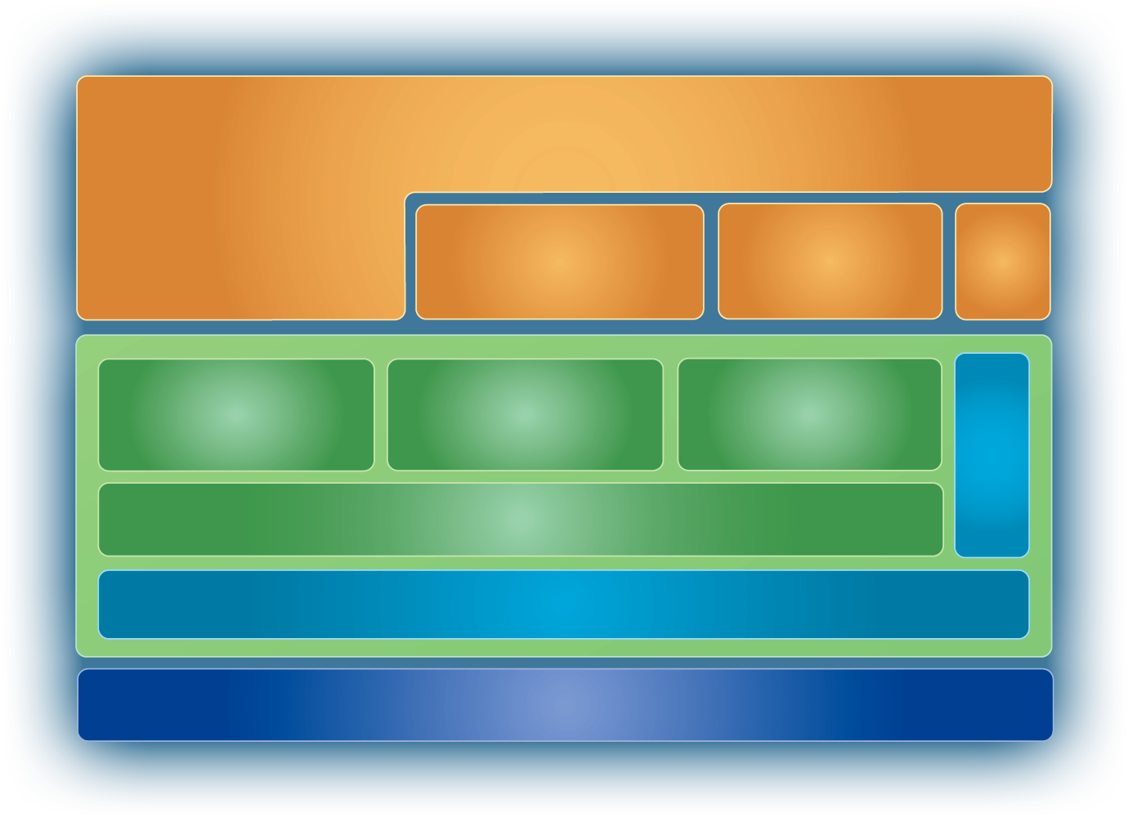
Web Services Architecture
Connected Applications
P2P
EAI
B2B
Grid
Devices
Mobile
Management
Business Process
…
Secure
Reliable
Transacted
Metadata
Messaging
XML
Transports

Slide 5
SRT Demo (Gates/Mills, 9/17)
Secure, Reliable, Transacted
Supply Chain Management
Application

Slide 6
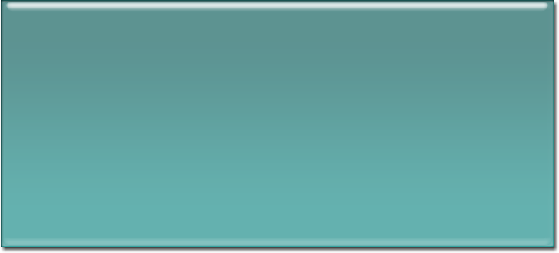


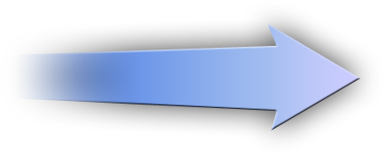



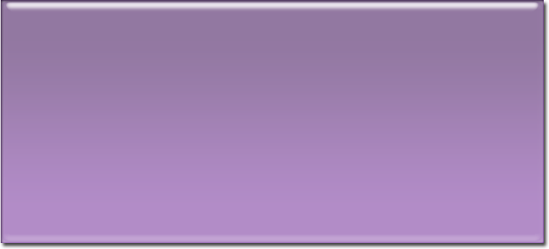




Example Scenario
Roaming Smart Client – Vendor Managed Inventory
Tony Logs In
Identity Flows To Manufacturer
Technologies
Security
Federation

Slide 7

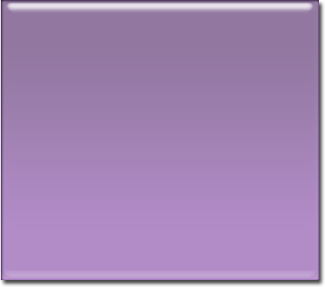

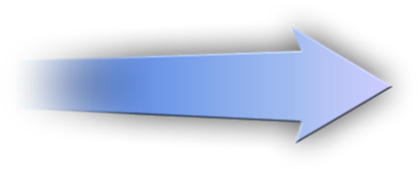
Example Scenario
Roaming Smart Client – Vendor Managed Inventory
Technologies
Security
Reliability
Transactions
Places Order
Secure, Reliable
Secure, Reliable Transacted
Warehouse

Slide 8
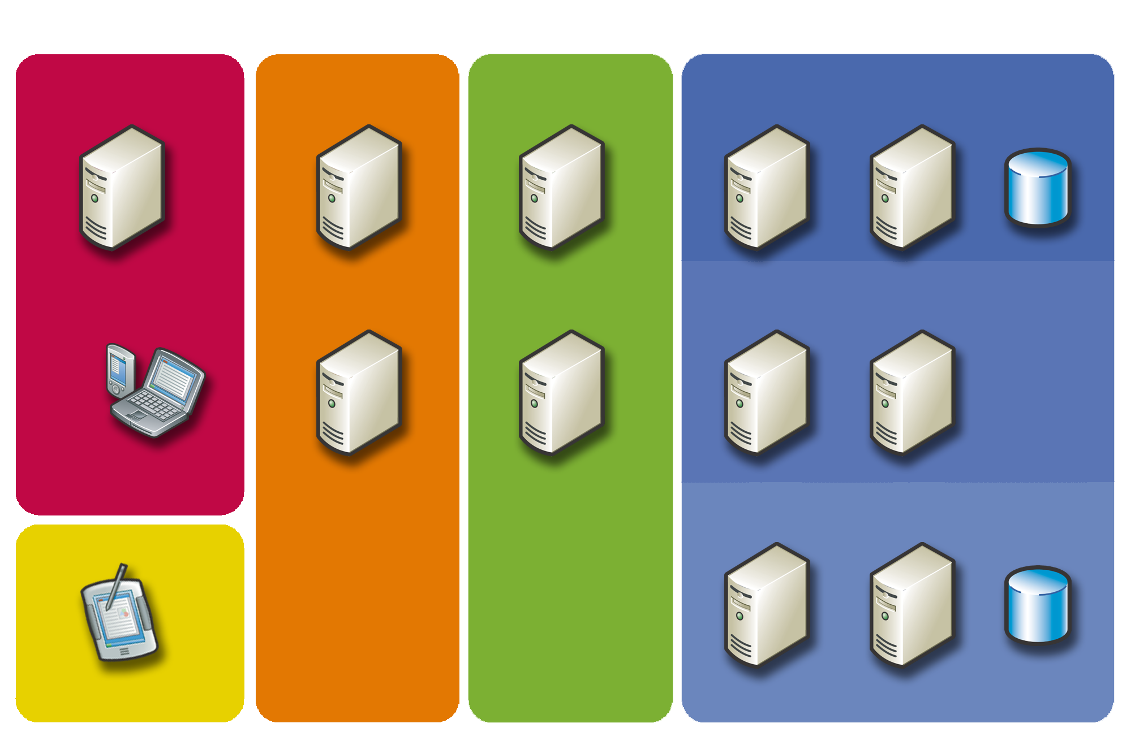
Tony – Example Login
Identity Provider
Authorization Service
Identity Provider
Warehouse 1
Coordinator
Storage
Order Service
Inventory Service
Warehouse Service
Transaction Coordinator
Heather
2
Dealer
1
Warehouse 2
Coordinator
Storage
Tony
Roaming
Manufacturing
Supplier
Warehouse
Assumes policies are known/cached

Slide 9
Backend Processing
Identity Provider
Authorization Service
Identity Provider
Warehouse 1
Coordinator
Storage
Inventory Service
Warehouse Service
Transaction Coordinator
Order Service
5
2
3
4
Heather
Dealer
1
Warehouse 2
Coordinator
Storage
5
Tony
Roaming
Manufacturing
Supplier
Warehouse

Slide 10
Spec Drilldown
Connected Applications
P2P
EAI
B2B
Grid
Devices
Mobile
Management
Business Process
…
Secure
Reliable
Transacted
Metadata
Messaging
XML
Transports

Slide 11
Web Services Design Principles
A general-purpose, composable protocol framework
Architecture is metadata-driven,
policy-based
Protocols are factored from both transports and application semantics
Architecture allows intermediaries
Uniform data model for protocols/content
Broad industry partnership

Slide 12
Messaging
SOAP
URI
WS-Addressing

Slide 13
WS-Addressing
WS-Addressing provides mechanisms for addressing resources
  Shipping those addresses in messages
  Addressing messages to those resources
Addressing mechanisms are
transport-neutral
Resources are not constrained
  Can be constructed, partitioned, named, addressed in arbitrary fashion
Internal resource organization is opaque

Slide 14
Resource Model
wsa:ReferenceProperties
wsa:ReferenceProperties
Resource
Resource
Resource
Resource
Resource
Resource
Resource
Resource
Resource
Resource
Resource
wsa:ReferenceProperties
wsa:ReferenceProperties
Port
wsa:Address

Slide 15
Endpoint Reference
“Generalized URI”
  EPR = Address + Reference Properties
<a:EndpointReference
xmlns:a='http://schemas.xmlsoap.org/ws/2003/03/addressing'
xmlns:m='http://example.net/ws/weather/forecasts'
xmlns:p='http://schemas.xmlsoap.org/ws/2002/12/policy' >
<a:Address>http://example.org/weather/us</a:Address>
<a:ReferenceProperties>
<m:Info>Services.Weather.Wind</m:Info>
</a:ReferenceProperties>
<p:Policy>
. . .
</p:Policy>
<a:/EndpointReference>
[Address] property -
Network address of resource
[Reference Properties] -
Other addressing information
Policy for this resource

Slide 16
Message Information Headers
WS-Addressing also defines header elements
Property | Header | Notes
destination | wsa:To | From wsa:Address
recipient | wsa:Recipient | An endpoint reference
source endpoint | wsa:From | An endpoint reference
reply endpoint | wsa:ReplyTo | An endpoint reference
fault endpoint | wsa:FaultTo | An endpoint reference
action | wsa:Action | Name of logical action
message id | wsa:MessageID | Unique ID
relationship | wsa:RelatesTo | Provides for correlation
* | * | From wsa:ReferenceProperties

Slide 17
Request/Response With WSA
<s:Envelope xmlns:s='http://www.w3.org/2003/05/soap-envelope'
xmlns:a='http://schemas.xmlsoap.org/ws/2003/03/addressing'>
<s:Header>
<a:To>http://example.org/weather/us</a:To>
<a:Action>http://example.org/weather/forecast</wsa:Action>
<a:ReplyTo>. . .</a:ReplyTo>
</s:Header>
<s:Body> . . . </s:Body>
<s:/Envelope>
Request
SOAP 1.2
<s:Envelope xmlns:s='http://www.w3.org/2003/05/soap-envelope'
xmlns:a='http://schemas.xmlsoap.org/ws/2003/03/addressing'>
<s:Header>
<a:To>http://example.org/weatherrequestor</a:To>
<a:Action>http://example.org/weather/forecastR</wsa:Action>
<a:RelatesTo RelationshipType='wsa:Response' >
. . .
</a:RelatesTo>
</s:Header>
<s:Body> . . . </s:Body>
<s:/Envelope>
Response
SOAP 1.2

Slide 18
Metadata
WS-Metadata
Exchange
WS-Policy
Assertions
WS-Policy
Attachment
WS-Policy
WSDL

Slide 19
Policy
WS-Policy: A framework for making statements about resources
  Used to express receiver requirements for incoming messages (e.g., transports, security)
  At runtime, can be used to match requirements to capabilities
WS-PolicyAssertions: Predefined basics
WS-PolicyAttachment: Attaching policy expression to a subject (e.g., EPR)

Slide 20
Metadata Driven Architecture
Policy used by X when sending a message out (often implicit)
X
Y
Policy used by Y when receiving a message in
Get
Policy
Compatible?
Cache
X’s Out
Y’s In
Y’s In
Yes
'
'
send(
)
receive(
)
To: Y
To: Y
To: Y
X’s Out
Y’s In
Y’s In

Slide 21
WS-Policy
Policy expressions express choices over domain-specific assertions
Operators and usages allow writing policies in a compact form
Preferences are hints in choosing between alternatives
ExactlyOne
All
All
A
B
C
D

Slide 22
WS-Policy Example
Preference
<wsp:ExactlyOne wsp:Usage='wsp:Required' >
<wsp:All wsp:Preference=‘1’>
<jeff:MainCourse>Burger</jeff:MainCourse>
<jeff:Side>Fries</jeff:Side>
</wsp:All>
<wsp:All wsp:Preference=‘2’>
<jeff:MainCourse>Pizza</jeff:MainCourse>
<jeff:Side>Yogurt</jeff:Side>
</wsp:All>
</wsp:ExactlyOne>
Domain-specific assertions
Operators
Usage

Slide 23
WS-PolicyAssertions
TextEncoding: Character encoding
Language: Natural (human) language
SpecVersion: URI asserting compliance with spec
MessagePredicate: XPath (or other) statement about message
<wsp:TextEncoding Encoding='utf-8' />
<wsp:Language Language='en-US' />
<wsp:SpecVersion wsp:Usage='wsp:Required'
URI='http://schemas.xmlsoap.org/ws/2002/04/secext' />
<wsp:MessagePredicate wsp:Usage='wsp:Required' >
count(wsp:GetHeader(.)/wsse:Security) = 1
</wsp:MessagePredicate>

Slide 24
WS-PolicyAttachment
Defines what a policy applies to
Associates domain expression with policy
  Domain expression indicates scope
  Policy makes statements about that scope
<wsp:PolicyAttachment>
<wsp:AppliesTo>
<wsa:EndpointReference>
<wsa:Address>http://jcs.org/lunch</wsa:Address>
</wsa:EndpointReference>
</wsp:AppliesTo>
<wsp:Policy> . . . </wsp:Policy>
</wsp:PolicyAttachment>
Domain expression

Slide 25
WS-MetadataExchange
How do I get metadata for another endpoint anyway?
  Extracted from WSDL
  Returned from discovery FIND (e.g., UDDI)
  Out of band
  MetadataExchange: Retrieved by a simple GET
    Applies to Policy, WSDL, Schema
<s:Envelope>
<s:Header>
<wsa:Action>
http://schemas.xmlsoap.org/ws/2003/10/md-exchange/GetPolicy
</wsa:Action>
</s:Header>
<s:Body />
</s:Envelope>
[Conceptual]

Slide 26
Security
WS-Security
WS-Trust
WS-Secure
Conversation
WS-Security
Policy
WS-Federation

Slide 27
WS-Security
Defines a framework for building
security protocols
  Integrity
  Confidentiality
  Propagation of security tokens
Framework designed for end-to-end security of SOAP messages
  From initial sender, through 0-n intermediaries to ultimate receiver
Support for pluggable algorithms
  Encryption, Digest, Signature, Canonicalization, Transforms

Slide 28
Integrity Example (Sender)
I want to send a SOAP message and ensure that the body is not modified
  I generate a digest of the SOAP body
  I generate a signature over the digest (and some other info) using my private key
  I include my certificate (which includes my public key) in a security token

Slide 29
Integrity Example (Sender)
Message
Body
Digest
Algorithm
Digest
Signature
Algorithm
X.509
Certificate
Signature

Slide 30
Integrity Example (Receiver)
You want to check that the body of the message was not modified
  You generate a digest for the SOAP body
  You verify the signature using my public key (which you got from my certificate )
  You compare the two values and ensure
  they match
As a side-effect, you also know the message was from me

Slide 31
Integrity Example (Receiver)
Message
Body
Digest
Algorithm
Digest
X.509
Certificate
Signature
Signature
Algorithm
Message
Body
Digest
Algorithm
Digest
Verification
Algorithm
Digest
Signature

Slide 32
<s:Envelope
xmlns:s='http://www.w3.org/2003/05/soap-envelope'
xmlns:wsu='http://schemas.xmlsoap.org/ws/2002/07/utility'
xmlns:ws='http://schemas.xmlsoap.org/ws/2003/07/secext'
xmlns:ds='http://www.w3.org/2000/09/xmldsig#' >
<s:Header>
<ws:Security s:mustUnderstand='true' >
<ws:BinarySecurityToken wsu:Id='Me' ValueType='ws:X509v3'
EncodingType='ws:Base64Binary' >
MeIIZFgea4FGiu5cvWEklO8pl...
</ws:BinarySecurityToken>
. . .
My security token

Slide 33
. . .
<ds:Signature>
<ds:SignedInfo>
<ds:CanonicalizationMethod
Algorithm='http://www.w3.org/2001/10/xml-exc-c14n#' />
<ds:SignatureMethod
Algorithm='http://www.w3.org/2000/09/xmldsig#rsa-sha1' />
<ds:Reference URI='#Body' >
<ds:DigestMethod
Algorithm='http://www.w3.org/2000/09/xmldsig#sha1' />
<ds:DigestValue>uJhGtef54ed91iKLoA...</ds:DigestValue>
</ds:Reference>
</ds:SignedInfo>
<ds:SignatureValue>FR8yaKmNDePQ7E3Hj...</ds:SignatureValue>
. . .
Reference to data I want to protect
Digest of data I want to protect
Signature over ds:SignedInfo element

Slide 34
. . .
<ds:KeyInfo>
<ws:SecurityTokenReference>
<ws:Reference URI='#Me' />
</ws:SecurityTokenReference>
</ds:KeyInfo>
</ds:Signature>
</ws:Security>
. . .
</s:Header>
<s:Body wsu:Id='Body' >
. . .
</s:Body>
</s:Envelope>
Reference to certificate that can be used to verify signature
Signed data

Slide 35
WS-Trust
Defines how to broker trust relationships
  Some trust relationship has to exist a priori
Defines how to exchange security tokens
Defined as an interface specification for a Security Token Service
  A RequestSecurityToken message is sent to the trust service
  It responds with a RequestSecurityTokenResponse

Slide 36
Example
Client
I want to talk to X
Trust
Service
Here’s a token
Here’s a token
X

Slide 37
<s:Envelope
xmlns:s='http://www.w3.org/2003/05/soap-envelope'
xmlns:wsu='http://schemas.xmlsoap.org/ws/2002/07/utility'
xmlns:ws='http://schemas.xmlsoap.org/ws/2003/07/secext'
xmlns:ds='http://www.w3.org/2000/09/xmldsig#' >
<s:Header>
<ws:Security s:mustUnderstand='true' >
<ws:BinarySecurityToken wsu:Id='Me'
ValueType='ws:Kerberosv5TGT'
EncodingType='ws:Base64Binary' >
MehgVCD3Efg7hJlaFvCdEFujH...
</ws:BinarySecurityToken>
<ds:Signature>
<!-- Signature over request -->
</ds:Signature>
</ws:Security>
</s:Header>
. . .
Security token that I share with the trust service

Slide 38
. . .
<s:Body wsu:Id='request' >
<ws:RequestSecurityToken>
<ws:TokenType>ws:Kerberosv5ST</ws:TokenType>
<ws:RequestType>ws:ReqIssue</ws:RequestType>
<ws:Base><ws:Reference URI='#Me' /></ws:Base>
</ws:RequestSecurityToken>
</s:Body>
</s:Envelope>
Type of token I want
I want a new token
Reference to security token I share with the STS

Slide 39
<s:Envelope
xmlns:s='http://www.w3.org/2003/05/soap-envelope'
xmlns:ws='http://schemas.xmlsoap.org/ws/2003/07/secext' >
<s:Header>
<ws:Security s:mustUnderstand='true' >
<ws:BinarySecurityToken wsu:Id='Me'
ValueType='ws:Kerberosv5TGT'
EncodingType='ws:Base64Binary' >
MehgVCD3Efg7hJlaFvCdEFujH...
</ws:BinarySecurityToken>
</ws:Security>
</s:Header>
<s:Body wsu:Id='response' >
<ws:RequestSecurityTokenResponse>
<ws:RequestedSecurityToken>
<ws:BinarySecurityToken ValueType='ws:Kerberosv5ST'
EncodingType='ws:Base64Binary' >
AlhgVCD3Efg7hJlaFvCdEFujH...
</ws:BinarySecurityToken>
</ws:RequestedSecurityToken>
. . .
Requested security token
Security token that I share with the trust service

Slide 40
. . .
<ws:RequestedProofToken>
<xe:EncryptedKey Id='Sym' >
<xe:EncryptionMethod
Algorithm='http://www.w3.org/2001/04/xmlenc#des' />
<ds:KeyInfo>
<ws:SecurityTokenReference>
<ws:Reference URI='#Me' />
</ws:SecurityTokenReference>
</ds:KeyInfo>
<xe:CipherData>
<xe:CipherValue>bvDfEg6Sh7GbCvDiAl</xe:CipherValue>
</xe:CipherData>
<xe:EncryptedKey>
</ws:RequestedProofToken>
</ws:RequestSecurityTokenResponse>
</s:Body>
</s:Envelope>
Requested proof token
Reference to security token that I share with the trust service

Slide 41
WS-SecureConversation
WS-Security provides for single
message security
Nodes will often want to exchange more than one message
  Specifying new symmetric keys for each message is tedious and verbose
WS-SecureConversation defines mechanisms to address this

Slide 42
WS-SecureConversation
Participants establish a shared context
  Context contains keys and other information
  Has an identifier – used in subsequent messages
  Optionally has creation/expiry timestamps
Context can be established in a variety
of ways
  Using WS-Trust
  Having one party create the context
  Through negotiation

Slide 43
<s:Envelope
xmlns:s='http://www.w3.org/2003/05/soap-envelope'
xmlns:wsu='http://schemas.xmlsoap.org/ws/2002/07/utility'
xmlns:ws='http://schemas.xmlsoap.org/ws/2003/07/secext'
xmlns:ds='http://www.w3.org/2000/09/xmldsig#' >
<s:Header>
<ws:Security s:mustUnderstand='true' >
<ws:SecurityContextToken>
<wsu:Identifier>
uuid:652d2aaa-4857-4d8c-865c-f9549e5806f0</wsu:Identifier>
<wsu:Created>2003-07-13T18:17:44Z</wsu:Created>
<wsu:Expires>2003-07-13T19:17:44Z</wsu:Expires>
<ws:Keys>
<xenc:EncryptedKey>
. . .
</xenc:EncryptedKey>
</ws:Keys>
</ws:SecurityContextToken>
</ws:Security>
</s:Header>
<s:Body wsu:Id='request'>
. . .
</s:Body>
</s:Envelope>

Slide 44
Subsequent Exchanges
<s:Envelope
xmlns:s='http://www.w3.org/2003/05/soap-envelope'
xmlns:wsu='http://schemas.xmlsoap.org/ws/2002/07/utility'
xmlns:ws='http://schemas.xmlsoap.org/ws/2003/07/secext'
xmlns:ds='http://www.w3.org/2000/09/xmldsig#' >
<s:Header>
<ws:Security s:mustUnderstand='true' >
<ws:SecurityContextToken>
<wsu:Identifier>
uuid:652d2aaa-4857-4d8c-865c-f9549e5806f0</wsu:Identifier>
</ws:SecurityContextToken>
</ws:Security>
</s:Header>
<s:Body wsu:Id='response'>
. . .
</s:Body>
</s:Envelope>

Slide 45
WS-SecurityPolicy
A set of policy assertions related to concepts defined by other WS-Sec* specs
Allows participants to specify
  Token types
  Whether integrity and/or confidentiality
  are required
  Algorithms for the above
  Which message parts need signing/encrypting

Slide 46
Security Assertion Examples
<wsp:ExactlyOne wsp:Usage='Required'
xmlns:wsp='http://schemas.xmlsoap.org/ws/2002/12/policy' >
<ws:SecurityToken wsp:Preference='100'
xmlns:ws='http://schemas.xmlsoap.org/ws/2003/07/secext' >
<ws:TokenType>ws:x509v3</ws:TokenType>
</ws:SecurityToken>
<ws:SecurityToken wsp:Preference='1'
xmlns:ws='http://schemas.xmlsoap.org/ws/2003/07/secext' >
<ws:TokenType>ws:Kerberosv5TGT</ws:TokenType>
</ws:SecurityToken>
</wsp:ExactlyOne>
Security Token
<ws:Integrity wsp:Usage='Required'
<ws:Algorithm Type='ws:AlgCanonicalization'
URI='http://www.w3.org/.../xml-exc-c14n' />
<ws:Algorithm Type='ws:AlgSignature'
URI='http://www.w3.org/2000/09/xmldsig#rsa-sha1' />
<ws:Algorithm Type='ws:AlgDigest'
URI='http://www.w3.org/2000/09/xmldsig#hmac-sha1' />
</ws:Integrity>
Integrity

Slide 47
Reliable Messaging
WS-ReliableMessaging

Slide 48
Distributed State Coordination
Reliable Messaging
  Two-party (source, destination), asynchronous
  Exactly once, in-order
Atomic Transaction
  Multi-party, all or nothing state change, synchronous
  Two Phase Commit
    Phase 1: Prepare to Agree
    Phase 2: Agree or Abort
Business Activity
  Multi-party, final consistent state, asynchronous
  Two Phases (almost)
    Phase 1: Cancel/Complete
    Phase 2: Close/Compensate
    Anytime: Exit/Fault

Slide 49
WS-ReliableMessaging
RM defines QoS over unidirectional message sequences
  Exactly once, in-order
Simplifies application programming – no need to defend against
  Lost, duplicated or delayed messages
  Endpoint failure
Acknowledgements sent upon receipt
  As opposed to after application processing
Durability is orthogonal to protocol definition

Slide 50
Sequence Example
<s:Envelope
xmlns:s='http://www.w3.org/2003/05/soap-envelope'
xmlns:wsu='http://schemas.xmlsoap.org/ws/2002/07/utility'
xmlns:wsrm='http://schemas.xmlsoap.org/ws/2003/03/wsrm‘ >
<s:Header>
<wsa:Action>CreateCoordinationContext</wsa:Action>
<wsa:To>http://localhost/TestCoordinator</wsa:To>
<wsrm:Sequence>
<wsu:Identifier>
http://fabrikam123.com/abc
</wsu:Identifier>
<wsrm:MessageNumber>10</wsrm:MessageNumber>
<wsrm:LastMessage/>
</wsrm:Sequence>
</s:Header>
<s:Body> . . . </s:Body>
</s:Envelope>

Slide 51
Acknowledgement Example
<s:Envelope
xmlns:s='http://www.w3.org/2003/05/soap-envelope'
xmlns:wsu='http://schemas.xmlsoap.org/ws/2002/07/utility'
xmlns:wsrm='http://schemas.xmlsoap.org/ws/2003/03/wsrm‘ >
<s:Header>
<wsa:Action>CreateCoordinationContext</wsa:Action>
<wsa:To>http://localhost/TestCoordinator</wsa:To>
<wsrm:SequenceAcknowledgement>
<wsu:Identifier>
http://fabrikam123.com/abc
</wsu:Identifier>
<wsrm:AcknowledgementRange Upper=’10’ Lower=‘1’ />
</wsrm:SequenceAcknowledgement>
</s:Header>
<s:Body> . . . </s:Body>
</s:Envelope>

Slide 52
Transactions
WS-Security
WS-Atomic
Transaction
WS-Trust
WS-Business
Activity
WS-Secure
Conversation
WS-Security
Policy
WS-Coordination

Slide 53
WS-AtomicTransaction
Classic 2 Phase Commit ACID protocol
  Prepare
  Commit/Rollback
Durable or volatile
All resources must be up (synchronous)
All-or-nothing (complete agreement)
Uses asynchronous messages
Resources are locked – easy
programming model
Appropriate for tightly coupled scenarios (shared assumptions about latency/trust)

Slide 54
AT Abstract State Diagram
Phase 1
Phase 2
Rollback
Aborting
Aborted
Prepare
Prepared
Commit
Committed
Active
Preparing
Prepared
Committing
Ended
ReadOnly
or
Aborted
Coordinator generated
Participant generated

Slide 55
WS-BusinessActivity
Looser consistency model
  Intermediate states visible
  No requirement to lock resources
  Shared state “settles out” at end of transaction
Use of compensation to move forward to a known good state
Relaxes “complete agreement” requirement
  Voting protocols can be constructed
Appropriate for loosely-coupled scenarios

Slide 56
WS-Coordination
Base Protocol for AT and BA
Creates and Registers for Transactions
Generates Coordination Context
  Passes Data to Register for Transactions
Based on WS-Addressing
Extensible Coordination Types
  AT and BA are the two predefined ones

Slide 57
WS-AT Register Example
<s:Envelope
xmlns:s='http://www.w3.org/2003/05/soap-envelope'
xmlns:wsu='http://schemas.xmlsoap.org/ws/2002/07/utility'
xmlns:wscoor='http://schemas.xmlsoap.org/ws/2003/09/wscoor‘ >
<s:Header>
<wsa:Action>http://…/2003/09/wscoor#CreateCoordinationContext
</wsa:Action>
<wsa:To>http://localhost/TestCoordinator</wsa:To>
</s:Header>
<s:Body>
<wscoor:Register>
<wscoor:ProtocolIdentifier>
http://schemas.xmlsoap.org/ws/2003/09/wsat#Volatile2PC
</wscoor:ProtocolIdentifier>
<wscoor:ParticipantProtocolService>
<wsa:Address>http://localhost/Participant1</wsa:Address>
</wscoor:ParticipantProtocolService>
</wscoor:Register>
</s:Body>
</s:Envelope>

Slide 58
WS-AT Register Response
<s:Envelope
xmlns:s='http://www.w3.org/2003/05/soap-envelope'
xmlns:wsu='http://schemas.xmlsoap.org/ws/2002/07/utility'
xmlns:wscoor='http://schemas.xmlsoap.org/ws/2003/09/wscoor’
xmlns:mstx='http://schemas.microsoft.com/wsat/extensibility’>
<s:Header>
<wsa:To>http://localhost/Participant1</wsa:To>
<wsa:Action>http://…/wscoor#RegisterResponse</wsa:Action>
</s:Header>
<s:Body>
<wscoor:RegisterResponse>
<wscoor:CoordinatorProtocolService>
<wsa:Address>http://localhost/TestCoordinator</wsa:Address>
<wsa:ReferenceProperties>
<mstx:transactionId>urn:3fd333f8-…</mstx:transactionId>
<mstx:enlistmentId>urn:d79c54be-…</mstx:enlistmentId>
</wsa:ReferenceProperties>
</wscoor:CoordinatorProtocolService>
</wscoor:RegisterResponse>
</s:Body>
</s:Envelope>

Slide 59
WS-AT Prepare Example
<s:Envelope
xmlns:s='http://www.w3.org/2003/05/soap-envelope'
xmlns:wsu='http://schemas.xmlsoap.org/ws/2002/07/utility'
xmlns:wscoor='http://schemas.xmlsoap.org/ws/2003/09/wscoor’
xmlns:wsat='http://schemas.xmlsoap.org/ws/2003/09/wsat’
xmlns:mstx='http://schemas.microsoft.com/wsat/extensibility’>
<s:Header>
<wsa:To>http://localhost/TestCoordinator</wsa:To>
<wsa:Action>http://…/2003/09/wsat#Prepare</wsa:Action>
<mstx:transactionId>urn:3fd333f8-…</mstx:transactionId>
<mstx:enlistmentId>urn:d1de41df-…</mstx:enlistmentId>
</s:Header>
<s:Body>
<wsat:Prepare />
</s:Body>
</s:Envelope>

Slide 60
Call To Action
Further Resources
  PDC CD has spec pointers and narrated powerpoint tutorials by spec authors
  http://msdn.microsoft.com/webservices
  omrig@microsoft.com
Early adopter enterprises: Use WSE
  Yearly RTM of latest advanced WS specs
  2+1 support policy
  No backward/forward compatibility guarantees
Attend Workshops
  http://msdn.microsoft.com/webservices/community/workshops
  Give feedback on specs
  Interoperate with other implementations

Slide 61
For More Information
Come see me
  Immediately after this session
  Web/Services Lounge: 309 Foyer
MSDN “Longhorn” DevCenter http://msdn.microsoft.com/longhorn
Newsgroup
  microsoft.public.windows.developer.winfx.indigo
At PDC
  Hands on labs: On-site or download from CommNet
  Ask The Experts: Tuesday 7 P.M. – 9 P.M. Hall G, H
  PDC Weblogs: http://pdcbloggers.net

Slide 62

© 2003-2004 Microsoft Corporation. All rights reserved.
This presentation is for informational purposes only. Microsoft makes no warranties, express or implied, in this summary.

Slide 63


