Slide 1

Microsoft® SharePoint™ Products
and Technologies Developer Tour
EMEA 2004

Slide 2
Incorporating Web Content Management
Into SharePoint Portals

Slide 3
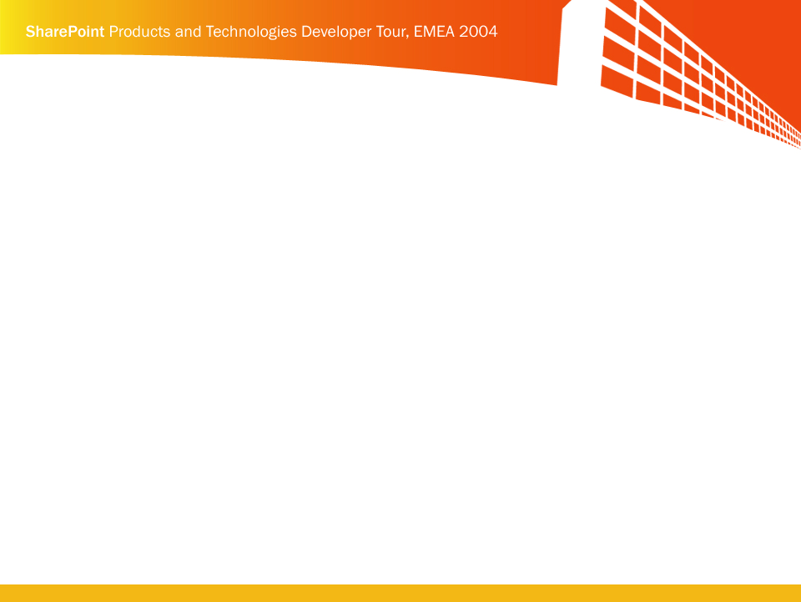

Agenda
Web content as a key component of portal environments
What is Microsoft® Content Management Server™ 2002 (MCMS)?
MCMS Fundamentals and Development
MCMS Connector for SharePoint Products and Technologies
MCMS Template Development for Microsoft® Office
SharePoint ™ Portal Server 2003
Architecture

Slide 4
Microsoft® Office SharePoint™ Portal Server
Primary Design Goal
A single point of access to an enterprise’s:
  People
  Teams
  Knowledge
  Applications

Slide 5
Let’s Focus on Knowledge…
Documents
  Located on SharePoint sites, file shares, etc.
  Word documents, PowerPoint slides, Acrobat PDFs, Excel spreadsheets, etc.
Web site content
  Web site home pages
  “Articles”
    News releases
    Magazine stories
  HTML content specifically created for Web sites

Slide 6

The SharePoint Products and Technologies
Need For Web Content Management
Document libraries are good for:
  Rich content, e.g., Word, Excel, PowerPoint, Acrobat
  Edit the format/structure and content at the same time
  Ultimate output is the printed page
Lists allow do for simple content input/rendering, but
  Formatting choices and dynamic
  content adaptation are limited
  Instant content reformatting is limited
What’s missing is HTML Web content support

Slide 7
Imagine A SharePoint Portal With
Web Content Management…
Much of the content stored independently of how it is rendered / consumed
  Managed in one place
  Reformat it on the fly
Content rendered within portal (alongside people, teams, applications, documents) can be reused in other
channels, such as:
  Public presence site
  Commerce site
  Web services
  Content syndication / aggregation
Simple light-weight tools for managing the content lifecycle
  Creation / Editing / Approval workflow / Scheduling / Targeting
  Mobile
  Custom applications
  Print
  CD

Slide 8








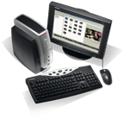
Microsoft Content Management Server 2002
Authoring And Publishing Framework
Intranet Sites
Build & Deploy
Site Structure,
Templates,
Site Design,
Integration,
Business rules,
Security
Content Creation,
Publishing,
Scheduling,
Archiving,
Versioning
Workflow
Extranet Sites
Web Site Developers
Business Managers/ Knowledge Workers/ Content Creators
Internet Sites

Slide 9
Microsoft® Content Management Server
demo

Slide 10


Content Management Server Provides Tools
To empower business users to effectively create, manage, and publish their own Web content
Web Author
  Template-based in-context
  authoring
  Workflow and approval process
  Publication scheduling
  Versioning and archiving
Authoring Connector
  Wizard-based publishing from
  Microsoft Word
  Integrated with MCMS workflow

Slide 11
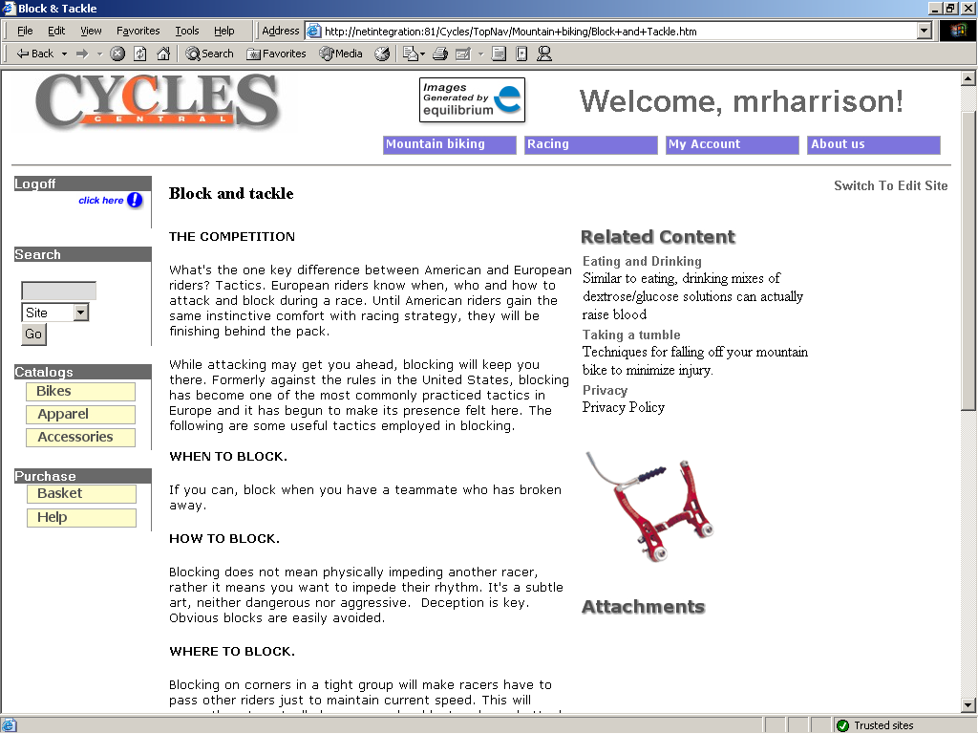
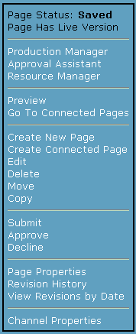
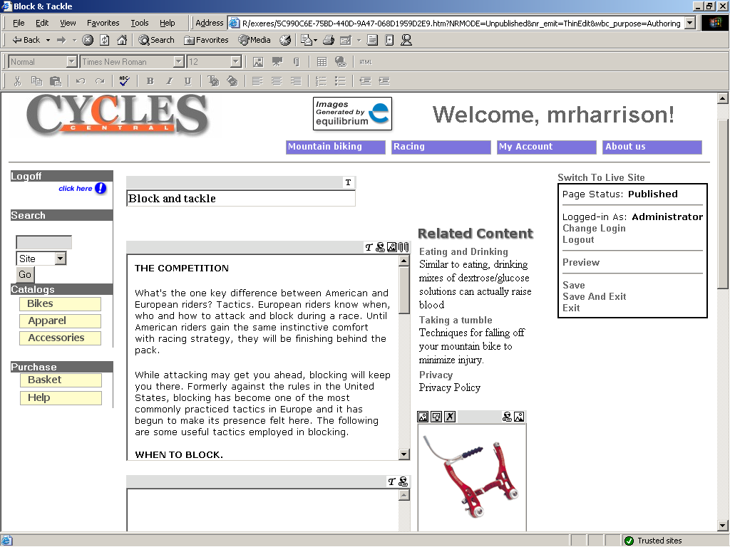
Content Authoring
Approval Workflow
Content Scheduling
Versioning
Custom Properties

Slide 12

Content Publishing

Slide 13
Demo
Show a Content Management Server site
Use Web Author to author content
Use Word Authoring Connector to author content
Show Web Services/use InfoPath to author content
SharePoint spin
  Show Spark web parts
  Show CMS RSS feed to puh content into a SharePoint XML Web part

Slide 14
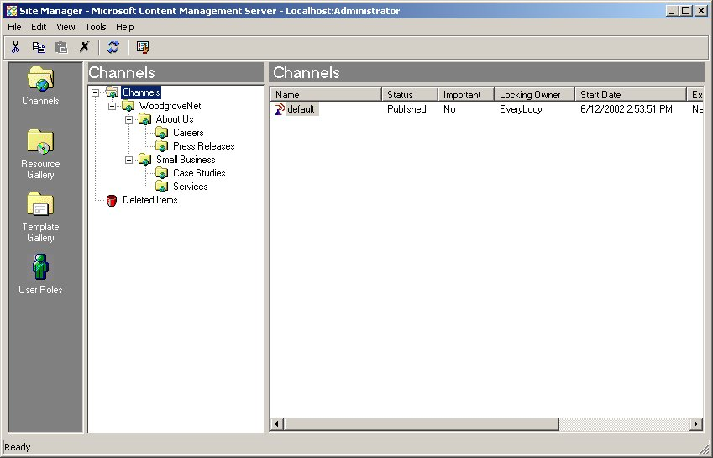
Site Manager
Channels/Postings
Resource Gallery
Templates
User Roles
Define the hierarchical structure of the site
Rights Groups – instances of user roles applied to the various nodes in the site structure

Slide 15
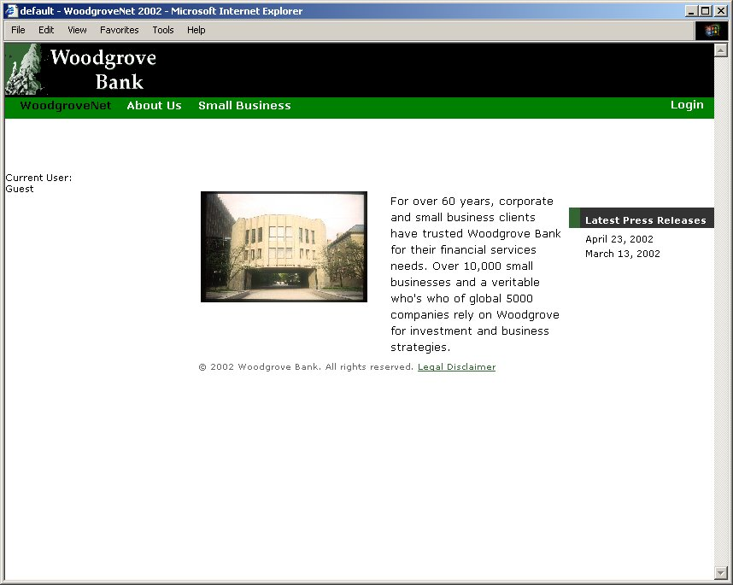
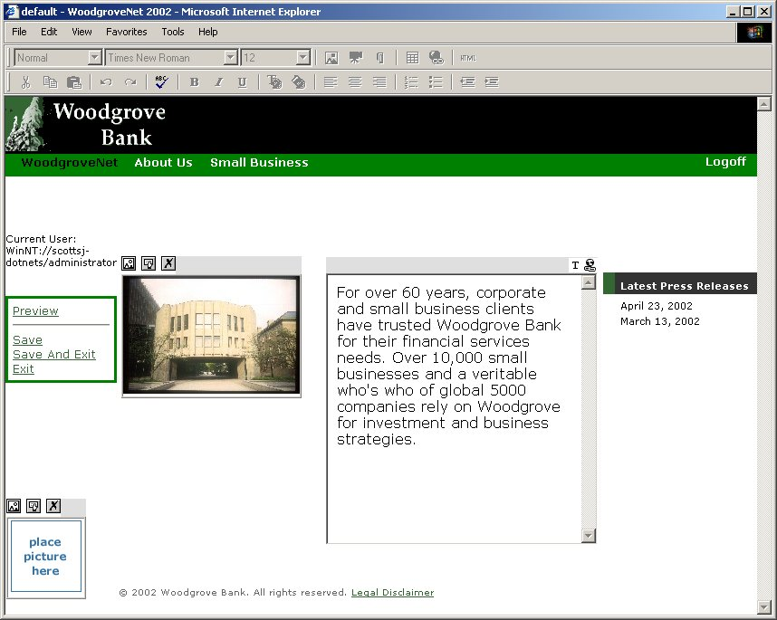
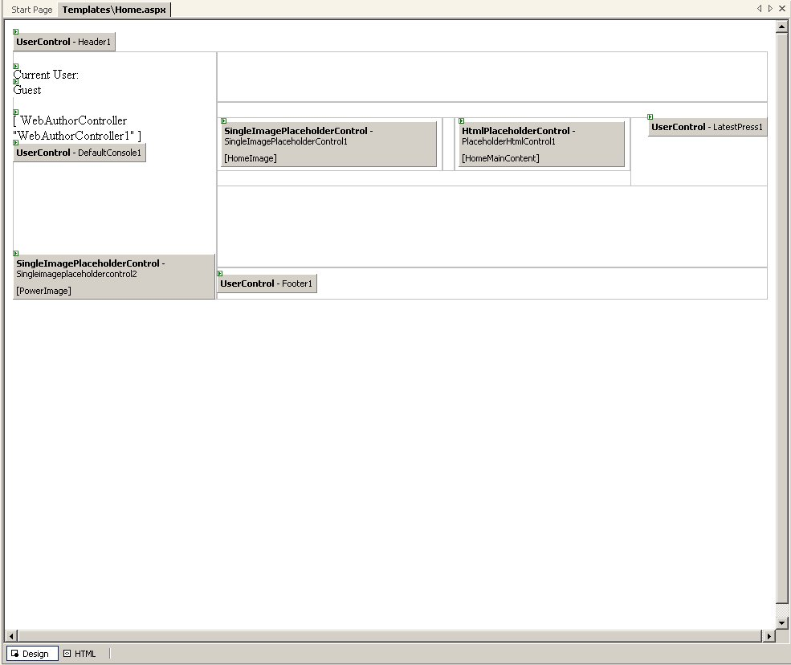
Content Management Server Templates
Woodgrove.Net Homepage
Template viewed in VS.NET
Woodgrove.Net Homepage
Woodgrove.Net
All Web pages are made up of distinct elements
Some elements are global to many pages
Some elements are local to the page content
Some elements are dynamically generated

Slide 16





Content Production
Connected Pages
  Multiple views of the same content
Rich
Browser
Template
XML/
XSLT
Posting
Page
(Content
stored in
placeholders)
Posting
Simple
Browser
Template
HTML
WAP
Browser
Template
Posting
WML
Notes:
All the HTML placeholder information is collectively stored as page.
A page is posted to a Web address and the posting specifies a template that defines how the placeholder information is presented to the user.
So here we have a template that is applying the appropriate HTML mark-up so it can be rendered by a standard Web browser.
But it is also possible to have multiple views of a page … or what Content Management Server calls ‘Connected Pages’.
So, in this example, we now have an additional Template that take the placeholder information and generates an XML document for use by a more modern device … or perhaps for use programmatically by an application.
Also, if we need to support a WAP device, then we could have an additional template that takes the placeholder information and wraps it the appropriate WML markup.
The smart thing about this is, that from the Authors point of view … they only create the content once and it is automatically deployed on all three channels.

Slide 17


Content Production
Internal
Connected Pages
  Multiple views of the same content
Intranet
View
Template
Display
all info
Posting
Page
(Content
stored in
placeholders)
Posting
Extranet
View
Template
Display
subset
of info
External
There is no need to have exactly the
same set of placeholders on connected pages
Notes:
There is no need to have exactly the same set of placeholders on connected pages.
So here we have another example … in this case we have a page that contains some business confidential information.
Perhaps it is some information about staff members and it might include their salary.
The Managers template will include all the placeholders and so the manager sees everything – including the salary information.
Most employees are not entitled to see the salary field and so their template will exclude all confidential placeholders.
As before, the business users only need to create and maintain one page – and the system uses multiple templates to give each set of users the appropriate view.

Slide 18




Multi-Language
Separate channel per language
Can share templates and images/resources
Placeholders support Unicode (every character/every language)
Posting
English
Page
(English
content
stored in
placeholders)
Template
Posting
Page
(French
content
stored in
placeholders)
Navigation in template needs to cater for the channels language
French
Notes:
There is no need to have exactly the same set of placeholders on connected pages.
So here we have another example … in this case we have a page that contains some business confidential information.
Perhaps it is some information about staff members and it might include their salary.
The Managers template will include all the placeholders and so the manager sees everything – including the salary information.
Most employees are not entitled to see the salary field and so their template will exclude all confidential placeholders.
As before, the business users only need to create and maintain one page – and the system uses multiple templates to give each set of users the appropriate view.

Slide 19
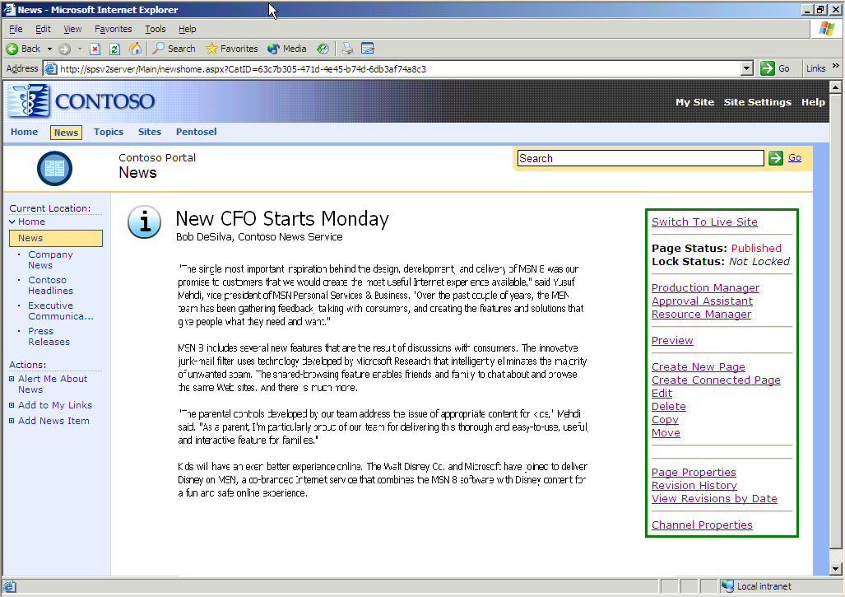


Page Processing
  External URL
  http://contoso/spark/news.htm
channel
posting
CMS
ISAPI
Maps between
external and internal URL.
  Internal URL
  http://contoso/spark/templates/home.aspx?
  NRMODE=Published&NRNODEGUID=%7b7DE6CC74-73ED-4EBC-04714D6EA80A%7d&<other parameters>
Template

Slide 20
Content Management Server
Publishing API
CMS
ISAPI
Developers have access to the CMS Publishing API which provides access to the Content repository
Uses include
  Navigation System
  Site Map page
  What’s new page
  Summary page
  Personalised content
  Links to related content
Use fragment caching
wherever possible
Template
CmsHttpContext
AutoSession
CMS
Publishing
API
User
Channels
Postings
Placeholders
Resource Galleries
Resources
Template Galleries
Templates
Searches

Slide 21

Extensible Placeholder Architecture
Placeholder Definitions
  Defines the general shape of content
  E.g., XML Placeholder Definition
    Schema for the XML content
    Validation required or not
Placeholder objects
  Manage content
  Allow interaction with content
  through PAPI
Placeholder controls
  ASP.NET Server Control
  with two modes
    Author – Facilitate content
    authoring
    User – Render content
Author/Editor
Site Visitor
Authoring
Mode
Presentation
Mode
Placeholder Control

Slide 22
MCMS Connector For SharePoint Products and Technologies Integration Scenarios
Integration Scenarios
  Scenario 1: Publishing Content Management Server content within SharePoint Portal Server portals
  Scenario 2: Publishing Microsoft® Windows® SharePoint Services and SharePoint Portal Server document library content to Content Management Server sites
  Scenario 3: Using SharePoint Portal Server Search with Content Management Server
Scenario 1 is the focus of this presentation
  Detailed information about Scenarios 2 and 3 is readily available at:
  http://www.microsoft.com/cmserver
  http://www.microsoft.com/webcasts

Slide 23
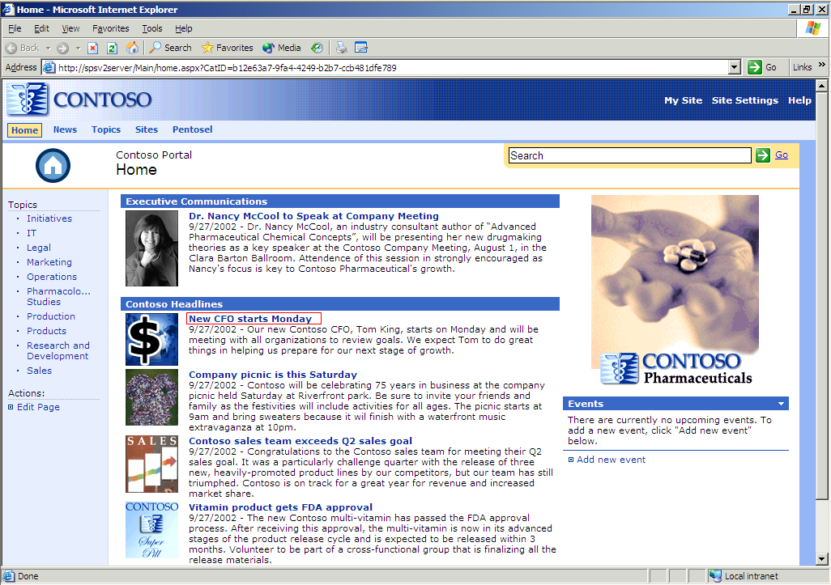
Scenario 1
Publishing Content Management Server Content To SharePoint Portal Server
Rich Web content in SharePoint Portal Server
  Page Listing Web Part
Content Management Server
SharePoint Portal Server
Editing Web content with
CMS Web Author

Slide 24
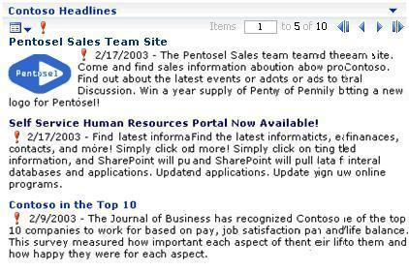
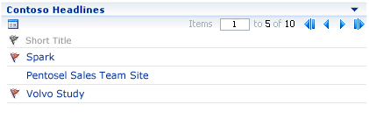
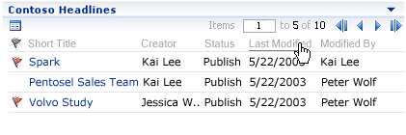
Scenario 1
Web Parts
Time/Date
Important flag
Short title
Summary
Image
Page
Description
Summary View
Basic View
Detail View
Custom Views…allow Web developers to customize/selectively display the different MCMS page properties and the placeholder contents

Slide 25
Creating A CMS Template
For SharePoint Portal Server

Slide 26
Demo
Task … is to manage content for ‘Open Job Positions’
Create a CMS Template …
Brand it to have SharePoint portal look and feel using SharePoint controls
Include a SharePoint placeholder (for Job Application Form attachment)
Create Posting
Add Web Part to Resource Topic Area / configure to consume postings from Open Job Positions Channel
Show seamless browsing between SPS and CMS

Slide 27

Architecture
Deployment Guide for Content Management Server 2002 Connector for SharePoint Products andTechnologies
Simple architecture
  Single computer
Network load balanced
  Multiple clusters
Content Viewing Requests
Content Authoring Requests
NLB
NLB
SharePoint Managed Paths … excluded Paths must include all CMS known virtual paths and top level channels.
Server Farm Running SharePoint Portal Server
SharePoint Portal Server and CMS Server Farm

Slide 28
Other Features of the MCMS Connector for SharePoint™ Technologies
Non-SharePoint sites benefit as well…
Using SharePoint Portal Server as a resource to other Web applications
  Content resource manager (i.e., “Scenario 2”)
  Search engine (i.e., “Scenario 3”)

Slide 29
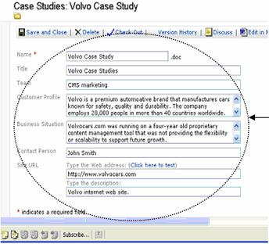
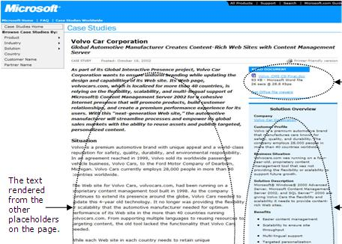
Scenario 2
Publishing SharePoint Products and Technologies document library content to Content Management Server sites
Document stored in SharePoint site’s document library, complete with metadata
Content
Syndication
Tool
Content
Management
Server
Document rendered as attachment
Windows SharePoint Services
Text rendered from other placeholders on the page
Properties rendered according to template
Notes:
A command line executable that updates mapped CMS pages with the corresponding SharePoint documents
Synchronizes all changes or just the “approved” documents
May be scheduled to perform synchronization continually
Generates a report each time it runs

Slide 30
SharePoint Placeholders
Extending the Content Management Server placeholder options
Enables a content author to select SharePoint library content and metadata to embed in a Content Management Server posting
  Documents / Images / XML files
Provide UI for locating and accessing SharePoint content at authoring time
Render document and properties based on style sheets at run-time
  Attachments
  Inline display (for images)
  HTML (for Word ML and InfoPath-produced XML files)
Allow developer direct access to data stored in placeholder
    Meta Properties / URLs / XML content / XSLT transformed versions
  Enable template customization without needing to touch the placeholder
  server control

Slide 31

Scenario 3
Search
Including Content Management Server content in enterprise wide searches
  SharePoint Portal Server crawls Web content, indexes metatags, and creates full text index
  Enables SharePoint Portal Server search Web service from Content Management Server applications
  Respects Content Management Server permissions
Content Management Server Meta Tag Control…converts Content Management Server standard and/or custom page properties into meta tags
Issues
  Incremental Indexing
  Indexed Content Management Server entries do not have ACLs
  Be careful about ASP.NET pages that adapt to user context
  Use a second entry point just for indexing if you use
  forms-based authentication
Notes:
There will be a KB article released describing how to configure your MCMS server to allow SharePoint incremental searching to run successfully

Slide 32
Summary
Content Management Server Connector for SharePoint Products and Technologies
  Integrate the content management features of Content Management Server 2002, the collaboration features of Windows SharePoint Services, and the portal features of SharePoint Portal Server 2003
  Use Web Parts to access Content Management Server features from SharePoint Products and Technologies
  Use placeholders in Content Management Server to view files stored in SharePoint document libraries
  Use the search features from SharePoint Portal Server to search Content Management Server sites
Mark Harrison
mharriso@microsoft.com
http://blog.markharrison.co.uk

Slide 33

© 2004 Microsoft Corporation. All rights reserved.
This presentation is for informational purposes only. Microsoft makes no warranties, express or implied, in this summary.

