Slide 1
Tips & Tricks for Using Key Windows Vista Native APIs from Managed Code
Windows Vista & IE7 Readiness Tour
Catherine Heller
Windows Vista Technical Evangelist

Slide 2
What We'll Cover Today
Tips & Tricks
User Account Control (UAC)
  How to make your app UAC-aware
Windows Vista Desktop Search
  How to integrate desktop search into your app
Windows Vista Win32 User Interface Elements
  How to use command links in Windows Forms
  How to use the new common file dialogs

Slide 3
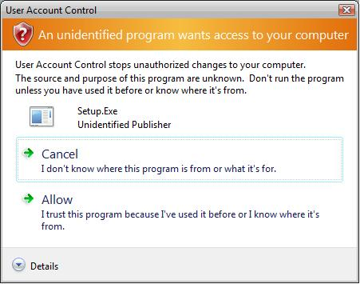
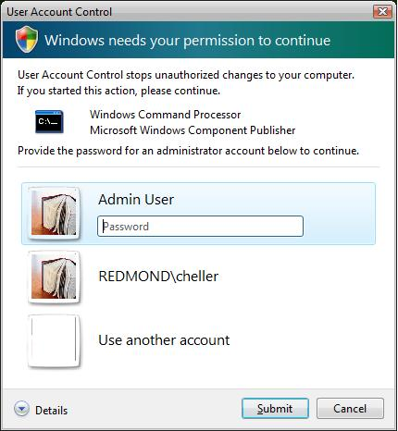
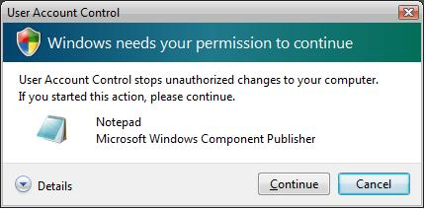

User Account Control
Feature Review
Apps run as standard user
Privilege elevation requires user consent
Security shield icon identifies privileged operations

Slide 4
Making an App "UAC-Aware"
What managed code developers need to know:
How to embed a manifest in a managed executable
How to launch an elevated process
How to set the security shield icon
How to debug UAC-aware apps in Visual Studio 2005

Slide 5
Demo: Making an App UAC-Aware
Windows Vista & IE7 Readiness Tour
Catherine Heller
Windows Vista Technical Evangelist

Slide 6
User Account Control
Windows Vista app compat review
Hidden slide: covered in demo
Registry and file system data redirection
  Redirects some write operations (system folders and HKLM\Software) to per-user virtual stores
    %userprofile%\AppData\Local\VirtualStore
    HKEY_CURRENT_USER\Software\Classes\VirtualStore
  Solely a compatibly feature for existing applications
Windows Vista applications should be “UAC-aware”
  UAC-aware apps provide an app manifest that assigns a value to the requestedExecutionLevel attribute
  Explicit request for elevation level eliminates the need for redirection

Slide 7
User Account Control
How to make an app UAC-Aware - Review
Hidden slide: covered in demo
Determine an elevation level
  Run as standard user (recommended)
  Run with user’s highest privileges
  Require administrator
Set the execution level in an app manifest
For mixed use applications
  App launches as standard user
  Privileged operations run in a separate, elevated process
  Security shield icon used to indicate privileged operations

Slide 8
User Account Control
UAC-Aware app manifest
Hidden slide: covered in demo
<?xml version="1.0" encoding="utf-8" ?>
<assembly xmlns="urn:schemas-microsoft-com:asmv.v1"
manifestVersion="1.0">
<assemblyIdentity version="1.0.0.0"
processorArchitecture="X86"
name="AppName"
type="win32" />
<description>App Description</description>
<trustInfo xmlns="urn:schemas-microsoft.com:asm.v2">
<security>
<requestedPrivileges>
<requestedExecutionLevel level="asInvoker" />
</requestedPrivileges>
</security>
</trustInfo>
</assembly>
requestedExecutionLevel
requireAdministrator
highestAvailable
asInvoker

Slide 9
User Account Control
How to embed a manifest in a managed assembly
Hidden slide: covered in demo
Option #1 – Step-by-step approach
  Create a native resource script file (AppName.rc)
#define RT_MANIFEST 24
#define APP_MANIFEST 1
APP_MANIFEST RT_MANIFEST AppName.exe.manifest
  Compile the resources using the resource compiler (rc.exe)
  rc.exe AppName.rc
  Embed the resources to the executable during build process
Compiler options for command line builds
  csc /win32res:AppName.res AppName.cs
  vjc /win32res:AppName.res AppName.jsl
  vbc /win32resource:AppName.res AppName.vb

Slide 10
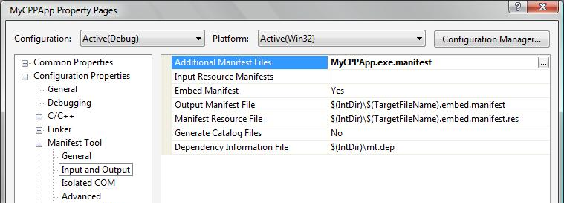
User Account Control
How to embed a manifest in a managed assembly
Hidden slide: covered in demo
Option #2 – Use mt.exe (any language)
Option #3 – Specify the manifest file in the Project Properties (C++ only)
mt.exe -manifest AppName.exe.manifest
–outputresource:AppName.exe;#1

Slide 11
User Account Control
Tips for building with Visual Studio 2005
Hidden slide: covered in demo
MSBuild command for including native resources
  <PropertyGroup>
  <Win32Resource>AppName.res</Win32Resource>
  </PropertyGroup>
Supported in C# and VB projects
To add the command from within Visual Studio 2005
  Unload the project (right click and select Unload Project)
  Edit the project (right click and select Edit <project name>)
  Save and close the project file
  Reload the project (right click and select Reload Project)
Note: you can safely ignore the schema error that is displayed for the <Win32Resource> element

Slide 12
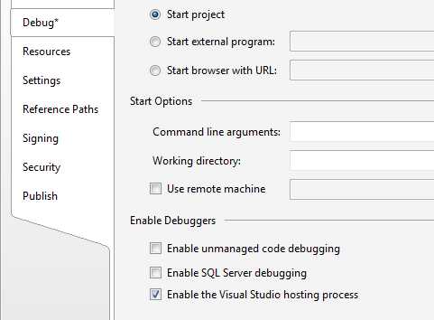
User Account Control
Tips for debugging in Visual Studio 2005
Hidden slide: covered in demo
To debug a standard user app (without UAC data redirection), disable the debugging host process
  Project properties
To debug a process that requires elevation, launch Visual Studio elevated
  Right click on the VS app icon and select Run as administrator

Slide 13
User Account Control
Setting the security shield icon
Hidden slide: covered in demo
Interop definitions for the BCM_SETSHIELD message
// Use standard SendMessage override
// (LRESULT)SNDMSG(hwnd,BCM_SETSHIELD,0,(LPARAM)fSet)
[DllImport("user32.dll")]
static extern IntPtr SendMessage(HandleRef hWnd,
UInt32 Msg, IntPtr wParam, IntPtr lParam);
const uint BCM_SETSHIELD = 0x0000160C;
Calling SendMessage to set the security shield icon
void SetShieldIcon(Button Btn, bool Show)
{
SendMessage(new HandleRef(Btn, Btn.Handle),
BCM_SETSHIELD, IntPtr.Zero,
new IntPtr (Show ? 1 : 0));
}

Slide 14
User Account Control
Launching an elevated process
Hidden slide: covered in demo
There is no way to elevate a running process
You can programmatically launch a new elevated process
  ShellExecute
  COM elevation moniker
Process.Start calls ShellExecute
Process proc = new Process();
proc.StartInfo = new ProcessStartInfo();
proc.StartInfo.CreateNoWindow = true;
proc.StartInfo.UseShellExecute = true;
proc.StartInfo.FileName = "PrivilegedExe.exe";
proc.Start();

Slide 15
User Account Control
Down-level considerations
Hidden slide: additional info
UAC is available on Windows Vista and above
UAC manifest entries are ignored on previous versions of Windows
Mixed use applications
  BCM_SETSHIELD message is ignored on previous versions of Windows
  In processes that are launched elevated, explicitly check the user’s token for required privileges

Slide 16
User Account Control
Additional information
Hidden slide: additional info
User Account Control Resources for IT Professionals (TechNet Landing Page) http://www.microsoft.com/technet/windowsvista/security/uac.mspx
Developer Best Practices and Guidelines for Applications in a Least Privileged Environment http://msdn.microsoft.com/library/default.asp?url=/library/en-us/dnlong/html/AccProtVista.asp?frame=true
UAC Team blog http://blogs.msdn.com/uac
COM Elevation Moniker http://msdn.microsoft.com/library/default.asp?url=/library/en-us/com/html/1595ebb8-65af-4609-b3e7-a21209e64391.asp
Windows Vista UX Guidelines for UAC http://msdn.microsoft.com/library/default.asp?url=/library/en-us/UxGuide/UXGuide/Environment/UAC/UAC.asp
Blog entry on how to embed a manifest into a managed assembly http://blogs.msdn.com/cheller/archive/2006/08/24/718757.aspx

Slide 17
What We'll Cover Today
Tips & Tricks
User Account Control (UAC)
  How to make your app UAC-aware
Windows Vista Desktop Search
  How to integrate desktop search into your app
Windows Vista Win32 User Interface Elements
  How to use command links in Windows Forms
  How to use the new common file dialogs

Slide 18
Windows Vista Desktop Search
Feature review
Search is fully integrated in Windows Vista
  Start Menu, Control Panel, Explorer Windows
Single, built-in, client indexing platform and a new Property System
  Used by Explorer, Outlook 2007 and OneNote 2007
  Can be used by third party applications
    OLE DB Provider for Windows Search
    ISearchQueryHelper

Slide 19
Windows Desktop Search
OLE DB Provider for Windows Search
What managed code developers need to know:
The provider can be easily used from ADO.NET
  System.Data.OleDb classes
Connection string format
Query syntax

Slide 20
Demo: Using the OLE DB Provider for Windows Search
Windows Vista & IE7 Readiness Tour
Catherine Heller
Windows Vista Technical Evangelist

Slide 21
Windows Vista Desktop Search
OLE DB Provider connection string format
Hidden slide: covered in demo
Beta 2 and later
Feb CTP and previous builds
"Provider=Search.CollatorDSO;Extended
Properties=‘Application=Windows’;"
“Provider=USearch.CollatorDSO;Extended
Properties=‘Application=Windows’;"

Slide 22
Windows Vista Desktop Search
OLE DB Provider query syntax
Hidden slide: covered in demo
SELECT properties
  Column values defined by Property System Schema
  Must specify at least one property (no SELECT * )
  Property names must be enclosed in delimiters (“”)
FROM SystemIndex..Scope()
FROM machine_name.SystemIndex..Scope()
WHERE predicates
Notes:
Single qualified scope: the system catalogue.
Can also query the catalogue on remote machines
Indexer has to be running
Has to be Vista or LH Server
Search service has to be running
Have to have at least shared out one file
Permissions have to be set
Results are always trimmed to those accessible by the user issuing the query

Slide 23
Windows Vista Desktop Search
OLE DB Provider query predicates
Hidden slide: covered in demo
Simple predicates
  LIKE, NULL, and literal value comparison (=,<, >)
Full-text predicates
  CONTAINS
  FREETEXT
Other predicates
  "SCOPE“ = '[file | mapi | csc ]:path'
    Deep traversal; includes subfolders
  “DIRECTORY" = '[file | mapi | csc ]:path'
    Shallow traversal; searches only specified folder
Notes:
LIKE: Searches column values using simple pattern matching with wildcards

Slide 24
Windows Vista Desktop Search
Down-level considerations
Hidden slide: additional info
Windows Desktop Search (WDS) 3.0 will be available as a download for Windows XP SP2 and Windows Server 2003 SP1
Preview available for download
  See KB917013 for details http://support.microsoft.com/?kbid=917013

Slide 25
Windows Vista Desktop Search
Additional information
Hidden slide: additional info
Property Description Schema Definition
http://windowssdk.msdn.microsoft.com/library/?url=/library/en-us/ShellCC/platform/shell/reference/schemas/propdesc_schema/propdescentry.asp?frame=true
Properties shipping in Windows Vista http://windowssdk.msdn.microsoft.com/en-us/library/ms788673.aspx
Microsoft Enterprise Search on MSDN http://msdn.microsoft.com/library/default.asp?url=/library/en-us/dnanchor/html/EntSearch_anch.asp
Blog entries on query syntax http://blogs.msdn.com/cheller/archive/2006/06/27/649120.aspx http://blogs.msdn.com/cheller/archive/2006/06/21/642220.aspx
Windows Desktop Search 3.0 Reference http://windowssdk.msdn.microsoft.com/en-us/library/aa361164.aspx
Property System Overview http://windowssdk.msdn.microsoft.com/en-us/library/ms649535.aspx
Notes:
Current version of WDS for XP is Windows Desktop Search 2.6.5

Slide 26
What We'll Cover Today
Tips & Tricks
User Account Control (UAC)
  How to make your app UAC-aware
Windows Vista Desktop Search
  How to integrate desktop search into your app
Windows Vista Win32 User Interface Elements
  How to use command links in Windows Forms
  How to use the new common file dialogs

Slide 27
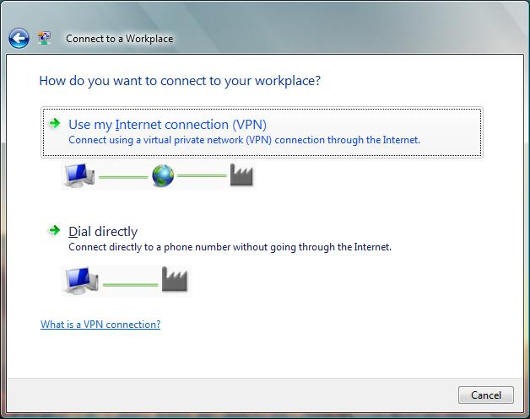
Command Link
Feature Review
New Win32 UI element in Windows Vista
  New button style (BS_COMMANDLINK)
  New button messages (BCM_SETNOTE, BCM_GETNOTE)

Slide 28
Using Command Links in Windows Forms
What you need to know:
How to add the BS_COMMANDLINK style
How to call the BCM_SETNOTE message
How to provide design-time support (optional)

Slide 29
Demo: Using Command Links in Windows Forms
Windows Vista & IE7 Readiness Tour
Catherine Heller
Windows Vista Technical Evangelist

Slide 30
Windows Vista Win32 UI Elements
Using command links in Windows Forms - Review
Hidden slide: covered in demo
Set the necessary button styles
  Add BS_COMMANDLINK during button creation
  Set FlatStyle property to FlatStyle.System
Set the note text
  Send the BCM_SETNOTE message by calling SendMessage
Provide design-time support (optional)
  Enable note text to be set at design time
  Enable the security shield to be set at design time
  Provide a default width

Slide 31
Command Links in Windows Forms
Setting the necessary styles
Hidden slide: covered in demo
BS_COMMANDLINK : add during button creation
Set FlatStyle property to FlatStyle.System
public class CommandLink : System.Windows.Forms.Button
{
public CommandLink() { this.FlatStyle = FlatStyle.System }
protected override CreateParams CreateParams
{
get
{
CreateParams cp = base.CreateParams;
cp.Style |= BS_COMMANDLINK;
return (cp);
}
}
}
Notes:
FAQ. Why do I need to set the FlatStyle property to System?
This enables the appearance of the control to be determined by the user's operating system.
Note that the following property values will be ignored: BackgroundImage, ImageAlign, Image, ImageIndex, ImageList, and TextAlign.
In addition, BackColor property is ignored for button controls
http://msdn2.microsoft.com/en-us/library/system.windows.forms.flatstyle.aspx
Subclass the button class
Override the CreateParams property and add the style

Slide 32
Command Links in Windows Forms
Setting the note text
Hidden slide: covered in demo
Interop definitions for the BCM_SETNOTE message
// SendMessage override for BCM_SETNOTE message
// (BOOL)SNDMSG(hwnd, BCM_SETNOTE, 0, (LPARAM)sz)
[DllImport("user32.dll", CharSet = CharSet.Unicode)]
static extern IntPtr SendMessage(HandleRef hWnd,
UInt32 Msg, IntPtr wParam, string lParam);
const uint BCM_SETNOTE = 0x00001609;
Calling SendMessage to set the note text
void SetNote(string NoteText)
{
SendMessage(new HandleRef(this, this.Handle),
BCM_SETNOTE, IntPtr.Zero, NoteText);
}

Slide 33
Command Links in Windows Forms
Providing design-time support
Hidden slide: covered in demo
Enable the note text to be set at design-time
[Category("Appearance")]
[Description("Specifies the supporting note text.")]
[BrowsableAttribute(true)]
public string NoteText
{
get { return (GetNote()); }
set
{
SetNote(value);
}
}

Slide 34
Command Links
Additional information
Hidden slide: additional info
New button styles and messages defined in commctrl.h (available in the Windows SDK)
  See %sysdrive%\Program Files\Microsoft SDKs\Windows\v6.0\include
SendMessage interop definition on PInvoke wiki
  http://www.pinvoke.net/default.aspx/user32/SendMessage.html
Details on the FlatStyle.System style http://msdn2.microsoft.com/en-us/library/system.windows.forms.flatstyle.aspx
UI guidelines for using command links in dialog boxes
http://msdn.microsoft.com/library/?url=/library/en-us/UxGuide/UXGuide/Windows/DialogBoxes/DialogBoxes.asp?frame=true#commandLinks

Slide 35
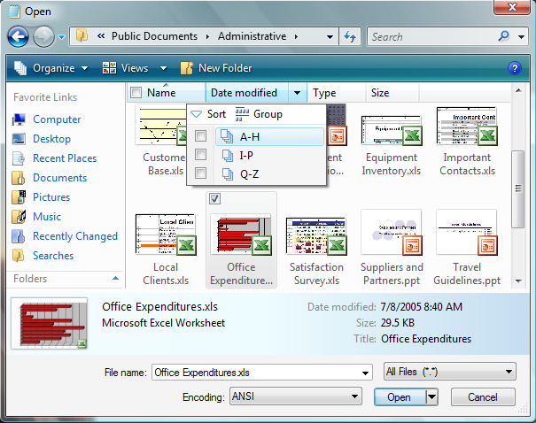
Windows Vista File Open Dialog
Anatomy of a Dialog Box
“friendly” address bar
enhanced column headers: sort, group and filter
Instant Search box
Live Icons
navigation buttons
Command bar (for context-based tasks)
extensible
Favorite Links
file properties
Details Pane
custom controls

Slide 36
Common File Dialogs – The API Story
New COM API
  IFileDialog, IFileOpenDialog, IFileSaveDialog
  IFileDialogEvents, IFileDialogControlEvents
  IFileDialogCustomize
Existing Win32 API
  GetOpenFileName / Get SaveFileName functions
  Still supported on Windows Vista
  Displays new Windows Vista dialogs (unless certain customization options are specified)

Slide 37
Using the New Common File Dialogs
What you need to know:
Windows Forms and WPF wrap the Win32 APIs - and they both provide a customization
To get the new dialogs, you must change your code
Current COM interop challenges

Slide 38
Using the New Common File Dialogs
Current COM interop challenges
Additional work is needed before you can call “Add Reference…”
  No interop assembly available
The new COM APIs are standard v-table based interfaces (i.e. they do not support IDispatch)
  Defined in IDL
  No type library available
Also applies to other new COM APIs
  KnownFolders API, Property Provider API, etc

Slide 39
Using the New Common File Dialogs
Options for managed code developers
Advanced techniques
  Hand-craft the interop definitions
  Build a managed wrapper using C++
More approachable options
  PInvoke to Win32 APIs
  Use the Windows “Vista Bridge” SDK samples!

Slide 40
Demo: Using the New Common File Dialogs
Windows Vista & IE7 Readiness Tour
Catherine Heller
Windows Vista Technical Evangelist

Slide 41
Windows Vista Win32 UI Elements
Down-level considerations
Hidden slide: additional info
Command links and the new common file dialogs are available on Windows Vista and above
  Can be added to existing apps and conditionally used when running on Windows Vista and above

Slide 42
Windows Vista Win32 UI Elements
Additional information
Hidden slide: additional info
Windows Vista User Experience Guidelines
http://msdn.microsoft.com/library/?url=/library/en-us/UxGuide/UXGuide/Home.asp?frame=true
PInvoke.NET Wiki http://www.pinvoke.net
Vista Bridge SDK Samples http://windowssdk.msdn.microsoft.com/en-us/library/ms756482.aspx

Slide 43
Summary
Many valuable Windows Vista features are currently exposed only through native APIs
  These features can be used from managed code
Existing tools can be used today
  Better tool support will be available in future releases of Visual Studio
New Win32 UI elements can be used to make your apps look more like a Windows Vista app
Interoping with some of the new COM APIs can be challenging
  The Windows “Vista Bridge” SDK Samples demonstrate many interop techniques in detail

Slide 44


© 2006 Microsoft Corporation. All rights reserved. This presentation is for informational purposes only.
MICROSOFT MAKES NO WARRANTIES, EXPRESS OR IMPLIED, IN THIS SUMMARY.

