Slide 1



Visual C++ “Whidbey”:
New Language Design And Enhancements
Session Code: TLS310
Herb Sutter
Architect, Microsoft Visual C++
hsutter@microsoft.com

Slide 2


Quake II Takeaways
960x720 + software-rendered on 1.2GHz PIII-M + Fx 1.1.4322
1. It’s easy to port C/C++ code to .NET:
100% JITted (IL) code; still native data
  Just rebuild with /clr
  1 day to port the entire Quake 2 source base. (Nearly all of the effort was to translate from C to C++, and had nothing to do with our compiler or the .NET platform)
2. It’s not hard to extend existing code
with CLR types
  2 days to implement the radar extension using Fx (gradient brushes, window transparency/opacity, Matrix.RotateAt)
3. It needs to be still easier, more natural,
and “first-class” to use C++ on the CLR

Slide 3
Overview
1. Rationale and Goals
2. Language Tour
3. Design and Implementation Highlights
  Unifications: Type system, pointer and storage system (stack, native heap, gc heap), boxing
  Deterministic cleanup: Destruction/Dispose, finalization, copying/assignment
  Generics × templates, STL on CLR
  Mixing native/CLR, other features
4. C++/CLI Standardization
  Venue, players, timelines

Slide 4
Rationale
C++: First-class .NET development language
  Remove “Why Can’t I” usability and migration barriers:
  Port and extend existing programs even more seamlessly
  Key Q: “Why should a .NET developer use C++?”
  Deliver promise of CLR
"Managed C++" doesn’t get us there:
  Great for basic interop, migrating existing code to .NET
  Second-class CLR support (e.g., __property)
  Poor integration of C++ and CLR features and idioms (e.g., no templates of CLR types)
  Hard to write pure (verifiable, secure) .NET apps
  Ugly and nonintuitive syntax, uneven and contorted semantics. Failed to achieve a natural, organic,
  “everything in its place” surfacing of features
  Low adoption. And those who do adopt still need to hand-wire way too much

Slide 5
Major Goals
Feature coverage:
  Provide organic first-class support for CLR features/idioms
    Example: Verifiability at first try in this
    complete program:
  int main() { System::Console::WriteLine( "Hello, world!" ); }
  Leave no room for a language lower than C++ (incl. IL)
Usability and adoptability:
  More elegant syntax, natural & pure extensions to ISO C++
C++ × CLR:
  "Bring C++ to .NET": Support C++’s powerful features also for CLR types (e.g., deterministic cleanup, templates)
  "Bring .NET to C++": Support the CLR’s powerful features also for native types (e.g., verifiability, garbage collection)

Slide 6
Overview
1. Rationale and Goals
2. Language Tour
3. Design and Implementation Highlights
  Unifications: Type system, pointer and storage system (stack, native heap, gc heap), boxing
  Deterministic cleanup: Destruction/Dispose, finalization, copying/assignment
  Generics × templates, STL on CLR
  Mixing native/CLR, other features
4. C++/CLI Standardization
  Venue, players, timelines

Slide 7


Basic Class Declaration Syntax
Type are declared “adjective class”:
  class N { /*…*/ }; // native
  ref class R { /*…*/ }; // CLR reference type
  value class V { /*…*/ }; // CLR value type
  interface class I { /*…*/ }; // CLR interface type
  enum class E { /*…*/ }; // CLR enumeration type
  C++ and .NET fundamental types are mapped to each other (e.g., int and System::Int32 are the same type)
Any type can:
  Have a destructor ~T(), and/or finalizer !T()
  Have a copy constructor, and/or copy assignment operator:
    Value class always have them. Native classes have them by default. Ref classes do not have them by default
  Be templated, or be used to instantiate a template
  (More on each of these later on)

Slide 8
Properties
Basic syntax:
  ref class R {
  int mySize;
  public:
  property int Size {
  int get() { return mySize; }
  void set( int val ) { mySize = val; }
  }
  };
  R r;
  r.Size = 42; // use like a field; calls r.Size::set(42)
Trivial properties:
  ref class R {
  public:
  property int Size; // compiler-generated
  }; // get, set, and backing store

Slide 9
Indexed Properties
Indexed syntax:
  ref class R { // …
  map<String^,int>* m;
  public:
  property int Lookup[ String^ s ] {
  int get() { return (*m)[s]; }
  protected:
  void set( int ); // defined out of line below
  }
  property String^ default[ int i ] { /*…*/ }
  };
  void R::Lookup[ String^ s ]::set( int v ) { (*m)[s] = v; }
Call point:
  R r;
  r.Lookup["Adams"] = 42; // r.Lookup[“Adams”].set(42)
  String^ s = r[42]; // r.default[42].get()

Slide 10
Delegates and Events
A trivial event:
  delegate void D( int );
  ref class R {
  public:
  event D^ e; // trivial event; compiler-generated members
  void f() { e( 42 ); } // invoke it
  };
  R r;
  r.e += gcnew D( this, &SomeMethod );
  r.e += gcnew D( SomeFreeFunction );
  r.f();
Or you can write add/remove/raise yourself

Slide 11
Virtual Functions and Overriding
Explicit, multiple, and renamed overriding:
  interface class I1 { int f(); int g(); };
  interface class I2 { int f(); int h(); };
  interface class I3 { int h(); int i(); };
  ref class R : I1, I2, I3 {
  public:
  virtual int ff() override; // error, there is no virtual ff()
  virtual int f() sealed; // overrides & seals I1::f and I2::f
  virtual int x() = I1::g; // overrides I1::g
  virtual int y1() = I2::h; // overrides I2::h
  virtual int z() = i, I3::h; // overrides I3::h and I3::i
  virtual int a() abstract; // same as “= 0” (for symmetry
  with class declarations)
  virtual int i() new; // new slot, doesn’t override I3::i
  };

Slide 12
Overview
1. Rationale and Goals
2. Language Tour
3. Design and Implementation Highlights
  Unifications: Type system, pointer and storage system (stack, native heap, gc heap), boxing
  Deterministic cleanup: Destruction/Dispose, finalization, copying/assignment
  Generics × templates, STL on CLR
  Mixing native/CLR, other features
4. C++/CLI Standardization
  Venue, players, timelines

Slide 13
Unified Storage/Pointer Model
Semantically, a C++ program can create object of any type T in any storage location:
  On the native heap: T* t1 = new T;
    As usual, pointers (*) are stable, even during GC
    As usual, failure to explicitly call delete will leak
  On the gc heap: T^ t2 = gcnew T;
    Handles (^) are object references (to whole objects)
    Calling delete is optional: "Destroy now, or finalize later."
  On the stack, or as a class member: T t3;
    Q: Why would you? A: Next section: Deterministic destruction/dispose is automatic and implicit, hooked to stack unwinding or to the enclosing object’s lifetime
Physically, an object may exist elsewhere

Slide 14
Pointers
Native pointers (*) and handles (^):
  ^ is like *, except ^ points to a whole object on the gc heap, can’t be ordered, and can’t be cast to void* (or integral type) and back. (There is no void^.)
  Widget* s1 = new Widget; // point to native heap
  Widget^ s2 = gcnew Widget; // point to gc heap
  s1->Length(); // use -> for member access
  s2->Length();
  (*s1).Length(); // use * to dereference
  (*s2).Length();
Use RAII pin_ptr to get a * into the gc heap:
  R^ r = gcnew R;
  int* p1 = &r->v; // error, v is a gc-lvalue
  pin_ptr<int> p2 = &r->v; // ok
  CallSomeAPI( p2 ); // safe call, CallSomeAPI( int* )

Slide 15
References And Unary &/%
Native (&) and tracking (%) references:
  % is like &, except % can refer into any memory area incl. the gc heap (and for now a % can only exist on the stack)
  String& s3 = *s1; // bind
  String% s4 = *s2; // bind & track
  s3.Length(); // reference syntax with
  s4.Length();
  void swap( Object^% o1, Object^% o2 ) // C# “ref”
  { Object^ tmp = o1; o1 = o2; o2 = tmp; }
Unary & and % for “address of”:
  &myobj → MyType* (or interior_ptr<MyType>, when myobj is physically on the gc heap)
  %myobj → MyType^.

Slide 16
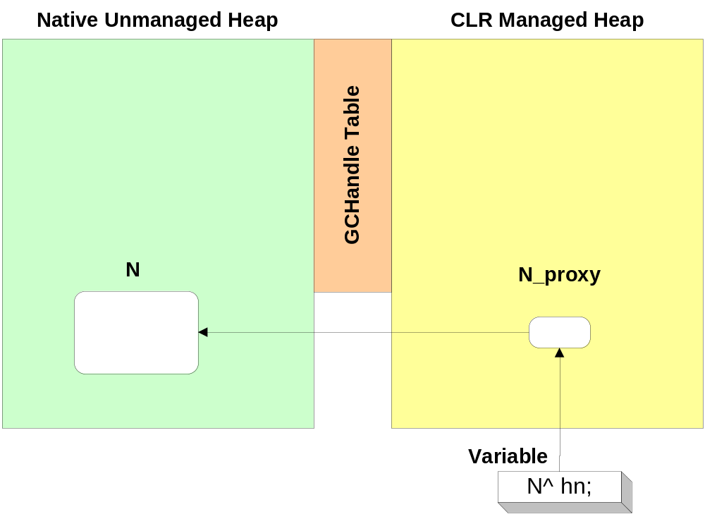
Native On The GC Heap
Create a proxy for native object on gc heap
  The proxy’s finalizer will call the destructor if needed
  N^ hn = gcnew N; // native object on gc heap

Slide 17
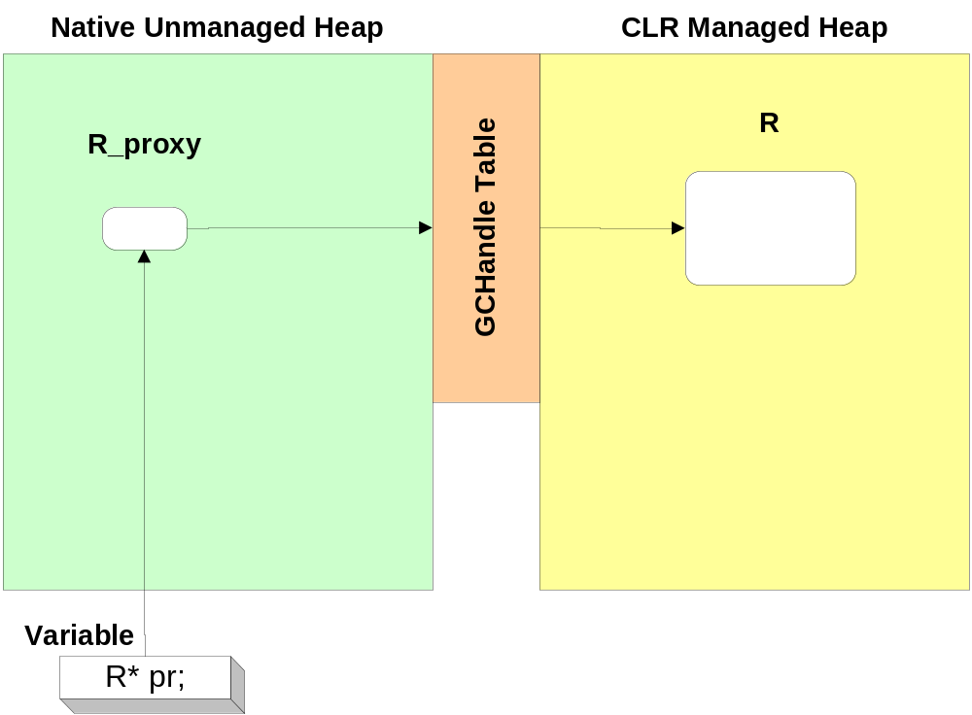

Ref Class On Native Heap
Already implemented as gcroot template
  No finalizer will ever run. Example:
  R* pr = new R; // ref object on native heap

Slide 18
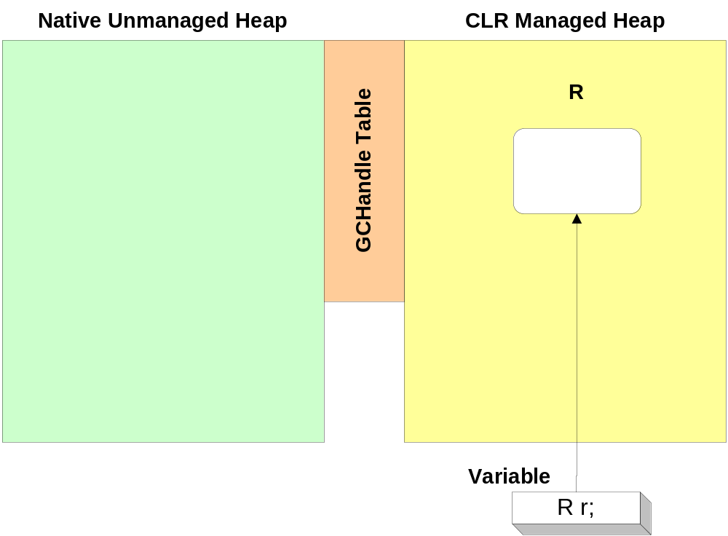
Ref Class On The Stack
The type of “%R” is R^.
  R r; // ref object on stack
  f( %r ); // call f( Object^ )

Slide 19
Boxing (Value Types)
Boxing is implicit and strongly typed:
  int^ i = 42; // strongly typed boxed value
  Object^ o = i; // usual derived-to-base conversions ok
  Console::WriteLine( "Two numbers: {0} {1}", i, 101 );
  i is emitted with type Object + attribute marking it as int.
  WriteLine chooses the Object overload as expected
  Boxing invokes the copy constructor
Unboxing is explicit:
  Dereferencing a V^ indicates the value inside the box, and this syntax is also used for unboxing:
  int k = *i; // unboxing to take a copy
  int% i2 = *i; // refer into the box (no copy)
  swap( *i, k ); // swap contents of box with stack variable
  // (no copy, modifies the contents of box)

Slide 20
Aside: Agnostic Templates
To demonstrate the unification, consider agnostic templates
Example 1: Usual swap, with % instead of &
  template<class T>
  void swap( T% t1, T% t2 )
  { T tmp( t1 ); t1 = t2; t2 = tmp; }
  Works for any copyable T:
  Object ^o1, ^o2; swap( o1, o2 ); // swap handles
  int ^i1, ^i2; swap( i1, i2 ); // swap handles
  swap( *i1, *i2 ); // swap values
  MessageQueue *q1, *q2; swap( q1, q2 ); // swap pointers
  swap( *q1, *q2 ); // swap values
  ref class R { } r1, r2; swap( r1, r2 ); // swap values*
  value class V { } v1, v2; swap( v1, v2 ); // swap values
  class Native { } n1, n2; swap( n1, n2 ); // swap values*
  * assuming copy construction/assignment are defined

Slide 21
Overview
1. Rationale and Goals
2. Language Tour
3. Design and Implementation Highlights
  Unifications: Type system, pointer and storage system (stack, native heap, gc heap), boxing
  Deterministic cleanup: Destruction/Dispose, finalization, copying/assignment
  Generics × templates, STL on CLR
  Mixing native/CLR, other features
4. C++/CLI Standardization
  Venue, players, timelines

Slide 22
Cleanup: Less Code, More Control
The CLR state of the art is great for memory
It’s not great for other resource types:
  Having lots of finalizers doesn’t scale, and usually the finalizer is run too late. Examples: files, database connections, locks
  The Dispose pattern (try-finally, or C# “using”) tries to address this, but is fragile, error-prone, and requires the user to write more code
Instead of writing try-finally or using blocks:
  Users can leverage a destructor. The C++ compiler generates all the Dispose code automatically, including chaining calls to Dispose. (There is no Dispose pattern)
  Types authored in C++ are naturally usable in other languages, and vice versa
  C++ choice: Correctness by default, speed by choice.
  (Other langs: Speed by default, correctness by choice)

Slide 23
Uniform Destruction/Finalization
Every type can have a destructor, ~T():
  Non-trivial destructor == IDispose. Implicitly run when:
    A stack based object goes out of scope
    A class member’s enclosing object is destroyed
    A delete is performed on a pointer or handle. Example:
    Object^ o = f();
    delete o; // run destructor now, collect memory later
Every type can have a finalizer, !T():
  The finalizer is executed at the usual times and subject to
  the usual guarantees, if the destructor has not already run
  Programs should (and do by default) use deterministic cleanup. This promotes a style that reduces
  finalization pressure
  “Finalizers as a debugging technique”: Placing assertions or log messages in finalizers to detect objects not destroyed

Slide 24
Deterministic Cleanup In C++
C++ example:
  void Transfer() {
  MessageQueue source( "server\\sourceQueue" );
  String^ qname = (String^)source.Receive().Body;
  MessageQueue dest1( "server\\" + qname ),
  dest2( "backup\\" + qname );
  Message^ message = source.Receive();
  dest1.Send( message );
  dest2.Send( message );
  }
  On exit (return or exception) from Transfer, destructible/ disposable objects have Dispose implicitly called in reverse order of construction. Here: dest2, dest1,
  and source
  No finalization

Slide 25
Deterministic Cleanup In C#
Minimal C# equivalent:
  void Transfer() {
  using( MessageQueue source
  = new MessageQueue( "server\\sourceQueue" ) ) {
  String qname = (String)source.Receive().Body;
  using( MessageQueue
  dest1 = new MessageQueue( "server\\" + qname ),
  dest2 = new MessageQueue( "backup\\" + qname ) ) {
  Message message = source.Receive();
  dest1.Send( message );
  dest2.Send( message );
  }
  }
  }

Slide 26
Deterministic Cleanup In VB/Java
Minimal VB/Java equivalent (in C# syntax):
  void Transfer() {
  MessageQueue source = null, dest1 = null, dest2 = null;
  try {
  source = new MessageQueue( "server\\sourceQueue" );
  String qname = (String)source.Receive().Body;
  dest1 = new MessageQueue( "server\\" + qname );
  dest2 = new MessageQueue( "backup\\" + qname );
  Message message = source.Receive();
  dest1.Send( message );
  dest2.Send( message );
  }
  finally {
  if( dest2 != null ) { dest2.Dispose(); }
  if( dest1 != null ) { dest1.Dispose(); }
  if( source != null ) { source.Dispose(); }
  }
  }

Slide 27
Overview
1. Rationale and Goals
2. Language Tour
3. Design and Implementation Highlights
  Unifications: Type system, pointer and storage system (stack, native heap, gc heap), boxing
  Deterministic cleanup: Destruction/Dispose, finalization, copying/assignment
  Generics × templates, STL on CLR
  Mixing native/CLR, other features
4. C++/CLI Standardization
  Venue, players, timelines

Slide 28
Generics × Templates
Both are supported, and can be used together
Generics:
  Run-time, cross-language, and cross-assembly
  Constraint based, less flexible than templates
  Will eventually support many template features
Templates:
  Compile-time, C++, and generally intra-assembly
  (a template and its specializations in one assembly
  will also be available to friend assemblies)
  Intra-assembly is not a high burden because you can
  expose templates through generic interfaces (e.g., expose a_container<T> via IList<T>)
  Supports specialization, unique power programming idioms (e.g., template metaprogramming, policy-based design, STL-style generic programming)

Slide 29
Generics
Generics are declared much like templates:
  generic<typename T>
  where T : IDisposable, IFoo
  ref class GR { // …
  void f() {
  T t;
  t.Foo();
  } // call t.~T() implicitly
  };
  Constraints are inheritance-based
Using generics and templates together works
  Example: Generics can match template template params
  template< template<class> class V > // a TTP
  void f() { V<int> v; /*...use v...*/ }
  f<GR>(); // ok, matches TTP

Slide 30
STL On The CLR
C++ enables STL on CLR:
  Verifiable
  Separation of collections and algorithms
Interoperates with Frameworks library
C++ “for_each” and C# “for each” both work:
  stdcli::vector<String^> v;
  for_each( v.begin(), v.end(), functor );
  for_each( v.begin(), v.end(), _1 += “suffix” ); // C++
  for_each( v.begin(), v.end(), cout << _1 ); // lambdas
  g( %v ); // signature of g is g( IList<String^>^ )
  for each (String^ s in v) Console::WriteLine( s );

Slide 31
Overview
1. Rationale and Goals
2. Language Tour
3. Design and Implementation Highlights
  Unifications: Type system, pointer and storage system (stack, native heap, gc heap), boxing
  Deterministic cleanup: Destruction/Dispose, finalization, copying/assignment
  Generics × templates, STL on CLR
  Mixing native/CLR, other features
4. C++/CLI Standardization
  Venue, players, timelines

Slide 32
CLR Types In The Native World
Basic interop example:
  class Data {
  XmlDocument* xmlDoc;
  public:
  void Load( std::string fileName ) {
  XmlTextReader^ reader = gcnew XmlTextReader(
  marshal_as<String^>( fileName ) );
  xmlDoc = new XmlDocument( reader );
  }
  };

Slide 33
CLR Types In The Native World (2)
Template<Ref> example:
  template<class T>
  void AFunctionTemplate( T ) { /*…*/ };
  ref class Ref { /*…*/ };
  Ref ref;
  AFunctionTemplate( ref ); // ok
Of course, any type can be templated:
  template<class T>
  ref class ARefTemplate { /*…*/ }; // ok

Slide 34
Native Types In The CLR World
Basic interop example:
  ref class MyControl : UserControl { //… // reference type
  std::vector<std::string>* words; // use native type
  public:
  void Add( String^ s ) { Add( marshal_as<std::string>(s)); }
  void Add( std::string s ) { words->push_back(s); }
  };

Slide 35
What Customers Are Doing
Example 1: Quake 2 extension example
(using v1 syntax):
  private __gc class RadarForm
  : public System::Windows::Forms::Form
  {
  std::vector<RadarItem>* m_items;
  public:
  RadarForm() : m_items( new std::vector<RadarItem> )
  { /*…*/ };
  ~RadarForm() { delete items; } // v1 finalizer syntax
  // … etc.
  };
  Their first attempt was without the * (embed the vector member), but that wasn’t allowed

Slide 36
What Customers Are Doing (2)
Example 2: Faking up base classes
(e.g., expose native types to a CLR world)
  private __gc class C { // can’t inherit from Native, so…
  Native* n;
  public:
  C() : n( new Native ) { /*…*/ };
  ~C() { delete n; }
  void Foo( /*… a param list …*/ ) { n->Foo( /*…*/ ); }
  void Bar( /*… a param list …*/ ) { n->Bar( /*…*/ ); }
  // etc.
  };

Slide 37
Future: Unified Type System, Object Model
Arbitrary combinations of members and bases:
  Any type can contain members and/or base classes of any other type. Virtual dispatch etc. work as expected
    At most one base class may be of ref/value/mixed type
  Overhead (regardless of mixing complexity, including deep inheritance with mixing & virtual overriding at each level):
    For each object: At most one additional object
    For each virtual function call: At most one additional virtual function call
Pure type:
  The declared type category, members, and bases are
  either all CLR, or all native
Mixed type:
  Everything else. Examples:
  ref class Ref : R, public N1, N2 { string s; };
  class Native : I1, I2 { MessageQueue m; };

Slide 38
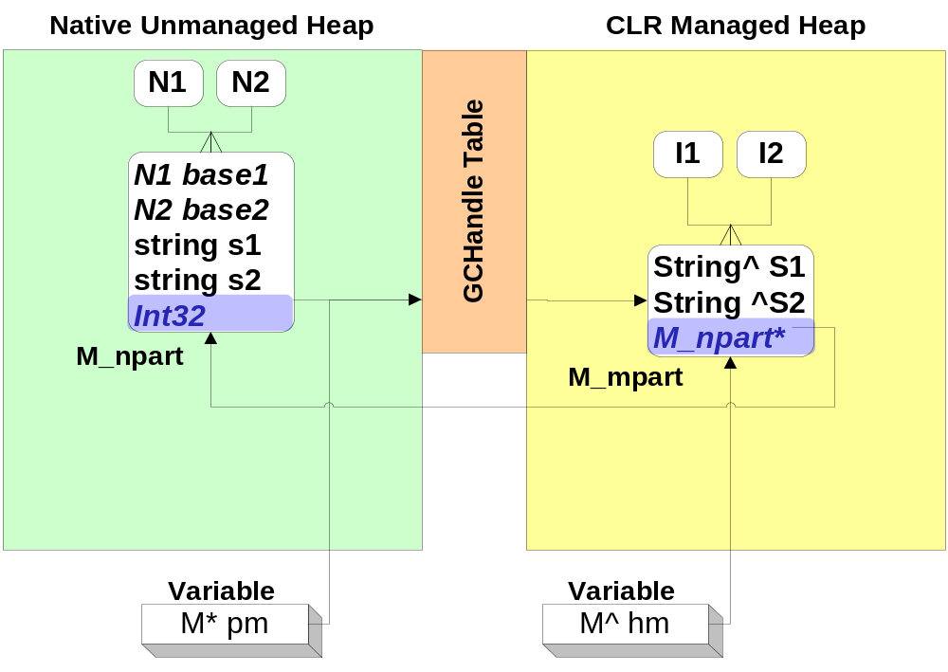
Future: Implementing Mixed Types
1 mixed = 1 pure + 1 pure
  ref class M : I1, I2, N1, N2 {
  System::String ^S1, ^S2; M* pm = new M;
  std::string s1, s2; M^ hm = gcnew M;
  };

Slide 39
Future: Result For Customer Code
  V1 Syntax:
  private __gc class RadarForm :
  public System::Windows::Forms::Form
  {
  std::vector<RadarItem>* m_items;
  Native* n;
  public:
  RadarForm() :
  : n( new Native )
  , m_items( new std::vector<RadarItem> )
  { /*…*/ };
  ~RadarForm() { delete items; delete n; }
  void Foo( /*… params …*/ )
  { n->Foo( /*…*/ ); }
  void Bar( /*… params …*/ )
  { n->Bar( /*…*/ ); }
  // etc.
  };
  V2 Syntax:
  ref class RadarForm
  : System::Windows::Forms::Form
  , public Native
  {
  std::vector<RadarItem> m_items;
  };
  One safe automated allocation, vs. N fragile handwritten allocations
  This class is also better because it also has a destructor (implements IDisposable). That makes it work well by default with C++ automatic stack semantics (and C# using blocks)

Slide 40
Other Features
Param arrays:
  Created when needed, preferred over varargs
  void f( String^ str, ... array<Object^>^ arr );
Unified CLR and C++ operators:
  Operators can now be static. Most work on handles
  ref class R { public: // ...
  static R^ operator+( R^ lhs, R^ rhs );
  };
  Equality tests reference identity. Can be overridden by user
Delegating constructors
XML doc comments

Slide 41
Overview
1. Rationale and Goals
2. Language Tour
3. Design and Implementation Highlights
  Unifications: Type system, pointer and storage system (stack, native heap, gc heap), boxing
  Deterministic cleanup: Destruction/Dispose, finalization, copying/assignment
  Generics × templates, STL on CLR
  Mixing native/CLR, other features
4. C++/CLI Standardization
  Venue, players, timelines

Slide 42
Why Standardize C++/CLI?
Primary motivators for C++/CLI standard:
  Stability of language
  C++ community understands and demands standards
  Openness promotes adoption
  Competing implementations should interoperate
Same TC39, new TG5: C++/CLI
  ISO C++ is still important to Visual C++. We remain actively involved in ISO WG21 and tracking ISO C++
  C++/CLI is a binding between C++ and CLI only

Slide 43
C++/CLI: People And Timeline
Who’s who:
  Convener: Tom Plum
  Project Editor: Rex Jaeschke
  Participants: Dinkumware, EDG, IBM, HP, Plum Hall
  Independent conformance test suite: Plum Hall
ECMA + ISO process:
  October 1, 2003: ECMA TC39 plenary. Kick off TG5
  December 2004: Adopt ECMA standard
  December 2004: Kick off ISO fast-track process
  December 2005: Adopt ISO standard

Slide 44
Overview
1. Rationale and Goals
2. Language Tour
3. Design and Implementation Highlights
  Unifications: Type system, pointer and storage system (stack, native heap, gc heap), boxing
  Deterministic cleanup: Destruction/Dispose, finalization, copying/assignment
  Generics × templates, STL on CLR
  Mixing native/CLR, other features
4. C++/CLI Standardization
  Venue, players, timelines

Slide 45
Summary: C++ × CLR
C++ features:
  Deterministic cleanup, destructors
  Templates
  Native types
  Multiple inheritance
  STL, generic algorithms, lambda expressions
  Pointer/pointee distinction (referring into boxes)
  Copy construction, assignment
CLR features:
  Garbage collection, finalizers
  Generics
  CLR types
  Interfaces
  Verifiability
  Security
  Properties, delegates, events

Slide 46
The Two FAQs
Q: Why should a C++ programmer use .NET?
  GC, reflection, serialization, XML, etc. for existing projects
  Full and easy access to the rich platform
Q: Why should a .NET programmer use C++?
  Easiest migration for existing code base: "Just use /clr."
  Deterministic (and automatic) cleanup as usual in C++,
  no coding patterns
  Easiest and most efficient native interop, incl. mixed types
  Leverage C++’s unique strengths (e.g., templates, generic programming, multiple inheritance, deterministic resource management and cleanup)
  Now not significantly harder or uglier than other languages

Slide 47
Community Resources
Get Your Questions Answered!
Newsgroups:
  microsoft.public.dotnet.languages.vc
Lounge: 309 Foyer
  connect with Microsoft product teams, and PDC 2003 Speakers
Ask The Experts:
  Tuesday 7 pm – 9 pm in Hall G,H
Web Sites:
  http://pdcbloggers.net
  http://msdn.microsoft.com/pdc/

Slide 48

© 2003-2004 Microsoft Corporation. All rights reserved.
This presentation is for informational purposes only. Microsoft makes no warranties, express or implied, in this summary.

Slide 49
