Slide 1



Visual C++ “Whidbey”: Advanced Code Generation
Session Code: TLS400
Kang Su Gatlin
VC++ Program Manager
Microsoft Corporation
kanggatl@microsoft.com

Slide 2

Top 5 Reasons Why You’re At This Talk
Your inner-loop took six cycles per iteration instead of four… and that gets you mad
You’re the “wolf”… the one they bring in when performance counts
You realize saving 10 seconds in a program used by a million users is 115 days saved
You read Itanium assembly for fun… obviously this talk looked interesting
You care about generating good code… and that is what Visual C++ does

Slide 3
Agenda
A Very Quick Refresher Course
WPO & PGO
Multithreading Support
Alias Hints
Floating Point Model
Security
Optimizations for MSIL Code
64bit Code Generation

Slide 4

A Refresher Slide And Quick Tips
There are a some things that many people still don’t do
  It’s OK to use /O2!
  /Gy is generally useful (con: slows link time)
    /DEBUG /INCREMENTAL:NO /OPT:REF /OPT:ICF
VC++ 2002 and 2003 added lots of code generation improvement
  Improved support for Pentium4 (/G7)
    The default is /GB = /G6 in VC2003
  Addition of /arch:SSE[2] switch

Slide 5
Refresher (cont): WPO
Whole Program Optimization was introduced in VC++ 2002
Basic Idea: Do code generation on the whole program at one time to allow analysis to be done on whole program
Use /GL when compiling and /LTCG when linking
Enables better inlining opportunities, stack alignment, and custom calling conventions
We’ve done work in Whidbey to improve this…

Slide 6
Improved Whole Program Optimization
Top Down
Proving “Theorems”
Which formals are declspec(
restrict) pointers
Constant parameters
Alignment of data params
Invariant globals
Propagate ranges down
Bottom Up
Creating “Theorems”
Which globals are changed
Check if pointer is only
dereferenced
Generate conditionals for
range propagation
Find global restrict pointers

Slide 7
Improved Whole Program Optimization (Example)
foo() {
double A[SIZE1];
double B[SIZE2];
…
bar(A, B);
…
}
void bar(double *A, double *B) {
…
memcpy(A, B, count);
…
}
A and B ARE aligned
Are A and B aligned?
foo
Are A and B aligned?
bar
A simple example, but indicative of what we do

Slide 8
Profile Guided Optimization?
Static analysis of code leaves many open questions for the compiler…
if(a < b)
foo();
else
baz();
for(i = 0; i < count; ++i)
bar();
How often is a < b?
What is the typical value of count?

Slide 9
Instrumentation
We instrument with “probes” inserted into the code
Two main types of probes
  Value probes
    Used to construct histogram of values
  Count (simple/entry) probes
    Used to count number of times a path is taken
We try to insert the minimum number of probes to get full coverage
  Minimizes the cost of instrumentation

Slide 10
Profile Guided Optimization
Compile with /GL
Object files
Source
Object files
Link with LTCG:PGI
Instrumented
Image
Scenarios
Instrumented
Image
Output
Profile data
Profile data
Link with LTCG:PGO
Optimized
Image
Object files
Build Lab Implications

Slide 11
PGO Demo Call Tree
main
1
1
1
safety
reward
analysis
10000
10000
10000
risk
reward
analysis
1
1
1
pricing
reward
analysis
15

Slide 12

PGO Whidbey Demo

Slide 13
Some of the Optimizations of PGO
Switch expansion
Better inlining decisions
Function/basic block layout
Cold code separation
Virtual call speculation
Partial inlining

Slide 14
Inlining
Profile Guided uses call graph path profiling.
a
foo
bar
baz
bat

Slide 15
Inlining
Profile Guided uses call graph path profiling.
10
75
a
bar
baz
20
50
foo
bar
baz
100
15
bat
bar
baz
15

Slide 16
Inlining (cont)
Inlining decisions are made at each call site.
10
a
20
125
foo
bar
baz
100
15
bat
bar
baz
15

Slide 17
Wins: Switch Expansion
Most frequent values are pulled out.
// 90% of the
// time i = 10;
if (i == 10)
goto default;
switch (i) {
case 1: …
case 2: …
case 3: …
default:…
}
switch (i) {
case 1: …
case 2: …
case 3: …
default:…
}

Slide 18
Run building
Basic blocks are ordered so that most frequent path falls through.
Default layout
Optimized layout
A
A
A
100
10
B
B
B
C
100
10
C
D
D
D
C

Slide 19
Separation
Cold functions/blocks are placed in a special section.
Default layout
Optimized layout
A
A
A
100
0
B
B
B
C
C
D
100
0
D
D
C

Slide 20
Virtual Call Speculation
The type of object A in function Bar was almost always Foo via the profiles
void Bar(Base *A)
{
…
while(true)
{
…
if(type(A) == Foo:Base)
{
// inline of A->call();
}
else
A->call();
…
}
}
void Bar(Base *A)
{
…
while(true)
{
…
A->call();
…
}
}
class Base{
…
virtual void call();
}
class Foo:Base{
…
void call();
}
class Bar:Base {
…
void call();
}

Slide 21
Partial Inlining
Basic Block 1
Cond
Hot Code
Cold Code
More Code

Slide 22
Partial Inlining
Basic Block 1
Cond
Hot path is inlined,
but NOT the cold
Hot Code
Cold Code
Additionally, we can do
different partial inline decisions
at each call site!
More Code

Slide 23

How Much Performance Does PGO Buy You?
Performance increase is architecture and application specific
  Itanium benefits the most
  Large applications tend to benefit more than small
If you understand your real-world scenarios then PGO is almost always a win

Slide 24
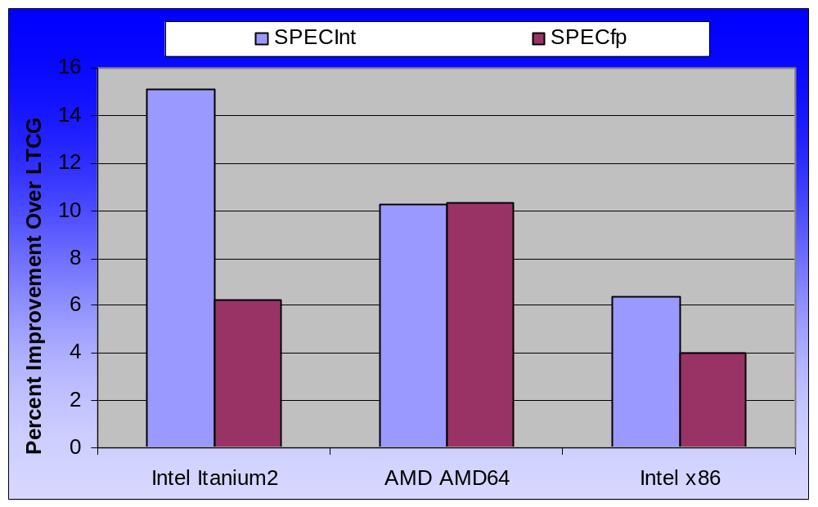
PGO Improvement Over LTCG

Slide 25
OpenMP
A specification for multithreaded programs
  Helps hyperthreading as well
It consists of a set of simple #pragmas and runtime routines
  #pragma omp parallel
A common technique:
  Start with sequential code and parallelize by adding #pragmas
Most value, where?
  Parallelizing large loops without loop-dependencies
    Can do more, but that’s the big win

Slide 26
OpenMP Parallelization
void test(int first, int last) {
#pragma omp parallel for
for (int i = first; i <= last; ++i) {
a[i] = b[i] + c[i];
}
}
That’s it… the code is parallelized!
void $test$OMP$1(int &first, int &last) {
int lower, upper;
if (first <= last) {
_vcomp_for_static_simple_init(first,
last, 1, 1, &lower, &upper);
for (int i = lower; i <= upper; ++i)
{
a[i] = b[i] + c[i];
}
_vcomp_for_static_end();
_vcomp_barrier();
}
}
void test(int first, int last) {
_vcomp_fork(1, 2, $test$OMP$1, first, last);
}

Slide 27

OpenMP Parallelization
void test(int first, int last) {
#pragma omp parallel for
for (int i = first; i <= last; ++i) {
a[i] = b[i] + c[i];
}
}
first = 1
last = 1000
1 ≤ i ≤ 250
251 ≤ i ≤ 500
501 ≤ i ≤ 750
751 ≤ i ≤ 1000

Slide 28
OpenMP for Straight Line Code
int bar(int x, int y) {
int a, b, c;
#pragma omp parallel sections
{
#pragma omp section
if(x < 0)
a = foo(x);
else
a = x + 5;
#pragma omp section
b = bat(y);
#pragma omp section
c = baz(x + y);
}
return a*b+c;
}
int bar(int x, int y) {
int a, b, c;
if(x < 0)
a = foo(x);
else
a = x + 5;
b = bat(y);
c = baz(x + y);
return a*b+c;
}

Slide 29
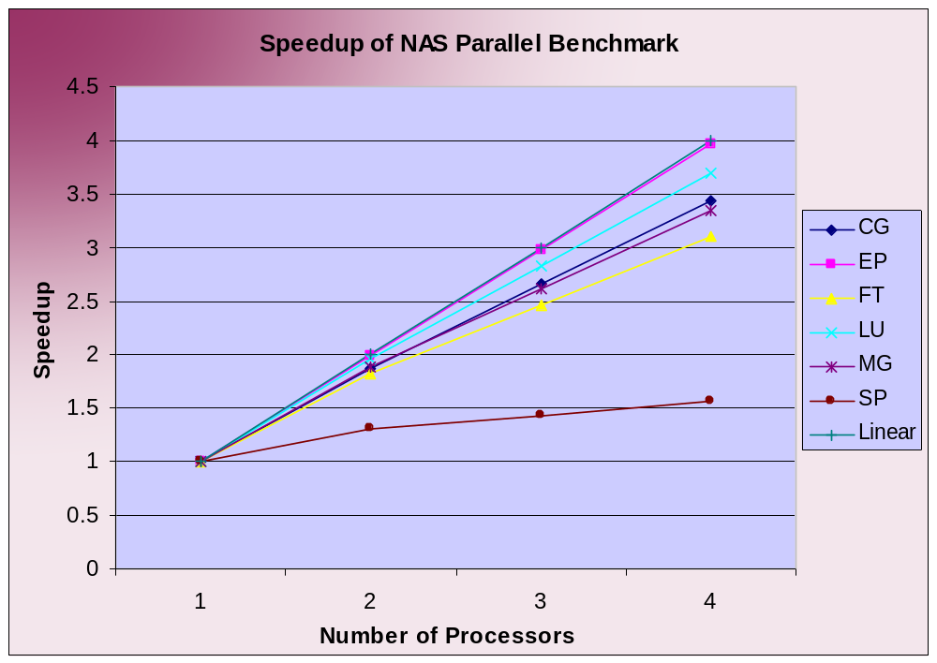
NAS Parallel Benchmark with OpenMP
HPC industry standard benchmark
We’ve only begun tuning and performance testing

Slide 30
OpenMP Demo

Slide 31
OpenMP Demo

Slide 32
Generating Efficient Code
Programmer knows a and b don’t overlap
ecx = a, eax = b
void copy8(int * a, int * b) {
a[0] = b[0];
a[1] = b[1];
a[2] = b[0];
a[3] = b[1];
a[4] = b[0];
a[5] = b[1];
a[6] = b[0];
a[7] = b[1];
}
mov edx, DWORD PTR [eax]
mov DWORD PTR [ecx], edx
mov edx, DWORD PTR [eax+4]
mov DWORD PTR [ecx+4], edx
mov edx, DWORD PTR [eax]
mov DWORD PTR [ecx+8], edx
mov edx, DWORD PTR [eax+4]
mov DWORD PTR [ecx+12], edx
mov edx, DWORD PTR [eax]
mov DWORD PTR [ecx+16], edx
mov edx, DWORD PTR [eax+4]
mov DWORD PTR [ecx+20], edx
mov edx, DWORD PTR [eax]
mov DWORD PTR [ecx+24], edx
mov eax, DWORD PTR [eax+4]
mov DWORD PTR [ecx+28], eax

Slide 33
Generating Efficient Code
Programmer knows a and b don’t overlap
*a
*b
void copy8(int * a, int * b) {
a[0] = b[0];
a[1] = b[1];
a[2] = b[0];
a[3] = b[1];
a[4] = b[0];
a[5] = b[1];
a[6] = b[0];
a[7] = b[1];
}
??
a
a+1
a+2
a+3
a+4
a+5
a+6
a+7

Slide 34
Aliasing
The problem is known as “aliasing”
Don’t know what a pointer can point to
/Oa is removed
  A death sentence for those that tried to use it
New keyword added “__restrict”
  Promise made to compiler: address pointed to by restrict pointer can NOT be accessed through other pointers
  Similar to the C99 ‘restrict’ keyword
  Example Usage: int * __restrict integerPtr;

Slide 35
__restrict – A compiler hint
Programmer knows a and b don’t overlap
eax = a, edx = b
void copy8(int * __restrict a, int * b) {
a[0] = b[0];
a[1] = b[1];
a[2] = b[0];
a[3] = b[1];
a[4] = b[0];
a[5] = b[1];
a[6] = b[0];
a[7] = b[1];
}
mov ecx, DWORD PTR [edx]
mov edx, DWORD PTR [edx+4]
mov DWORD PTR [eax], ecx
mov DWORD PTR [eax+4], edx
mov DWORD PTR [eax+8], ecx
mov DWORD PTR [eax+12], edx
mov DWORD PTR [eax+16], ecx
mov DWORD PTR [eax+20], edx
mov DWORD PTR [eax+24], ecx
mov DWORD PTR [eax+28], ed

Slide 36
Floating Point Model
/Op made your code run slow
  No intermediate switch
New Floating Point Model
  /fp:fast
  /fp:precise (default)
  /fp:strict
  /fp:except

Slide 37
/fp:fast
Used when performance matters most
Used when you know your application is not in the dark corners of FP world
What can /fp:fast do?
  Association
  Distribution
  Factoring inverse
  Scalar reduction
  Copy propagation

Slide 38
/fp:precise
The default floating point switch
The sweet spot…
  Performance and Precision
    A few percent slower than /fp:fast
IEEE Conformant (sans exceptions)
  Hoisting of expressions (even if they can raise exceptions)
At assignments, casts, function calls this will round to the appropriate precision
  Sometimes requires the writing of a value from register to memory (homing)

Slide 39


/fp:except and /fp:strict
/fp:except[-]
  Reliable floating point exceptions
    Thrown and not thrown when expected
      Faults and traps, when reliable, should occur at the line that causes the exception
      FWAITs on x86 might be added
    AMD64 and IA/64 are reliable at the hardware level
    Not compatible with /fp:fast
    Not compatible with /clr
/fp:strict
  The strictest FP option
    Turns off contractions
    Assumes floating point control word can change or that the user will examine flags
  /fp:except is implied
  Low double digit percent slowdown versus /fp:fast
  Not compatible with /clr

Slide 40
Floating Point Precision Characteristics
 | X86 | AMD64 | Itanium
Default Precision (significand) | 53bit | Based on source/dest precision (uses SSE[2]) | 64bit
/fp:fast | Will not home, may spill | Will choose fastest | Will not use completer
/fp:precise | Will home, except when assigning to double | Has appropriate sized operations | Will use completer for precision at rounding point
/fp:strict | Always home | Has appropriate sized operations | Will use completer for precision on each operation

Slide 41
Floating Point Example
a + b evaluated with “default” precision
x is promoted up and c + x is
evaluated with “default” precision
/fp:precise,fast – the final result is left
in a register.
/fp:strict – the final result is rounded to
double
double a, b, c, d;
float x, m, z;
d = (a + b) * (c + x);
z = (x + m) * m;
/fp:precise,fast – x + m evaluated with
“default” precision.
/fp:strict – x + m rounded to float,
except on x86
m promoted up, except on AMD64
/fp:fast – the final result, z, is
left in a register
/fp:precise,strict – the final result is
rounded to a float

Slide 42
Better Security for Generated Code
/GS introduced in 7.0 and improved in 7.1
Helped prevent attacking the return address
Introduced the cookie to the stack
Safe Exception Handling
Parameters
Parameters
Return Address
Return Address
Frame Pointer
Frame Pointer
Cookie
Exception Handler
Frame
Exception Handler
Frame
Locals
Locals
Callee save
registers
Callee save
registers

Slide 43
Better Security for Generated Code
We continue this improvement in security for Whidbey
Hijack
Parameters
Pointer parameters are vulnerable
Return Address
Frame Pointer
Cookie
Exception Handler
Frame
Locals
Callee save
registers

Slide 44
Better Security for Generated Code
Vulnerable parameters are now safe
Parameters
Safe Parameters
Return Address
Return Address
Frame Pointer
Frame Pointer
Cookie
Cookie
Exception Handler
Frame
Exception Handler
Frame
Locals
Locals
Vulnerable Parameters
Callee save
registers
Callee save
registers

Slide 45
C++ Optimizer Meets MSIL
Optimization at the MSIL level (prior to JITing)
  Does your standard optimizations including expression optimization and global optimization
  Where does it have problems?
    Strength reduction
    Inlining
  New Types of Decisions
    Loop Unrolling
    Inlining
“Leveraging Native Code with .NET” – TLS 311… Wednesday@11:30am

Slide 46
64bit Code Generation
x86 is no longer the only desktop/server platform
Visual C++ Compiler for Itanium and AMD64
  Cross Compilers and 64bit Hosted Compilers
Get your code 64bit clean
  int and long are 32bit, but pointers are 64bit
  Common pitfalls:
    Truncation
    Alignment

Slide 47
64bit Whidbey Demo

Slide 48
Take Aways
Generating Quality Code is What Visual C++ Does
  Understand scenarios necessary for PGO
  OpenMP, the easiest way to write multithreaded code
  Alias hints with __restrict can improve code
  New FP model has performance and accuracy
  /GS will help prevent even more attacks
  MSIL code with VC++ will be faster
  Get your code 64bit clean now

Slide 49
For More Information
Hands-on-lab here at the PDC
Ask the Experts (Hall F/G)
  Tuesday 6:30pm-9:00pm
VC++ Demo Booth (Product Pavilion)
  Several VC people there and walking around conference… talking to you is their top priority
64 bit Code Cleaning:
  http://msdn.microsoft.com/msdnmag/issues/01/11/XP64/default.aspx
OpenMP specification located at:
  http://www.openmp.org
PDC Newsgroups
  http://msdn.microsoft.com/vstudio/whidbeypdc
My email: kanggatl@microsoft.com

Slide 50

© 2003-2004 Microsoft Corporation. All rights reserved.
This presentation is for informational purposes only. Microsoft makes no warranties, express or implied, in this summary.

