Slide 1



Visual C++ Whidbey Under the Covers:
Targeting the CLR
Session Code: TLS401
Scott Currie
Program Manager
Microsoft Visual C++
srcurrie@microsoft.com

Slide 2

Agenda
The Basics
Compiling C++ to MSIL
Machine Code
Compilation Modes
Optimization
MSIL Linking

Slide 3

CLR Technologies
MSIL Code
  MSIL: a portable, stack based representation
  Easy to verify type safety and memory safety
  All MSIL code is compiled by the JIT
CLR Data
  Resides on the Garbage Collecting (GC) Heap
  Prevents memory leaks and other common problems
  Metadata encodes all type information

Slide 4
MSIL And C++
Verifiability is great, but I use pointers!
  …in a decidedly unverifiable way!
MSIL supports:
  Verifiable data access through metadata
  First class unverifiable instructions
    Pointer arithmetic
    Statically laid out types
    Access to native heap

Slide 5

Native Heap Access

Slide 6
Agenda
Basics
Compiling C++ to MSIL
Machine Code
Compilation Modes
Optimization
MSIL Linking

Slide 7
CLR Types
Type represented in metadata
Methods implemented in MSIL
  Members of the type
  User specifies scope/visibility
  Access enforced by runtime
  Optimizations limited
Data on managed heap
  Layout usually determined by runtime
  Named offsets → No pointer arithmetic

Slide 8
Managed Types

Slide 9
Native Types
Type does not exist in metadata
Methods or thunks implemented in MSIL
  Members of the module
  Globally scoped
  Access enforced by compiler
  Fully public → Optimizable
Data on native heap
  Layout similar to layout in native codegen
  Pointer arithmetic → No Verifiability

Slide 10
Native Types Limitations
#using cannot import native types
  Data members not exposed
  Must #include from object’s header
Native types not visible to other languages
Native member methods awkward to access through reflection

Slide 11
Native Types

Slide 12
Agenda
Basics
Compiling C++ to MSIL
Machine Code
Compilation Modes
Optimization
MSIL Linking

Slide 13
Machine Code
I still want Machine code
  Performance sensitive or hand tuned code
  Inline assembly, CPU specific intrinsics
  Exports to native apps
Solution: Mixed Images

Slide 14
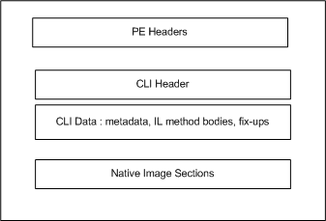

Image Layout
.NET Assemblies are just PE files
Additional Data embedded
  CLR Header
  Metadata
  MSIL
There is still a place for all of the native constructs
OS Loader

Slide 15
Machine Code

Slide 16
Agenda
Basics
Compiling C++ to MSIL
Machine Code
Compilation Modes
Optimization
MSIL Linking

Slide 17
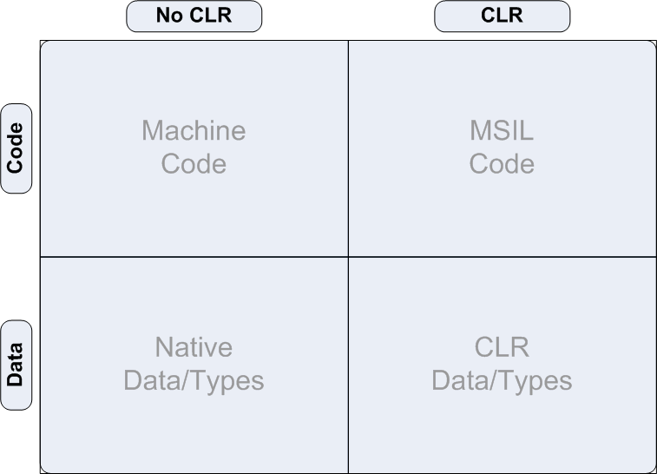
Compilation Modes

Slide 18
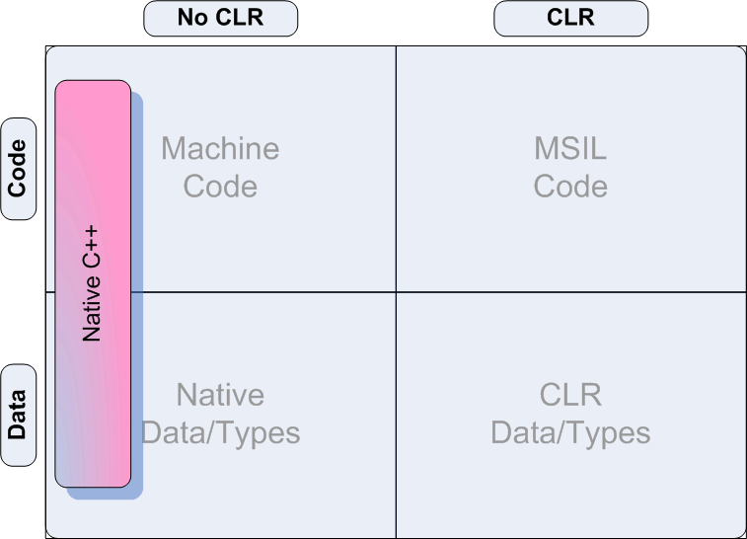
Compilation Modes

Slide 19
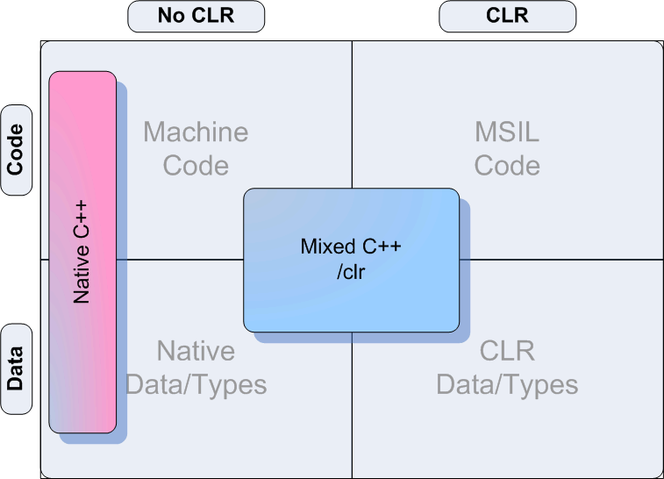
Compilation Modes

Slide 20
Interop Fundamentals
All global/native member methods have both unmanaged and managed
entry points
  Actual method implementation
  Forwarding/Transition thunk
Method Implementation is MSIL unless:
  Compiler can’t generate MSIL
    Inline ASM
    CPU specific intrinsics
  User specifies Machine code

Slide 21
.NET↔Native Code Transitions
.NET code and native code cannot call each other without transitions
  Calling Convention
  Type Marshalling
  GC
IJW Thunks
  Compiler provides implementation
  Call into method through offset or IAT jump
Managed P/Invokes
  No method implementation
  Managed P/Invoke with complete metadata
Cost

Slide 22
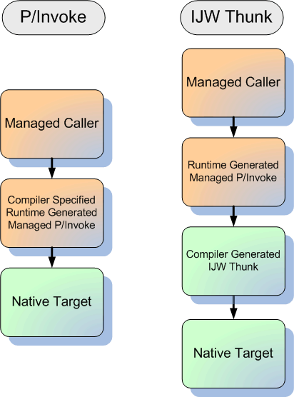
Transition Thunks Illustrated

Slide 23
IJW Thunk Versus P/Invoke
Intra-assembly
  IJW Thunks always used
Inter-assembly
  IJW Thunk implicitly specified
    Use #include
  P/Invoke Thunks explicitly specified
    Use DLLImport attribute

Slide 24
Mixed Code

Slide 25
Compilation Modes

Slide 26
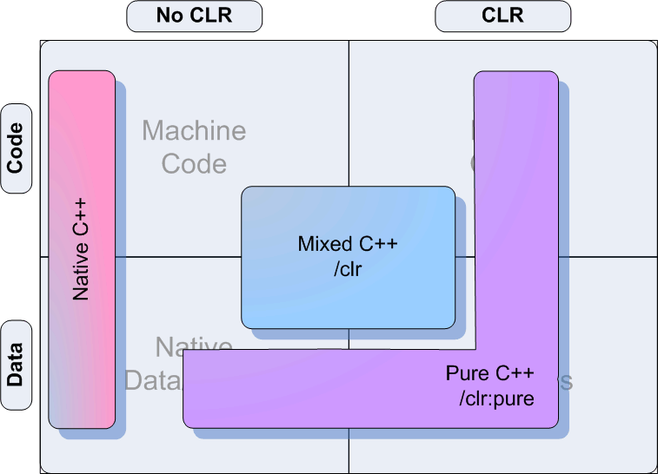
Compilation Modes

Slide 27
Issues With Mixed Images
Native image constructs can create problems
  CLI compliance
  Native entry point
  Transition Penalties
  Static Data
Solution: Pure MSIL
  Cut out everything native

Slide 28
Pure MSIL
CLI compliant
Enables compelling scenarios
  ClickOnce
  Form Designers
  Anything that uses reflection
Potential performance wins
Pure code is not necessarily verifiable
What about interop?

Slide 29
Implicit DLLImport
Linker fixes up metadata on pure images so that a managed P/Invoke thunk is generated
Example
[DLLImport(msvcrt.dll)]
int printf(const char *format, …);
int main(void) {
printf(“Hello World!”);
}
#include <stdio.h>
int main(void) {
printf(“Hello World!”);
}

Slide 30
Portability?
Pure Images are CLI compliant
BUT, they are not portable in general
CRT Initialization
Native Types
  Data is statically laid out
  Different pointer sizes

Slide 31
Pure Code

Slide 32
Compilation Modes

Slide 33
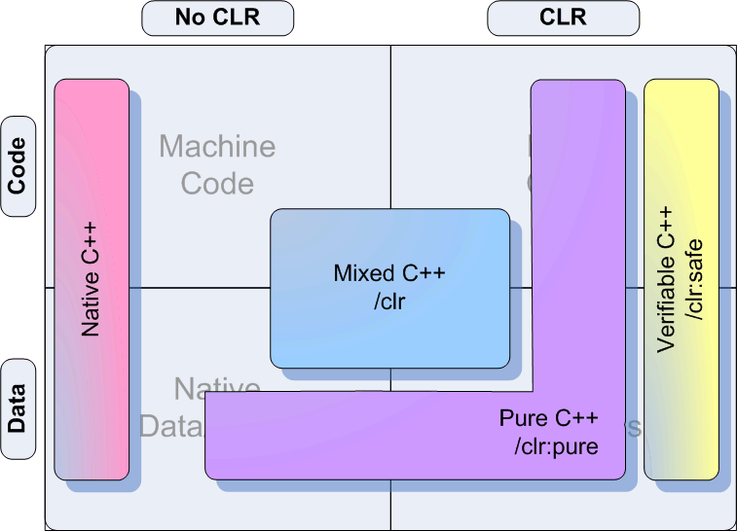
Compilation Modes

Slide 34
Safe MSIL
Enables low trust scenarios
  Remote Code (Web, File Shares, etc.)
  Yukon
Ensures that native types are not used
Potentially more portable
How it works
  Forbid all non-verifiable constructs
  Compiler enforced

Slide 35
Safe Code

Slide 36
Agenda
Basics
Compiling C++ to MSIL
Machine Code
Compilation Modes
Optimization
MSIL Linking

Slide 37
Optimization
Native Code
  Improvements over 2003
  “Advanced Code Generation” - 4:45PM
MSIL for Native Types
  Improvements over 2003
  Most opts from native but with different tuning
MSIL for Managed Types
  Optimizing for the first time in Whidbey
  Much happening statically
    Inlining
    Expression optimizations
    Loop optimizations

Slide 38
Verifiable Inlining
#using <mscorlib.dll>
__gc class Type {
private: int hidden;
public: int Accessor() { return this->hidden; }
};
int main() {
Type *t = new Type();
return t->Accessor();
}
/******************* Inlining *******************/
IL_0004: newobj instance void Type::.ctor()
IL_0005: stloc.0
IL_0006: ldloc.0
IL_0007: ldfld int32 Type::hidden
IL_0008: ret
/***************** No Inlining *****************/
IL_0004: newobj instance void Type::.ctor()
IL_0005: stloc.0
IL_0006: ldloc.0
IL_0007: call instance int32 Type::Accessor()
IL_0008: ret

Slide 39
Verifiable Inlining: Solutions
Analyze for legal inlining opportunities
  Visibility
  Security Boundaries
  Attributes
Relax above restrictions where possible

Slide 40
MSIL Strength Reduction
#define MAX_ARRAY 50
int main() {
int a[MAX_ARRAY];
for (int i=0; i<MAX_ARRAY; i++) {
a[i] = 0;
}
return 0;
}
IL_0002: ldloc.0
IL_0003: ldc.i4.4
IL_0004: mul
IL_0005: ldloca.s V_1
IL_0007: add // a[i]
IL_0008: ldc.i4.0
IL_0009: stind.i4 // a[i] = 0;
IL_000a: ldloc.0
IL_000b: ldc.i4.1
IL_000c: add
IL_000d: stloc.0 // i++;
#define MAX_ARRAY 50
int main() {
int *a = new int[MAX_ARRAY];
for (int *end = a+MAX_ARRAY; a<end; a++) {
a = 0;
}
return 0;
}
IL_0003: ldc.i4.4
IL_0005: ldloca.s V_1
IL_0007: add
IL_0008: stloc.1 // a++;
IL_0009: ldloc.1
IL_0008: ldc.i4.0
IL_0009: stind.i4 // a = 0;

Slide 41
Agenda
Basics
Compiling C++ to MSIL
Machine Code
Compilation Modes
Optimization
MSIL Linking

Slide 42
MSIL Linking
Link.exe can now consume .netmodules
Permits multiple languages in same single-file assembly
Dependencies can be created among modules and objects written in different languages
No more MSIL roundtripping

Slide 43
Linker Consumable Files
Object Files
  Native C++
  Mixed C++ (/clr)
  Pure C++ (/clr:pure)
  Safe C+ (/clr:safe)
.netmodules
  C#, VB, etc.
  Pure C++ (/clr:pure)
  Safe C++ (/clr:safe)

Slide 44
MSIL Linking

Slide 45
Summary
Mixed code enables gradual transition to WinFX
  Be mindful of transition penalties
Pure code enables variety of tools based scenarios
Safe code enables low trust scenarios
Optimization of MSIL improves performance
MSIL Linking improves multi-language assemblies

Slide 46

Additional Resources
Related sessions
  Leveraging Native Code with .NET (TLS311) – Wed - 11:30AM / 150,151
  Advanced Code Generation (TLS400) – Today - 4:45PM / Room 408AB
Send us feedback!
  srcurrie@microsoft.com
  vswish@microsoft.com
  Public newsgroups
    microsoft.public.vc.*
    microsoft.public.dotnet.languages.vc.*
Other resources
  VC++ Hands On Lab Here at the PDC
  Ask The Experts
  VC++ Product Booth

Slide 47

© 2003-2004 Microsoft Corporation. All rights reserved.
This presentation is for informational purposes only. Microsoft makes no warranties, express or implied, in this summary.

Slide 48


