Slide 1

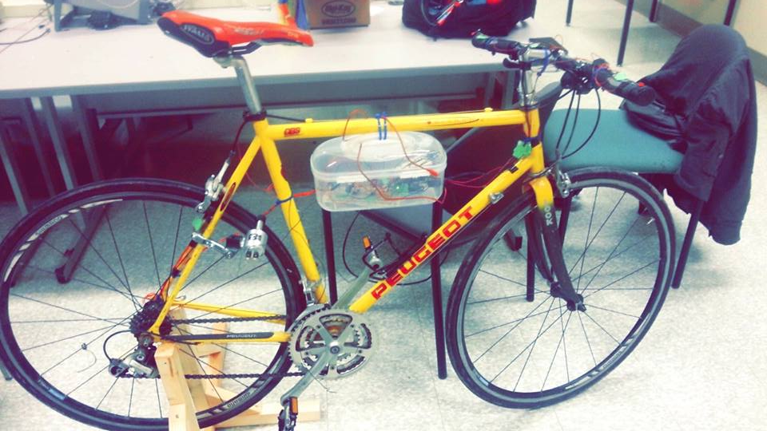
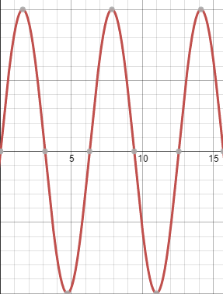
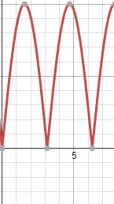
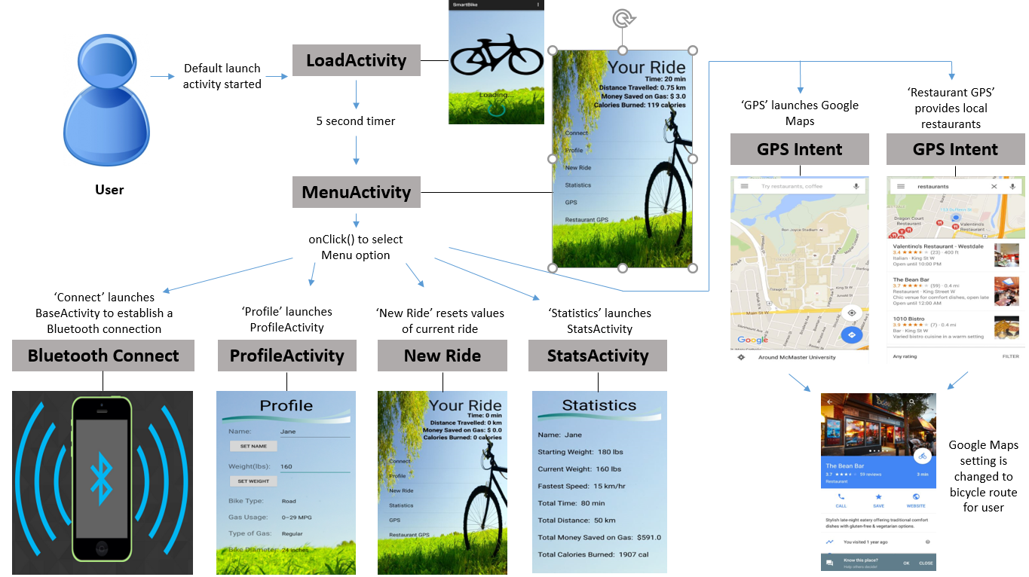
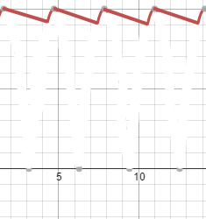

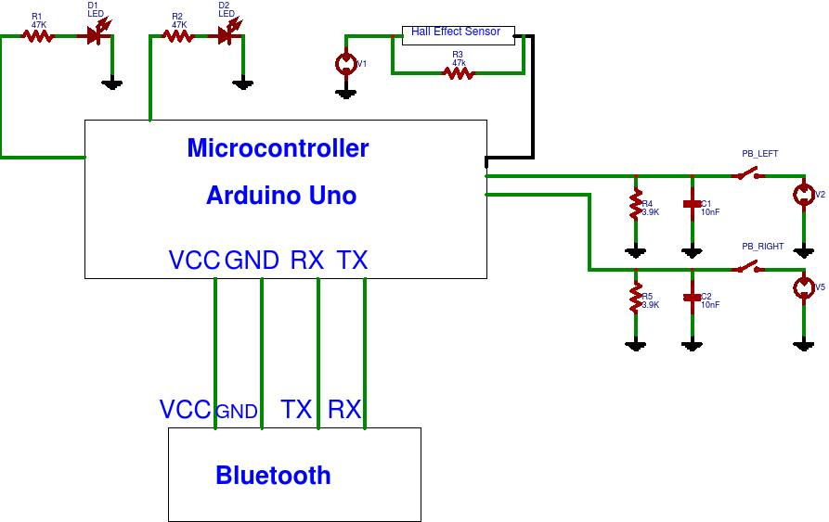
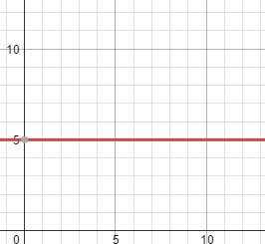
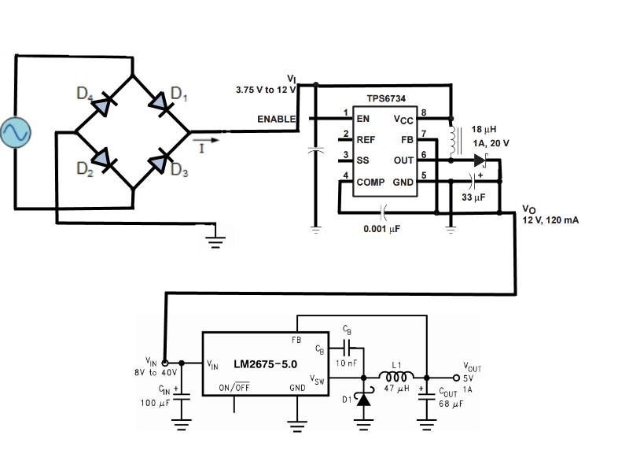
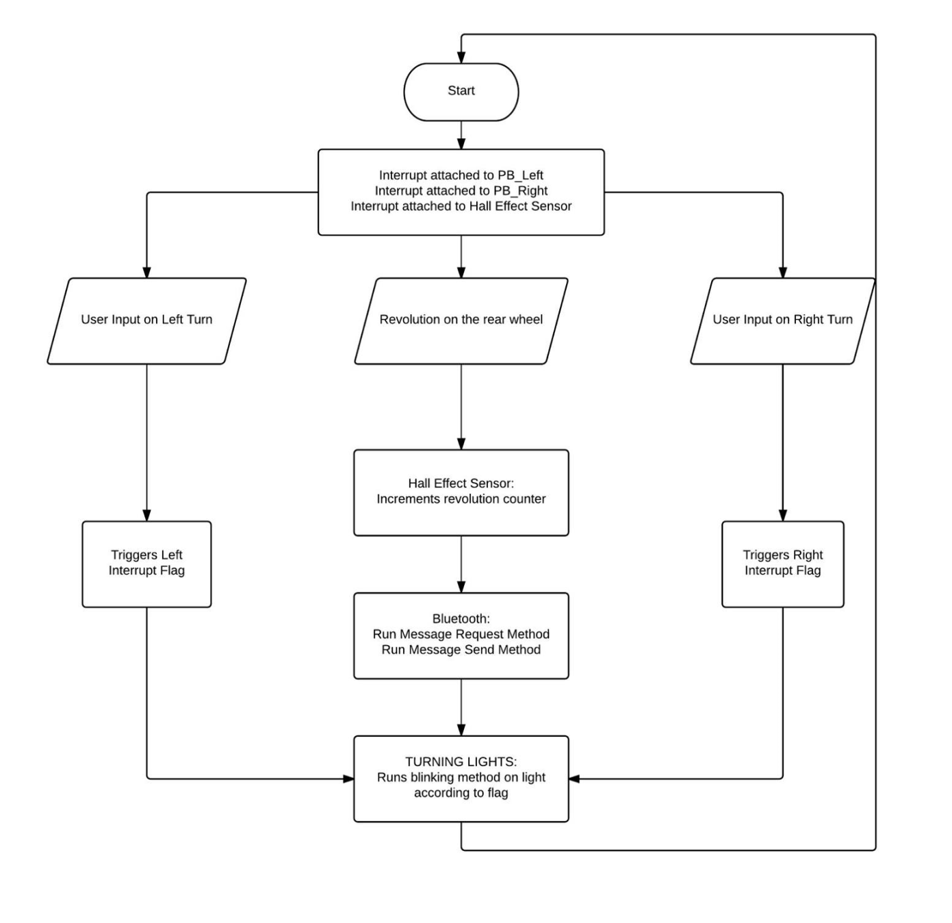
SmartBike Retrofit Kit
Eric Phillips-Sheldon, Syed Nabi, Stephanie Porretta-Howorth, Jake Goulding, Suraj Mistry
ELEC ENG 40I6 – Capstone Presentation
Power Generation
Project Goals
Microcontroller
Devices used in the kit need a 5 Volt DC signal to charge and to run.
Using a small alternator made for bicycles, an AC sine wave of approximately 20 V peak to peak can be generated.
This signal is passed through a full bridge rectifier. The rectified signal is passed through a large smoothing capacitor to obtain a DC voltage level with a small ripple.
The signal is then passed through a boost converter, upping the voltage to a 12 V DC signal. The boost converter ensures proper voltage level for the operation of the buck converter.
The buck converter lowers the 12 V DC signal to a 5 V DC signal. The 5 V signal is then used to charge the battery pack.
The Goal of this project was the creation of a kit that could be easily added to any bike, that would help make biking more accessible and enticing to the average commuter or resident. Currently, most smart bikes are built into an existing bike, and are mostly marketed towards high end heavy bike users, not the casual user.
This kit can be added to any bike with relative ease, and adds a number of useful features. The turning lights are a much more familiar concept and device than the hand signals traditionally used in bikes, and are more recognizable by cars as well. The power generation is a very sustainable method of keeping the microcontroller on the bike charged, as well as charging a connected Android phone. The phone and the microcontroller can communicate through the application, allowing the user to see information about their ride. The application provides the user information such as GPS location, along with nearby restaurants, provides fitness information, and tells the user how much money they have saved on gas.
Microcontroller : Arduino UNO
The microcontroller unit acts as one of the processing units for the system. It controls the turning lights, counts the revolutions made by the wheel and communicates to PC or Android application via Bluetooth.
Turning Lights: The user presses a push button that triggers an interrupt service routine which then triggers a blinking method for the LEFT and RIGHT LEDs.
Hall Effect Sensor: The hall effect sensor is placed on the back wheel of the bike and a magnet is attached to one of the spokes. Every time the magnet crosses the hall effect sensor, it triggers an interrupt service routine which increments a counter. The value stored in this counter is the number of revolutions made by the rear wheel which is then used to calculate various performance matrices.
Bluetooth: The communication to PC or Android Application is maintained via a Bluetooth connection by the Arduino. A Bluetooth module is attached as a peripheral to the board which waits for a request from the connected device and sends the time and number of revolutions since the last request.
Smart Bike Prototype in the lab
Android Application
AC sine wave from alternator
Full Bridge Rectified Signal
DC voltage with small ripple
Boost converter up to 12 V
This diagram maps the user’s experience through the SmartBike application. It gives a visual representation of how the user will navigate through different features.
The framework for the application can be divided into two sections, screens and intents. Screens map out the structure for the user interface within the application. They enable the user to interact with the application’s functionality. Each screen has a corresponding ‘Activity’ file. These ‘Activity’ files are java classes that outline the underlying logic behind the graphical interface. The graphical interface’s structure of a screen is identified with a corresponding xml file. These xml files define the text boxes, text sizes, images, lists, input boxes, scrolls and various other fields for the screen’s interface.
The second component to the framework of the application consists of intents. An intent is an object within the Android operating system that handles task requests. It enables the application to launch from one screen to another or pass information through to other applications such as Google Maps.
Microcontroller circuit diagram
Buck converter lowers voltage to 5 V
Power generator circuit diagram
Microcontroller block diagram

