Slide 1
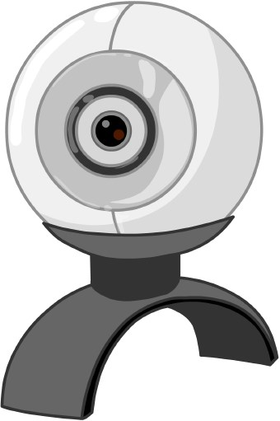
/dev/video0
mjpg_streamer -i “input_uvc.so”
Servo 20
Serial connection
(/dev/ttyS1)
Signal USR1
RBC
basic or rbasic
test.jpg
115200, 8, N, 1
servos
10 !IMAGE LOAD 32
Robobuilder
Linux based PC
Or Omnima EmbWifi

