Slide 1

IKEA
Stella Tang
Diana Bui
Phil Liu

Slide 2
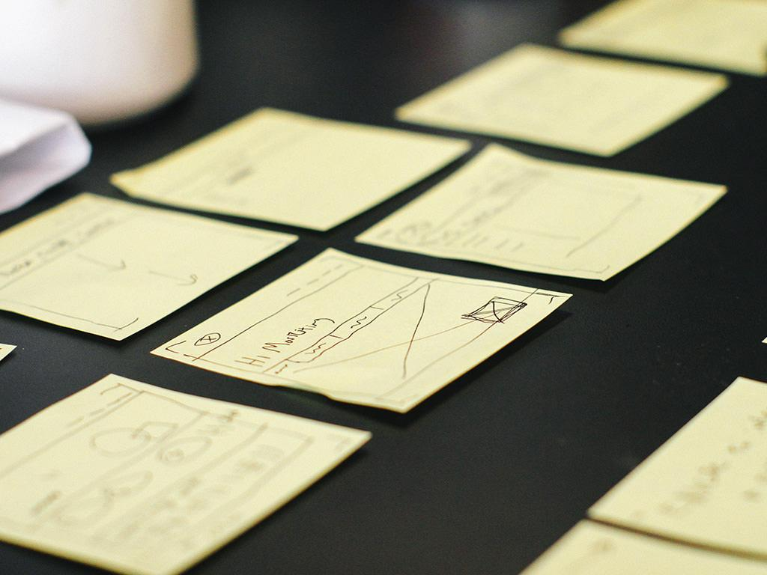
Why IKEA?
•For our database project, our team decided to focus on Ikea as our company that we would create our database design and SQL queries for. We had a difficult time choosing our company because there are many companies that have shown significant success in their business models. Ikea stuck out to us because of the company’s vision and business idea. Ikea’s vision is “to create a better everyday life for the many people” while their business idea is to “to offer a wide range of well-designed, functional home furnishing products at prices so low that as many people as possible will be able to afford them”. Many businesses have a vision but have found difficulty executing it. IKEA impressed us due to their competitive advantage with their core competencies in their supply chain.

Slide 3
Background
Ikea’s founder is Ingvar Kamprad who realized from a young age that he could buy items in bulk cheaply but resell them individually at a low price while still making a profit. He was entrepreneurial when expanding into the furniture market with Ikea. In 1953, there were furniture showrooms that opened in Sweden. This was an momentous occasion because it was the first time that customers can directly touch IKEA furniture before they committed to buying the furniture. Currently, Ikea displays all their products in mock rooms that helps customers to imagine how the pieces of furniture would look together. In addition, they also offer in-store childcare and extended hours facilities for working customers who need to shop at odd hours. After pressure from other competitors for suppliers to boycott Ikea, the company started designing their own furniture for self-assembly and flat packs. The flat package enables a reduction in the cost of shipping, storing, and construction.

Slide 4

