Slide 1
LISA Maintenance

Slide 2
ORACLE Basics
Because analysts need to make many changes to the database in order to process samples, each user has permission to SELECT, INSERT and UPDATE data in the transactional tables.
Restrictions on these privileges are enforced through LISA forms ORACLE SQLPLUS and SQL Developer are not available to the users.
Changes made using SQL Developer are temporary and apply to the SQL Developer database session until they are committed using the COMMIT; command or the commit icon
Unwanted changes should be undone with the ROLLBACK; command or the undo icon before committing the change. After the change is committed, you must use UPDATE statement(s) to change back.

Slide 3
ORACLE Basics
Lines in a SQL statement may be commented out with a double dash at the beginning of the line. Double dashes in the middle of a line will omit the rest of the line.
Note: copying the queries from these slides may change the character used for single quote and cause an error in SQL Developer. If this happens, replace the single quote.
SELECT lab_assigned_no,smpl_id,smst_smst_id,inspection_no,sampling_number, flof_office_id --, clmd_media_id,
submission_no, sampled_establishment, recvd_in_lab, sampling_date, shipping_date
FROM l_samples, l_sample_sets
WHERE smst_id =smst_smst_id
AND lab_assigned_no between 'F12346' and 'F12346'
--AND sampling_number in ('428893')
--AND inspection_no like '1757190'
ORDER BY 1,5;
clmd_media_id is commented out and will not be returned from SELECT statement
Choose which AND statement to use based on what you know and comment out the others

Slide 4
LISA Basics
LISA was designed for manual entry of information. Some things have been automated over time, but the option to use LISA forms to manually enter data still exists.
LISA is a normalized database which is optimized for entering data. Normalization is used to reduce the number of times data is repeated in different tables by creating “parent/child” relationships.
Full normalization of OSHA sampling data would look something like this:

Slide 5
OSHA Office
Office has one-to-many Inspections
Inspection
Inspection has one-to-many Sampling Sheets
Sampling Sheet
Sampling Sheet has one Employee
Sampling Sheet has one-to-many Samples
Employee
Sample
Employee has one-to-many PPE
Sample has one-to-many Times On/Off
Employee has one Occupation
Sample has one-to-many Analytes
Occupation
PPE
Analyte
Time On/Off
To improve performance, office, inspection and sampling sheet were combined into one table. Primary key (smst_id) is combination of all three

Slide 6
LISA Basics
Beginning with the hurricane Katrina response, a way to upload data into staging tables. The login form was modified to search the staging tables and pull existing information into the form for entry into LISA. The search function occurs after the “primary key” is entered.
When login form is saved, the information is loaded into the appropriate tables in LISA.

Slide 7
LISA Transfer from OIS
If there is no data to populate the form, chances are that the transfer from OIS did not occur (database server was down or there was a failure in the nightly batch jobs on the Mapforce server (10.150.39.15).
The task to bring the xmls from Ashburn runs nightly at 3:00 AM and is D:/lims/shells/OIS_am.bat.

Slide 8
LISA Transfer from OIS
This batch file
Copies the xmls to directories on the Mapforce server
Uses the Mapforce project D:\mapforce\v19\labRequests\labRequest1_9_stage_p.mfd to parse the xml data into tables in the SOURCE_RECEIVE schema in LISA
Runs the procedure lims_stage.p_ois_load_lims_stage8 to put the data into the staging tables
Part of each step is to send an email to Heather and I that the task was successful. Heather can add people to receive the automated emails.

Slide 9
LISA Basics – main tables
The main transactional tables in LISA are:
SAMPLE_SETS: this table corresponds to the top section of the 91A and contains the office, inspection number, sampling number, sampling and shipping dates, and whether an 8-hr TWA was requested.
SAMPLED_EMPLOYEES: contains the occupation of the sampled employee
SAMPLES: sample type, media, CSHO sample identifier (submission_no), blank status (Y,N), time sampled, flow rate, sample weight

Slide 10
LISA basics – main tables 2
ANALYSIS_TARGETS: analyte, result (A and B portions), unit, solution volume, result qualifier, reporting limit, analyte specific comments
LAB_SETS: analytical method used, instrument used, set specific comments and chain of custody information (analyst, checker, supervisor and dates assigned, posted, checked and released)

Slide 11
LISA basics
Because of the relationships between the tables, before you delete a “parent,” you must first delete any dependent records (“children,” “grandchildren”)
Sample_sets
sample
analysis_targets
analysis_targets
analysis_targets
sampled_employees
Start at right and work your way to the left

Slide 12
LISA basics
LISA is a relational database which is designed to make data entry easier. Because it is relational, when you query from multiple tables you must link (join) the tables. There are two common types of joins: INNER and OUTER.
Most of the queries to manage the data use INNER joins. Joins are usually foreign keys that relate to primary key in related table; i.e., foreign key smst_smst_id in SAMPLES table relates to primary key smst_id in SAMPLE_SETS table. These are listed in the column tab for the table in SQL Developer (see example)

Slide 13
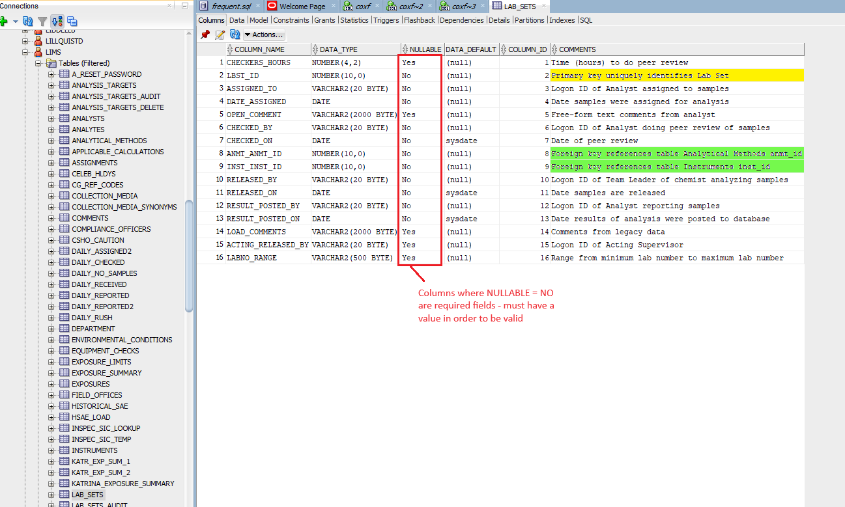

Slide 14
INNER joins result in data that is in both of the joined tables (intersection)
and OUTER joins take all the selected rows from one table and the corresponding rows in the other table
INNER Join
(LEFT) OUTER Join

Slide 15
Sample assigning/un-assigning
When samples are logged in to LISA, each sample and requested analyte are entered into the ANALYSIS_TARGETS table with the required lbst_lbst_id set to 0.
All unassigned sample/analyte combinations are members of lab set 0, only samples in lab set 0 will show in the Assign form
Assign form in LISA groups the compatible sample/analytes. When samples are assigned a unique lab set is created and the selected sample/analytes are given the new lbst_lbst_id in the ANALYSIS_TARGETS table

Slide 16
Sample assigning/un-assigning
To find assigned status of samples, use the following query:
SELECT anly_id,smpl_id,lab_assigned_no, submission_no,lbst_lbst_id,labno_range,anlt_analyte_id,
analyte_code IMIS, smty_type_code as type,
assigned_to, date_assigned, checked_by, checked_on, released_by, released_on
--, result_portion_a, net_weight, uom_abbreviation, qlfr_type
FROM l_samples a, l_analysis_targets b, l_analytes c, l_lab_sets
WHERE smpl_id = smpl_smpl_id AND anlt_analyte_id = analyte_id
AND lbst_lbst_id=lbst_id
AND lab_assigned_no BETWEEN 'F24968' and 'F24973'
ORDER BY lab_assigned_no, anlt_analyte_id;

Slide 17
Sample assigning/un-assigning
To add unassigned analyte to existing set:
a) find lbst_id for set to add to:
SELECT lbst_lbst_id from l_analysis_targets
WHERE smpl_smpl_id in
(SELECT smpl_id from l_samples WHERE lab_assigned_no = 'F24968')
AND anlt_analyte_id in
(SELECT analyte_id FROM l_analytes WHERE analyte_code = 'G301');
b) add sample
UPDATE l_analysis_targets set lbst_lbst_id = ###### (number from previous query)
WHERE smpl_smpl_id in
(SELECT smpl_id from l_samples WHERE lab_assigned_no = 'F24969')
AND anlt_analyte_id in
(SELECT analyte_id FROM l_analytes WHERE analyte_code = ‘9130');

Slide 18
Sample assigning/un-assigning
Remove assigned analyte(s) from set:
Note: this example unassigns 2 analytes for each sample
(F47605, F47606 and F47607)
UPDATE l_analysis_targets SET lbst_lbst_id = 0
WHERE smpl_smpl_id IN (SELECT smpl_id FROM l_samples
WHERE lab_assigned_no between 'F47605' AND 'F47607')
AND anlt_analyte_id IN (SELECT analyte_id FROM l_analytes
WHERE analyte_code IN ('G301','G302'))
AND lbst_lbst_id IN (select lbst_lbst_id FROM l_analysis_targets, l_analytes
WHERE anlt_analyte_id = analyte_id AND analyte_code IN ('G301'));

Slide 19
Sample unassigning
You cannot un-assign a sample from an analyst through the LISA Edit form. Changing the initials and date assigned keeps them in a separate set from lab set 0
Frequently you only want to remove a few samples from a set. Changing the assigned to and date assigned in the Edit form will affect all samples in that lab set.
Do not edit the values in lbst_id 0. That may result in no samples showing up to be assigned.

Slide 20
Deleting a sample
Samples have “children” (analysis_targets) so you must delete all the analysis_targets before you delete the sample
SQL statements to delete samples
delete l_analysis_targets where smpl_smpl_id in
(select smpl_id from l_samples where lab_assigned_no between ‘156484’ and ‘156484’);
delete l_time_checks where smpl_smpl_id in
(select smpl_id from l_samples where lab_assigned_no between ‘156484’and‘156484’);
select smst_smst_id from l_samples where lab_assigned_no between ‘156484’ and ‘156484’;
--You need the smst_id for the last two deletions
delete l_samples where lab_assigned_no between ‘156484’ and ‘156484’;
delete l_sampled_employees where smst_smst_id in (231929);
delete l_sample_sets where smst_id in (231929);

Slide 21
Changing analytes on a sample
Chemists can change analytes through the edit screen (1 sample at a time), if there are many samples to change it can be with this UPDATE statement. If more than 1 analyte need to be changed, they must be changed 1 analyte at a time.
Using SQL Developer you can change multiple samples at a time
UPDATE l_analysis_targets SET anlt_analyte_id =
(SELECT analyte_id from l_analytes where analyte_code = '9130')
WHERE smpl_smpl_id IN
(SELECT smpl_id FROM l_samples
WHERE lab_assigned_no between 'F47605' AND 'F47607')
AND anlt_analyte_id IN
(SELECT analyte_id FROM l_analytes
WHERE analyte_code = 'G301’);

Slide 22
Add missing analytes to sample
Rarely a sample will be logged in but there are no analysis targets. Use this insert statement to add analytes to a sample. If there are multiple analytes to be added they must be done individually.
First, run query to get analyte_id:
Query result:
SELECT analyte_code, analyte_id from l_analytes
WHERE analyte_code = 'G302';
ANALYTE_CODE ANALYTE_ID
G302 1106

Slide 23
Add missing analytes to sample
Then modify INSERT statement with analyte_id (in red below)
If you need to add several analytes to a sample, you must run the insert statement for each analyte (cannot add multiple analytes with one insert statement)
INSERT INTO l_analysis_targets (anly_id,requested_analyte_flag,result_portion_a,detection_limit,uom_abbreviation,
lbst_lbst_id,anlt_analyte_id,smpl_smpl_id)
SELECT l_anly_seq.NEXTVAL,'Y',0,0,'AAAAA',0,1106, smpl_id
FROM l_samples
WHERE lab_assigned_no BETWEEN 'F46843' and 'F46844'
--WHERE lab_assigned_no in ('F47043','F47046')
;

Slide 24
Changing “primary key” information
Rarely, pieces of the “primary key” for a sampling sheet need to be edited (Office ID, Inspection #, Sampling #). Since the combination of these 3 fields has a unique constraint in the sample_sets table, they can’t be changed from the LISA Edit form.
SELECT smst_id, flof_office_id, inspection_no, sampling_number
FROM l_sample_sets where sampling_number = '445162’;
SMST_ID FLOF_OFFICE_ID INSPECTION_NO SAMPLING_NUMBER
240530 134000 1736024 445162
UPDATE l_sample_sets SET
flof_office_id = 3384115 --,
-- inspection_no = '84070-6424' --,
-- sampling_number = '945162'
WHERE smst_id = 151730;

Slide 25
Find # of samples analyzed by analyst
Sometimes an analyst will need to know how many samples he has analyzed
Note: when using an aggregating function (i.e., COUNT, SUM, etc.)
You must use GROUP BY for the other elements in the SELECT statement
SELECT analyte_code, COUNT(DISTINCT smpl_smpl_id)
FROM l_analysis_targets, l_analytes, l_lab_sets
WHERE lbst_lbst_id = lbst_id AND anlt_analyte_id = analyte_id
AND assigned_to = 'DHALTERMAN' AND analyte_code = 'S777'
AND released_on between '01-JAN-2019' AND '30-JUN-2024'
GROUP BY analyte_code;
ANALYTE_CODE COUNT(DISTINCTSMPL_SMPL_ID)
S777 669

Slide 26
The dreaded “unique constraint” error
LISA has analyte codes that are composed of multiple analytes. The most common is 2587 – Welding Fumes. When this is requested, LISA will return analytical results for 12 metals.
Some substances are created because analytes collected on different media are analyzed by different methods and are not assigned at the same time.
When someone enters the results form in LISA, a procedure runs to break the substances down into their component analytes.
If one (or more) of the components already exists for that sample, the procedure will return a unique constraint error (LISA doesn’t allow 2 results for the same analyte).

Slide 27
The dreaded “unique constraint” error
The easiest way I have found to correct this error is to run the query:
Then you look at the analytes for each sample and remove the analytes that are included in the substance (use the boxed query in previous slide for finding assigned status of a sample)
SELECT lab_assigned_no, lbst_id, analyte_id, analyte_code, date_assigned, assigned_to
FROM l_samples, l_analysis_targets, l_lab_sets, l_analytes
WHERE smpl_smpl_id = smpl_id AND lbst_lbst_id = lbst_id AND anlt_analyte_id = analyte_id
AND lbst_lbst_id > 0
AND anlt_analyte_id IN (SELECT DISTINCT anlt_subs_id FROM l_substances)
ORDER BY 1,2;

Slide 28
Unique constraint example
Query on previous slide results
“Boxed” query with lab numbers from results
LAB_ASSIGNED_NO LBST_ID ANALYTE_ID ANALYTE_CODE DATE_ASSIGNED ASSIGNED_TO
A12345 235028 22365 PB-B 24-JUL-2024 11:52:30 COXF
A12346 235028 22365 PB-B 24-JUL-2024 11:52:30 COXF
SELECT anly_id,smpl_id,lab_assigned_no, submission_no, lbst_lbst_id, labno_range, anlt_analyte_id,
analyte_code IMIS, --smty_type_code as type,
assigned_to, date_assigned --, checked_by, checked_on, released_by, released_on
--, result_portion_a, net_weight, uom_abbreviation, qlfr_type
FROM l_samples a, l_analysis_targets b, l_analytes c, l_lab_sets
WHERE smpl_id = smpl_smpl_id AND anlt_analyte_id = analyte_id
AND lbst_lbst_id=lbst_id
AND lab_assigned_no BETWEEN ‘A12345' and ‘A12346'
ORDER BY lab_assigned_no, anlt_analyte_id;

Slide 29
Unique constraint example
“Boxed” query results
Delete other analytes in “substance”
ANLY_ID SMPL_ID LAB_ASSIGNED_NO SUBMISSION_NO LBST_LBST_ID LABNO_RANGE ANLT_ANALYTE_ID IMIS ASSIGNED_TO DATE_ASSIGNED
1719719 474980 A12345 66 235028 A12345-A12346 sttn 22 55 0260 COXF 24-JUL-2024 11:52:30
1719718 474980 A12345 66 235028 A12345-A12346 sttn 22 887 C141 COXF 24-JUL-2024 11:52:30
1719717 474980 A12345 66 235028 A12345-A12346 sttn 22 22365 PB-B COXF 24-JUL-2024 11:52:30
1719722 474981 A12346 67 235028 A12345-A12346 sttn 22 55 0260 COXF 24-JUL-2024 11:52:30
1719721 474981 A12346 67 235028 A12345-A12346 sttn 22 887 C141 COXF 24-JUL-2024 11:52:30
1719720 474981 A12346 67 235028 A12345-A12346 sttn 22 22365 PB-B COXF 24-JUL-2024 11:52:30
DELETE l_analysis_targets WHERE lbst_lbst_id = 235028 AND anlt_analyte_id <> 22365;
4 rows deleted.

Slide 30
Unique constraint example
Now the unique constraint has been eliminated and when LISA Results form is opened there is no error
SELECT anly_id,smpl_id,lab_assigned_no, submission_no, lbst_lbst_id, labno_range, anlt_analyte_id,
analyte_code IMIS, --smty_type_code as type,
assigned_to, date_assigned --, checked_by, checked_on, released_by, released_on
--, result_portion_a, net_weight, uom_abbreviation, qlfr_type
FROM l_samples a, l_analysis_targets b, l_analytes c, l_lab_sets
WHERE smpl_id = smpl_smpl_id AND anlt_analyte_id = analyte_id
AND lbst_lbst_id=lbst_id
AND lab_assigned_no BETWEEN ‘A12345' and ‘A12346'
ORDER BY lab_assigned_no, anlt_analyte_id;
ANLY_ID SMPL_ID LAB_NO SUBMISSION_NO LBST_LBST_ID LABNO_RANGE ANLT_ANALYTE_ID IMIS ASSIGNED_TO
1719725 474980 A12345 66 235028 A12345-A12346 sttn 22 55 0260 COXF
1719717 474980 A12345 66 235028 A12345-A12346 sttn 22 376 1591 COXF
1719726 474980 A12345 66 235028 A12345-A12346 sttn 22 887 C141 COXF
1719727 474981 A12346 67 235028 A12345-A12346 sttn 22 55 0260 COXF
1719720 474981 A12346 67 235028 A12345-A12346 sttn 22 376 1591 COXF
1719728 474981 A12346 67 235028 A12345-A12346 sttn 22 887 C141 COXF

Slide 31
QC Changes
QC schema is QC_DEV2
QC tables refer to LIMS tables for common elements (analysts, analytes, instruments, media, methods…)
Most changes are made to batch expiration dates, set assignment, “killing” samples and theoretical values

Slide 32
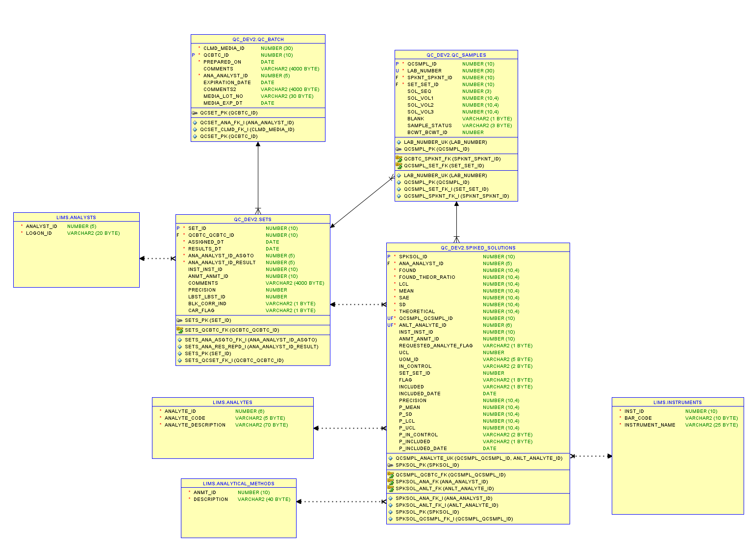

Slide 33
QC Changes
Change batch expiration date:
Find qcbtc_id:
SELECT distinct qcbtc_qcbtc_id
FROM q_sets, q_qc_samples
WHERE set_set_id = set_id
AND lab_number BETWEEN 127164 and 127211;
59856
UPDATE q_qc_batch SET expiration_date = '28-DEC-2024' WHERE qcbtc_id = 59856;

Slide 34
QC Changes
“Kill” QC samples
Other values for sample_status are
0LQ – logged
0AQ – assigned
0FQ - finished
SELECT lab_number, set_set_id, sample_status FROM q_qc_samples WHERE lab_number BETWEEN 128920 and 128923;
LAB_NUMBER SET_SET_ID SAMPLE_STATUS
128920 26396 0FQ
128921 26396 0FQ
128922 26396 0FQ
128923 26396 0FQ
UPDATE q_qc_samples SET sample_status = '0AQ' WHERE lab_number BETWEEN 128920 and 128923;

Slide 35
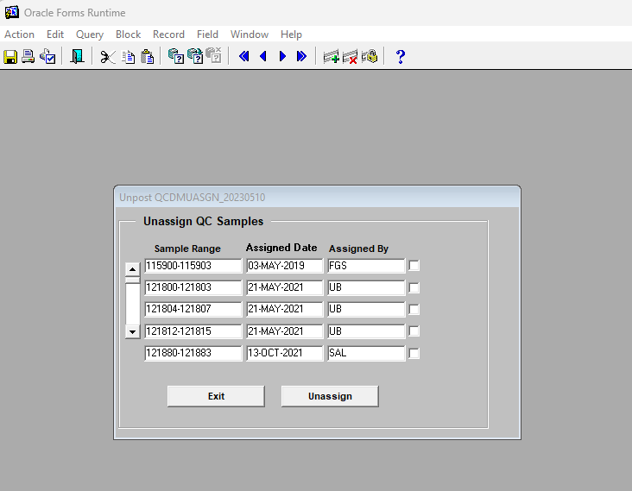
QC changes
Unassigning QCSMs is best done by IHC supervisors using the form – QCSMUASGN.fmx

Slide 36
QC Changes
Sometimes an analyst will need to correct ASM values – usually due to an error in calculation (wrong extraction efficiency, density, etc.)
Although these changes can be made using update statements, I find it easier to do by editing the spiked_solutions table in QC_DEV2 using SQL Developer:
Click on the table to open it in a tab
Filter the results
Double click in field to be changed
Commit the change with the commit icon

Slide 37
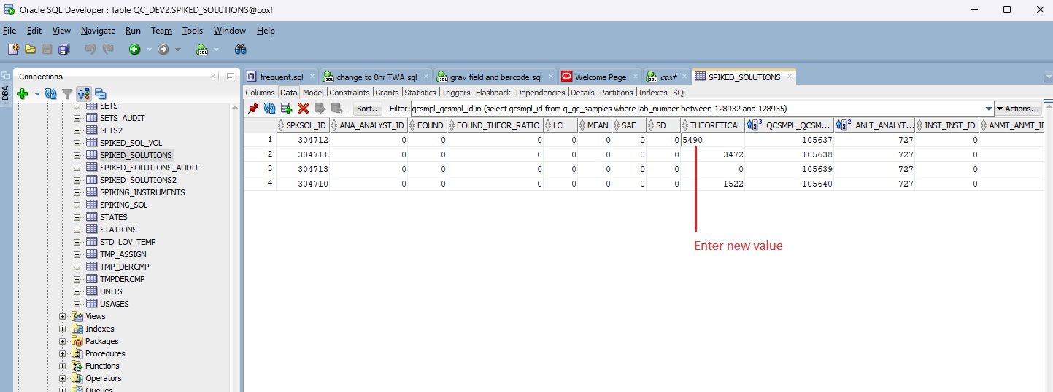

Slide 38
Nightly transfers to OIS
Should include all samples released that day that were received from OIS with a request.xml file
Can check if sample was received by:
Check lims_stage.sample_sets for sampling number
Check Mapforce server (10.158.39.15) for xml. Format is Request_samplingnumber.xml
Xml files received from OIS are in D:/ois_xchng/receive/OIS/archive

Slide 39
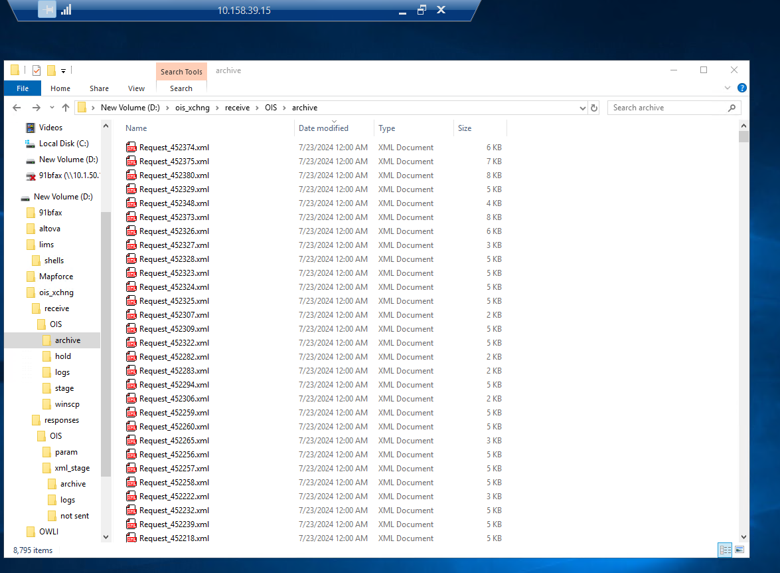

Slide 40
Nightly transfers to OIS (2)
Parameter list (ois_list.par) is generated by database nightly at 9:30 PM using procedure lisarpt.OIS_XML_RELEASE
If database or Mapforce server are down for the night, ois_list.par is not generated and no samples are transferred to OIS
Maintenance of servers usually begins on Friday evening at 2100 eastern time (we have tried on multiple occasions to get them to delay the start on SLTC servers because 2100 eastern is still working hours in Salt Lake but that usually only lasts a week)
Because of these shutdowns and occasional failures to generate parameter file, I usually check each day to see what xmls were sent for OIS to pick up

Slide 41
Nightly transfers to OIS (3)
Each night that xml responses are sent for OIS pickup an email is to me with the xml files attached. Heather can add people to receive the email by editing OIS_pm_3_upload.bat on the Mapforce server.
Each morning I open the email and check that number of attachments matches the number of sampling sheets released the previous day (query on next slide)
In the event that the nightly process fails, use the query below to re-generate the parameter list. For me it is easiest to export the list as text to the clipboard and paste it into an ois_list.par file on the mapforce server (D:/ois_xchng/response/OIS/param) and execute the Windows batch file that generates the xmls (D:/lims/shells/new_ois_run_lab_response_no_gen_list.bat)

Slide 42
SELECT
distinct flof_office_id, inspection_no, sampling_number, lbst_id
-- , to_char(released_on, 'DD-MON-YYYY HH24:MI'), labno_range
FROM l_sample_sets, l_samples, l_analysis_targets, l_lab_sets lbst
WHERE lbst_lbst_id = lbst.lbst_id and smpl_smpl_id = smpl_id and smst_smst_id = smst_id
AND released_on >= trunc(SYSDATE)
--AND trunc(released_on) = '18-JUN-2024'
--AND trunc(released_on) BETWEEN '02-MAR-2024' AND '05-MAR-2024'
AND flof_office_id BETWEEN 100000 AND 1099999
AND sampling_number IN
(SELECT sampling_number FROM lims_stage.sample_sets
WHERE date_created > trunc(sysdate) - 90)
order by 3,2;
Note: There are 3 options for release date, choose the appropriate one by commenting/uncommenting the others. You can also un-comment the line with released_on and range if needed. This query only looks for samples received in the last 90 days. That number may be extended by editing the nested select statement.

Slide 43
Data missing from OIS
When sample results are missing from OIS (usually by report from the field), the parameters can be generated using the appropriate identifier (inspection #, sampling #, lab #) from the following query:
SELECT DISTINCT flof_office_id, inspection_no, sampling_number, lbst_id
--, sampling_date, recvd_in_lab, released_on
FROM l_sample_sets, l_samples, l_analysis_targets, l_lab_sets
WHERE smst_smst_id = smst_id
AND smpl_smpl_id = smpl_id
AND lbst_lbst_id = lbst_id
AND result_posted_on > '01-JAN-1900'
--and lab_assigned_no between 'F23499' and 'F23524'
--AND sampling_number in ('412400','413982','413983','413984')
AND inspection_no IN ('1740661')
--and trunc(released_on) BETWEEN '02-MAR-2024' AND '05-MAR-2024'
order by 2,3 -- this is inspection_no, sampling_number
;

Slide 44
Data Missing from OIS (2)
Copy the results from the query as txt file to clipboard
Paste results into ois_list.par and save on Mapforce server (D:\ois_xchng\responses\OIS\param) and execute the Windows batch file that generates the xmls (D:/lims/shells/new_ois_run_lab_response_no_gen_list.bat)

Slide 45
Adding analysts to LISA
When a new analyst is hired, they will need a user account in LISA and they will also need to be entered in the analyst table so they can assign, edit and review samples.
Adding a new user requires the CREATE USER system privilege which can be granted by an Oracle DBA. Users with CREATE USER privilege may be required to take additional security training each year.

Slide 46
Creating a user
SET DEFINE OFF; -- skips prompting for values
CREATE USER SANDERSON
IDENTIFIED BY SEA20090826
DEFAULT TABLESPACE USERS
TEMPORARY TABLESPACE TEMP
PROFILE CHEMIST_ACCOUNTS
ACCOUNT UNLOCK;
-- 4 Roles for SANDERSON
GRANT CONNECT TO SANDERSON;
GRANT QC_USER TO SANDERSON;
GRANT QC_USER2 TO SANDERSON;
GRANT ANALYST2 TO SANDERSON;
ALTER USER SANDERSON DEFAULT ROLE ALL;

Slide 47
Adding users to analyst table
SET DEFINE OFF;
Insert into LIMS.ANALYSTS
(ANALYST_ID, PAY_GRADE, TITLE, LAST_NAME, FIRST_NAME,
DEPT_DEPT_ID, HOME_PHONE, MIDDLE_INITIAL, DATE_HIRED, EXPERTISE,
E_MAIL, EXTENSION, ANA_INITIALS_ID, INITIALS_ID, STATUS,
LOGON_ID, END_DATE, BEGIN_DATE)
Values
(l_ana_seq.nextval, 'GS-9', 'CHEMIST - ANALYST', 'EBAID', 'Bassem',
9, NULL, NULL, TO_DATE('05/23/2022 00:00:00', 'MM/DD/YYYY HH24:MI:SS'), 'CHEMISTRY',
'EBAID.BASSEM.S@DOL.GOV', NULL, 'BJA', 'BSE', NULL,
'SEBAID', NULL, NULL);
COMMIT;

Slide 48
Adding users to analyst table
Initials_id values are unique in LISA therefore I try to get 3 initials to avoid overlap
ana_initials_id are the initials of the analyst’s supervisor
Title needs to include “ANALYST” in order to show in the lists of value popups in LISA forms. When an analyst leaves or is no longer using LISA, edit the title to remove ANALYST
To see examples of titles:
select distinct title from l_analysts order by 1;

