Slide 1
Bell CI Requirements: Target Architecture

Slide 2
Hadoop ETL Demo

Slide 3


Hadoop ETL Platform
PDE binary files
Data Analytics Layer
HADOOP
Analytics Value Packs
Context Preferences Value Pack
Analytics & Reporting
(Tableau)
Nokia SGS-IWF (XML)
Analytics Core Platform
KPI Engine
HP CMS
ETL Function
Scheduler Engine
Database
Nokia vSMSC (XML)
HADOOP
HP Smart Profile Server (SPS)
E911
Femtocell
DEG
HLR/HSS

Slide 4
Flow Definition
Notes:
Add the data source and data sink and color it

Slide 5
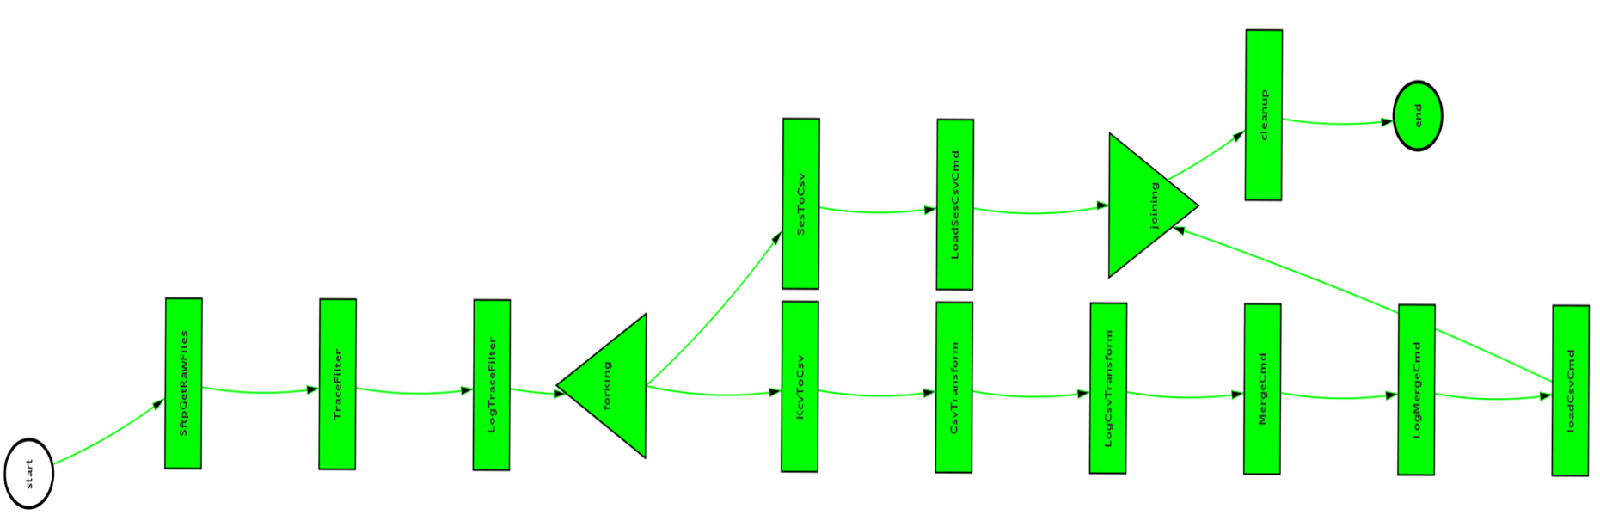
Flow Batch Execution on hive

Slide 6
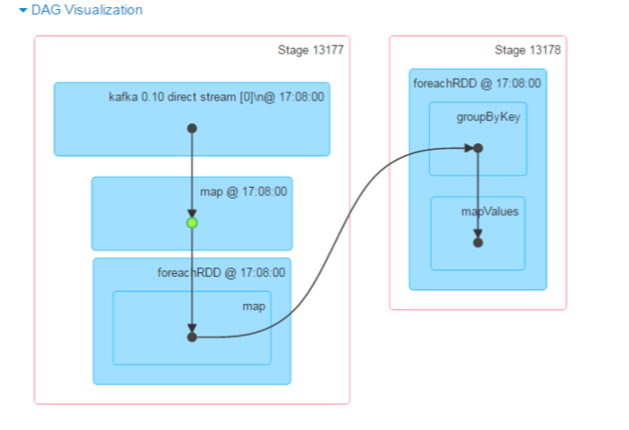
Flow Streaming Execution on Spark

Slide 7
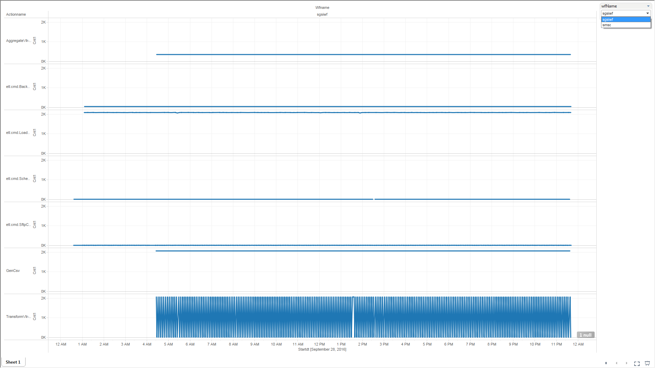
Flow Monitoring

Slide 8
Reusable/Extensible Cmd Library

Slide 9
Csv Transform Cmd

Slide 10
Csv Merge Cmd

Slide 11
Csv Aggregate Cmd

Slide 12
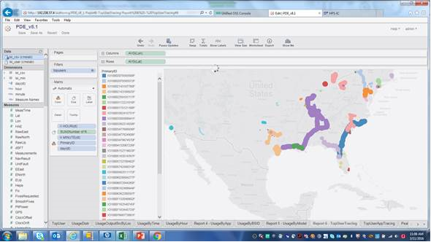
Sample Project 1: Location Based Services Analytics
HP provide the Assisted GPS (A-GPS) Location Based Services (LBS) platform for low-power, 3G A-GPS and Advanced Forward Link Trilateration (ALFT) location service in 2005
The CSP purchased Hughes Telematics in 2012, and launched a Fleet Tracking service in 2013, exclusive to the CSP’s network
With Internet of Things (IoT) and Machine to Machine (M2M) acceleration via Communication Service Provider (CSP) Fleet Tracking service, rapid growth demand generated on the HP CMS A-GPS Position Determining Entity (PDE) platform, and the CSP’s 4G A-GPS PDE platform
Analytics are needed to correlate highest users of A-GPS look-up by device type, geo-graphic location, MSISDN and application, to plan and proactively manage this growth and SLA’s for applications and partners.
The HP Big Data Analytics solution resolves these challenges. The HP CMS Smart Profile Server (SPS) with Hadoop Extract Transfer and Load (ETL) solution allows the operator to manage growth patterns and peak usage of the PDE system.
The Hadoop ETL is used to load large amounts of data and convert from binary to CSV files for the SPS platform

Slide 13
LBS (SPS) System Architecture
PDE binary files
Data Analytics Layer
HADOOP
Analytics Value Packs
Context Preferences Value Pack
Analytics & Reporting
(Tableau)
Nokia SGS-IWF (XML)
Analytics Core Platform
KPI Engine
HP CMS
ETL Function
Scheduler Engine
Database
Nokia vSMSC (XML)
HADOOP
HP Smart Profile Server (SPS)
E911
Femtocell
DEG
HLR/HSS

Slide 14
Example Project 2: Mobile Terminated Core Nokia Analytics Overview
Verizon is deploying new Mobile Terminated Call (MTC) virtual equipment, the SGS-IWF and vSMSC
Nokia could not provide the KPI’s and data to integrate to customer’s Operations reporting environment
Instead, Verizon has contracted with HPE to provide the analytics for these components using the HPE LBS Analytics SPS platform, currently operation at Verizon
HPE will interface to the SGS-IWF and SMSC components and collect data from these systems
The SPS will ingest this data, and dashboards will be created from the data
The existing Verizon system had hardware capacity to install and operate this new MTC Core Analytics Value Pack

Slide 15
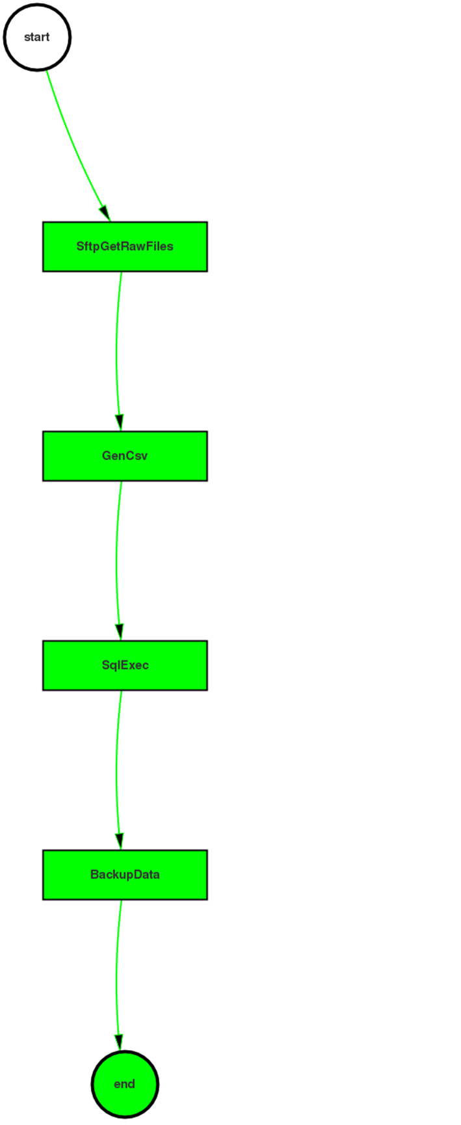

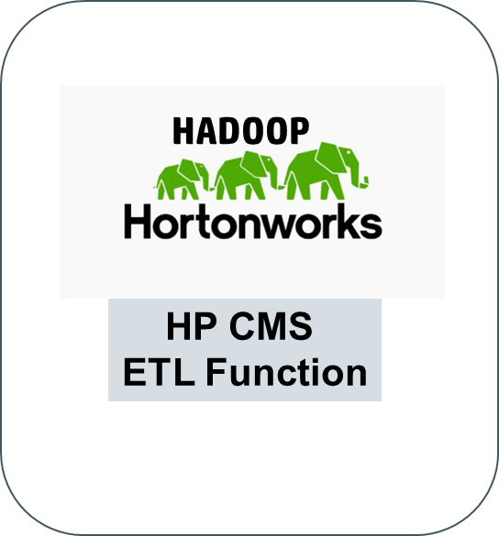
Sample Project 2: MTC Core Analysis
Nokia XML input
ETL Process
CSV for SPS
ETL process provides dynamic discovery of XML data from Nokia
Changes made in the XML data are automatically discovered and stored in the database

Slide 16
Sample Project 3: E911 Analytic System Architecture
LBS
Data Analytics Layer
HADOOP
Analytics Value Packs
Nokia MTC
Value Packs
Analytics & Reporting
(Tableau)
Analytics Core Platform
KPI Engine
Femtocell
HP CMS
ETL Function
Scheduler Engine
Database
SPC
HP Smart Profile Server (SPS)
E911
PKI, SYSLOG, others
Currently under contract
In work

Slide 17
Sample Project 4: SPC (DEG) Analytics Overview
Up to 70 X Speed Improvement and Simplified Analysis and ETL Using the SPS DAL
Overview
Verizon has deployed the Subscriber Profile Controller (SPC) to provide subscriber authentication and application authorization of 4G services hosted by ASPs
The SPC Management Complex uses data from the SPC to provide robust reports with graphical displays that are interactive and allow the user flexibility to view the report based on their needs
The Management Complex also provides reporting capabilities around hardware and OS metrics that display database growth for Unique Identifier Header (UIDH) and the subscriber base
Business Need
Due to the growth of the SPC, the Management Complex reporting capabilities are approaching the limits of the current Oracle database causing reports to run too slowly (in excess of 10 minutes)
HPE has conducted a Proof of Concept with the SPS offering improvement in analysis time, a much simpler process for Extract, Transfer, and Load (ETL), and improved analysis capabilities

Slide 18
Sample Project 5: Femtocell Analytics
The femto access point (FAP) is a Samsung hardware device located at the customer’s premise that interfaces with mobile devices over-the air radio interface.
Verizon has contracted with HPE to provide Femtocell analytics using the SPS analytics system
Analytics reports include:
In service units - band class
RRC connection setup failure %
RRC Connection Ues
ERAB setup failures, ERAB drops
S1 handover failures
S1 HO failures by Market ID
X2 handover failures
Throughput, downlink volume, uplink volume
Volume vs. number of eFemtos
Number of devices reporting VoLTE
QCI1 setup failures

