Slide 1
Modeling for Outbreak Prediction

Slide 2
Research Question
Can a temporal, heterogeneous hospital graph + GNN identify undetected VRE carriers early enough to guide screening/isolation?
VRE (Vancomycin-Resistant Enterococcus)
VRE are gut bacteria that have become resistant to vancomycin, one of the last-line antibiotics. They can live harmlessly in the intestine but spread easily in hospitals via surfaces and staff contact.
Motivation
There is a lack of standardized screening criteria for VRE. We hope to make strides in proposing a model to predict VRE carriers.

Slide 3
Data
Setting/Scope
Single Tertiary Hospital, 2019
EHR extract of >8000 patients
125,947 recorded interactions/movements
Labels
Daily VRE status
ICD diagnoses
Barthel indices
Origin
From patient data management system
Laboratory information system
Privacy
Dataset not publicly shareable for data-protection reasons

Slide 4
Network Construction
Heterogeneous, Undirected, Unweighted

Slide 5
Nodes and Edges
Patients
Age, Sex
Care Level
Open Wounds
Days since admission
No weights, exposure is implied via repeated links
Wards
Various clinical wards including ICUs
39 Total Wards
Binary Feature (ICU or not)
Rooms/Beds
606 rooms
Rooms sit on wards and on organizational units
770 bed places
Beds sit on rooms
Organizational Units
Services
Clinics
150 Org Units
Patients are linked to Org Unit visits

Slide 6
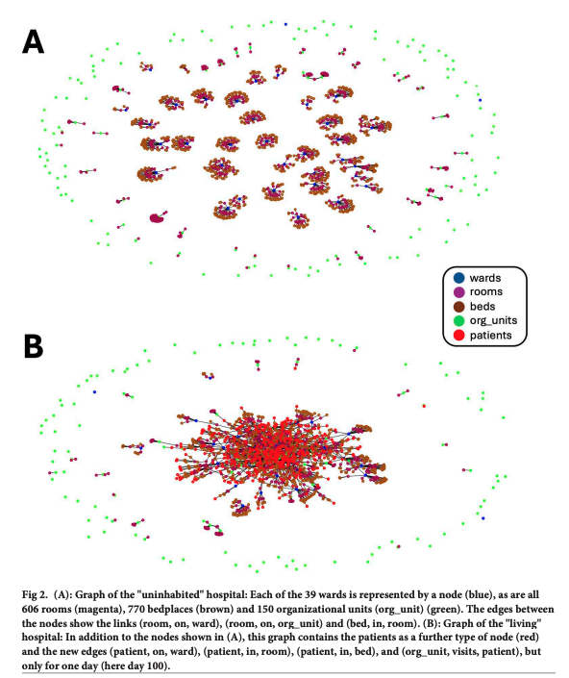

Slide 7
Static vs Dynamic
Static
Dynamic
Daily graph G(T) with all patients & spatial relations on day T
Temporal edges connect G(T), G(T−1)…G(T−7) (rolling 7‑day context)
Patient features restricted to information available up to day T
Enables alerting and evolving risk per ward/room
Single time-collapsed graph for the full period
Patients connected via shared spaces across time
Simple baseline, learns structural risk
May lead to spurious long‑range links across months

Slide 8
Metrics
1
Structure
Degree/Turnover (Ranked by no. of contacts and rate of churn)
Betweenness (Bridges that move risk e.g. CT room)
Clustering (Local outbreaks)
2
Dynamics
Assortativity (Is risk exported?)
Two-hop exposure (Who gets indirect exposure in the 7-day window)
Communities (Natural care paths that introduce/mitigate risk)
3
Proof
Relation/Importance (Which edges or patient features matter most)
Performance (is it timely?)

Slide 9
Training
Labeling – Static
Label patient positive if any positive test in year
Label patient negative if ≥1 negative and never positive
Otherwise, unknown
Labeling – Dynamic
Label patient positive if positive test ≤ T or within T…T+3 (up to 3‑day look‑ahead)
Label patient negative if no positive ≤ T+3 and a negative test in [T−2, T+12]
Otherwise, unknown
Training – Static
Split: 5‑fold cross‑validation (transductive on full graph), with a held‑out validation slice per fold
Optimizer & loss: Adam + cross‑entropy
Typical hyperparams: hidden dim ≈ 512; batch size ≈ 512; lr ≈ 1e‑5; up to 200 epochs with early stopping
Training – Dynamic
Temporal split: train on sequences up to cutoff day; validate on next 7 days; test on following 7 days
Repeat across multiple temporal shifts for robustness
Training window sensitivity: compare 30 vs 60 vs 90 days using identical val/test windows

Slide 10
Findings
Primary Results
Accurate early identification: The dynamic heterogeneous GNN flagged likely VRE carriers up to 3 days before microbiologic confirmation
Dynamic model (all features) achieved macro F1 = 0.880, sensitivity = 0.808, specificity = 0.942.
Model Comparisons
Dynamic > Static across the board (≈+20% macro‑F1 with all features):
Static (all features): F1 0.685, sens 0.624, spec 0.788.
Dynamic (all features): F1 0.880, sens 0.808, spec 0.942
Temporal modeling matters: Injecting day-by-day hospital graphs reduced false positives vs. the static graph by capturing time-varying ward/room risk and patient trajectories.
Training window sufficiency: 30-day training was enough, extending to 60 or 90 days produced no meaningful improvement

Slide 11
Reflections
1
Class Imbalance and Sample Size
2
Label Noise
3
Deployability

Slide 12
Questions

