Slide 1

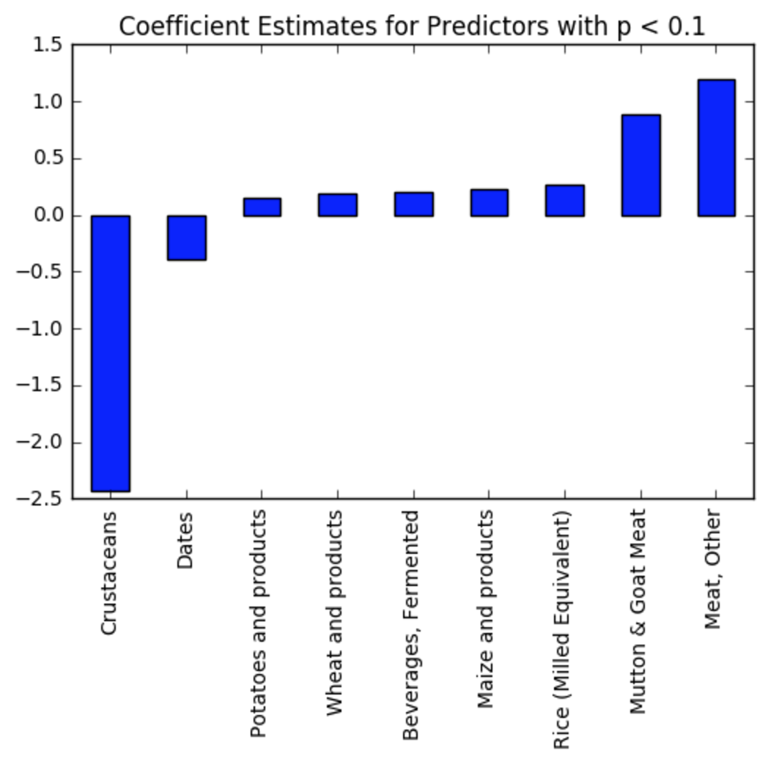
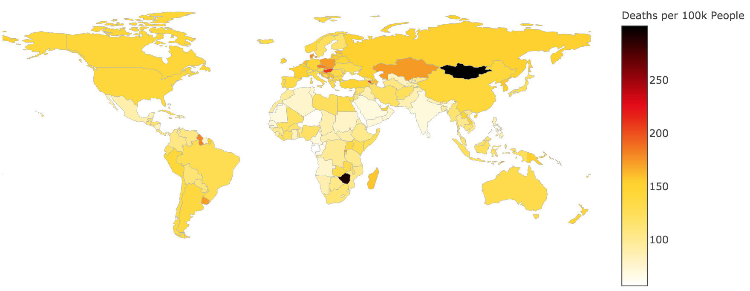
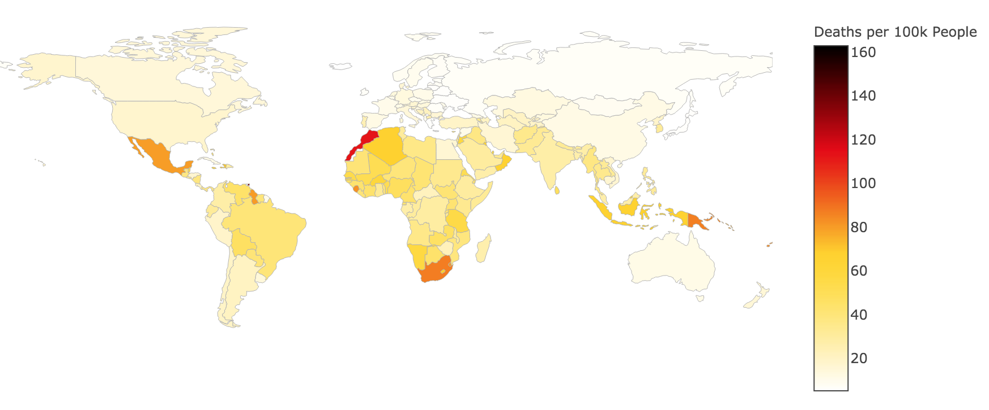
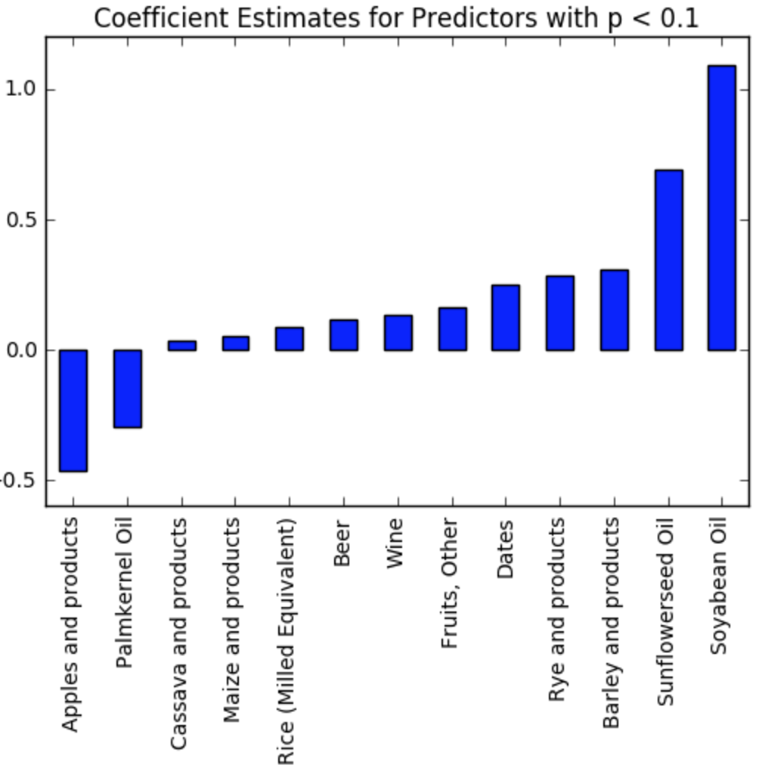
You Are What You Eat:
The Effect of Diet on Health
By Christopher Chen, Joshua Felizardo, Phillip Huang, and Harry Xue | CS 109: Data Science | TF: Steve Klosterman | Fall 2016
Summary
In this project we investigate the effect of the types of foods people eat on their health. We accomplish this by measuring the connection between food consumption amounts and deaths from non-communicable diseases for countries around the world.
Data Sources
Current Model
Crop and Meat Data from Food and Agriculture Organization of the United Nations (FAO)
Non-communicable Disease Data from World Health Organization (WHO)
Steps taken after baseline:
Removed food items that overlap significantly
Used variable selection via Lasso Regression
Results:
Deaths from Cancer per 100k people
Cleaning the Data
Averaging each individual food category over different ranges of years
Dropping countries and food categories with more than 50% of their data missing
Dealing with aggregate food categories
Data Visualization
Deaths from Cancer per 100k people in 2000
Deaths from Diabetes per 100k people in 2000
Deaths per 100k, Diabetes
Baseline Linear Regression
Counterintuitive results
Issues: normality of residuals, heteroscedasticity, multicollinearity, linearity
Next step: variable selection (Lasso), transformations
John A. Paulson School of Engineering and Applied Sciences

