Slide 1
Entering the population
HIV-negative
HIV-positive

Slide 2
Entering the population
HIV-negative
HIV-positive
PrEP Users

Slide 3
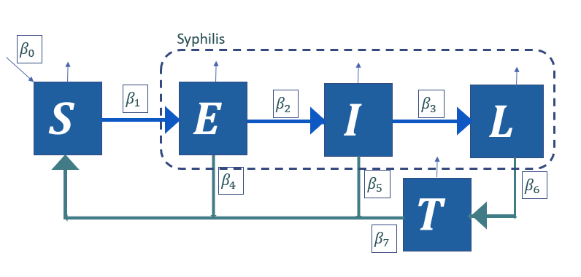
Entering the population
HIV-negative
HIV-positive
PrEP Users

