Slide 1
Credit Decision Update Process Overview
Prepared for Credit One
By Phillip Roman

Slide 2
Goals
The goal is to determine whether the insights that can be derived from the customer’s payment history is consistent enough to be used to determine the probability of default. Below are the three top outcomes:
Identify customer attributes that are correlated to default status.
Utilize identified attributes to create a better credit approval model.
Reduce default rate by implementing model in production.

Slide 3
Data Science Framework
The BADIR framework is the best to use for this situation.
BADIR stands for:
Business Question
Analysis Plan
Data Collection
Insights
Recommendation
Each step is dependent on the others. This is a great framework for business because the root of all action is to answer the defined business questions.

Slide 4
BADIR
Business Question
Predict the probability of default during the credit decision process to reduce write-offs and increase interest collection
Analysis Plan
Validate the hypothesis that customers who default on other bills are likely to default on the targeted loan
Data Collection
Normalize the balance and payment amounts
Insights
Features with the largest correlation with default status
Recommendation
Implement the updated model in the production environment for credit decisions

Slide 5
Managing the Data
The consumer credit information is provided by Credit One.
The data set contains:
Consumer attributes
History of past payment
Repayment status
Bill statement amount
Payment amount
The dataset will be loaded into a Python environment called Jupyter Notebook.
Jupyter Notebooks allow for advanced algorithms to be completed to determine the features that are highly correlated to default status
Models will be tested and ranked to determine the best set of conditions to minimize default

Slide 6
Initial Insights and Known Issues
The range of the payments and balances fields is vast
These fields will need to be normalized to add context

Slide 7
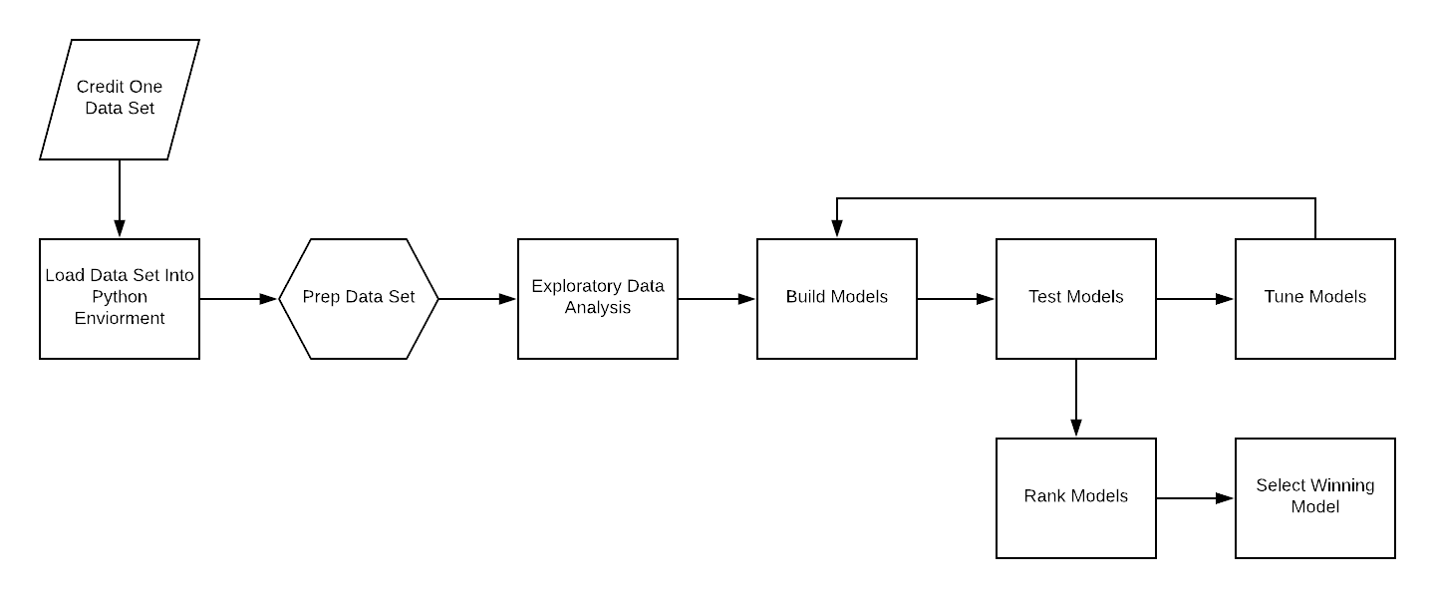
Flowchart

Slide 8
Appendix
Full BADIR Write-up

Slide 9
BADIR - Business question
What is the stated business question?
Credit One has seen an increase in loan defaults from their partner’s customers. The client would like to reduce the default rate in order to prevent writing off loans and capture interest payments.
What is the intent underlying the question (e.g., what is the context, what is the impacted segment, and what are stakeholders’ current thoughts about the underlying reasons?
Since Credit One is the credit scoring service, the company stands to lose clients if clients perceive an inability to correctly predict credit worthiness.
What business considerations (e.g., stakeholders, timeline, and cost) are likely to impact the analysis?
The data team was given full authority to find a solution to the issue.

Slide 10
BADIR - Analysis plan
What is the analysis goal?
We have been asked to design and implement a solution to predict customers who are likely to default on loans.
What hypotheses are to be tested?
There is an understanding that customers who default on other bills are likely to default on the targeted loan.
What data is required/available to test the hypotheses?
We have payment history for 6 previous months. We also have the bill amount and amount paid.
What methodology(-ies) will you employ?
Default rate from customer segmentation of customers that had late payments and that did not have late payments. Segmentation analysis can help validate assumptions between different groups of customers. Also, correlation analysis can help determine the relationship between different attributes. Features that are highly correlated should be included in the analysis.
What is the project plan (timeline and milestones, risks, phasing, prioritization, …)?
The timeline will be dictated by the client. Once the initial meeting has been established.

Slide 11
BADIR - Data collection
From where can the data be obtained?
The data was provided by the client and includes payment history and default status of 30,000 customers.
How must the data be cleansed and validated?
The data is structured in a table and does not include any null values. The payment and balance fields do have large ranges that will make analysis difficult. There are a few different tactics that can be implemented to ensure that proper analysis can be conducted. The fields can be bucketed into appropriate groups or normalized to show distance between the different points.

Slide 12
BADIR - Insights
What patterns do you see in the data?
Significant patterns have not been observed in the preliminary views.
Are each of the hypotheses proven or disproven?
Hypotheses have yet to be tested.
How much confidence should stakeholders place in the results?
Data analytics have varying levels of confidence based on the methodologies used. Models used for prediction will have corresponding confidence intervals based on based on training data.
How do you rank your findings in terms of quantified impact on the business?
The findings of this analysis should have lasting impacts to the business. The client is looking to better predict default. Once a better model is developed, the default rates will be reduced and insuring the repayment of borrowed money will be paid back with interest.

Slide 13
BADIR - Recommendation
How can you most effectively present the results of your analysis to your stakeholders (in terms they can understand and in alignment with information they’ll value)?
The results will be shared with the client in two forms. There will be a technical analysis report that is given to the client and shared with system engineers for implementation into their credit systems. Furthermore, the finding will also be shared with the leadership team in a non-technical executive summary. The high-level concepts of the model will be broken down and outlined for consumption.

