Slide 1
Overview
A new cryptographic primitive: Access Control Polynomial (ACP)
Its powerful features and applicability to various security functions uniformly
Trusted Collaborative Computing (TCC) and ACP support to TCC

Slide 2
A new group key management scheme
Assumption:
  A group controller,
  a group of users U₁,…,U_{n} with secret identifiers SID₁,…,SID_{n} ,
  f : a cryptographic hash function and made public
A new cryptographic primitive: Access Control Polynomial (ACP)
  A(x)=(x-f(SID₁,z))(x-f(SID₂,z))•••(x-f(SID_{n},z))
    z is a random value and changed every time
    A(x) will be evaluated to ZERO when x is substituted by f(SID_{i},z), otherwise, a random value.
Compute P(x)=A(x)+K, K is some secret to be distributed
Multicast (z, P(x))
Any user whose SID_{i} is included in A(x) can get K as:
    K=P(f(SID_{i.}, z))

Slide 3
Security and performance of ACP
Secure against any form of attacks including colluding attacks.
  One-way feature of cryptographic hash function f.
  Randomized and ever-changing z
Complexity:
  Generation of A(x) or P(x): O(n²)
  Key computation and derivation: O(n),
    even O(log(n)) by hierarchical grouping.
  Communication: O(n).

Slide 4
Powerful Features
Seamless/uniform support to various security functions
  Secure group communication, secure dynamic conference, differential access control, hierarchical access control
Support high dynamics
  Single join, singe leave, multiple joins/leaves
  Allow temporary revocation
Support random relations and structures (fine-granularity)
Simple, practical and efficient

Slide 5
Powerful Features (Cont.)
Defend against any form of collusion.
Support anonymity
  Hide group members and group size
  A(x)=(x-f(SID₁,z))•••(x-f(SID_{n},z))(x-VID₁)•••(x-VID_{r})
Support non-member serialization

Slide 6


ACP Support to Secure group communication (SGC)
A (large) group of users communicate with one another in such a way such that outsiders are unable to understand any information even when they are able to intercept the messages.
??
Internet
  ACP:
  1. all group users’ SID1,SID2,…,SIDn
are included in A(x).
2. When users join and leave, the group
controller reselects a new K and just
includes the SIDs of the joining users and
excludes the SIDs of leaving users in the
computation of A(x).

Slide 7
ACP Support to Secure Dynamic Conferencing (SDC)
  Any subset of users in a universe can form a secure communicating group,
ACP: For any conference,
A(x) contains the SIDs of all
the members in the conference.

Slide 8
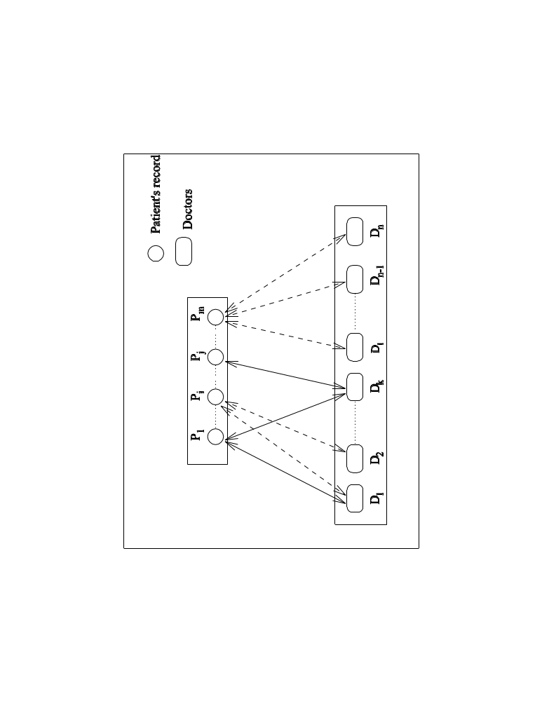
Differential access control (DIF-AC)
Many-to-many relation.
  ACP:
  For each resource, its A(x)
  contains the SIDs of all the
  users able to access
  the resource.
  For each user, its SID is
  contained in A(x)s of all the
  resources to which the
  user can access.
A doctor can (and only can) access certain patients’ records
A patient’s record can (and only can) be accessed by certain doctors

Slide 9
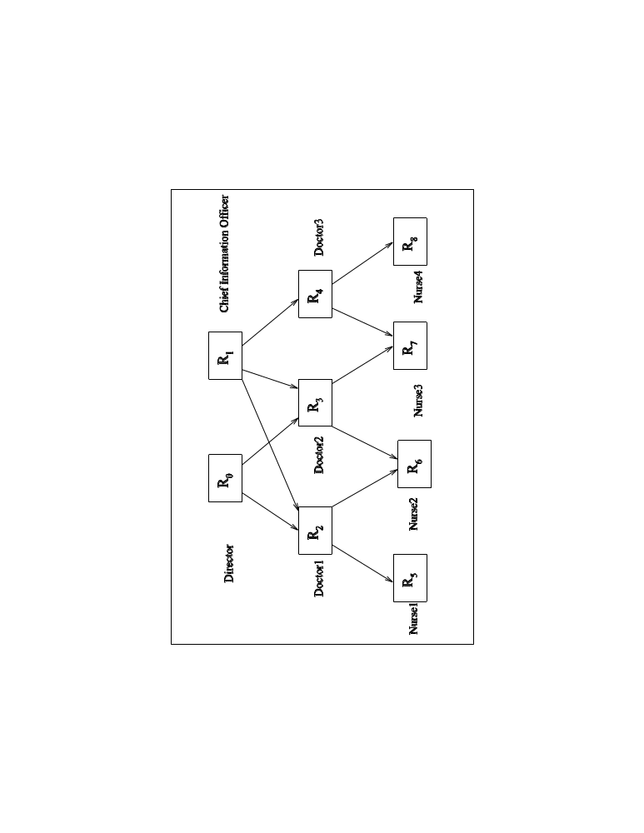
Hierarchical access control (HAC)
  ACP:
  1. For any resource R_{i} with RID_{i},
  suppose R_{i1},…,R_{im} are its ancestors
  with RID_{i1},…,RID_{im}, then its key K_{i}
  is sent as: P_{i}(x) = A_{i}(x) +K_{i}
  =(x-f(RID_{i},z))(x-f(RID_{i1},z))•••(x-f(RID_{im},z))+ K_{i}
  As a result, R_{i} as well as all its ancestors
  can get key K_{i}.
2. Moreover, RID_{i} can be securely sent to
the users in R_{i} using ACP itself.
Patients’ records possess hierarchical properties, so do users.
A doctor who can access some kind of records is automatically
granted to access its subsidiary records.

Slide 10
Collaborative computing (CC)
Traditional two-party applications:
  Client-server (request-response) model or two party interaction
Collaborative computing , Increasingly popular:
  Multi-party collaboration and interaction
  Typical applications:
    Tele-conferencing, tele-medicine, multi-party computation, collaborative decision-making, information distribution, video/audio streaming service, …
Collaborative Virtual IT World
(from ACM article ”Coming Soon...a Single, Global, Collaborative Virtual IT World (Phew!)” http://www.acm.org/technews/current/homepage.html#item9)

Slide 11
Trusted Collaborative Computing (TCC)
The Internet is not security-oriented by design
  Various Attacks
  Faults and failures
  Patches resulting in more vulnerability
Multiple users
  Dynamics
  Internal malicious users,
  Collusions
Voluminous Shared resources
  Dynamics
  Heterogeneity
  Fine-tuned access control
Need to establish trust for CC
  Highly Secure
  Highly Dependable
  Able to defend against external attacks but also internal faults and failures, most importantly, prevent the internal attacks.

Slide 12
ACP support for TCC
CC is characterized by multiple entities performing collaborative tasks
Two fundamental security functions for TCC
  Group-oriented communication and interaction
    Secure group communication (SGC)
    Secure dynamic conferencing (SDC)
  Resource/data sharing and access control
    Differential access control (DIF-AC)
    Hierarchical access control (HAC)
ACP seamlessly supports TCC.

Slide 13
Summary
An elegant cryptographic primitive and
key management mechanism: ACP
Its powerful support to different security functions, in particular, its seamless support to Trusted Collaborative Computing

