Slide 1
(Hierarchy) Access Control
Which subject (user) accesses which object (resource) in which mode (permission, operation).
Traditional Access Control
  DAC (Discretionary Access Control)
  MAC (Mandatory Access Control)
  RBAC (Role-Based Access Control).
Cryptography based Access Control.
Hierarchical Access Control.

Slide 2
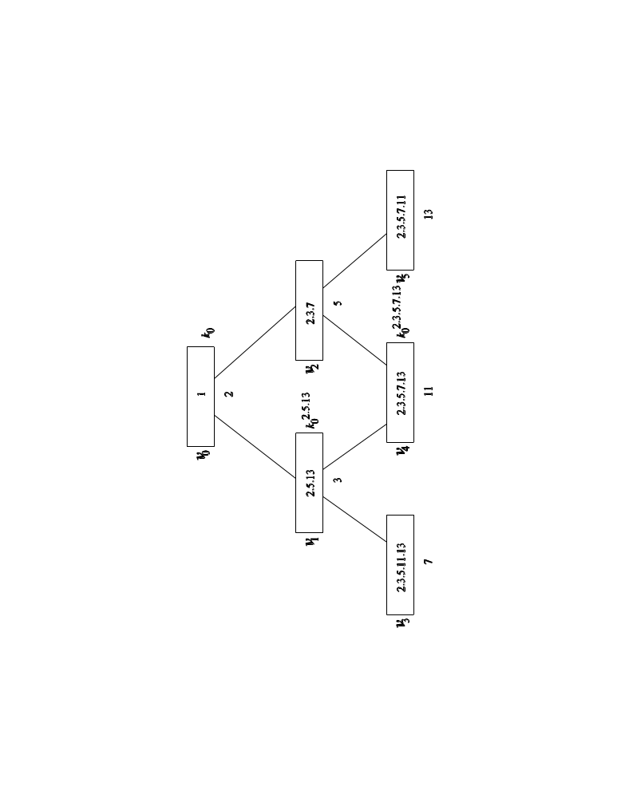
CHAC (Cryptographic Hierarchical Access Control)
Every node is associated a key, an ancestral node can derive its
descendant’s key via its key, but the reverse is not allowed.
N=pq, where p and q are two large primes.
Each node ni is assigned:
a distinct prime pi.
a public value ti , which is the product of pj and vi≤vj. The root is 1.
a secret ki =k0^{ti} mod N where k0 is the root key.
For any vi≤vj, tj|ti. vj can compute vi’s key as: ki=(kj)^{ti/tj mod N (i.e.,} =k0^{ti}).

Slide 3
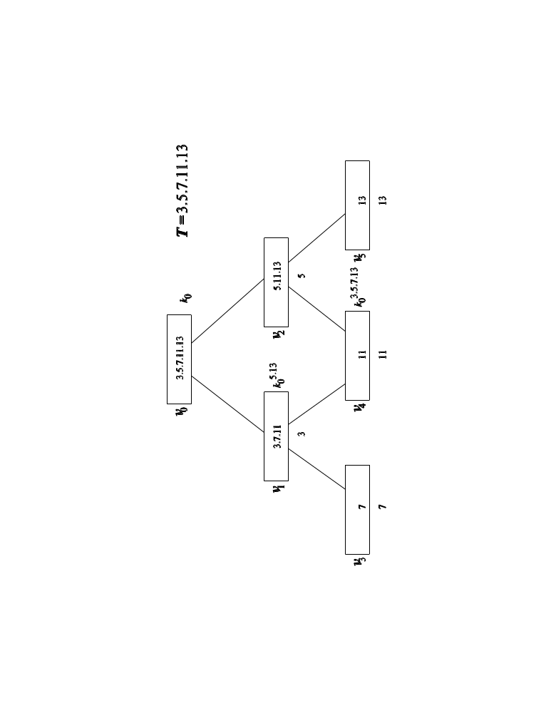
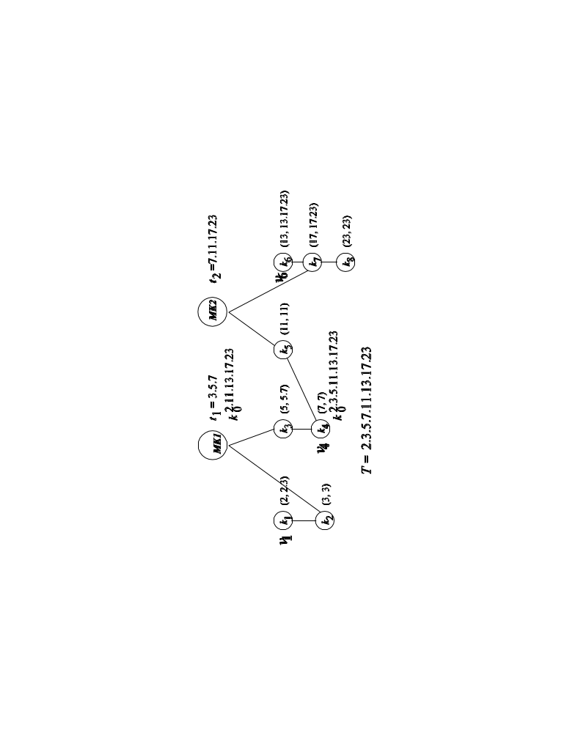
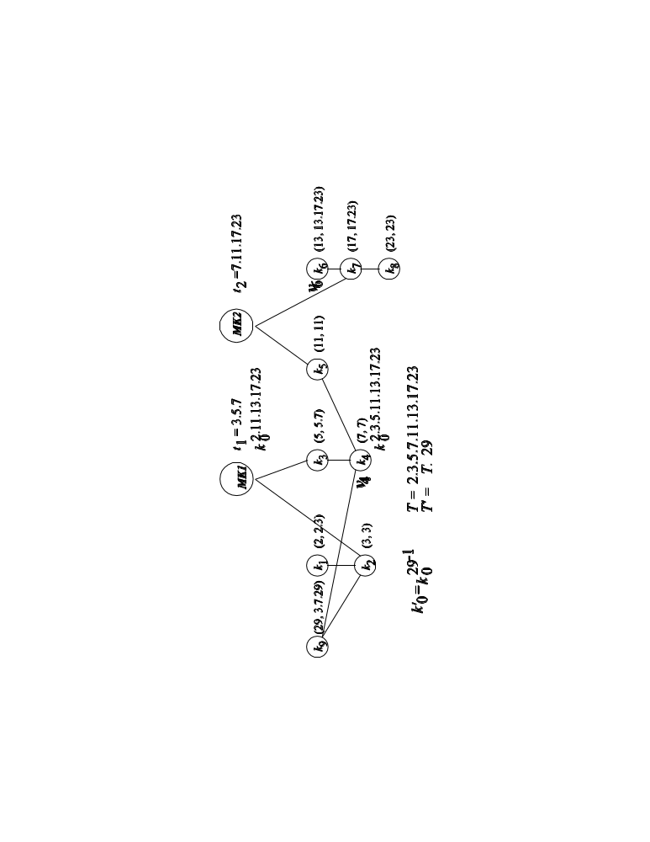
Improvement to Akl-Taylor scheme
Multiple roots
ti may be smaller
Addition of a root node.
k_{i}=k₀^{(T/ti)}
Vn+1, pn+1 (gcd(pn+1,φ(N)=1), tn+1 as before
T’=T*pn+1,, k0’=k0^{pn+1-1}, kn+1=(k0’)^{T’/tn+1}
All other ki keep unchanged.

Slide 4
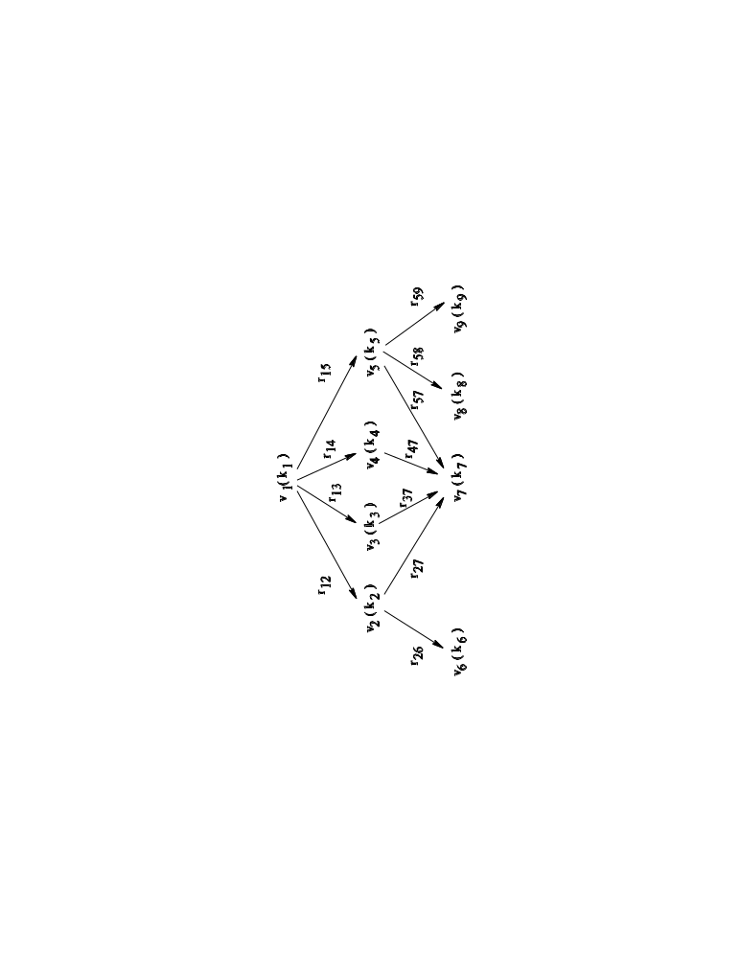
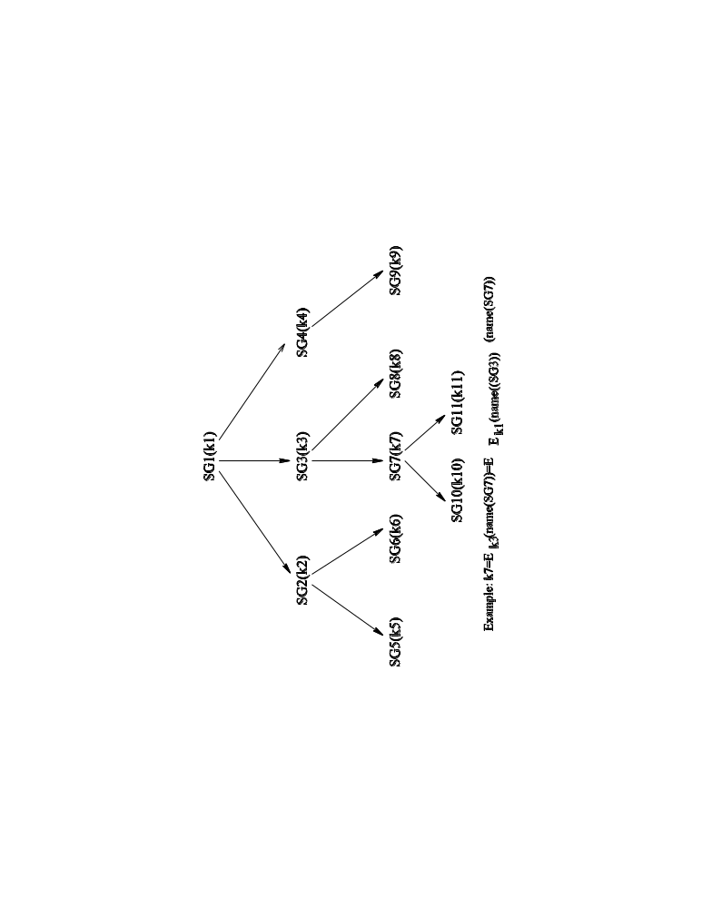
Lin’s scheme and Sandhu’s scheme
For vi≤ vj, rji=F(kj,IDi)⊕ki.
So vj can compute ki as
ki=rji ⊕F(kj,IDi)
kj=Ek_{i}(name(Sj)).

Slide 5

Index based CHAC and CRTHACS
Omitted, refer to the print-out.
Also Chapter 5 of the SGC book.

Slide 6
Many different schemes
Problems:
  Restrict hierarchy to have a root or to be a tree
  Can not deal with dynamics efficiently
    Node level
    User level

Slide 7
Symmetric polynomial based CHAC
Principles:
  One secret symmetric polynomial p(x1,x2,…,xm).
  Each node n_{i} is assigned a public value s_{i}.
  Some other public values s_{j}′.
  Each node n_{i} is assigned a secret poly g_{i} computed from p by setting x1, x2,…,xr to s_{i} and its ancestral s_{i}.
  Node n_{i} key is the value computed from g_{i} by setting the xi with the s_{j}′, or to say from p by setting some xi with itself and its ancestral s_{i} and the left xi with the s_{j}′.
  Thus a node can compute its descendant key using its g_{i.}
Solve all the above problems.
Server keeps the same poly as each node.

Slide 8
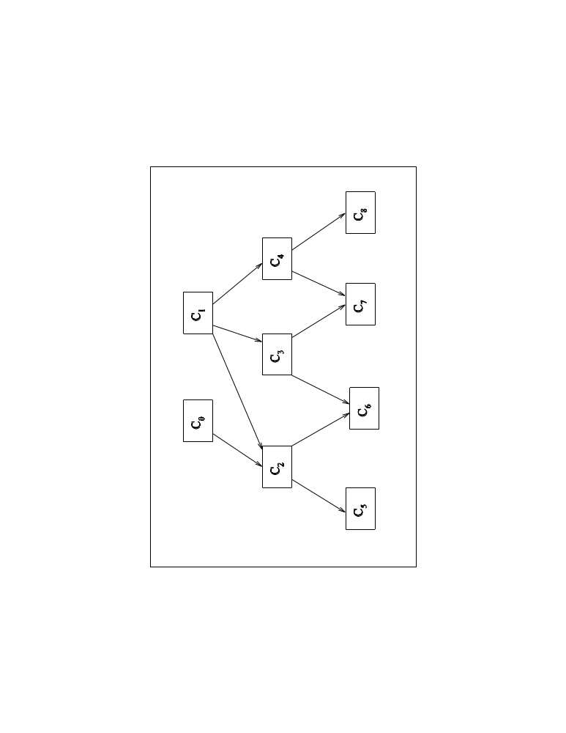
Example
M=6, p(x1,x2,x3,x4,x5,x6) (secret)
s1’,s2’,s2’,s4’,s5’,s6’, (public)
s0,g0
C2: g2(x4,x5,x6)=p(s0,s1,s2,x4,x5,x6)
C6: g6(x6)=p(s0,s1,s2,s3,s6,x6)
C7: g7(x5,x6)=p(s1,s3,s4,s7,x5,x6)
s2,g2
s4,g4
C2: k2=g2(s1’,s2’,s3’)=p(s0,s1,s2,s1’,s2’,s3’)
C6: k6=g6(s1’)=p(s0,s1,s2,s3,s6,s1’)
C7: k7=g7(s1’,s2’)=p(s1,s3,s4,s7, s1’,s2’)
C2→C6: k6=g2(s3,s6,s1’)
But C2 can not for C7, since s0 is not in k7.
s6,g6
s7,g7

Slide 9
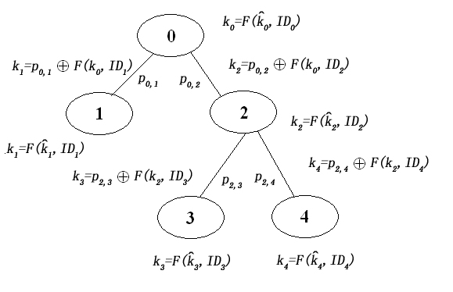
New CHAC scheme (Prof. Atallah)
1. Every node ni is assigned IDi and Ki’, IDi is public.
2. ni computes ki=f(ki’,IDi).
3. Each edge, pi,j=Kj⊕f(ki,IDj)
Thus, ni can compute Kj as:
Kj=pi,j⊕f(ki,IDj)
Dynamics can be done locally.
Note: ki’ is \hat{ki}

