Slide 1
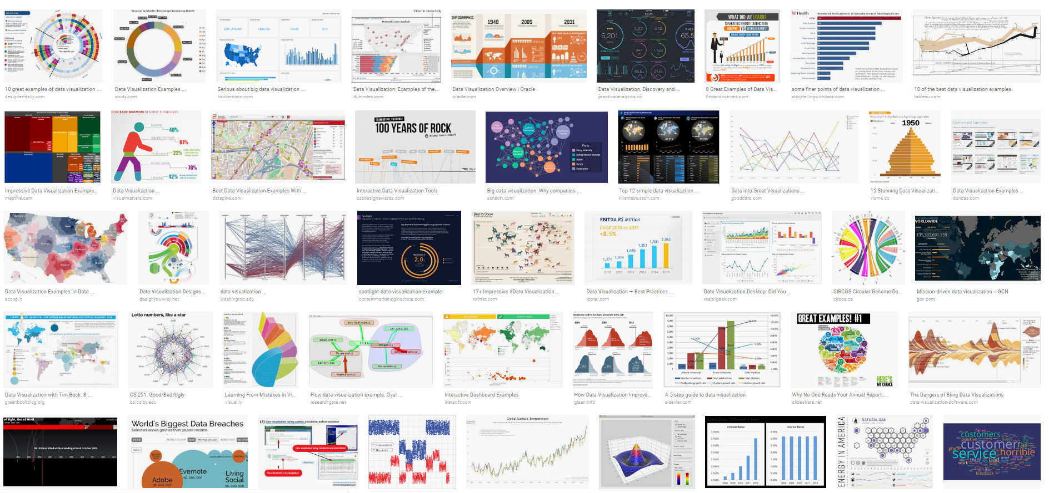
So…you want to get involved in Data Analytics!!
What is the US job Market showing
Presented by: Zhen Yang, Wenchao Wang, Bing Zhang,
Enrique Lambrano and Kevin Phillips
January 19, 2019

Slide 2

Key findings
Data Analysis is a skill and a job title
While Data Scientists are expecting significant growth other Occupations with Data Analytics skill requirements have experienced similar growth trends over 2014-2017
Occupations with a Data Analytics focus are high paying jobs, though there is a wide range based on Industry and Occupation title
In August 2018 Amazon was the top hiring company
Top 5 cities with Data Scientist positions in August 2018
New York
Seattle
Cambridge
Boston
San Francisco

Slide 3

About our data
BLS has a huge amount of data so we applied filters on the Occupation to make this data relevant
We focused on 11 occupations that appeared the most relevant
Data Scientists are lumped into the “statistician” Occupation title
One of the BLS data series provided data from 2014 – 2017
This data is available in the form of a CVS
The second BLS series had more regional information but has fewer data points available to analyze. This data set was also restricted to 2017
This data was from the API call which had some very complex variables that needed to be coded around to properly pull data from the AP

Slide 4

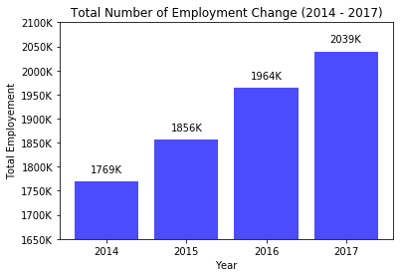
◆ Total Number of Employment Growth (2014 – 2017)
Increase over 4 years: 270K
Destination
2018

Slide 5
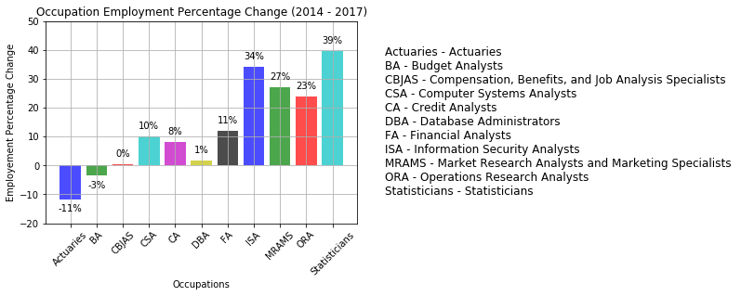
◆ Occupation Employment Percentage Change (2014 - 2017)
[Top 3] Statisticians, Information Security Analysts, Market Research Analysts and Marketing Specialists

Slide 6
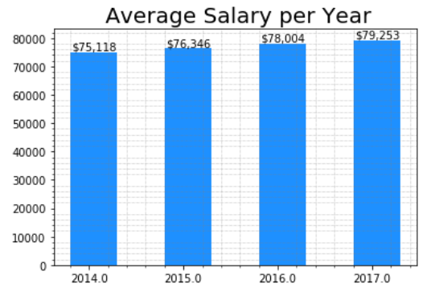
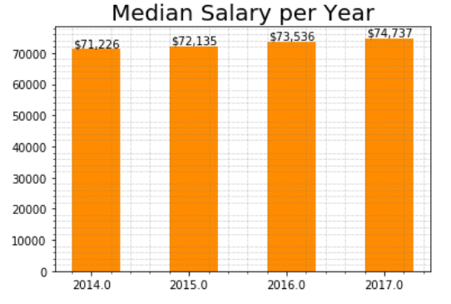
◆ Trend of salary growth └ Median is a better predictor in this case └Average＞Median, which means the distribution of salary is skewed (=some analysts’ salary is much higher than the majority)
【Increase Range】：$75k~79k (about$4k)
【Growth Rate】 ：［Average］≈ 1.8%
【Increase Range】：$71k ~74k (about$4k)
【Growth Rate】 ：［Average］≈ 1.6%

Slide 7
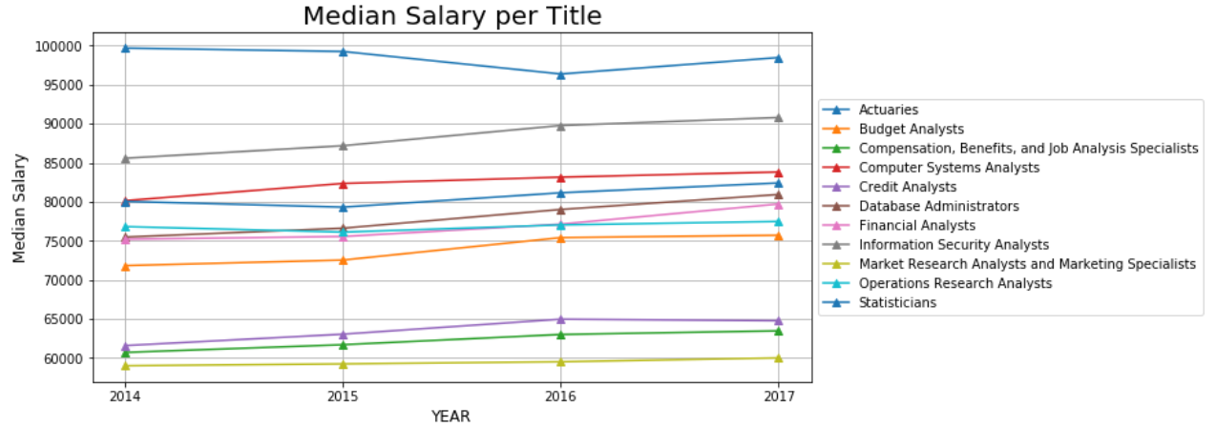
◆Compare the Yearly Salary for each job title
[Top 5] Actuaries, Information Security Analysts, Computer Systems Analysts,
statisticians, Database Administrators
Most of them is more than $70,000 per year
Marketing Analysts is lower than $60,000

Slide 8
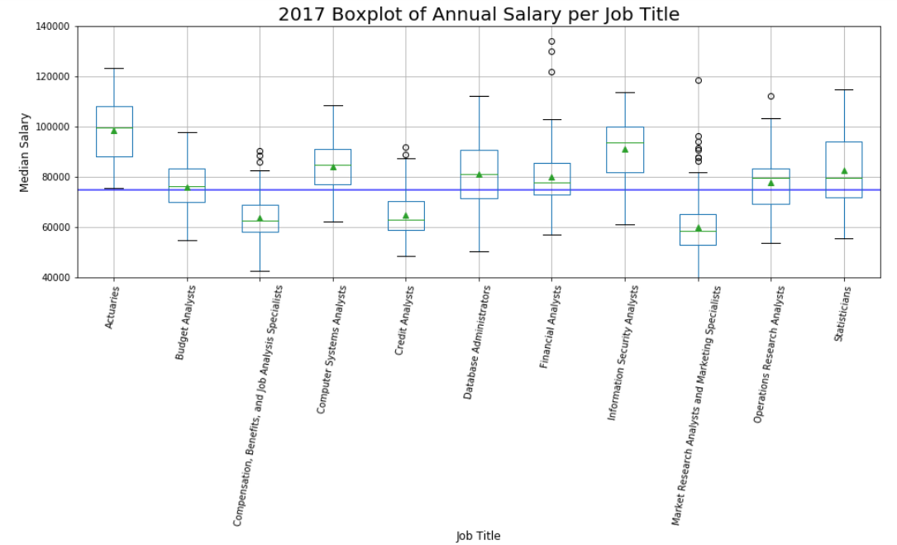

◆Salary Distribution of each job title You may need rich experiences , multiple skills or get into the right industries to have high salary Especially for statisticians, Database Administrators, Marketing Analyst
Range is around 6,000, the majority is around 4,000

Slide 9
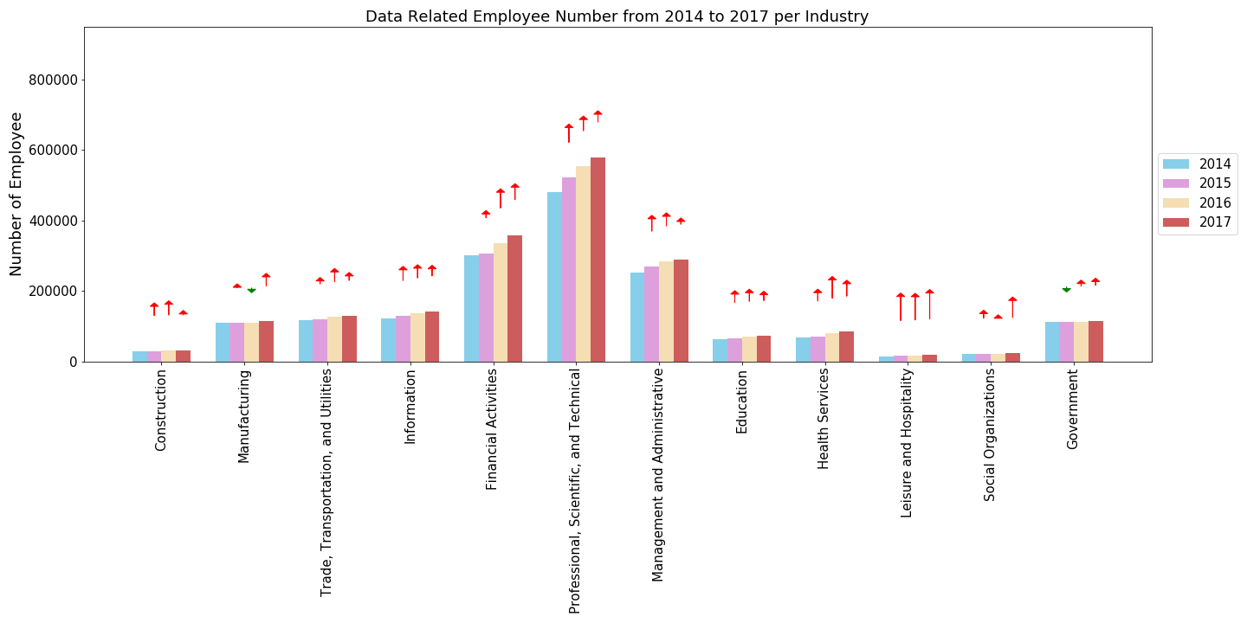












Industry 4 year trending – Employee Number

Slide 10
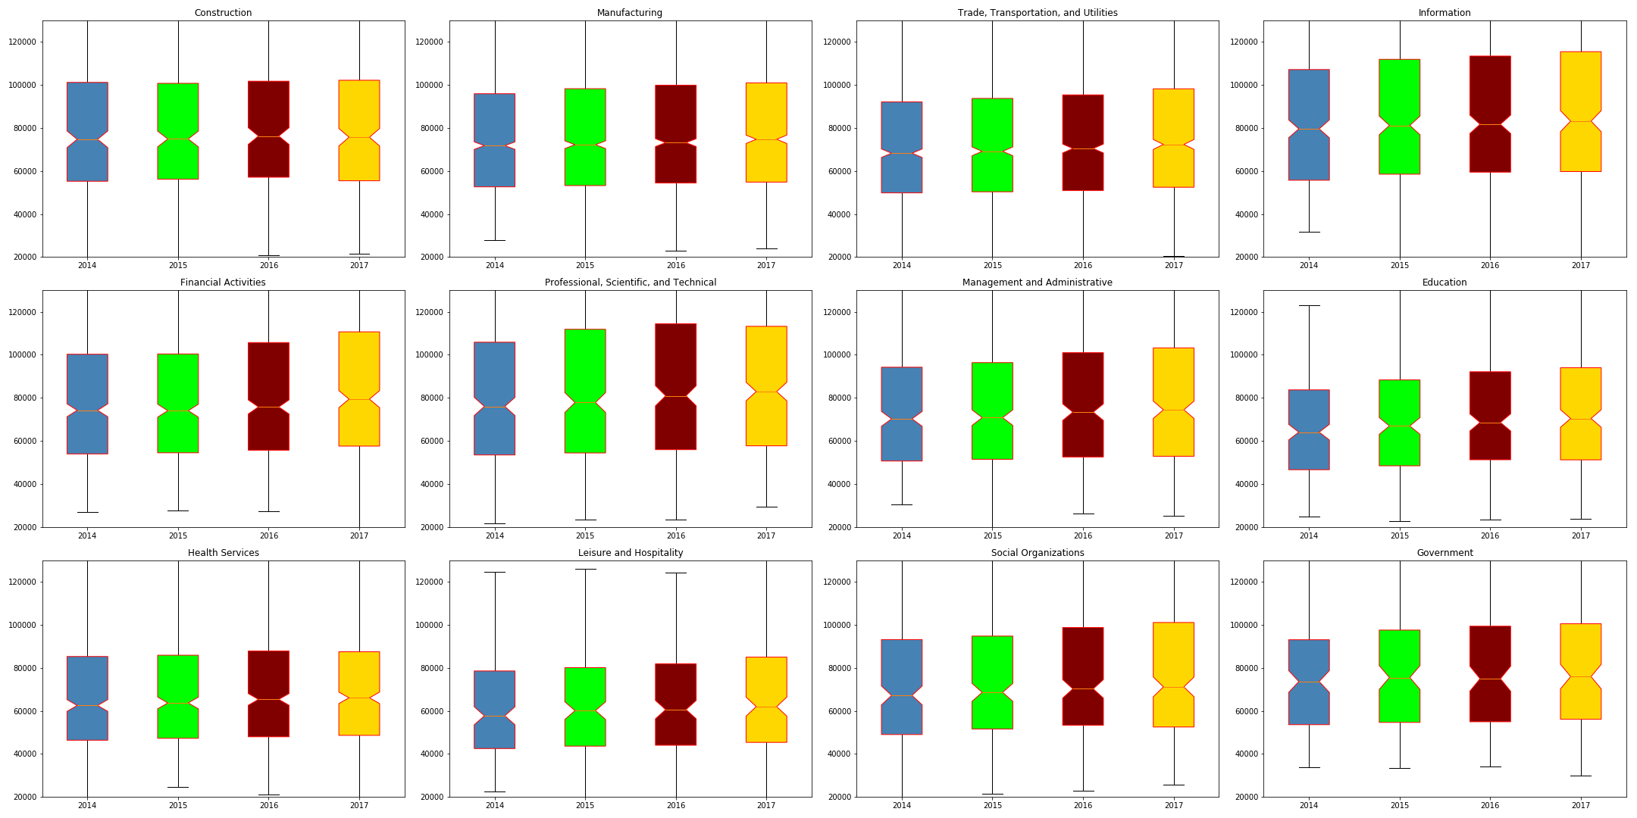
Industry 4 year trending – Salary

Slide 11
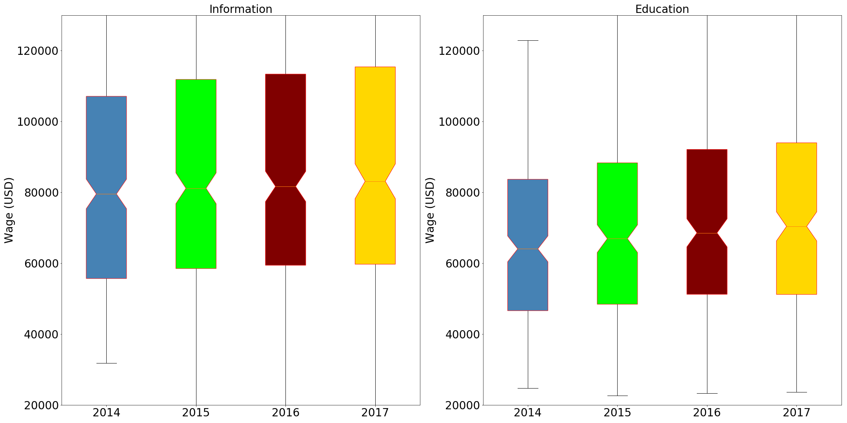
Industry 4 year trending – IT and Education Comparison

Slide 12

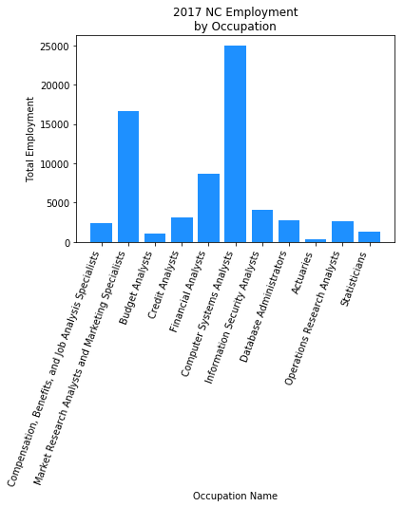
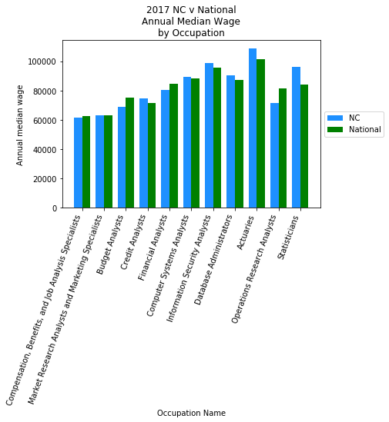
◆Local Market 2017 North Carolina
NC Statisticians, Actuaries, DBAs, Information Security, Computer Systems and Credit Analysts make more
than the national median wage

Slide 13


About our data
Access to Linkedin and Indeed data is restricted however we found a similar analysis on Kaggle and we used the Linkedin August 2018 Workforce Report and the CSV file they used for their analysis
This CSV file was built by scraping Indeed job postings from August 3rd.
This file was already cleaned and filtered to only list “Data Scientist” postings
The criteria used to define a position as “Data Scientist” is not clearly defined
While there is likely overlap between the BLS and LinkedIn data set they should not be viewed as the same criteria.

Slide 14
Summary
For those who are actively looking for data scientist jobs in the U.S., the best news this month is the LinkedIn Workforce Report August 2018. According to the report, there is a shortage of 151,717 people with data science skills, with particularly acute shortages in New York City, San Francisco Bay Area and Los Angeles.
To help job hunters to better understand the job market, this data was scraped from the Indeed website to find ~7,000 data scientist jobs around the U.S. on August 3rd. The information that I collected are: Company Name, Position Name, Location, Job Description, and Number of Reviews of the Company.

Slide 15
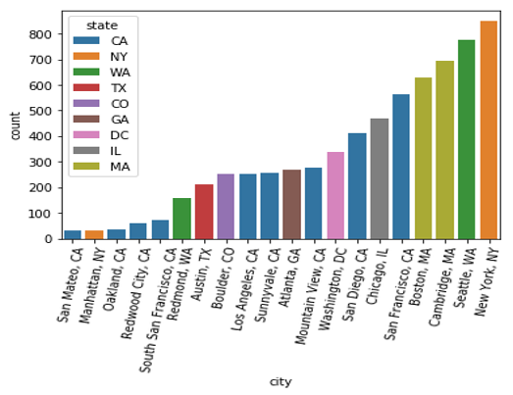
Top 20 Cities with Data Science Positions

Slide 16
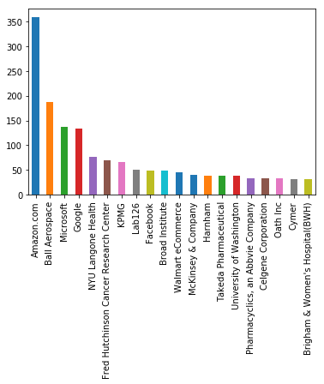
Top 20 Companies with Data Science Positions

Slide 17
Questions?

