Slide 1
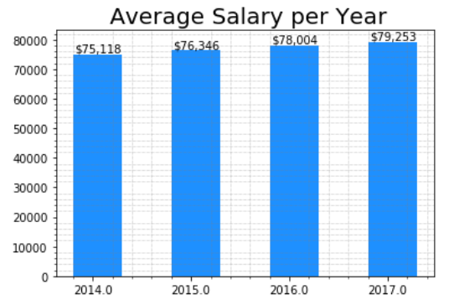
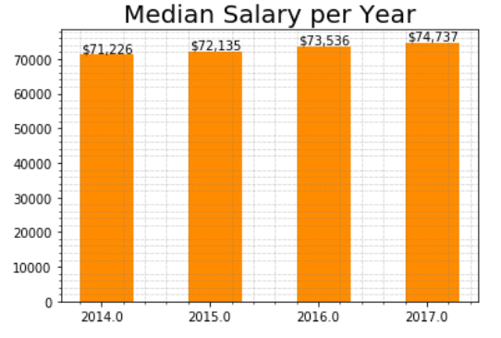
◆ Trend of salary growth └ Median is a better predictor in this case └Average＞Median, which means the distribution of salary is skewed (=some analysts’ salary is much higher than the majority)
【Increase Range】：$75.118 ~79.253(about$4,000)
【Growth Rate】 ：［Average］≈ 1.8%
【Increase Range】：$71,226 ~74,737(about$4,000)
【Growth Rate】 ：［Average］≈ 1.6%

Slide 2
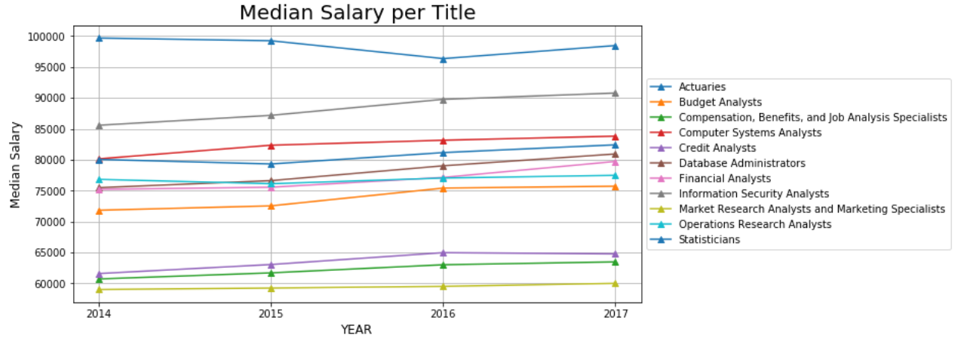
◆Compare the Yearly Salary for each job title
[Top 5] Actuaries, Information Security Analysts, Computer Systems Analysts,
statisticians, Database Administrators
Most of them is more than $70,000 per year
Marketing Analysts is lower than $60,000

Slide 3
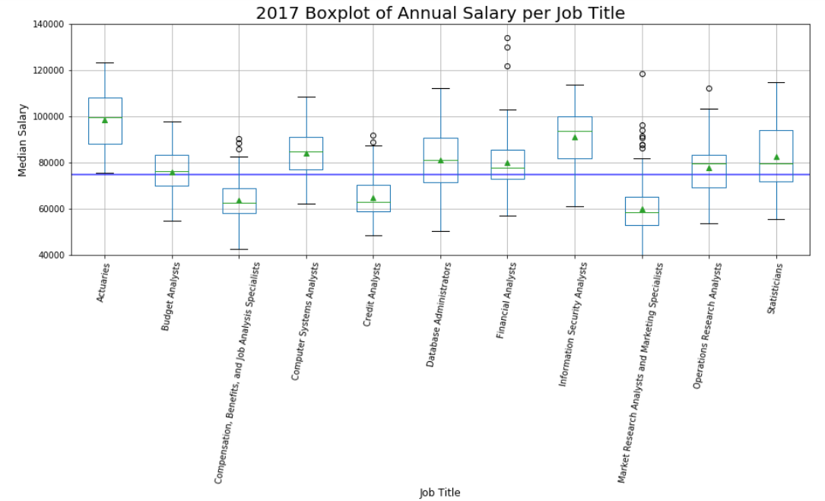

◆Salary Distribution of each job title You need rich experiences or multiple skills to get high salary Especially for statisticians, Databasa Administrators, Marketing Analyst
Range is around 6,000, the majority is aroud 4,000

