Slide 1
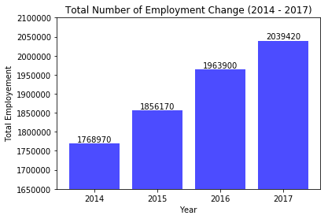
◆ Total Number of Employment Growth (2014 – 2017)
Increase over 4 years: 270,450

Slide 2
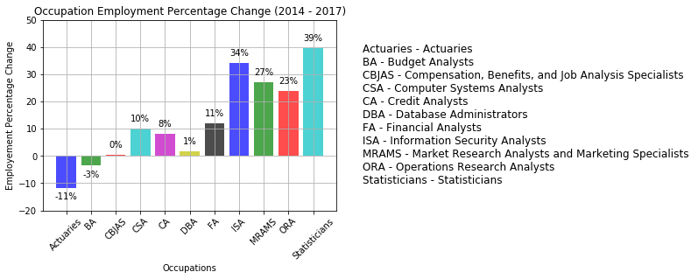
◆ Occupation Employment Percentage Change (2014 - 2017)
[Top 3] Statisticians, Information Security Analysts, Market Research Analysts and Marketing Specialists

