Slide 1
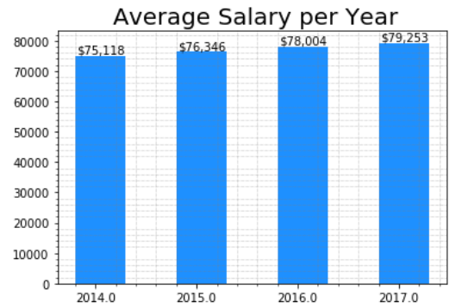
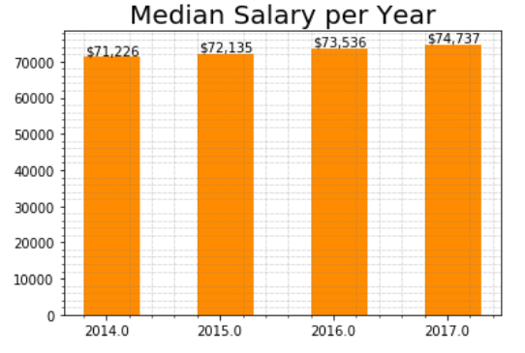
◆ Trend of salary growth └ Median is a better predictor in this case └Average＞Median, which means the distribution of salary is skewed (=some analysts’ salary is much higher than the majority)
【Increase Range】：$75k~79k (about$4k)
【Growth Rate】 ：［Average］≈ 1.8%
【Increase Range】：$71k ~74k (about$4k)
【Growth Rate】 ：［Average］≈ 1.6%

Slide 2
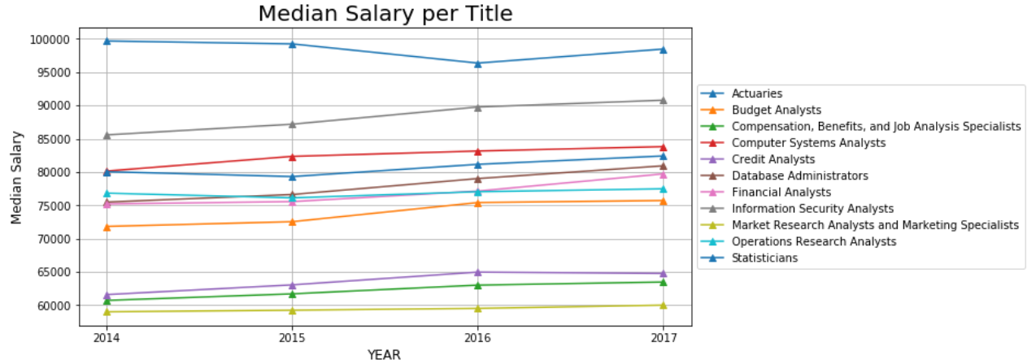
◆Compare the Yearly Salary for each job title
[Top 5] Actuaries, Information Security Analysts, Computer Systems Analysts,
statisticians, Database Administrators
Most of them is more than $70,000 per year
Marketing Analysts is lower than $60,000

Slide 3
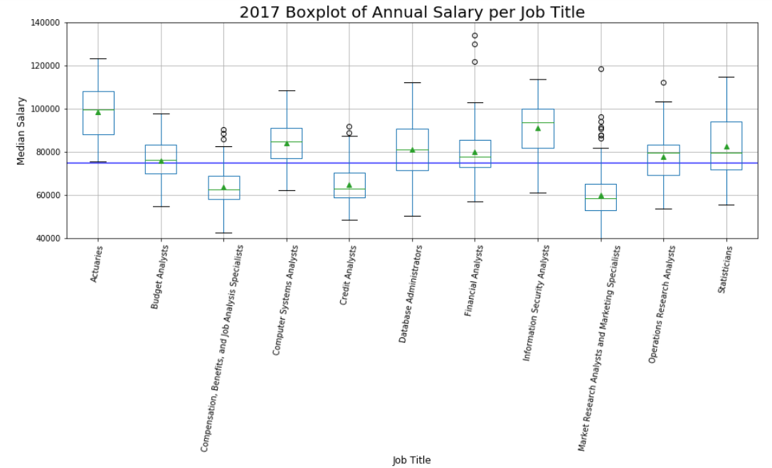

◆Salary Distribution of each job title You may need rich experiences , multiple skills or get into the right industries to have high salary Especially for statisticians, Database Administrators, Marketing Analyst
Range is around $60,000,
the majority is around $40,000

