Slide 1
I have a problem.

Slide 2
I love the internet.

Slide 3
I spend too much time on the internet.

Slide 4
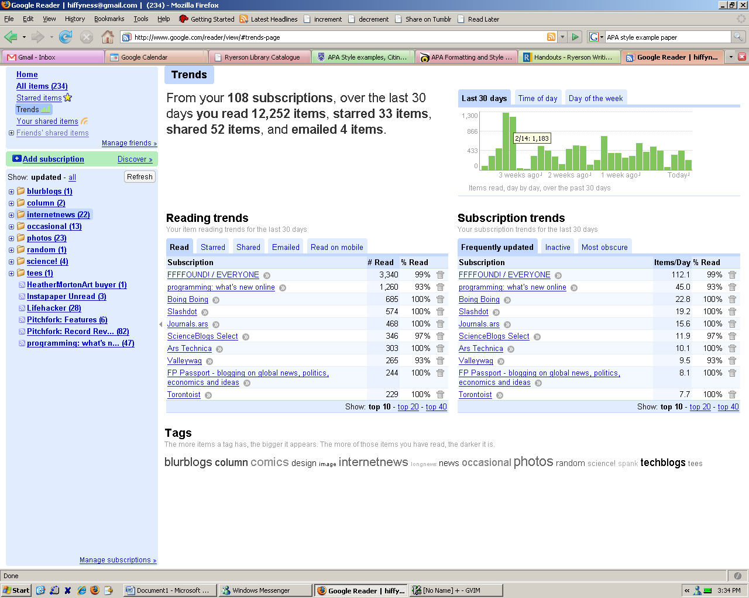
Notes:
March 2008

Slide 5
Notes:
It used to be much worse. 72 minutes is actually tolerable.

Slide 6
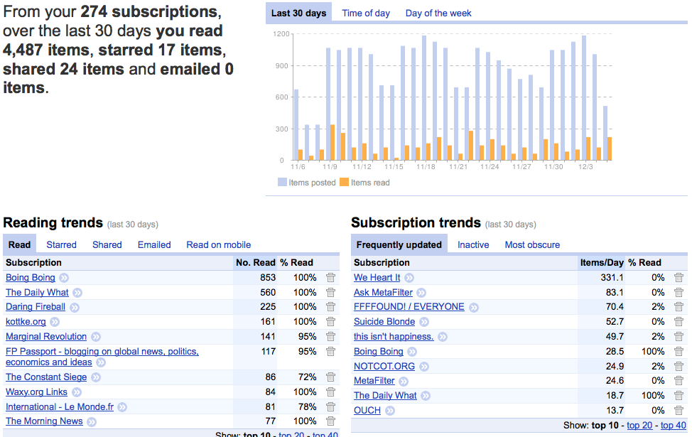
Notes:
December 2009

Slide 7
Now, there are a couple of problems with that screenshot.

Slide 8
wtf

Slide 9
If it takes 30 seconds to read the average item,
I am spending 74 minutes out of everyday just to
Problem 1:
catch up
Notes:
This is just an estimate, which I feel may be over generous but is probably in the ballpark.

Slide 10
Does not include:
Facebook
Reddit
Twitter
Email

Slide 11
This is terrible.

Slide 12
Obviously a waste of time: not all of it is worth reading.

Slide 13
Problem 2

Slide 14
Notes:
Second problem: more things come in than they go out

Slide 15
What I want to read

Slide 16
What I actually read
Notes:
There is totally an inefficiency here.

Slide 17
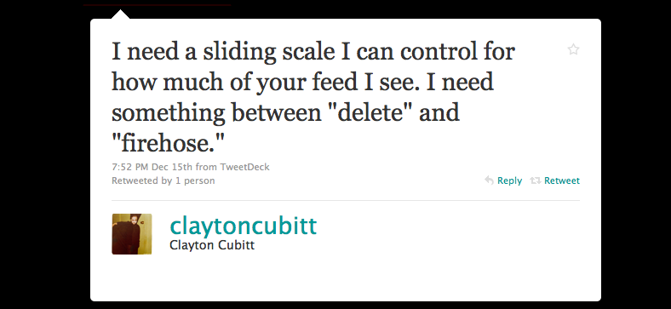
Over time yields poor return on investment: not all of it is worth reading.

Slide 18
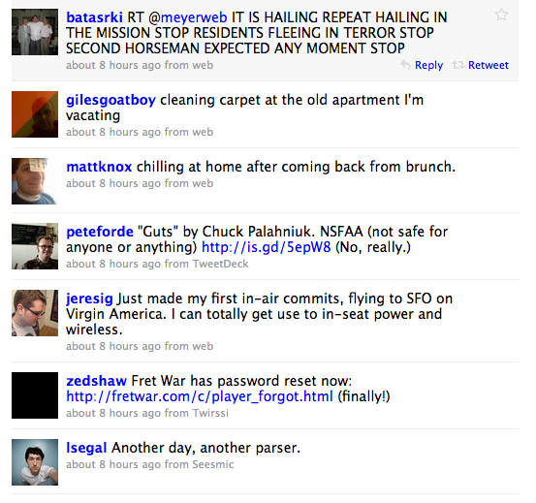
Twitter suffers
from basically
the same issues:
Following 130
people costs me
about 30+ mins
everyday.

Slide 19
meh:
interesting
meh:

Slide 20
It’s impossible to manage.
What am I missing out on? Is there a way to sample more variety?
Problem 2:
Notes:
The same sources become stale. You need a natural progression

