Slide 1

Team Denmark
Notes:
10 mins max, a link to the video/the video pushed ot the dev or readme topmost level of repo. then email him that you’re done for the order. make sure you say who you are, when youre graduating, and say what you did for the app. don’t do a really long description of firebase or anything that is pretty well nown. focus the time on the stuff that’s unique or novel to your group.

Slide 2





Our Team
Phillip Le
CS CC ‘24
Overall App Mapping, Database Schema, ViewModels,Profile/Home, Feed, Aesthetics, General Debugging
Claudia Cortell
CS Barnard ‘25
Leaderboard, HealthKit Integration, Database, Groups, General Debugging
Eugenia Bornacini
CS & Math CC ‘24
Profile, Groups, Overall App Architecture, Aesthetics, App Name, Slides
Teodora Sutilovic
CS & IEOR SEAS ‘24
Login, Registration, Friends, Search, Figma design, Logo, Slides, Wiki
Ben Vazzana
CS & Music SEAS ‘25
Create Groups, Goals, Feed, SwiftUICharts, Database
Notes:
1-2 mins

Slide 3
About
StepItUp! cultivates a social health experience by empowering users to participate in competitions with their friends, centered around health goals and fitness metrics. Integrated with HealthKit, the app diligently tracks users' daily and weekly steps and miles.
Firebase Storage
Groups
Leaderboard
SwiftUICharts
Health Data Integration
Friends
Feed
ViewModels
Notes:
1 min
HealthKit:
Integration with HealthKit to access health data from iOS devices.
Track and update progress towards individual and group goals using health metrics.
Firebase:
Users can create accounts with basic information
Secure firebase storage of users, groups, health data,
Groups:
Users can form groups for collaborative health challenges.
Group-specific leaderboards and challenges.
Leaderboard:
Global leaderboard for individual achievements.
Group-specific leaderboards with various filters (e.g., steps, distance).
Integration with HealthKit for accurate health metrics.
Friends:
Search functionality for finding friends.
Feed:
Users can post whatever they want to their friends; like Twitter (X)

Slide 4
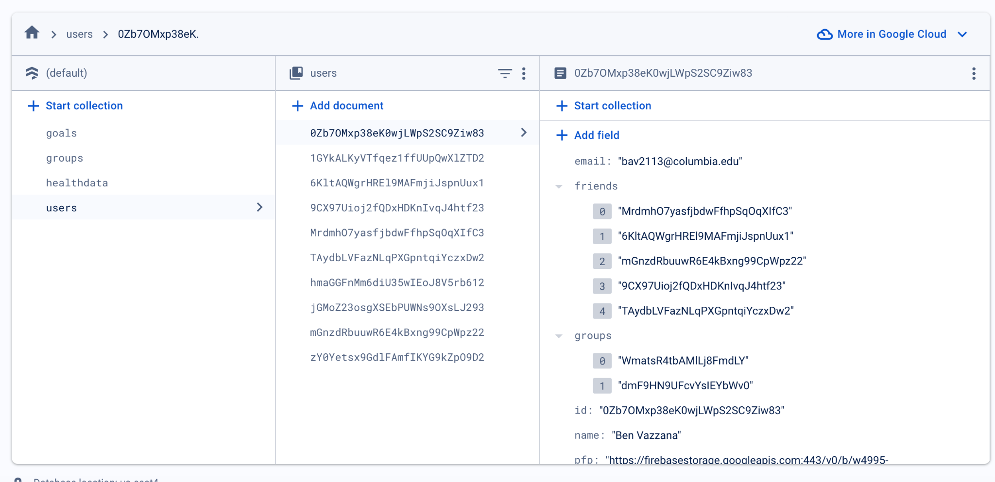
Database Schema

Slide 5
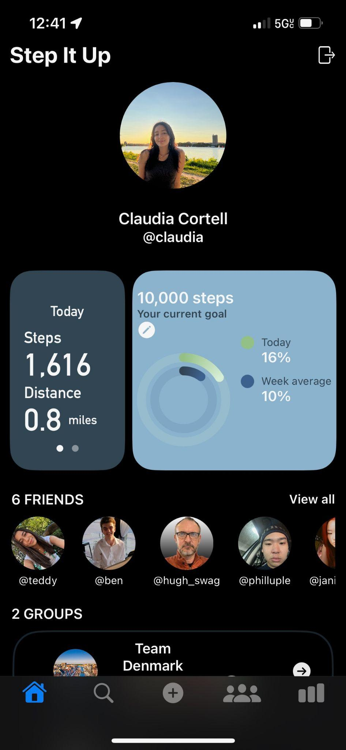
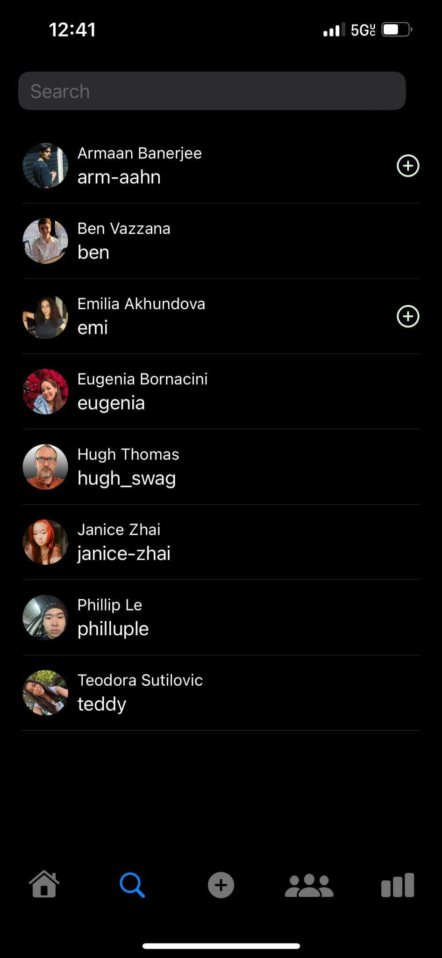
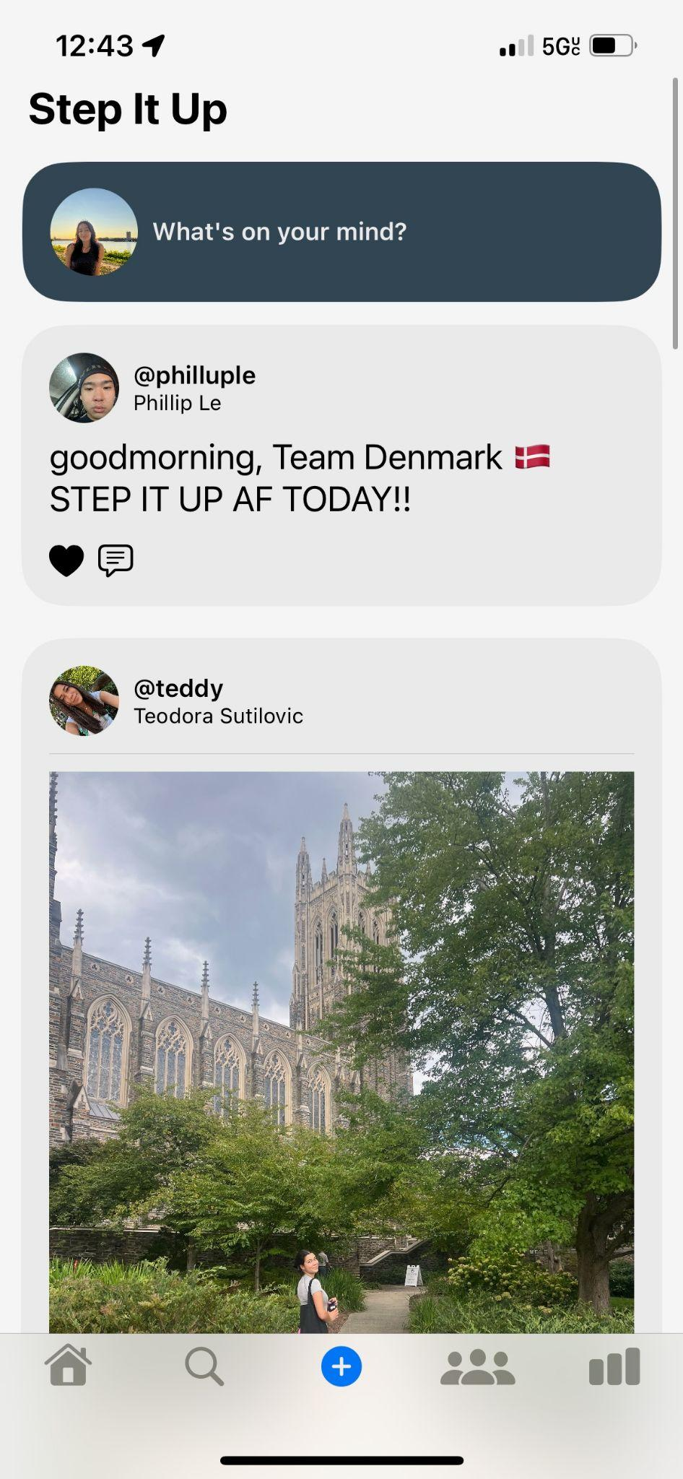
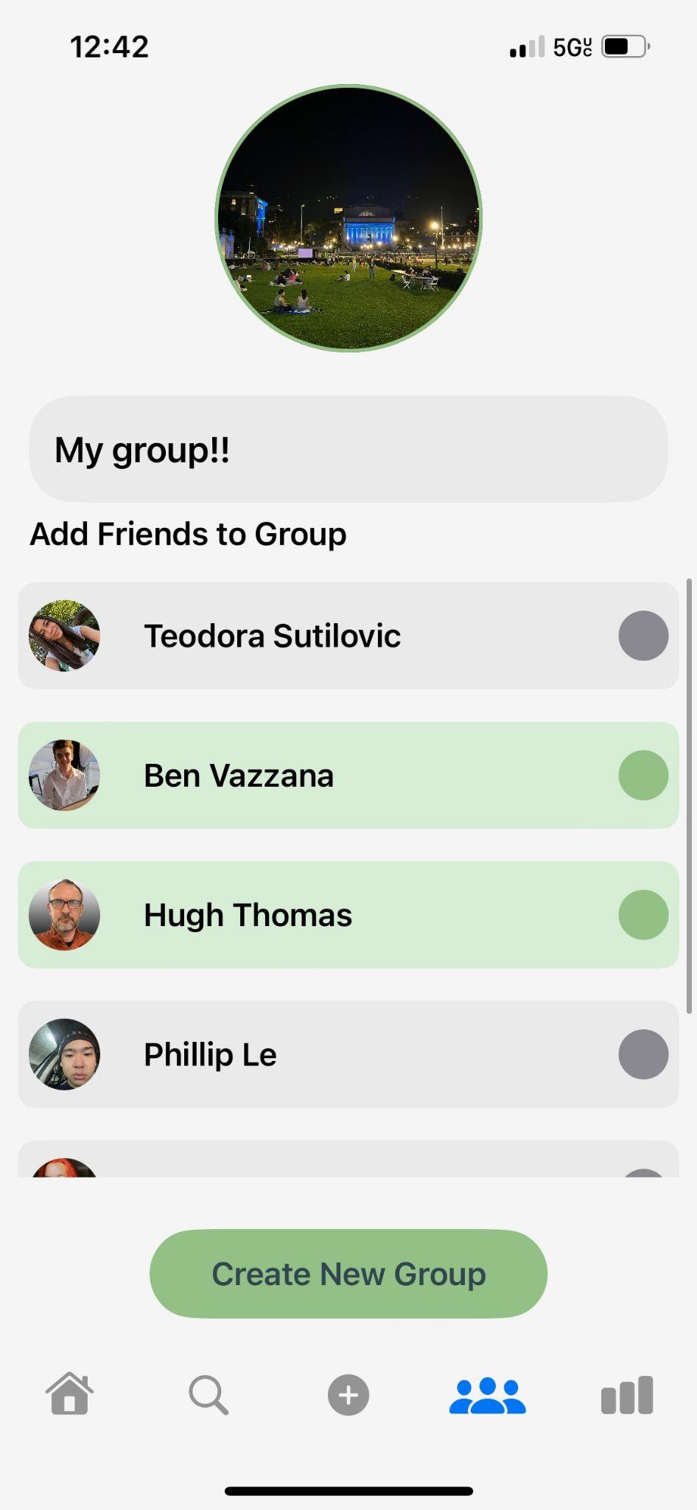
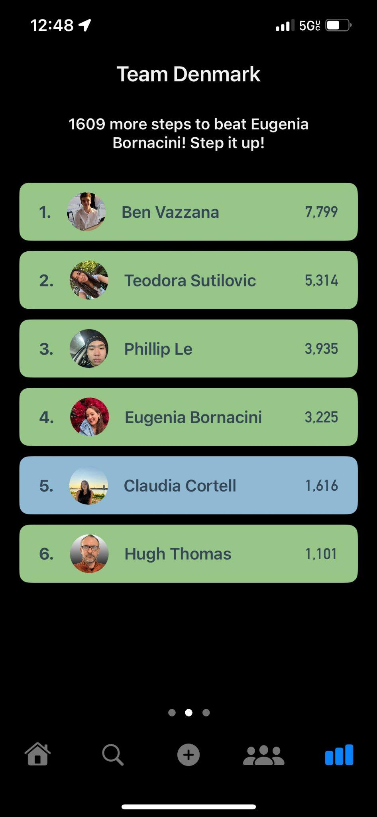
App Screens
Notes:
1 min
HealthKit:
Integration with HealthKit to access health data from iOS devices.
Track and update progress towards individual and group goals using health metrics.
Firebase:
Users can create accounts with basic information
Secure firebase storage of users, groups, health data,
Groups:
Users can form groups for collaborative health challenges.
Group-specific leaderboards and challenges.
Leaderboard:
Global leaderboard for individual achievements.
Group-specific leaderboards with various filters (e.g., steps, distance).
Integration with HealthKit for accurate health metrics.
Friends:
Search functionality for finding friends.
Feed:
Users can post whatever they want to their friends; like Twitter (X)

Slide 6
Demo
Demo walkthrough of StepItUp
Notes:
4-6 mins; for video we do a live demo, for slides we turn in we need to put 5-8 ish screenshots

