Slide 1
CNN computation
Yi-sheng (Ethan) Liao
Date: 2021/12/14

Slide 2
Outline
CNN model
Convolutional layer
Pooling layer
Flat layer
Dense layer
Notes:
看CODE PAPER

Slide 3
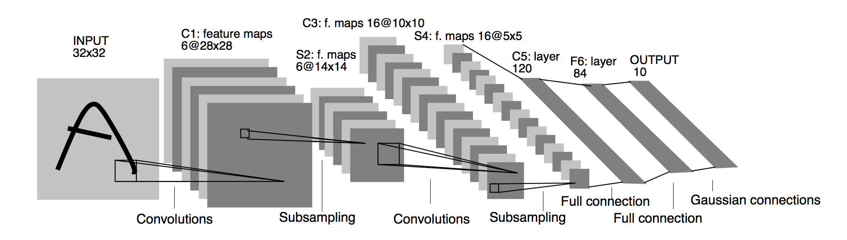
CNN model
LeNet

Slide 4
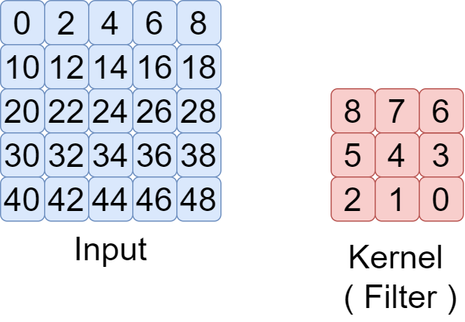
Convolutional layer
Filters : Number of output data channels
Kernel_size : Size of kernel
Strides : The distance the kernel moved during calculation
Padding : Decide whether the size of output data should be the same as input data (height and width)

Slide 5
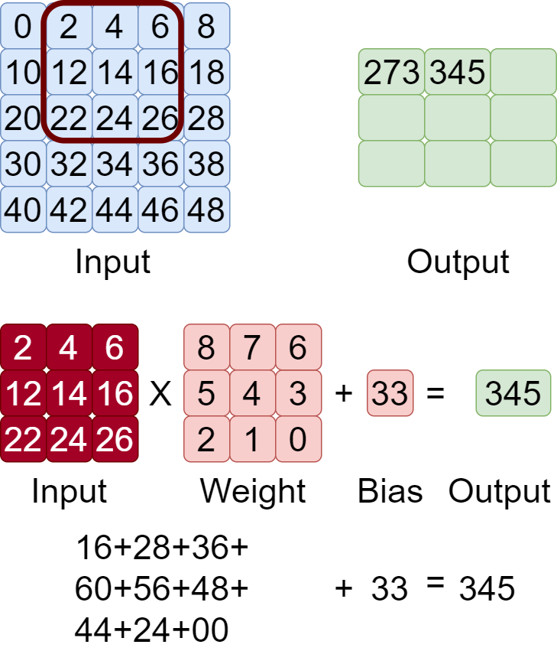
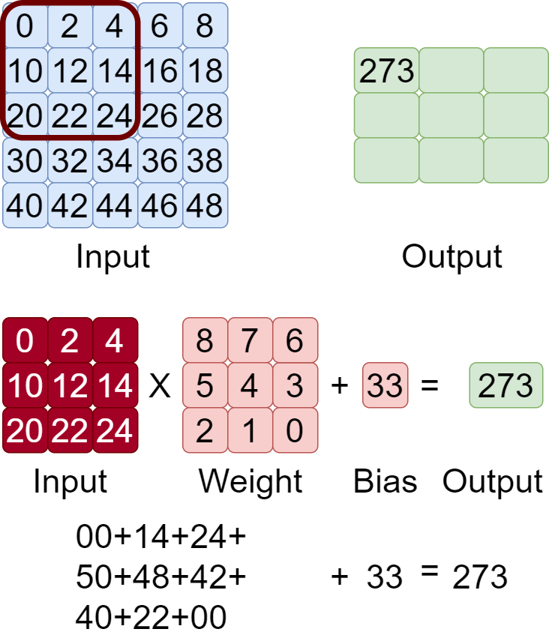
Convolutional layer
Input data channel = 1, Output data channel = 1

Slide 6
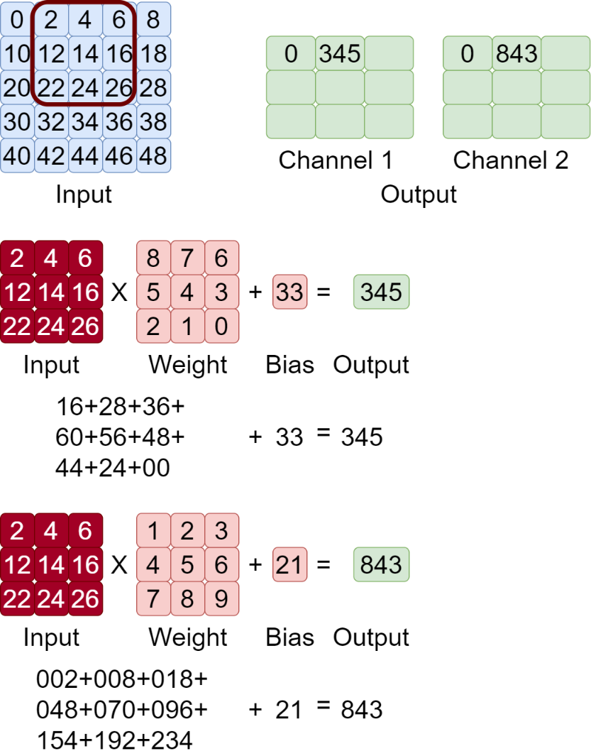
Convolutional layer
Input data channel = 1, Output data channel = 2

Slide 7
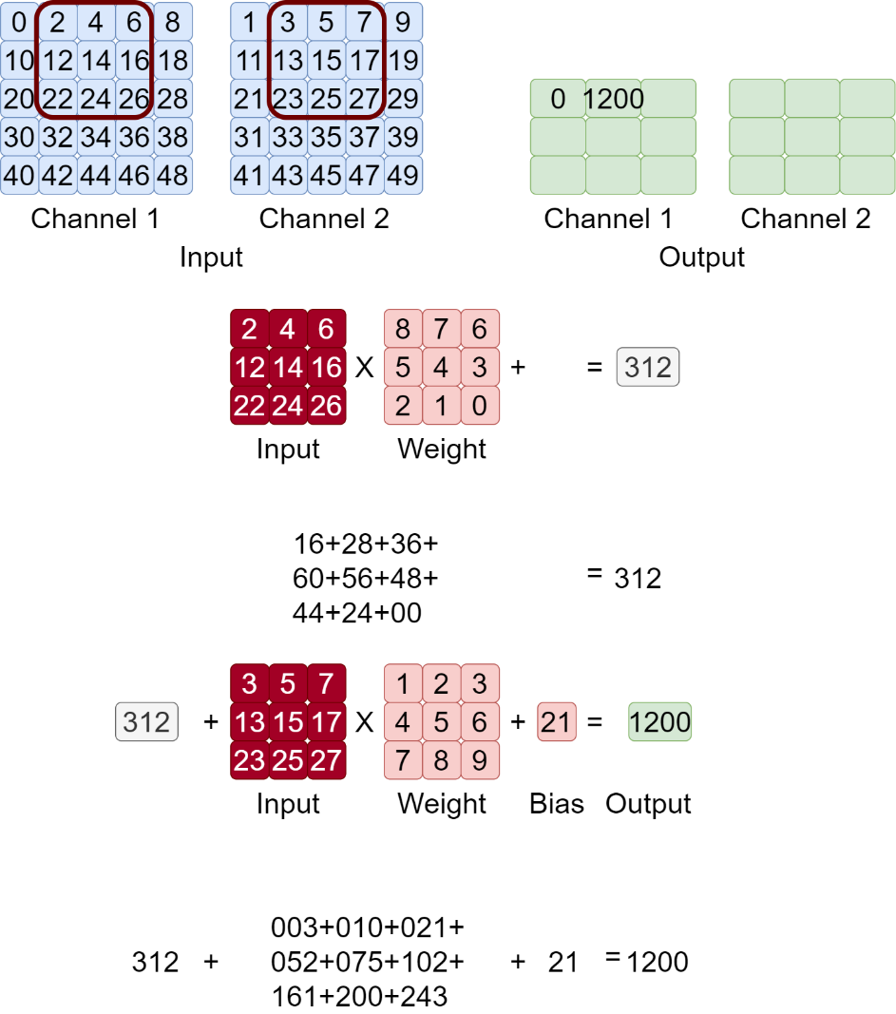
Convolutional layer
Input data channel = 2, Output data channel = 2

Slide 8
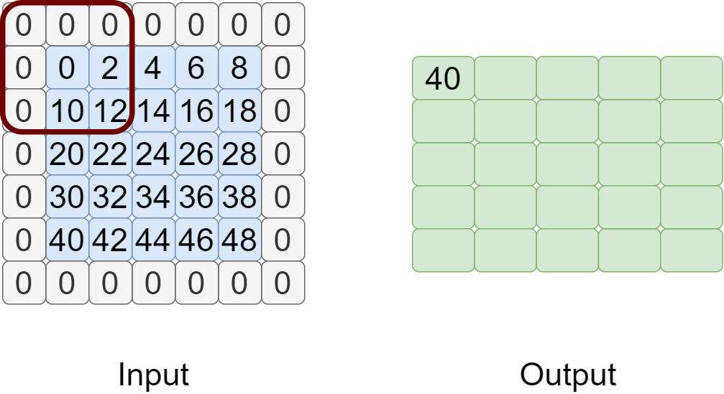
Convolutional layer
Padding

Slide 9
Convolutional layer

Slide 10
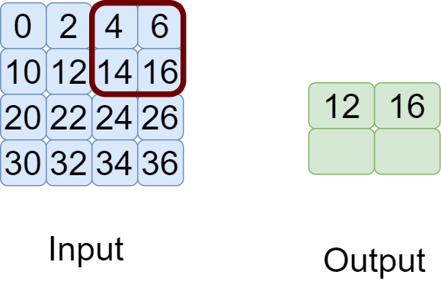
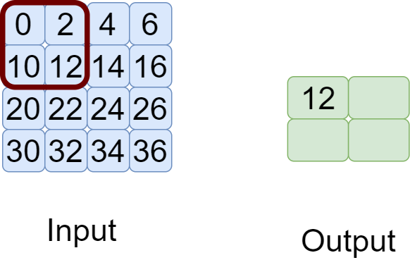
Pooling layer
Take maxpooling as an example
Pooling performs operations at each channel

Slide 11
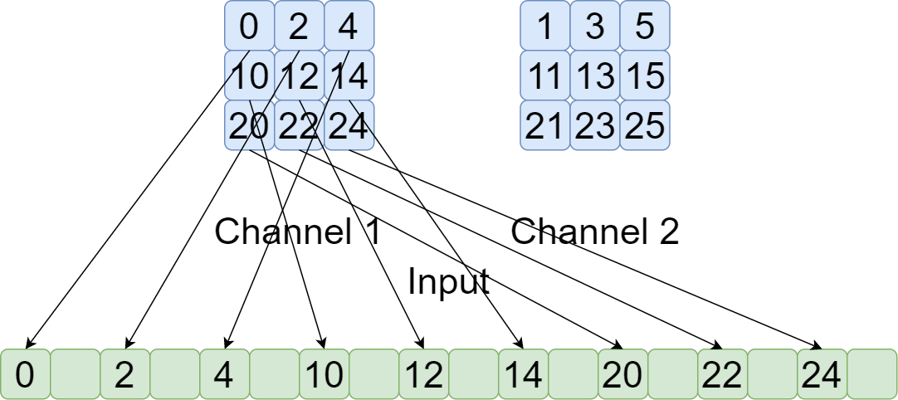
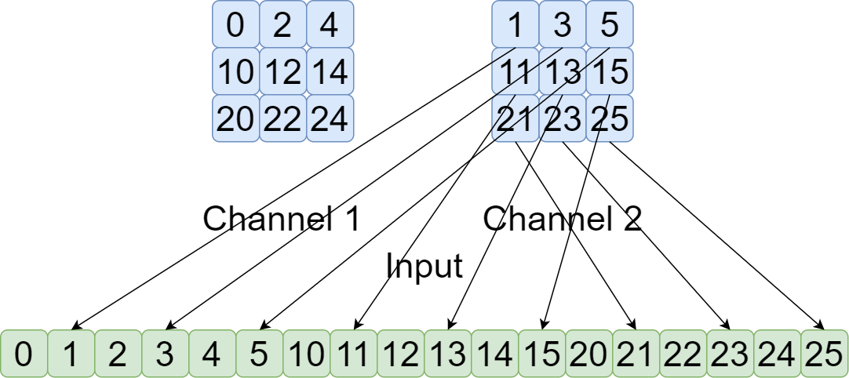
Flat layer
Take keras as the example

Slide 12
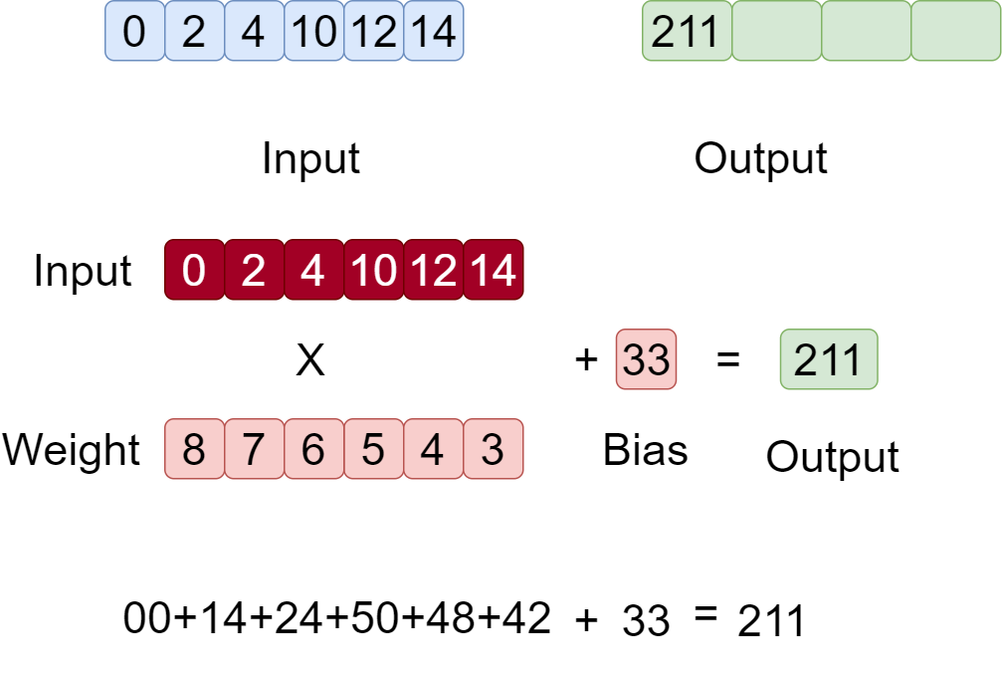
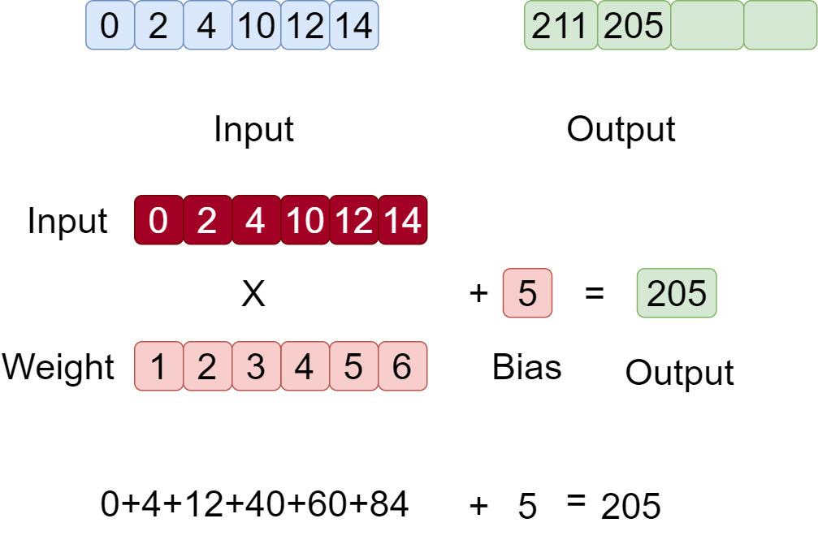
Dense layer

