Slide 1
The Value of Agile
2.5
Notes:
Today we are going to talk about the value of agile in the delivery of software. We will discuss some techniques teams can use to delivery a quality product, how they can predict delivery dates and manage a budget.

Slide 2


Scott Ocamb
Microsoft developer & architect since 1992
Agile Coach & Scrum Master since 2006
Served as Consultant at numerous firms in the Delaware Valley
Contact Information
Scott.ocamb@roadmaptoagile.com
Website: RoadmapToAgile.com
Twitter: @ScottOcamb
Blog: OcambOnConsulting.com
Notes:
My name is Scott Ocamb. I began my career as a Microsoft developer and consultant. Since 2006 I have moved into the agile world. I have served as an Agile coach and scrum master at numerous firms in the area. Use my contact information if you need me for anything.

Slide 3
Why
Notes:
No one cares about agile. They care about a product. Agile is an means to an end. The level of success a company has using agile is dependent on how high up in the organization agile is accepted.

Slide 4
Facts
What we think we want today will not ultimately be what we need
We need to manage changing priorities and still be able to predict dates and manage the budget
The team will make mistakes
Notes:
Let’s start with some facts. What we think we want today, is not what we will need. We need to manage changing priorities and still be able to predict dates and manage a budget. The team will definitely make mistakes.

Slide 5
Goals
Learn what we need in a reasonable manner, our customers are a big part of this
Manage budget and delivery time frames
Learn from our mistakes without catastrophic consequences
Identify Minimal Viable Product (MVP) releases
Notes:
We need to learn what we need in a reasonable manner, manage our budget and delivery time frames. We want to learn from out mistakes without making catastrophic mistakes.
We want to identify small frequent releases that equate to an MVP.

Slide 6
Fundamentals

Slide 7
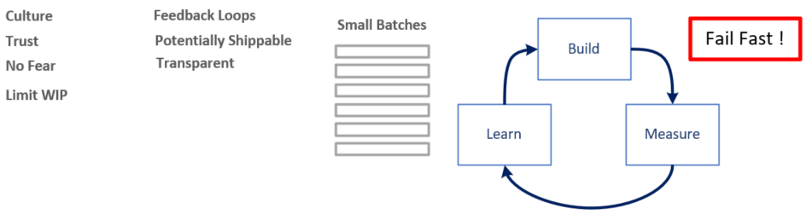
Goals
Notes:
Build a culture of trust so our teams may work and learn from their mistakes without fear. Feedback loops allow us learn and improve. The process will be transparent so all may see the team’s progress. We will deliver potentially shippable product increments often. A partnership relationship is needed.
-----------------------
We want to work in small batches so we will not make catastrophic mistakes.
We want to work in a build/measure/learn feedback loop and fail fast and learn from our mistakes.

Slide 8
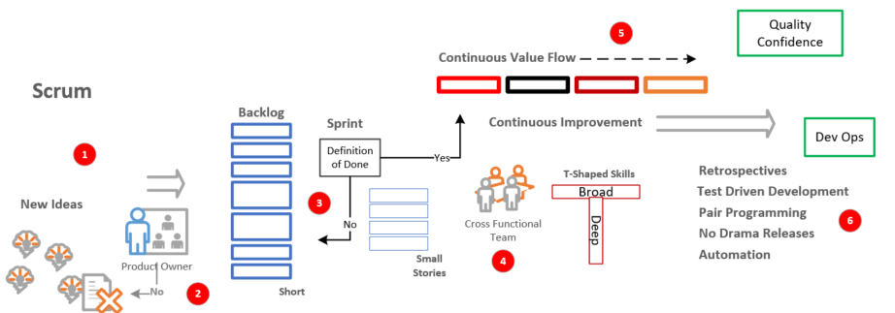
Scrum Master
1 – New ideas arrive from customers and stakeholders.
2 – The product owner owns the backlog. He has a passion for the product and is the one responsible for building the right thing.
3 – The team implements the product in a set of short sprints that get stories DONE. Daily standup meetings are a checkpoint. The team is responsible for building the thing right.
4 – The team is cross-functional and has T-Shaped skills. The team may work on any tasks it has the skills to complete. The team is also self-organizing.
5 – As quality features are delivered into production sprint after sprint, confidence increases. Dev Ops techniques improve the value flow.
6 – Retrospectives are where the team reflects on past performance and identifies areas for improvement.
Notes:
Scrum master acts as a servant leader and helps the team stick to agile/scrum practices. Team is self organizing. Ants building an ant hill.

Slide 9
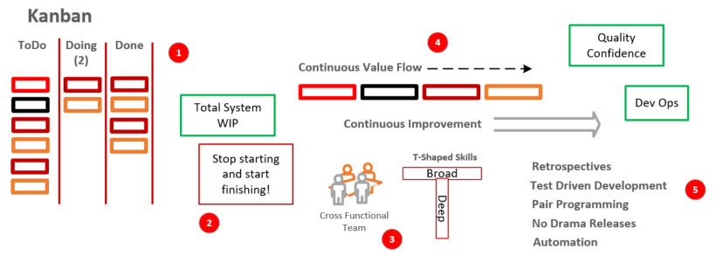
Kanban Coach
1 – Kanban makes all work visible. Columns are identified that equate to a team’s workflow. Kanban uses continuous flow.
2 – Constraints are established to ensure that the team focuses on a small set of tasks at a time.
3 – The team is cross-functional and has T-Shaped skills. The team may work on any tasks it has the skills to complete.
4 – As quality features are delivered into production, confidence increases. Dev Ops techniques improve the value flow.
5 – Retrospectives are where the team reflects on past performance and identifies areas for improvement.
Notes:
1 – a development example could be Todo/In Dev/Ready to Test/Testing/Done
Kanban coach acts as a servant leader and helps the team stick to agile/knaban practices.

Slide 10
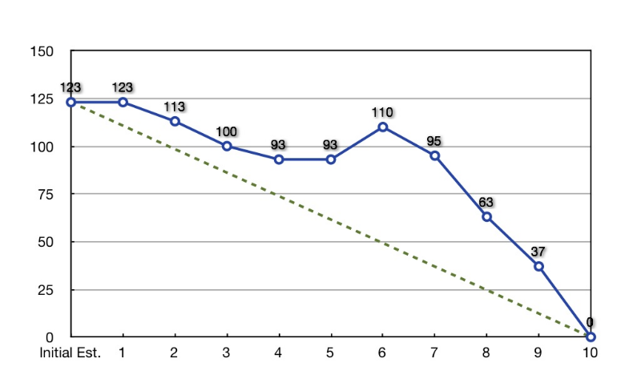
Burndown Chart
Shows the team’s estimate of remaining work in a sprint compared to an ideal trend
Notes:
The burndown chart is how scrum teams monitor progress. It compares the work identified at the beginning of the sprint to the daily remaining work and an ideal trend.

Slide 11
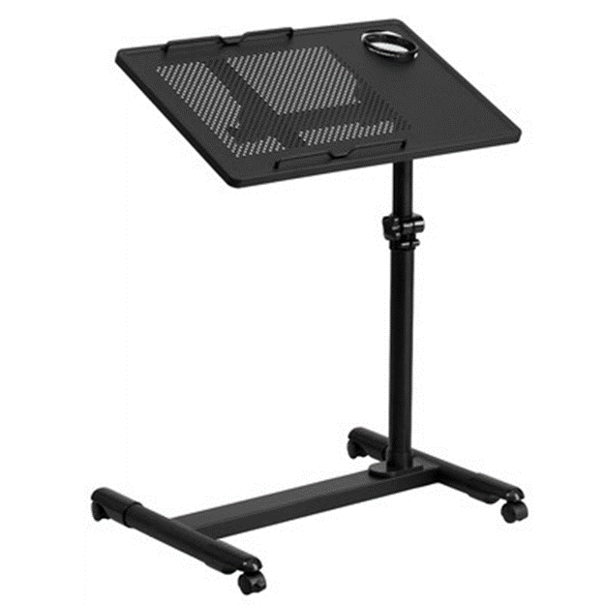

Feature Estimation
Story points measure the relative size of a feature
0, 1, 2, 3, 5, 8, 13, 20, 40, 100
This is a 5
What is this?
Notes:
In order to predict delivery dates we need to estimate our user stories. Story points measure the relative size of stories.

Slide 12
T-Shirt Size
This is a simplified way to estimate
Baby, Small, Medium, Large and Extra Large (Baby-1 | Small-2 | Medium-4 | Large-8 | XL-16)
Notes:
T-Shirt size is a simplified technique. This works well with new teams. It assigns story points based on the size of a shirt.

Slide 13
Budget & Schedule

Slide 14
Things We Know ….
What we think we want today will not ultimately be what we need
We will learn more about what we need as valuable software is delivered, sprint after sprint
The backlog Will change
We need to manage the changing backlog and still predict dates and manage the budget
As the team progresses, we will develop a velocity in story points we can use for forecasting
We can forecast if we do not need to be exact
Notes:
What we think we want today will not ultimately be what we need. We learn what we need as valuable software is delivered sprint after sprint.
We need to manage the changing backlog and still predict dates and manage a budget.
As the team progresses, we use the average number of story points DONE to help forecast. We can do this if we do not need to be exact.

Slide 15
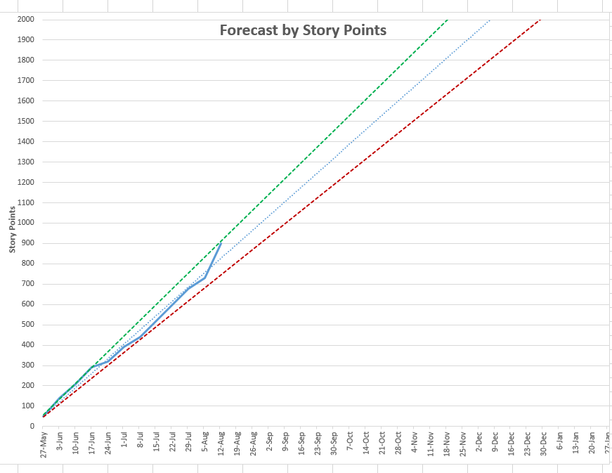
Fixed Date-Variable Scope
About this many story points
Actual Data
By this date we can deliver ..
Notes:
The left axis is the number of story points DONE. The blue line is the actual story points the team has DONE. The dotted blue line is a trend based on the actual data.
The dotted green line is a optimistic trend, the actual trend -10%. The dotted red line is a pessimistic trend, actual trend + 10%. We can use this to predict dates if we do not need to be exact.
By this date, we can deliver about this many points.

Slide 16
Fixed Scope-Variable Date
We can deliver these story points ..
Actual Data
Within this date range
Notes:
The left axis is the number of story points DONE. The blue line is the actual story points the team has DONE. The dotted blue line is a trend based on the actual data.
The dotted green line is a optimistic trend, the actual trend -10%. The dotted red line is a pessimistic trend, actual trend + 10%. We can use this to predict dates if we do not need to be exact.
We can deliver these story points by this date range.

Slide 17
Monitor Release Scope Change
Set baseline for original release scope
Track scope change and its effect on schedule
Notes:
To monitor scope change, we set a baseline for the original scope and track scope change and its affect on the schedule.

Slide 18
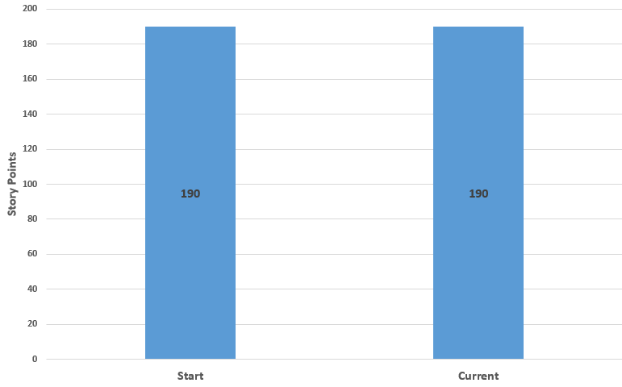
Release Progress Example
Start is the number of Story Points at the start of the project. Current is the number of Story Points at a given point in time.
Notes:
The left bar shows the original scope of 190 points. The right bar will show the current scope in points. Here they are both the same.

Slide 19
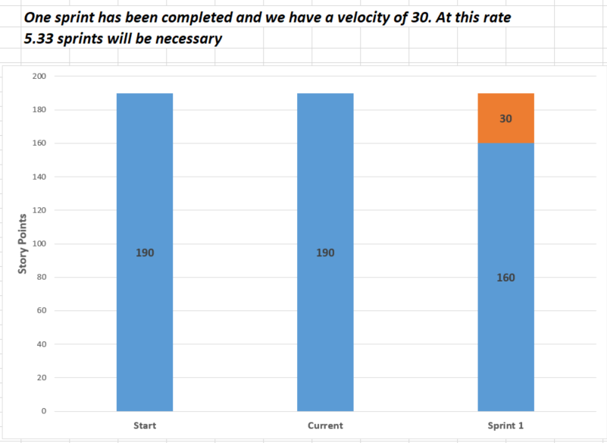
Release Progress Example
Notes:
Here we see the team has gotten 30 points DONE.

Slide 20
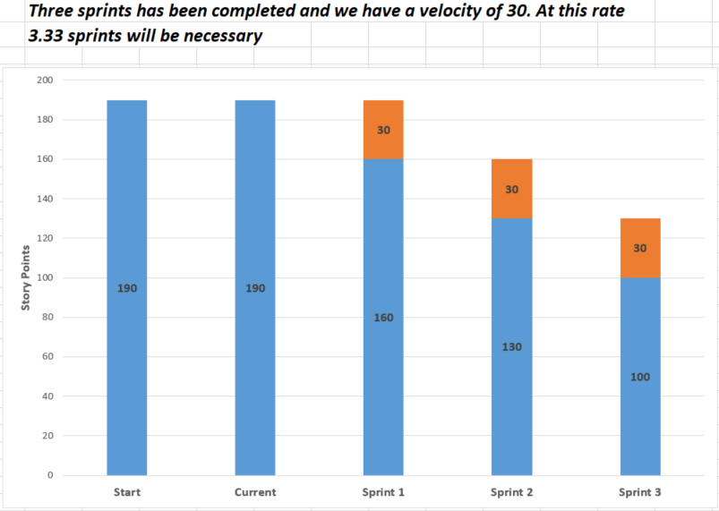
Release Progress Example
Notes:
Here there are 3 sprints completed. We can predict the there are 3.3 sprints required to complete the release.

Slide 21
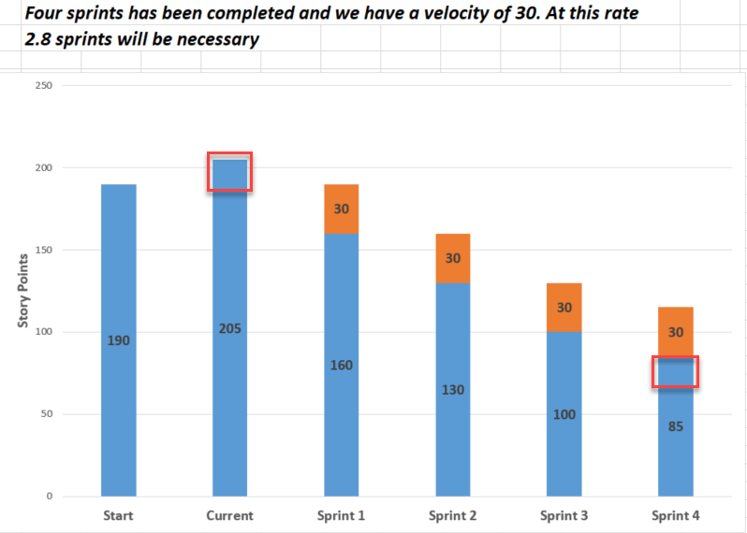
Release Progress Example
In Sprint 4, a backlog grooming meeting was conducted. The Product Owner decided to add 15 Story Points of new stories. The Current story points are now 205 and the remaining story points are 85.
Notes:
Here the product owner added 15 points to the release. We see the scope change in the current bar and see it added to sprint 4.

Slide 22
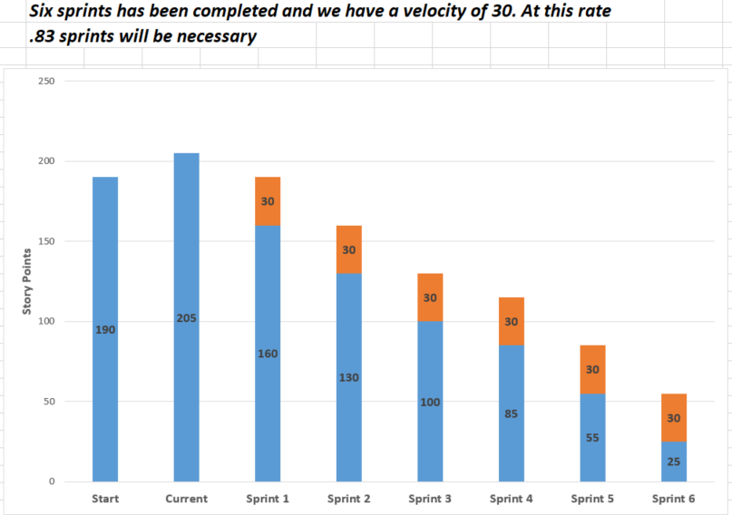
Release Progress Example
The team is almost done. Sprint 6 is complete, and there are 25 story points remaining.
Notes:
Here we see the team is almost done with the release.
There is tooling available in most agile tools to create these reports.

Slide 23
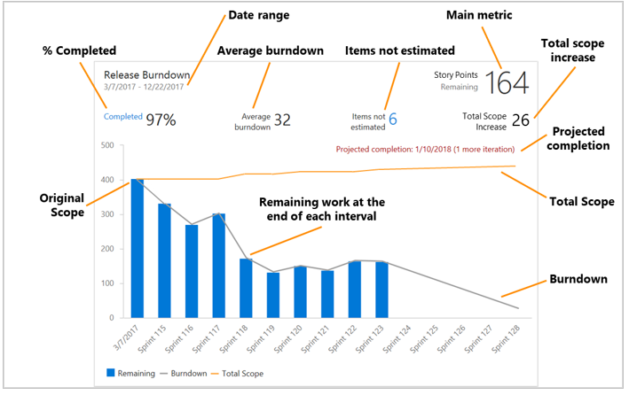
Azure DevOps Reports
Notes:
This what you can expect. Things will seem to be going very well. Then, things will seem to degrade and go down hill. Stick to it and the true improvement will be found.

Slide 24
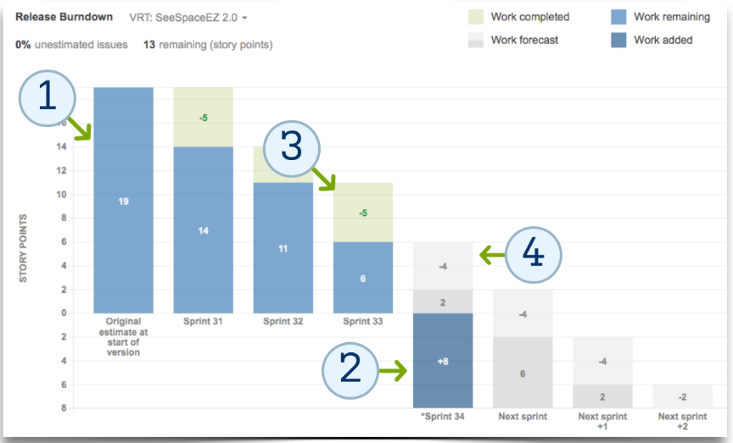
Jira Reports
Notes:
This what you can expect. Things will seem to be going very well. Then, things will seem to degrade and go down hill. Stick to it and the true improvement will be found.

Slide 25
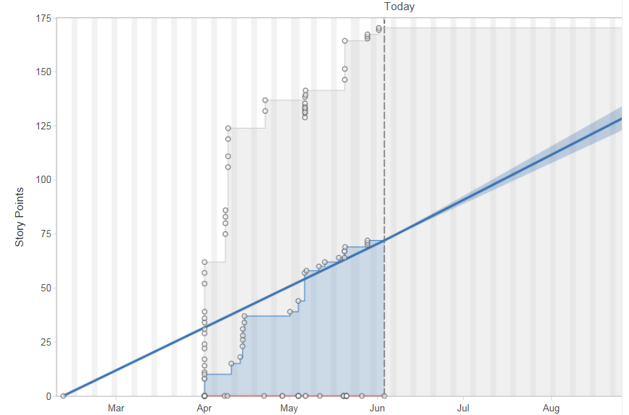
Jira Reports
Notes:
This what you can expect. Things will seem to be going very well. Then, things will seem to degrade and go down hill. Stick to it and the true improvement will be found.

Slide 26
Managing the Schedule & Budget
Once we have a stable team and velocity, we will know the rate at which stories can be delivered
When scope changes, we can see the effect on the schedule.
What we deliver is up to the Product Owner as we groom the backlog and set the priority
Our forecast tells us how many sprints remaining
We develop a budget based on the cost of a sprint and the number of sprints remaining
Notes:
Once we have a stable team and velocity we will know the rate that stories can be delivered. When scope changes, we can see the affect it has in release dates.
What we deliver and when is completely up to the product owner.
Budgets are determined by the cost of a sprint. If an engineer cost $10 per day we can calculate the cost based on the number of engineers and the length of the sprint.

Slide 27
Maximizing the Value of an Agile Transformation
Start at the top
Include the whole company
We are changing culture and people’s behavior, patience is required
Start small and gain some successes
Notes:
To maximize the value of a transformation, start a close to the top of the organization that you can. Include as much of the company as you can. This will take a long time since we are changing people’s behavior. That is why they call agile transformations a journey.
Start small and gain some successes.

Slide 28
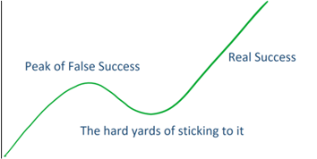
What to Expect
Notes:
This what you can expect. Things will seem to be going very well. Then, things will seem to degrade and go down hill. Stick to it and the true improvement will be found.

Slide 29
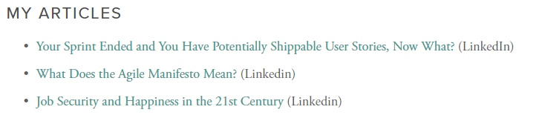

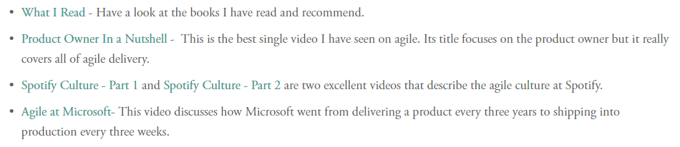
Additional Information & Questions?
http://roadmaptoagile.com/

