Slide 1

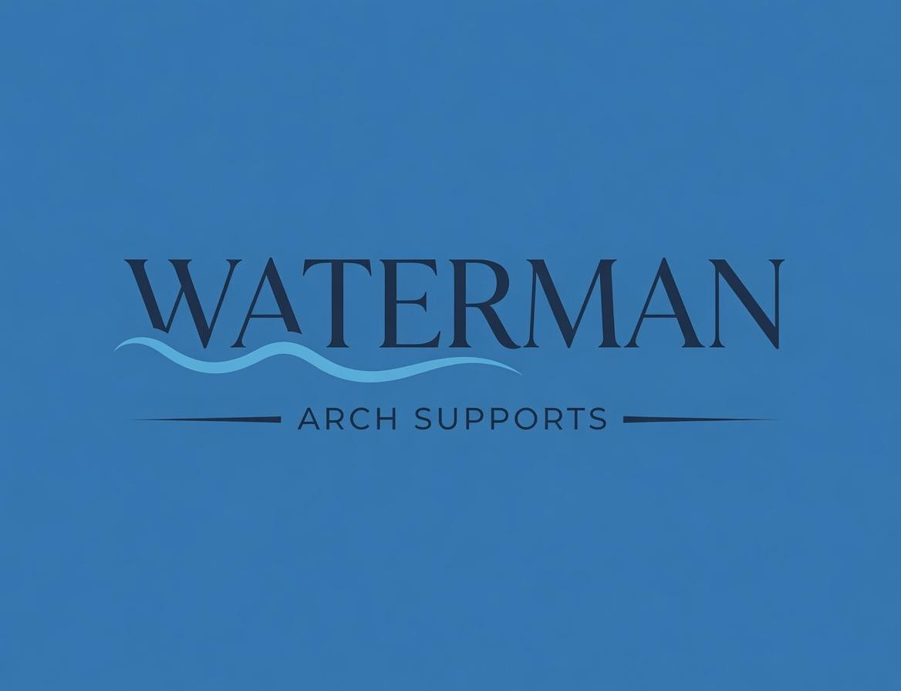

Building a Complete Solution
Every component has a job. A partial Solution is an incomplete Solution.
We present one complete system, not a product with extras.
Specialists · Blue Track
A Remarkable Experience. Every Client. Every Time.

Slide 2


In this module
1
Language Creates Hierarchy
2
Partial = Incomplete
Replace “add-on / upsell” language with “Solution Component” so nothing feels optional.
Frame every component as required for full pain resolution — not an extra.
3
Name Each Component’s Job
4
Match Without Stepping Down
Explain what Brooks, OS1st, MedMassager, and Architek each deliver for the Client.
When investment is questioned, reconnect to the goal, protect credibility, keep the core strong.

Slide 3
The Language Creates the Hierarchy
OLD LANGUAGE
NEW LANGUAGE
“Add-on” · “Accessory”
“Extra” · “Upsell”
“Solution Component”
“Part of the System”
These words tell the Client (and the Specialist) that there is a real product… and then some optional stuff hanging off it.
The hierarchy is baked into the word before we ever make the case.
Everything belongs to one complete Solution. Nothing was ever separate.
We explain each component’s job in the Client’s outcome, not its position in the transaction.

Slide 4
The Frame Underneath Everything
A partial Solution is an incomplete Solution.
Nobody takes half a prescription.
If a Client has support in one pair of shoes and is unsupported the other sixteen hours of the day, they haven’t solved the problem — they’ve solved part of it.
That’s not an “extra” conversation. That’s a “here’s what completing your pain resolution actually requires” conversation.

Slide 5
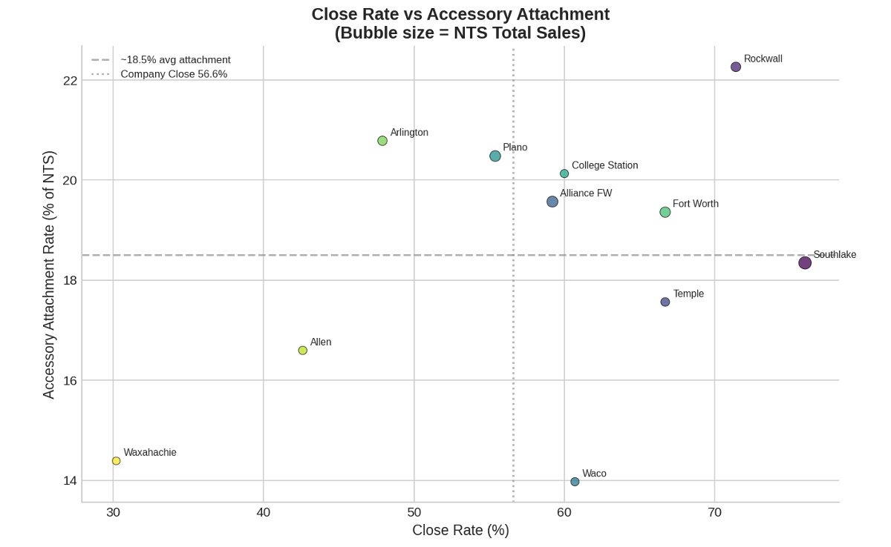
What the Data Shows About Complete Solutions
Stores that present a fuller system close more and generate higher total sales

Slide 6
Four Solution Components — Each Has a Job
Name what it does for the Client, not where it sits in the transaction
01
02
03
04
Brooks Shoes
OS1st Wellness Socks
MedMassager
Architek by Good Feet
Carries the correction into the shoes they wear most
Protects comfort and consistency every hour
Extends recovery beyond the fitting
Completes the system with the right shoe
The supports do their job only when the footwear works with them. This is how the Solution travels with the Client all day.
Reduces friction, manages moisture, and helps the supports feel right from the first step to the last.
Supports circulation and comfort at home so the work done in the store keeps paying off after they leave.
Designed to work with the supports. Gives the Client a full Good Feet Solution instead of fighting against regular footwear.

Slide 7
How We Talk About Each Component
Language that keeps everything inside one Solution
Brooks Ghost / Adrenaline
“These shoes carry the correction we just created into the footwear you wear most. That’s how the Solution stays with you all day, not just in the store.”
OS1st Socks
“These protect the comfort and consistency of the supports every hour you’re on your feet. They help the system feel right from the first step to the last.”
MedMassager
“This extends the recovery work beyond the fitting. It helps with circulation and comfort at home so what we did today keeps working after you leave.”
Architek
“This is the shoe designed to work with the supports. It completes the system so you’re not fighting against regular footwear the rest of the day.”

Slide 8
The Specialist Mindset
We don’t present a product and then upsell.
We present one complete Solution and explain each component’s job.
“Everything I’m showing you is part of the same Solution. It’s what it takes to keep you out of pain all day, not just some of the day.”
— The language that belongs in every presentation

Slide 9
When the Client Pushes Back
We Match the Right Solution — we never “step down”
1
Reconnect to the Goal
Bring them back to why they came in before you change anything in the Solution.
2
Explain the Component’s Job
Protect credibility. Tell them why that component was part of the original Solution for them.
3
Keep the Core Strong
If the Solution needs to be adjusted, make sure they still feel the foundation will deliver what they need most.

Slide 10
Example: Matching the Right Solution
When the Client says the investment is higher than expected
RECONNECT
“I hear you. Before we look at any changes, can I make sure I’m still focused on what brought you in? You said the aching after work has been going on for months and it’s starting to limit time with the family. Is getting that relief still the main goal?”
EXPLAIN THE JOB
“I included the MedMassager because it extends the recovery work beyond the fitting. It supports circulation at home so the correction we created keeps working after you leave.”
KEEP THE CORE
“The custom supports themselves are doing the majority of the work for the issue you described. They correct the alignment at the root. With this focused Solution you’ll still get the stability and relief you need. The recovery piece is a strong complement you can always add when you’re ready.”

Slide 11
The Bottom Line
We don’t sell a product and then add things to it.
A partial Solution is an incomplete Solution.
We present one complete Solution and explain each component’s job in the Client’s outcome.
Nobody takes half a prescription.

Slide 12
A Remarkable Experience. Every Client. Every Time.
Waterman COGS · Blue Track

