Slide 1


Building Non-Tangible Value
A client will only move forward if the value outweighs the price in their mind.
This training helps you create non-tangible value that reinforces the tangible value of our supports, shoes, socks, and Med Massager.
Specialists · Blue Track
A Remarkable Experience. Every Client. Every time.

Slide 2
In This Module
01
Price vs. Value Refresher
Why clients pay more for the same category of product
02
What is Non-Tangible Value?
Clear definition and why it multiplies perceived value
03
The Controllable Pillars
Store, Appearance, Product Handling, Language, Follow-up & more
04
Self-Audit + Role Plays
Checklists, practice, and real scenarios
05
7-Day Action Challenge
Turn insight into daily habits that lift closes
A Remarkable Experience. Every Client. Every time. | Waterman COGS · Blue Track
2

Slide 3
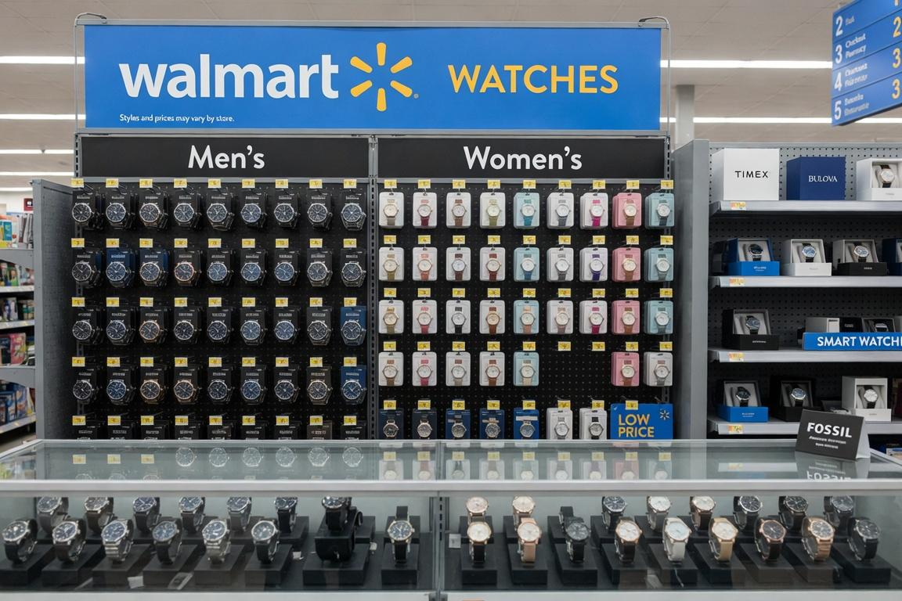
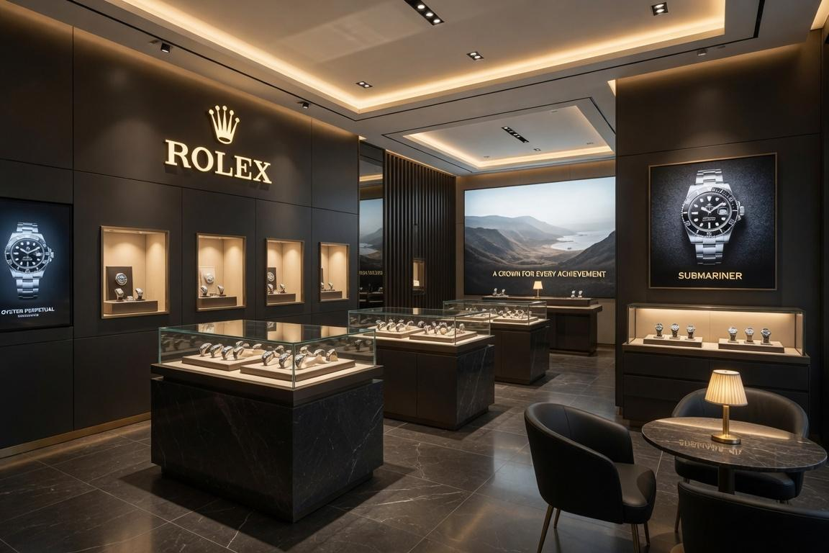
Price vs. Value Refresher · Watches
WALMART
ROLEX
Average Watch
Most Common Steel Models
$20 – $40
$8,000 – $11,000+
Typical everyday options
Datejust · Explorer · Submariner
A Remarkable Experience. Every Client. Every time. | Waterman COGS · Blue Track
3

Slide 4
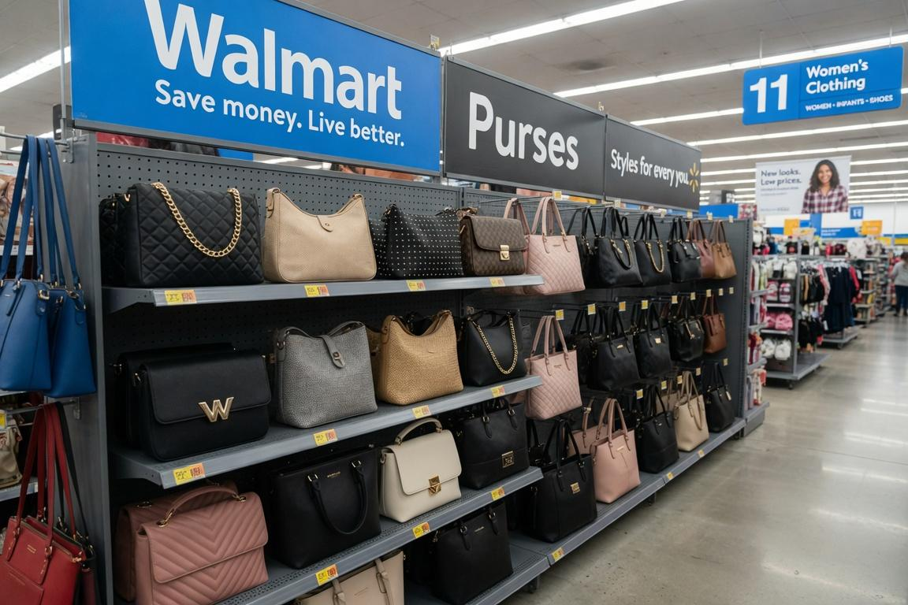
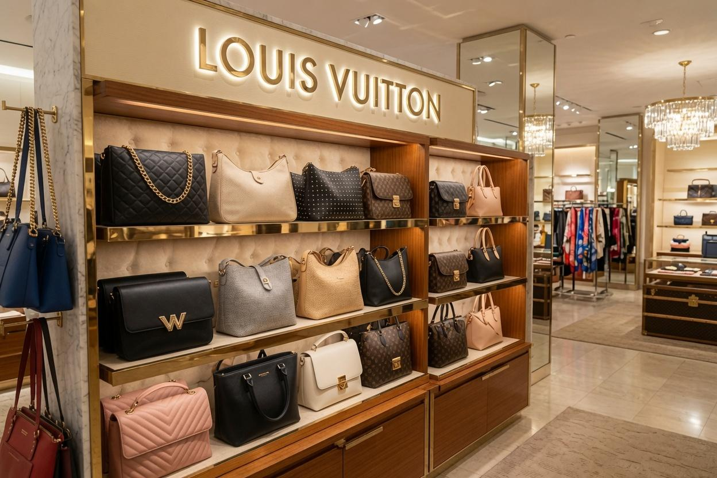
Price vs. Value Refresher · Handbags
WALMART
LOUIS VUITTON
Average Everyday Purse
Typical Women's Handbag
$15 – $35
$2,000 – $3,000+
Many options under $25
Most popular styles in this range
A Remarkable Experience. Every Client. Every time. | Waterman COGS · Blue Track
4

Slide 5
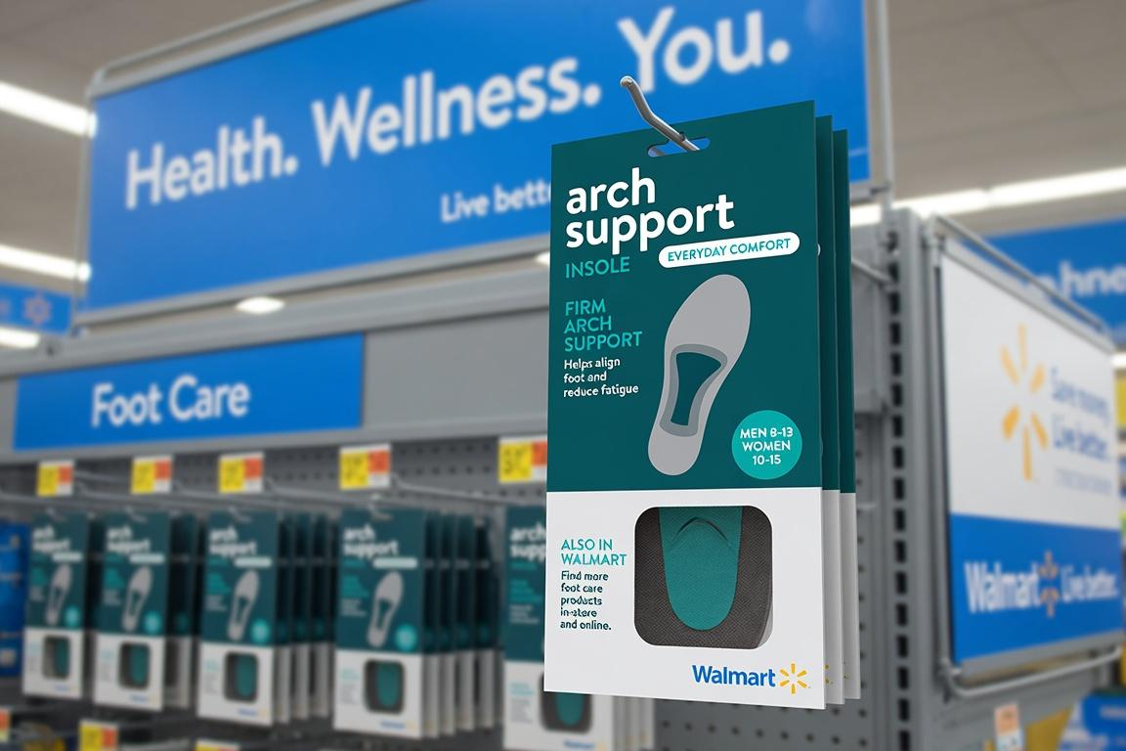
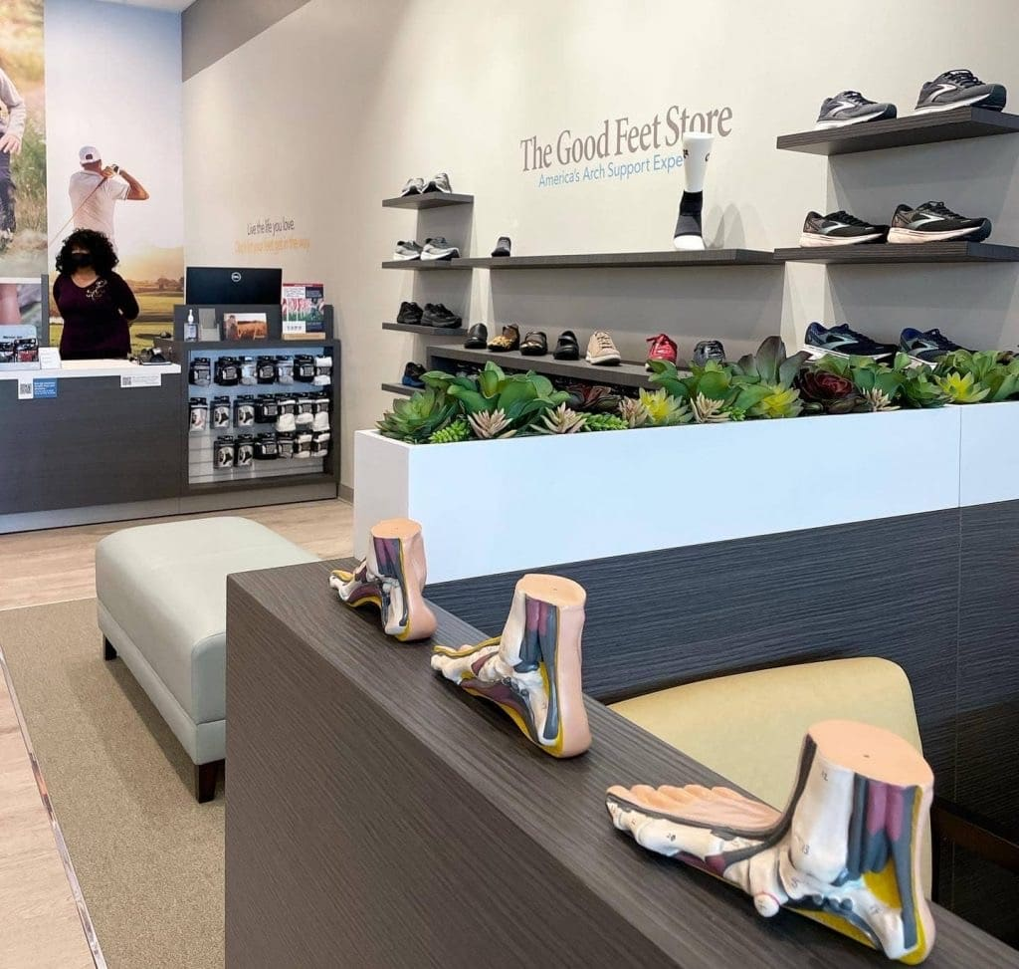
Price vs. Value Refresher · Arch Supports
WALMART
THE GOOD FEET STORE
Basic to Mid-Range Arch Supports
Custom Arch Supports / Full System
$10 – $20
$525 / support
$2,000+ full system
Insoles, sleeves, or straps
A Remarkable Experience. Every Client. Every time. | Waterman COGS · Blue Track
5

Slide 6
Why Does This Information Matter?
Ask yourself these questions:
1
What do the insides of a Walmart vs. a Rolex boutique, Louis Vuitton store, or The Good Feet Store look like?
2
How do the staff members dress, stand, speak, and act in each environment?
3
If you walked into one store vs. the other without saying or hearing a single word, would you expect a higher price and higher-quality item?
4
What creates the permission for a client to invest $2,000+ instead of $20?
A Remarkable Experience. Every Client. Every time. | Waterman COGS · Blue Track
6

Slide 7
What is Non-Tangible Value?
Definition
Everything the client sees, feels, experiences, and remembers that is NOT the physical product itself — yet dramatically increases (or destroys) the perceived value of that product.
Reinforces the Tangible
100% Controllable
The Multiplier
Makes our supports, shoes, socks, and Med Massager feel worth every dollar
We own it every single day — no budget or inventory required
It is how we deliver “A Remarkable Experience. Every Client. Every time.”
A Remarkable Experience. Every Client. Every time. | Waterman COGS · Blue Track
7

Slide 8
Why Non-Tangible Value Matters for the Numbers
Non-tangible excellence is free leverage on every metric that matters.
Non-Tangible Element | Primary Metric Impact | Risk if Missed | Opportunity
Cart / Product Handling | Close rate, AOV | Looks cheap → price objection | +10-15% close potential
Specialist Appearance & Presence | Demo rate, trust, close | Undermines $2k value | Immediate perception shift
Store Environment (first 10s) | Traffic-to-demo conversion | Sets “Walmart” expectation | Protects entire pipeline
Follow-up Quality | Retention, referrals, reviews | Lost lifetime value | Compounding growth
Language & Ownership | Close rate, objection handling | Weak confidence = discount pressure | Higher full-system closes
A Remarkable Experience. Every Client. Every time. | Waterman COGS · Blue Track
8

Slide 9
The Controllable Non-Tangible Pillars
1
Cart & Product Handling
2
Specialist Appearance & Presence
3
Store Environment
Highest leverage on perceived value
First 30-60 seconds decide premium vs cheap
Sets price expectation before you speak
4
Assessment, Test Walk & Flow
5
Language & Ownership
6
Follow-Up Quality
Smooth = consultative & expert
Confidence protects the price
Turns sale into relationship + referrals
A Remarkable Experience. Every Client. Every time. | Waterman COGS · Blue Track
9

Slide 10
1. Cart & Product Handling · Treat It Like a Rolex
Why it matters for closes: Careless handling instantly makes a $525 support feel like a $20 insole. Deliberate, respectful presentation multiplies perceived value.
DO THIS
NEVER
✓ Keep cart and fitting station pristine and organized at all times
✗ Toss or casually drop supports onto the cart or floor
✓ Present every support, shoe, sock, and Med Massager deliberately
✗ Leave a messy, cluttered, or dirt/dust-covered station
✓ Clean hands / trays / tablets / Med Massager
✗ Stack items carelessly or leave packaging open and scattered
✓ Stage items with care and visual respect
✗ Allow the cart to look like a discount bin
✓ Treat the system like the high-value solution it is
✗ Handle products in a way that says “this is ordinary”
A Remarkable Experience. Every Client. Every time. | Waterman COGS · Blue Track
10

Slide 11
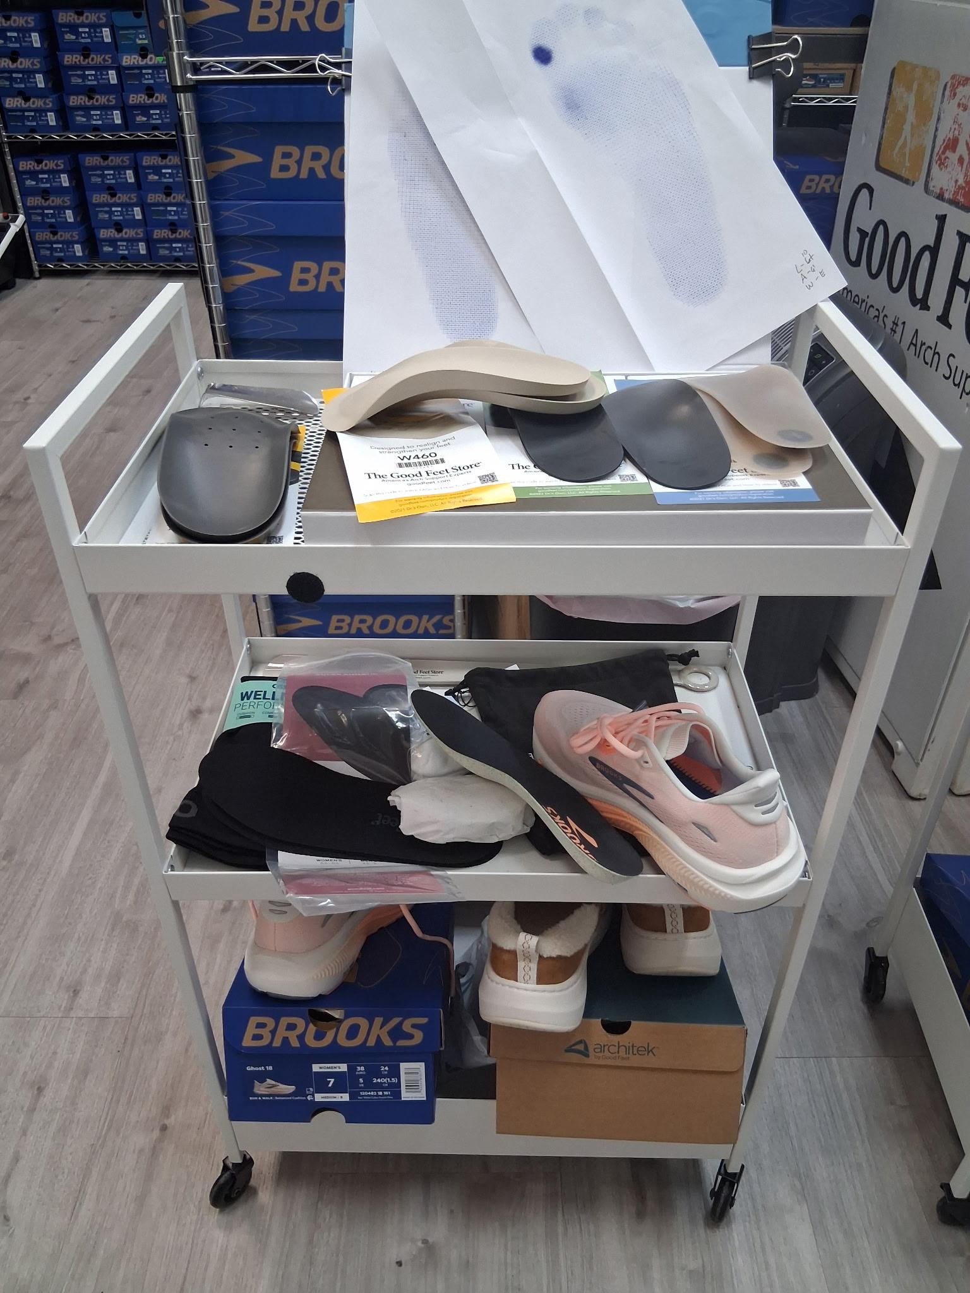
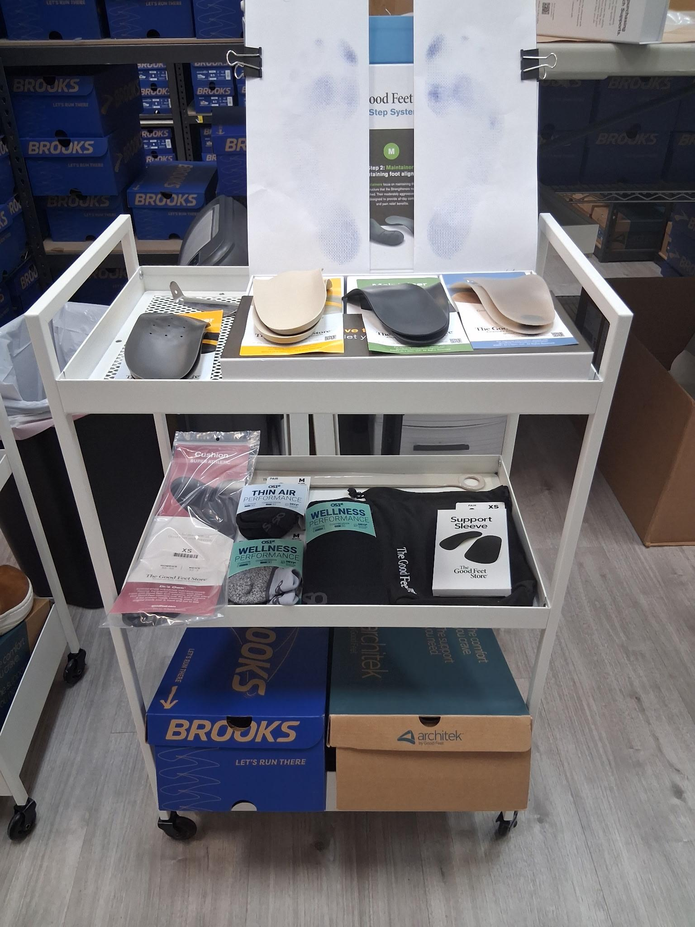
Cart Presentation: Clean vs. Messy — Real Examples
MESSY CART
CLEAN / ROLEX-LEVEL CART
Looks ordinary / discount-bin energy
Kills premium perception instantly
Organized · Deliberate · Premium
Supports the $2,000+ value story
A Remarkable Experience. Every Client. Every time. | Waterman COGS · Blue Track
11

Slide 12
2. Specialist Appearance & Presence
Why it matters: Clients decide in the first 30–60 seconds whether this feels like a $2,000 solution or a $20 one. Your presence either supports or undermines the price.
DO THIS
NEVER
✓ Sharp, clean, every single shift
✗ Wrinkled, incomplete, or casual appearance
✓ Strong posture, open body language, genuine energy
✗ Low energy, slumped posture, or distracted vibe
✓ Professional yet warm language and tone
✗ Transactional or uncertain language
✓ Confident, consultative presence, never rushed
✗ Looking at the phone or multitasking during the experience
✓ Grooming and overall presentation that matches a premium brand
✗ Anything that says “this is just another job”
A Remarkable Experience. Every Client. Every time. | Waterman COGS · Blue Track
12

Slide 13
3. Store Environment · The First 10 Seconds
Why it matters: The environment sets the price expectation before a single word is spoken. A “Walmart-level” first impression makes the $2,000+ system feel mismatched.
DO THIS
NEVER
✓ Spotless floors, mirrors, glass, and fitting area
✗ Clutter, dust, or dirty surfaces anywhere a client sees
✓ Clean bathrooms and entryway — every client notices
✗ Messy fitting area or overflowing trash
✓ Organized visual merchandising and lighting
✗ Dim, harsh, or poorly maintained lighting
✓ Calm, premium atmosphere (music, scent if used, volume)
✗ Anything that sets a discount or “ordinary” expectation
✓ Fitting chairs and stations ready and inviting
✗ Letting high-traffic days become an excuse for lower standards
A Remarkable Experience. Every Client. Every time. | Waterman COGS · Blue Track
13

Slide 14
4–6. Flow, Language & Follow-Up
4. Assessment & Flow
5. Language & Ownership
6. Follow-Up Quality
• Care & respect during footprint / pressure mapping
• Confident ownership language about the system
• Personal, timely check-ins
• Patient, expert coaching on the test walk
• Speak as the expert who owns the outcome
• Feel caring, not scripted
• Smooth transitions: greeting → assessment → demo → close
• Protect the value of the Lifetime Guarantee
• Reinforce the relationship and guarantee
• Never rush or make it feel retail
• Never use discounting or uncertain language
• Turns one sale into referrals and retention
A Remarkable Experience. Every Client. Every time. | Waterman COGS · Blue Track
14

Slide 15
Additional Good Feet-Specific Non-Tangibles
Packaging & Take-Home
Privacy & Respect
Team Atmosphere
Beautiful, organized packaging of the full system. Neat materials. A premium hand-off that feels special.
Protect client privacy during fitting and assessment. Never make the process feel clinical or exposed.
Zero tolerance for negativity. Supportive, seamless handoffs. The whole store team acts as one premium brand.
Post-Sale Touches
Guarantee Ownership
High-Traffic & Transition Days
Thank-you notes, thoughtful check-ins, and small gestures that reinforce we care beyond the sale.
How we talk about and live the Satisfaction Guarantee — with full ownership and confidence.
Standards do not drop on busy days or during lower staffed days. These are the highest-risk windows.
A Remarkable Experience. Every Client. Every time. | Waterman COGS · Blue Track
15

Slide 16
Specialist Self-Audit & Manager Scorecard
Rate 1–5 daily or weekly. Managers: pair the average score with that week’s close rate / AOV / ranking.
Element | What “5” Looks Like | My Score (1-5)
Cart & Product Handling | Pristine, deliberate, Rolex-level presentation | _______________
Personal Appearance & Energy | Sharp uniform, posture, presence | _______________
Store Environment Contribution | Floors, stations, bathrooms, overall feel | _______________
Assessment / Demo Flow | Patient, expert, smooth transitions | _______________
Language Confidence & Ownership | No discounting language, full ownership | _______________
Follow-Up Quality | Timely, personal, caring | _______________
Overall “Rolex Test” | Would a walk-in expect $2,000+ or $20? | _______________
A Remarkable Experience. Every Client. Every time. | Waterman COGS · Blue Track
16

Slide 17
Role-Play Scenarios
Scenario 1: Cart & Handling
One specialist presents with a messy cart and casual handling. Another presents the same supports with pristine, Rolex-level care. Debrief: How did the client’s reaction to price change?
Scenario 2: Presence
Low-energy, distracted greeting and presence vs. sharp, confident, warm presence. Observe the client’s engagement and trust level.
Scenario 3: Price Objection + Non-Tangibles
Client says “That’s a lot of money.” Specialist leans on the experience just delivered (environment, handling, expertise, follow-up commitment) to reinforce value without discounting.
A Remarkable Experience. Every Client. Every time. | Waterman COGS · Blue Track
17

Slide 18
7-Day Action Challenge
Pick your top 1–2 gaps. Make them habits this week. Share wins in the next huddle for shout-outs.
Cart Standards
Day 1–2
Reset every cart and station to pristine. Practice deliberate product handling on every demo.
Appearance & Presence
Day 3–4
Self-check + peer feedback. Own energy, posture, and language for every client.
Flow & Language
Day 5–6
Master one smooth transition. Use ownership language on the system and guarantee.
Follow-Up Excellence
Day 7
Deliver one perfect personal follow-up call. Report the client’s response and any referral or review.
A Remarkable Experience. Every Client. Every time. | Waterman COGS · Blue Track
18

Slide 19
We already crush the tangible product knowledge and fitting process.
Non-tangible value is how we make every client feel the difference
so the value is undeniable and the price conversation becomes easier.
A Remarkable Experience.
Every Client. Every time.
Let’s own it — together.
Waterman COGS · Blue Track · Specialists

