Slide 1
GT.M Internals
K.S. Bhaskar
Fidelity National Information Services. Inc.
ks.bhaskar@fnis.com
(610) 578-4265

Slide 2
GT.M (http://fis-gtm.com)
Implements M[UMPS] – ISO/IEC 11756:1999
  Language tightly bound to a database
Primarily used on banking & finance
  Including at largest real time core processing system that is live anywhere in the world
  Increasingly used in health care too
Multi-license
  GPL – x86 GNU/Linux and Alpha/AXP OpenVMS & Tru64 UNIX [Windows (Cygwin) soon]
  Traditional – IBM pSeries AIX, SUN SPARC Solaris, HP PA-RISC HP-UX [Itanium HP-UX & GNU/Linux soon]

Slide 3
Database access
No database daemon
Each open database file has a shared memory segment associated with it
  Cooperatively managed by run-time logic in each process' address space
  OS semaphores used for set-up / tear-down of shared memory segments
  Shared memory semaphores used for critical sections

Slide 4
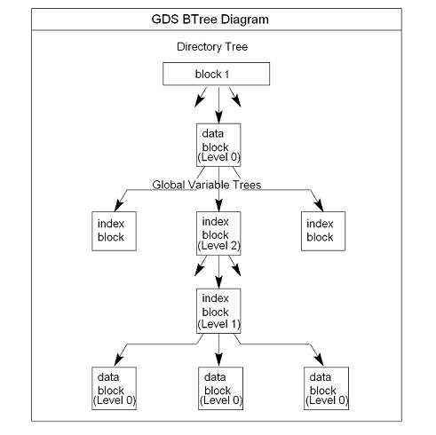
Typeless indexes & values
Local variables
  Hashed variable names
  Modified linear search for subscripts within a variable – optimized for small numbers of subscripts
Global variables
  B* tree variable names
  B* tree each variable

Slide 5
Locks
Like traffic lights, not locks on doors
  Locks a resource in shared memory
Tree structure

Slide 6
Network services
STDIN / STDOUT can be inherited from inetd / xinetd

Slide 7
Recoverability
Journaling
  NOBEFORE_IMAGE journaling / forward recovery
  BEFORE_IMAGE journaling / backward recovery

Slide 8
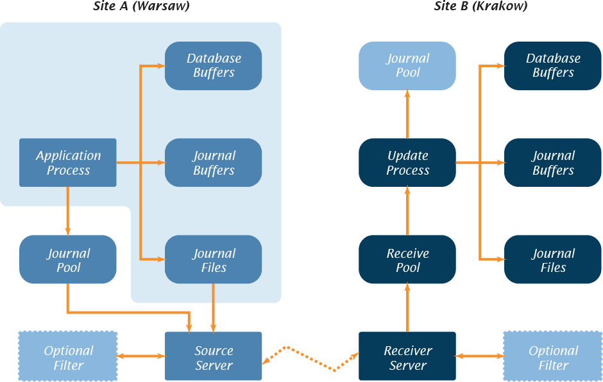
Business continuity – dual site
New York)
Los Angeles)

Slide 9
Business continuity – multi-site
16 secondaries to root primary
  each secondary can feed 16 tertiaries
  and so on...
Any node in the tree can potentially become the new primary
Rolling upgrades

Slide 10
Language implementation
Mostly written in C – a small amount of assembler
Compiler generates xxx.o object file from xxx.m source file
  Compile on demand if source newer than object
Stack oriented threaded code – push parameters / call runtime routine / pop results
Two phase compiler
  Parse phase produces abstract syntax tree
  Generate code phase produces native machine code
Dynamic stack frames & code cache for indirection and Xecute

Slide 11
Code
Layered APIs
Portability
  Routines can reside in portable directory, OS flavor directory (UNIX, OpenVMS), hardware architecture specific directory (x86, Alpha/AXP, POWER, SPARC, Itanium) or OS specific directory (GNU/Linux, Solaris, AIX, HP-UX)
  On some platforms, OS specific directory takes precedence over hardware architecture specific directory, sometimes the other way around

Slide 12
¿¿Questions?? ¡¡Comments!!
  K.S. Bhaskar
  ks.bhaskar@fnis.com
  (610) 578-4265

