Slide 1
A TEAM PROJECT
BY JAYA ARASALIKE, PHIL MAO, NICHOLAS NOCIFORO, KIRA ZOLTAN

Slide 2

DESCRIPTION
Preparing for an a technical interview can be challenging and frightening. Our project aimed to solve this problem through a web application that preps the user with code-related questions to improve their technical know-how.

Slide 3

MOTIVATION
Lack of code-related questions are scarce on the internet unless you buy something.
Knowing the technicalities behind code will help an interviewee handle technical questions that are presented at the time of an interview.

Slide 4
RESULTS
Using an AJAX call to reference local JSON files containing our interview questions, LinkedIn API for user authentication, we were able to develop a professional web application for practicing code related questions for interview practice and populate the users’s results with Firebase.

Slide 5


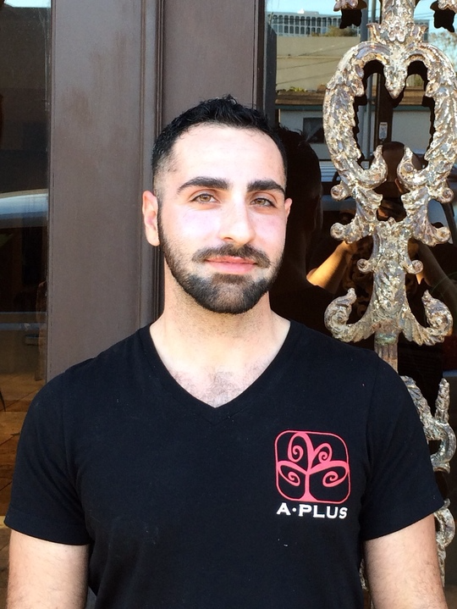

TEAM EFFORTS
Jaya
Phil
Nick
Kira
LinkedIn API
JavaScript
JSON
Firebase
QA
JavaScript
AJAX
JSON
Logic
Project Manager
JSON
Made presentation
Google Map API
QA
Bootstrap
Css
HTML
Front End
jQuery
QA

Slide 6
CHALLENGES
Github was challenging to work with, especially when you get behind on a few commits
Getting an AJAX call for a local JSON file was tricky to figure out because of Cross Origin problems
Design compromise and style selections
LinkedIn Authentication for User Login

Slide 7

IMPROVEMENTS
Randomized questions instead of the same 1-10 questions appearing every time.
Mobile optimization for the test taker on the go.
Provide pre-screen interview questions for companies

