Slide 1
An overview of EPA’s Integrated Climate and Land-use Scenarios
Phil Morefield
Integrated Environmental Assessment Branch - DC (IEABD)

Slide 2
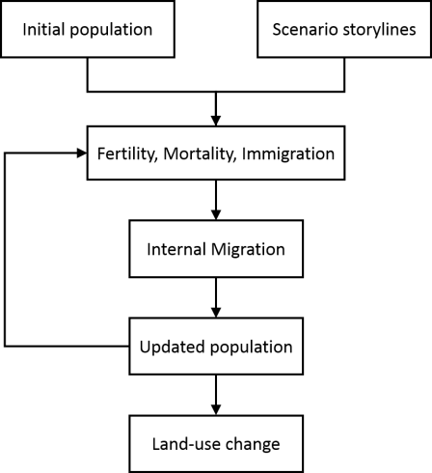
Integrated Climate and Land-Use Scenarios
V1: SRES
Goal: To produce projections of population, land use, and impervious surface change that improve impact and vulnerability assessments of global change.
Version 1: National-Scale Housing Density Scenarios Consistent with Climate Change Storylines (2009)
Version 2: Updates to the Demographic and Spatial Allocation Models to Produce Integrated Climate and Land Use Scenarios (ICLUS) Version 2 (2017)
Version 3: Coming in 2022 2023.
Version 4: Coming in 2024
V2: SSP
V2: Climate amenities
V1: County
V2: County + MSA
V1: Housing density
V2: Residential, commercial, industrial

Slide 3
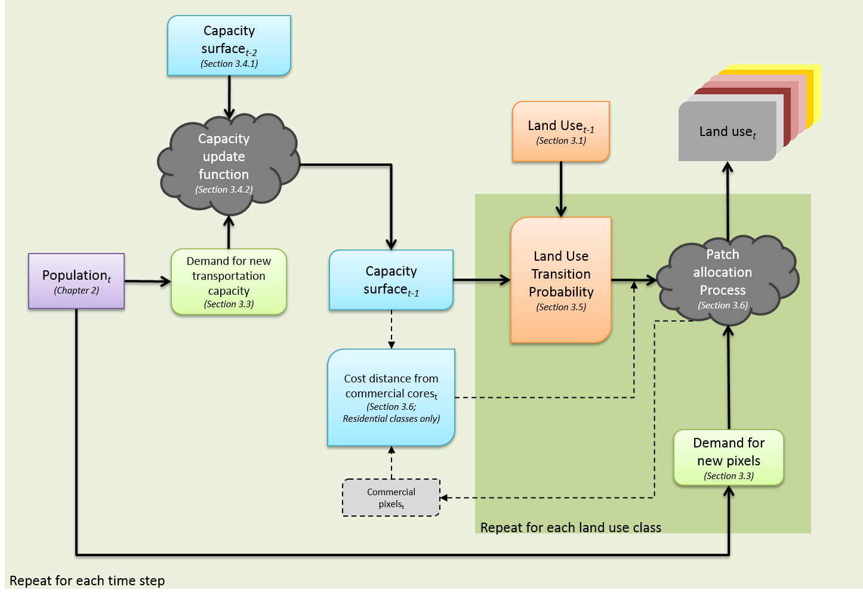
ICLUS model flow

Slide 4
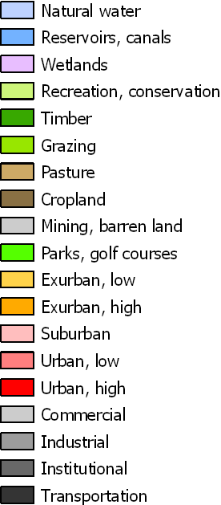
Washington, D.C.
SSP2 (medium population growth)
SSP5 (high population growth)

Slide 5
FASOM + ICLUS
Projections of temperature and precipitation
Urban growth
(ICLUS)
Forest productivity
(MC2)
Crop productivity
(EPIC)
FASOM

Slide 6
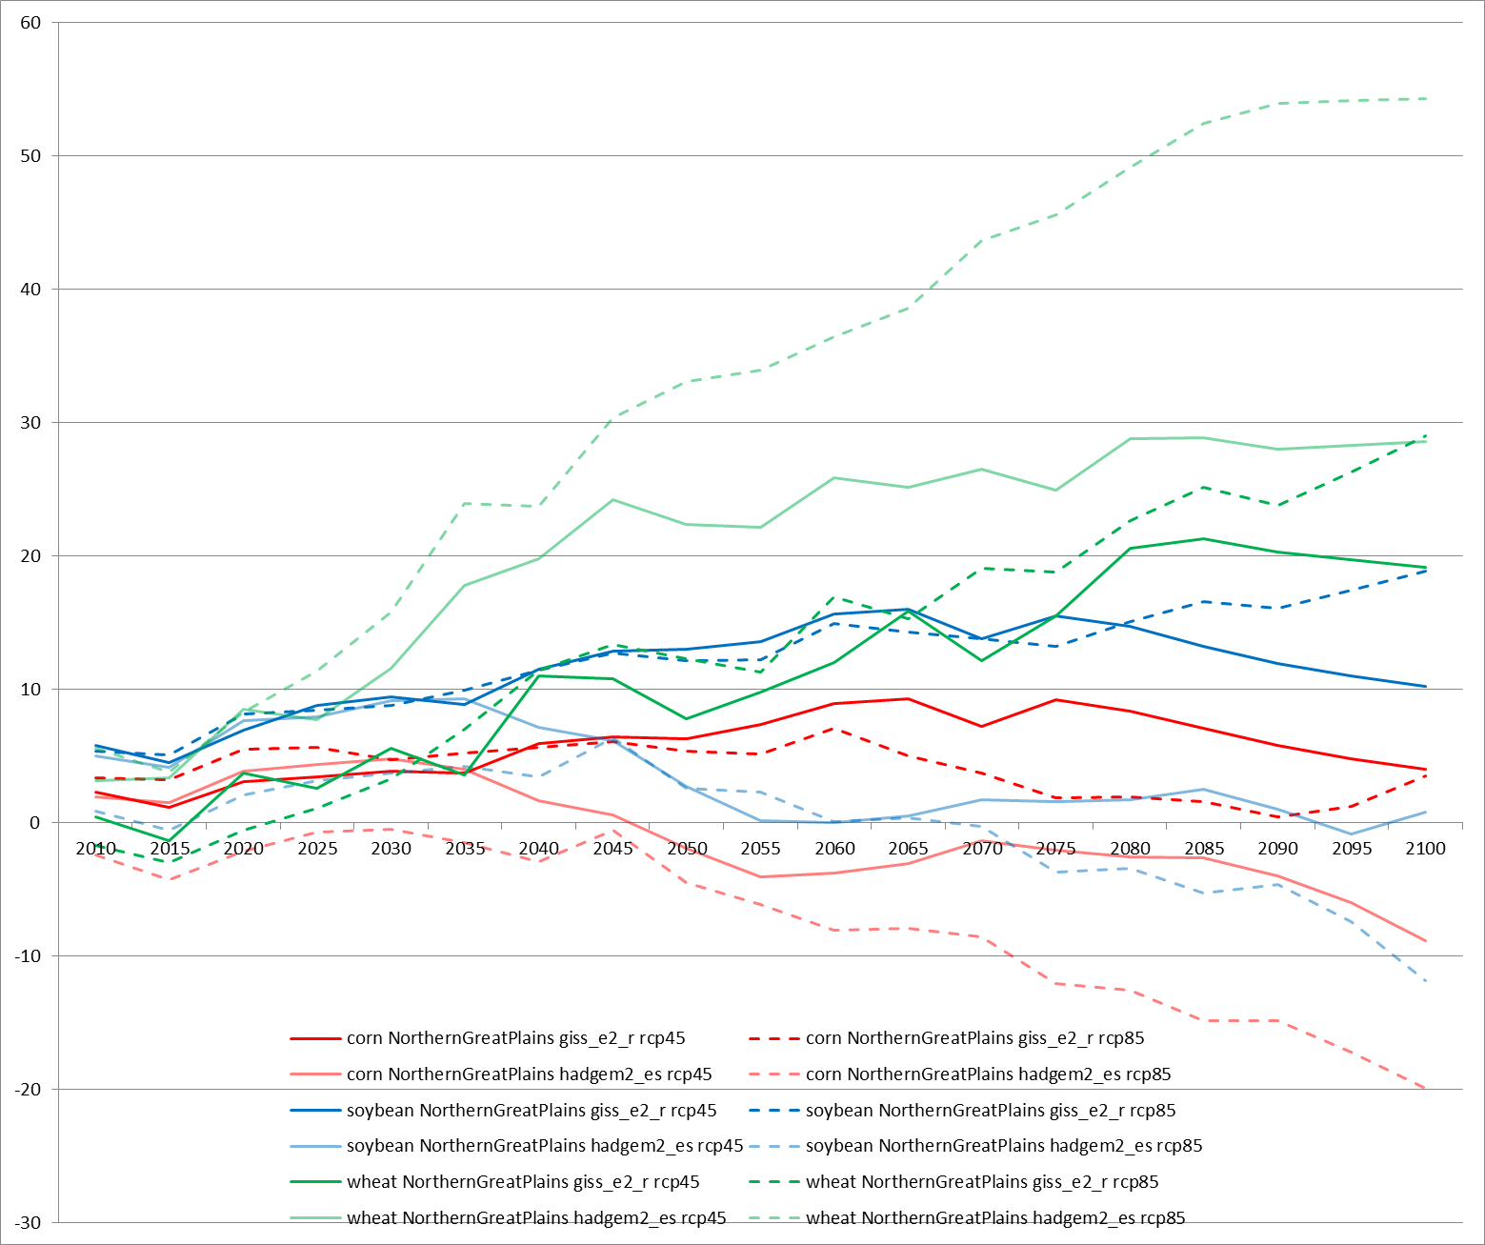
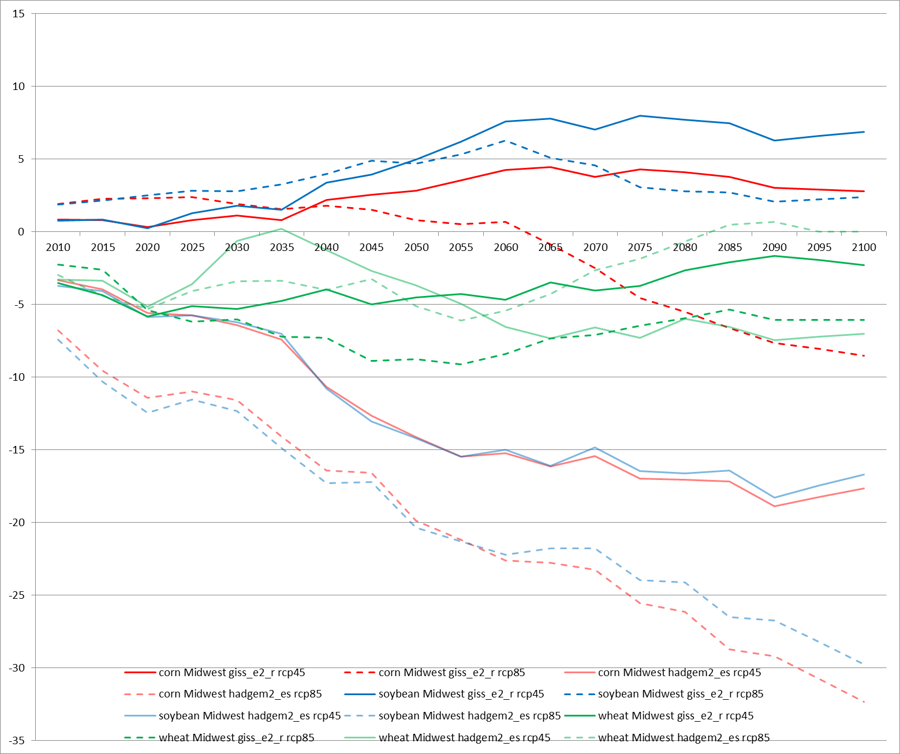
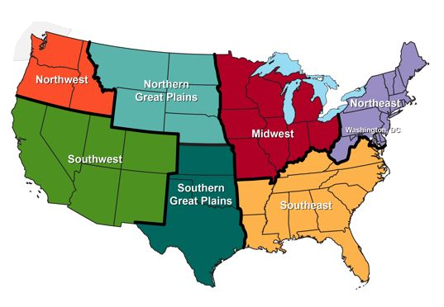
FASOM + ICLUS: Some Preliminary Results
Northern Great Plains
Yields generally increased
Model choice alone can determine the sign of change
e.g., corn under RCP8.5
Midwest
Yields generally decreased
Only GISS-e2-r results increased yields, and mostly under RCP4.5
Soybean yields increase under RCP8.5

Slide 7
FASOM + ICLUS: Preliminary Assessment
After accounting for urban growth, temperature and precipitation changes, and land use shifts between forestry and agriculture, our results suggest the extent of cropland will increase through 2100.
The primary driver of this trend is decreasing yields nationally, although some crop-region-scenario combinations could experience higher yields.
Forestry yields are generally 1-3% higher than baseline, with some years dipping lower than the baseline projection.
Choices regarding emissions scenario and climate model remain an important factor in these types of analyses; sign and magnitude of change may depend on those decisions.

Slide 8
Using ICLUS to Assess Future Mobile Emissions
Use ICLUS v2 population and land use changes
County-level
Decadal to 2100
Allocate households to residential density classes
High-density urban
Urban
Suburban
Exurban
Rural
Calculate VMTs per household as a function of residential density
Use MOVES 2014 to calculate changes in passenger vehicle emissions
MOtor Vehicle Emissions Simulator
Use 2010 as the baseline for comparison

Slide 9
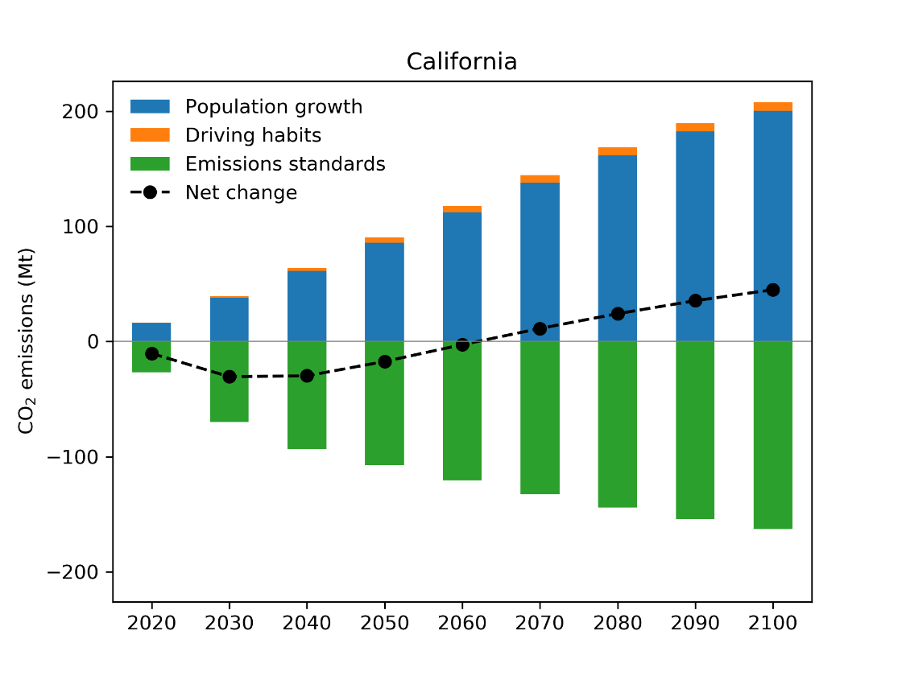
Decomposing the decline in emissions: California
Densification should reduce per-person VMT (“Driving habits”)
Instead, per-person VMT increased in several states

Slide 10
Assessing the results
Existing emissions standards for passenger vehicles can entirely mitigate population growth – and more – through 2050
After 2050, additional standards may be needed; none of the states densify quickly enough to overcome population growth in our simulations
The role of land use change is complicated; overall density of households needs to increase in order to realize a benefit

Slide 11
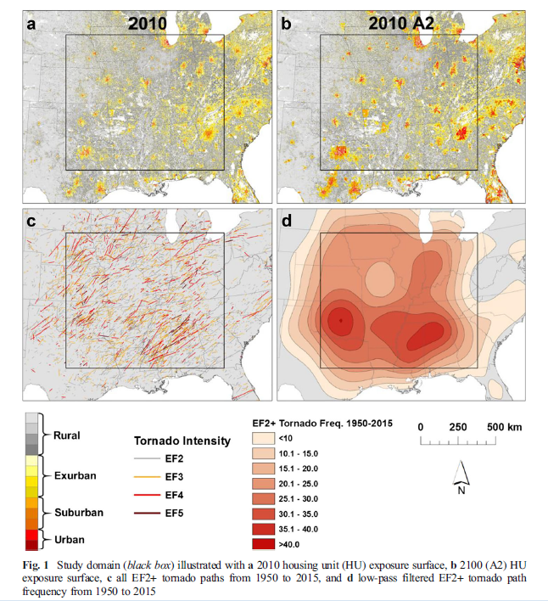
Population growth, climate change and tornado risk
Strader et al. (2017)
Uses the Tornado Impact Monte Carlo (TorMC) model
Simulate (n=10,000) 2010 housing density and historical (1954-2015) tornado activity
Simulate 2010 housing density and future tornado frequency and variability (+50%)
Simulate 2100 A2 housing density and historical tornado activity
Results:
Account for population growth and increased tornado activity increases impacts by 170% (# of housing units impacted)
Importance: Population growth > tornado frequency > tornado variability

Slide 12
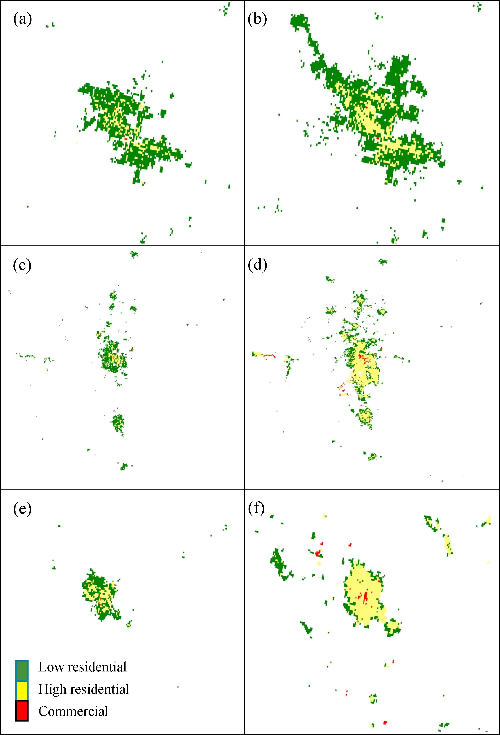
Urban growth and temperature
2010
2100 A2
Wang & Upreti (2019)
Studies have shown that nocturnal warming (“urban heat island”) has implications for human health
Examined urban growth patterns (expansion vs. intensification) and the resultant effects on diurnal temperature
Three cities (Phoenix, Denver, Las Vegas) comparing 2010 to 2100
Phoenix
Denver
Las Vegas

Slide 13
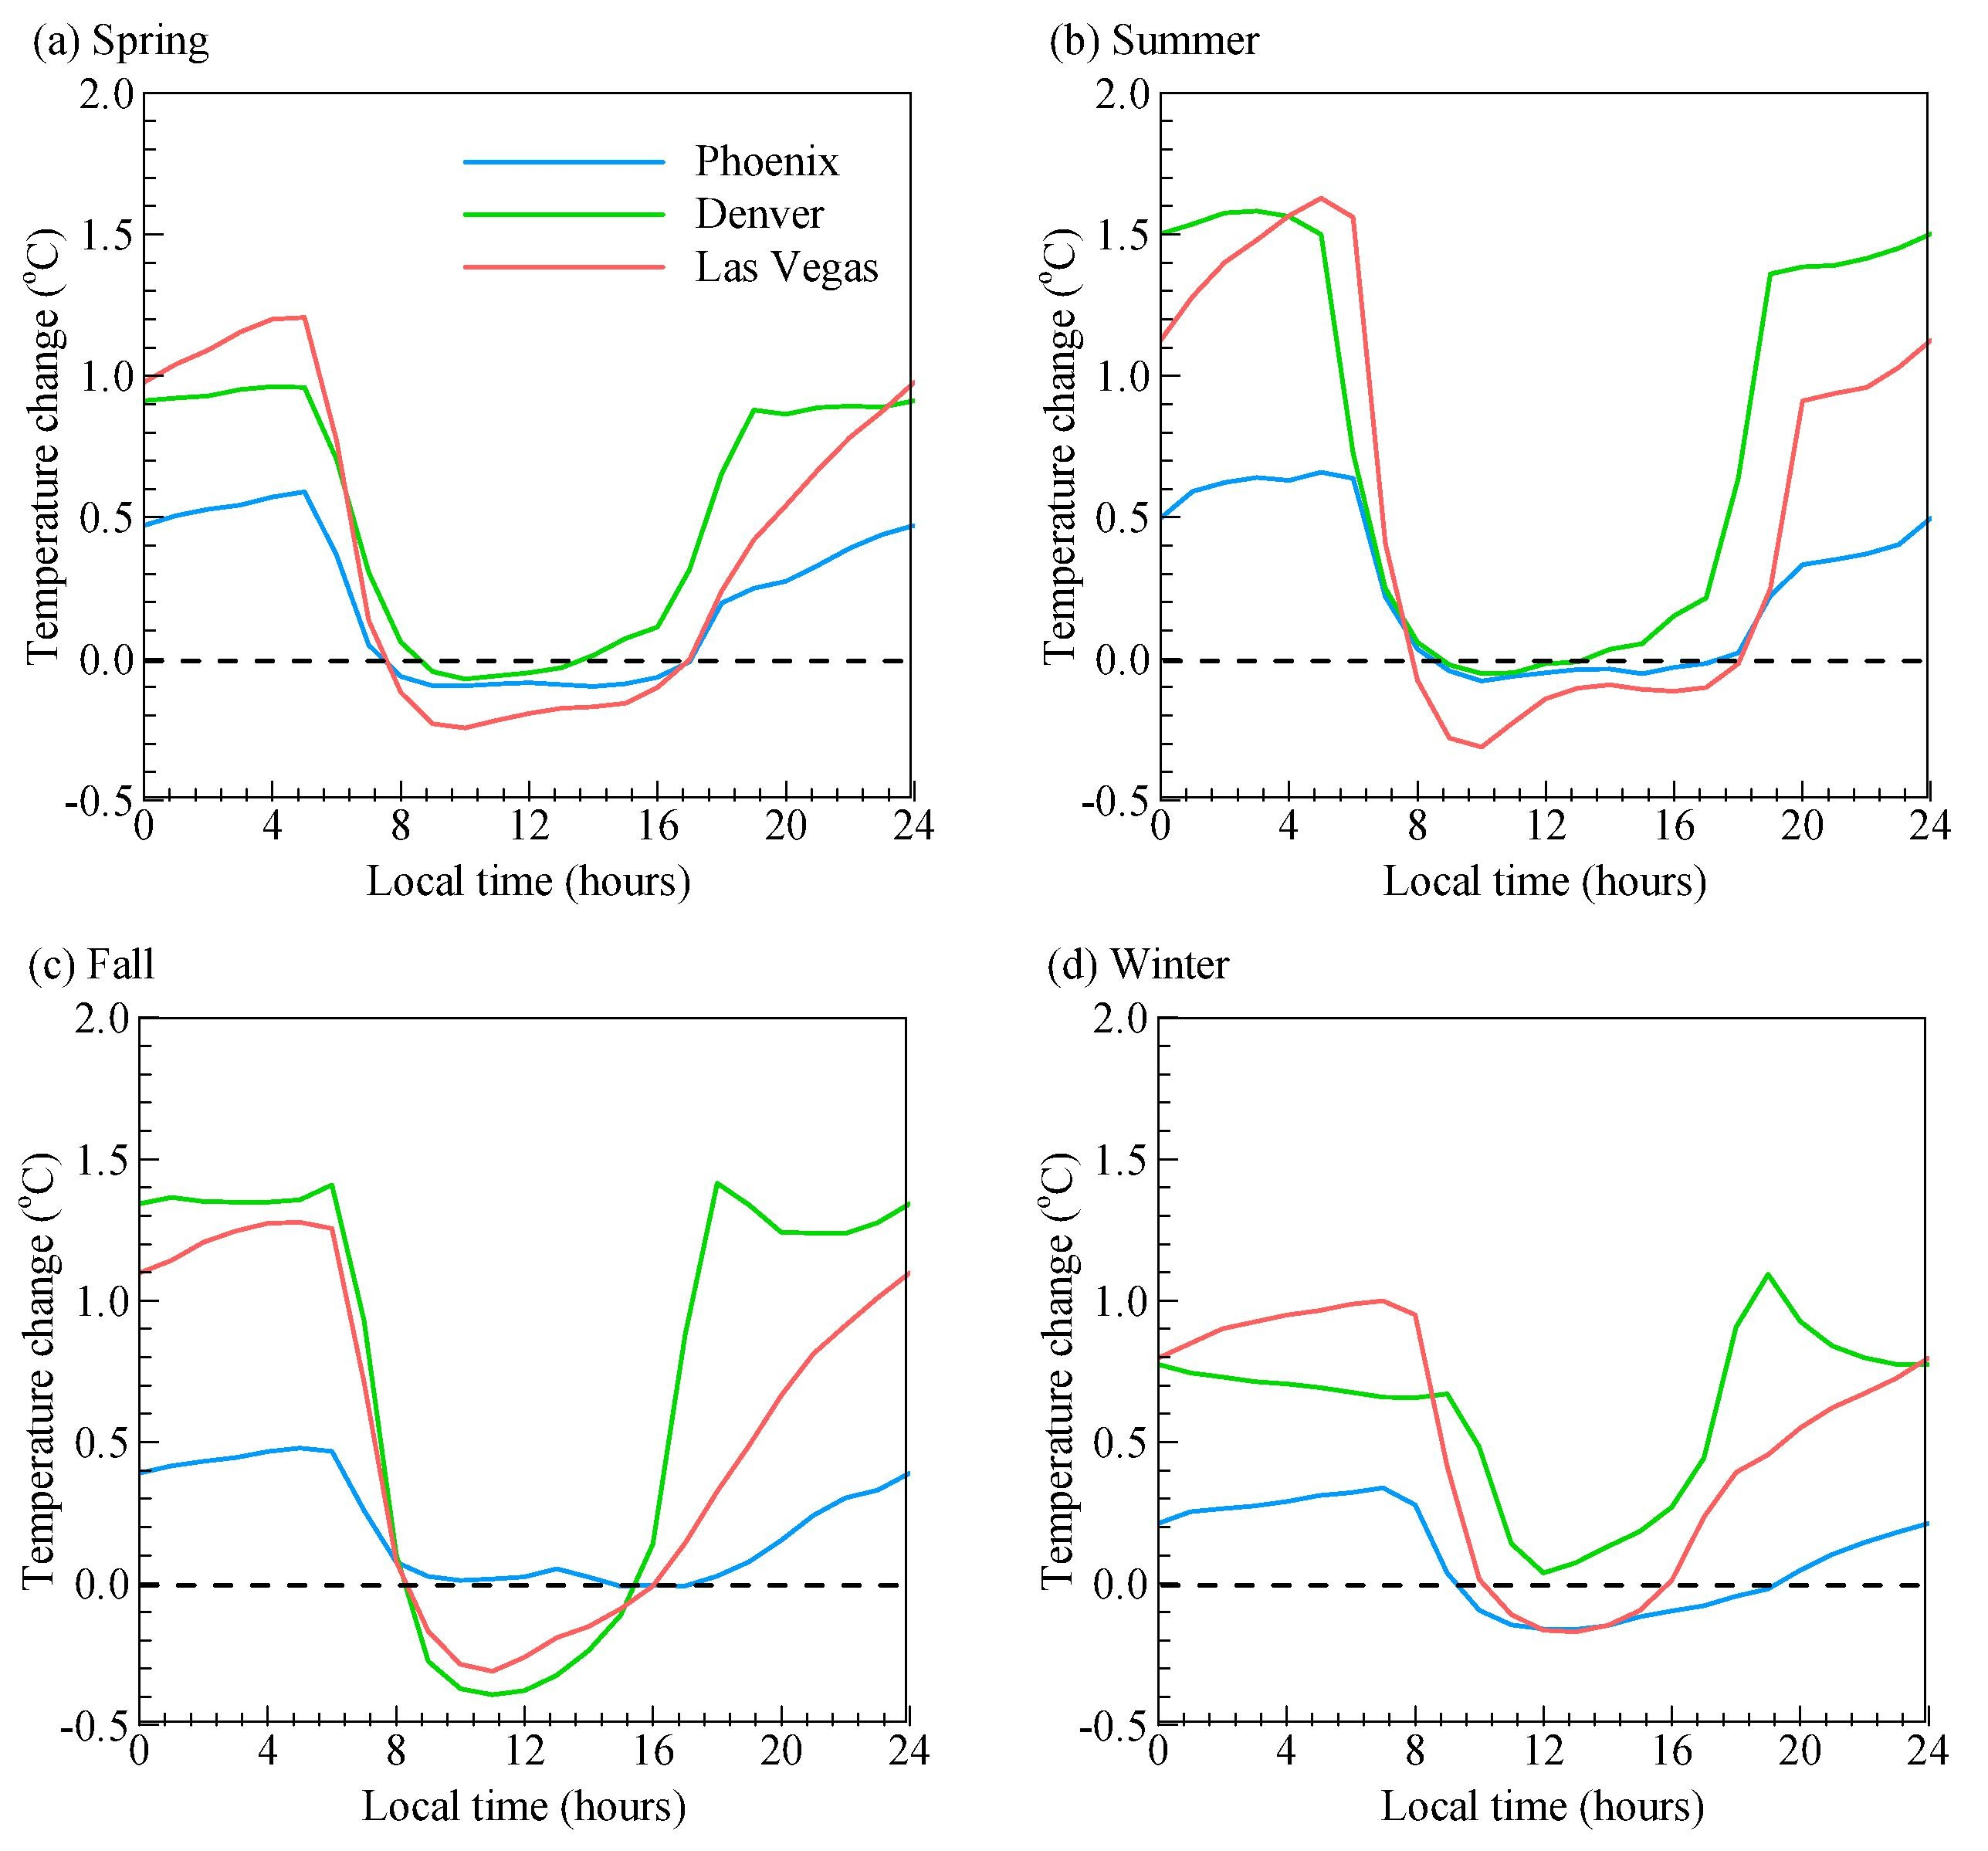
Urban growth and temperature
The sprawliest city – Phoenix – shows the least nocturnal warming
The “oasis effect”
More compact growth leads to warmer nights
Adaptation can have unexpected consequences.
Simulations help uncover unintentional outcomes.

Slide 14
ICLUS as an assessment tool
National/regional
FASOM + ICLUS
Regional
Strader et al. (2017)
State
MOVES + ICLUS
City
Wang and Upreti (2019)
Coastal Assessments
USACE North Atlantic Coast Comprehensive Study (2015)
USACE South Atlantic Coastal Study (2022)

Slide 15
ICLUS v3
County level population by:
Race (x6)
White
Black
Asian
AIAN
NHPI
Two or More
Age (x18)
Gender
Includes Alaska and Hawaii (population only?)
Variety of scenarios to 2100
Wittgenstein v2 (i.e., SSPs)
Census 2017 (with immigration scenarios)

Slide 16
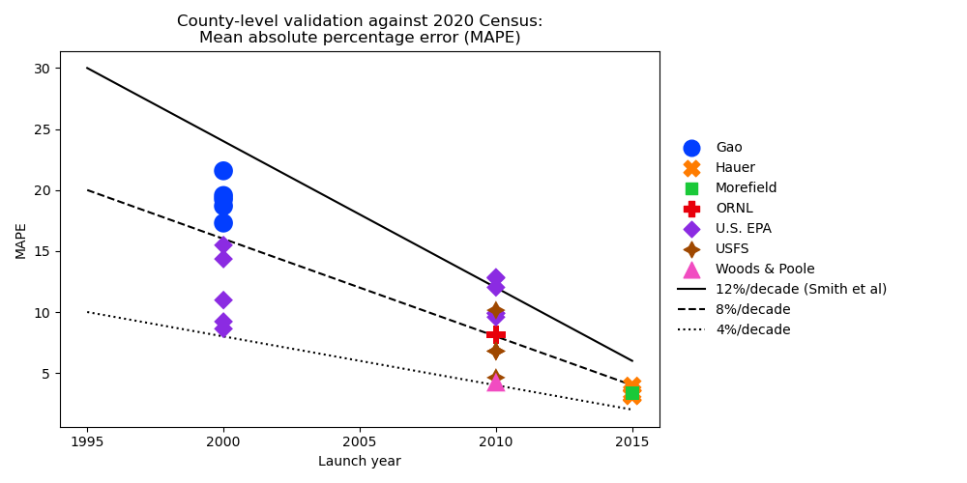

Slide 17
National Land Use Database
High-resolution (90m) land use data for CONUS
Theobald, D. (2014)
Integrated Climate and Land Use Scenarios (ICLUS), version 2
Uses NLUD transition probabilities (2000→2010)
NLUD for ICLUS v3
Modify some land use classes
Retain 30m resolution
Improve documentation and reproducibility
Quantify classification accuracy

Slide 18
2010 NLUD Data Sources (partial)
 | Transportation | Institutional: Developed | Institutional: Undeveloped | Mixed Use | Industrial | Commercial | Residential: Very high density | Residential: High Density | Residential | Residential: Low density | Residential: Very low density | Parks and Golf Courses
NLCD 2011 (LC) |  | X | X | X |  |  |  |  |  | X | X
NLCD 2011 (ID) | X |  |  |  | X
ESRI Data & Maps | X | X | X |  | X | X |  |  |  |  |  | X
TIGER | X | X | X |  | X | X |  |  |  |  |  | X
Navteq 2011 | X | X | X |  | X | X |  |  |  |  |  | X
DHS |  | X | X
LODES |  |  |  | X | X | X
UW Silvis BLHD |  |  |  | X | X | X | X | X | X | X | X
PAD-US |  |  |  |  |  |  |  |  |  |  |  | X

Slide 19
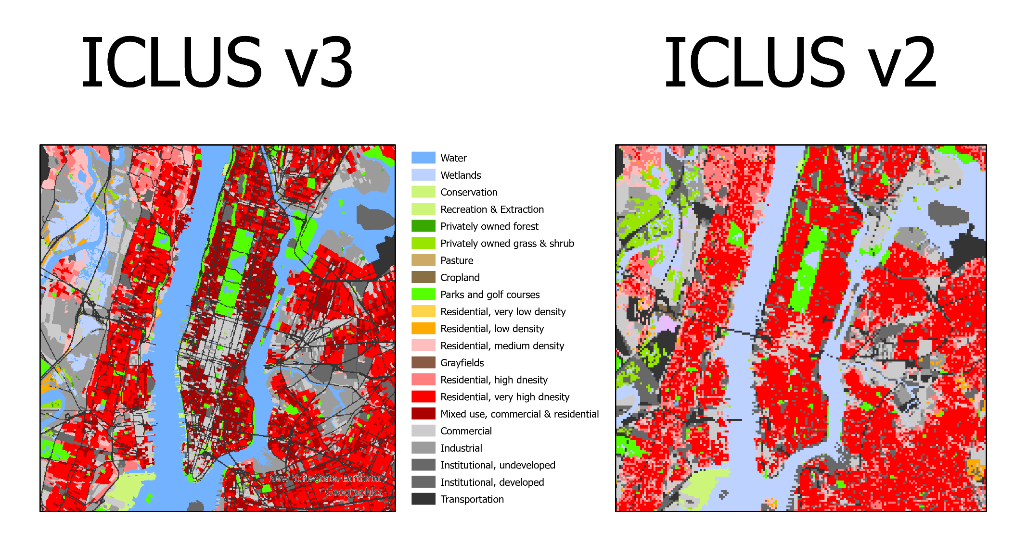
Comparison: Manhattan

Slide 20
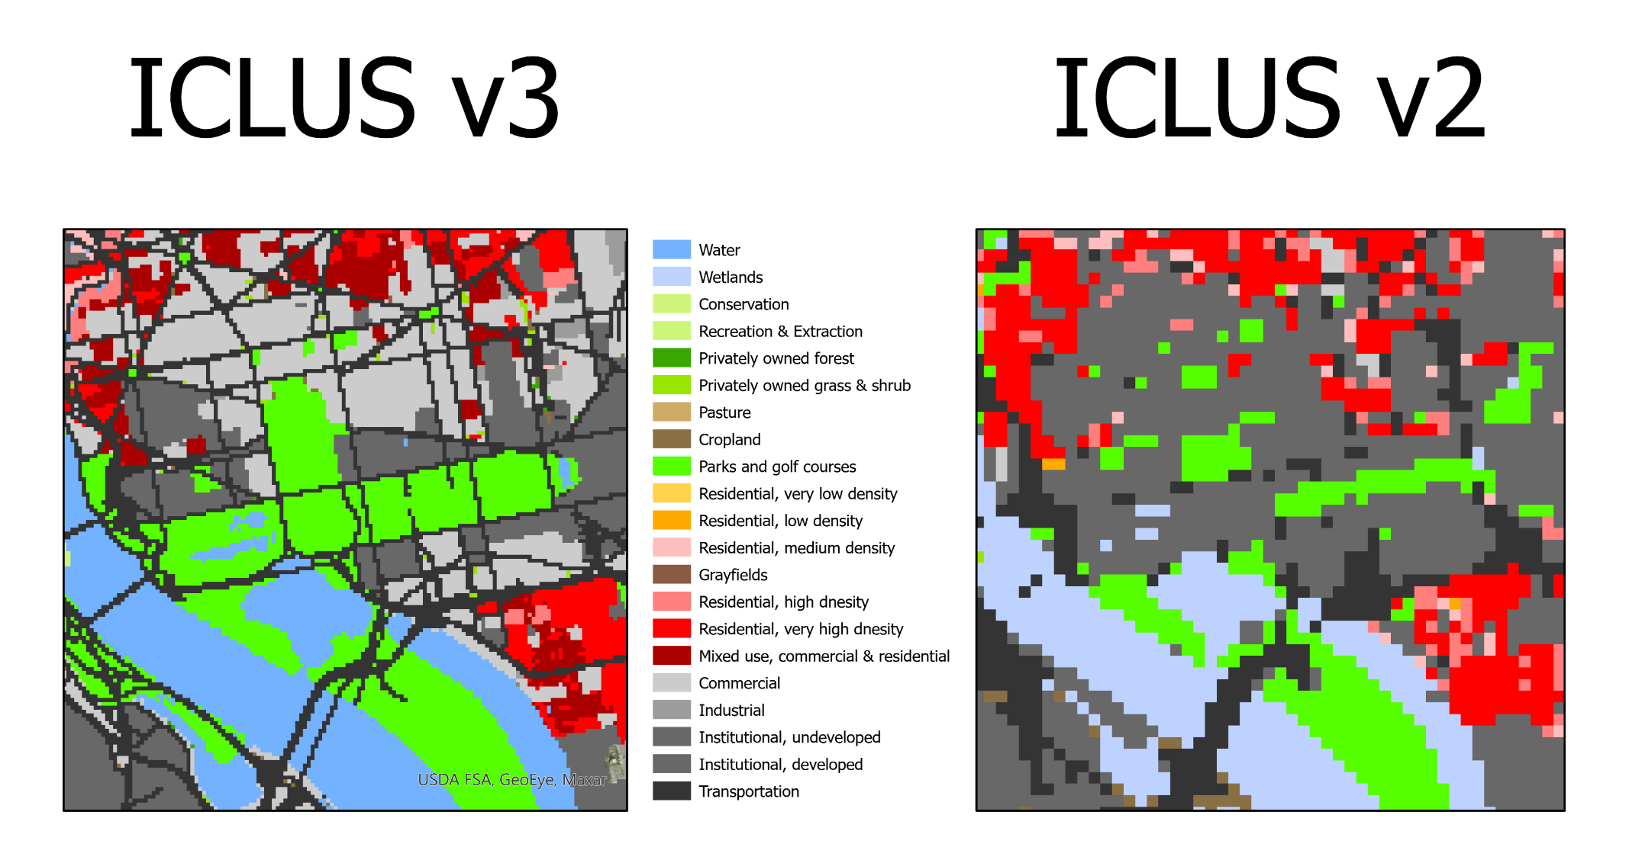
Comparison: Washington, D.C.

Slide 21
Outputs
 | Format | Spatial resolution | Size (single decade) | Size (entire century)
Population | SQLite | County |  | ~ 100 Mb
Land use | GeoTiff | 30 meter | ~14 Gb | ~140 Gb

Slide 22
ICLUS v4
Microsimulation of synthetic households
Economic considerations of migration patterns
FY 2022
Identify microsimulation platforms
Identify migration model(s)
FY 2023
Develop input data
Develop population model; deploy to HPC
FY 2024
Produce 2+ population scenarios

