Slide 1
Using Zero-inflated Regression and the Homophily Principle to Model Migration for Population Projections
Phil Morefield

Slide 2
My Research Interests
Population projections to assess environmental impacts and climate change vulnerability
Sub-national
End of century
Minority and vulnerable population
Migration
Under-represented in population projections
Response to climate change & sea-level rise

Slide 3
My Research Process
Proposal
Dissertation
Evaluate the radiation model
Explore race and age in migration modeling
Assess sub-national population projections
The radiation model doesn’t work
Identify alternative
The Homophily Principle
Accuracy benchmarks

Slide 4
Research Question #1
Does the radiation model outperform regression-based spatial interaction models?

Slide 5
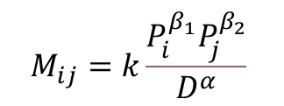
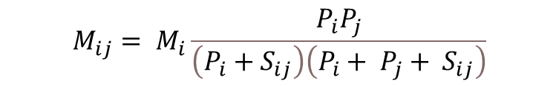
The Radiation Model Simini et al (2012)
$$M_{ij}= M_{i}\frac{P_{i}P_{j}}{\left(P_{i}+S_{ij}\right)\left(P_{i}+ P_{j}+ S_{ij}\right)}$$
Parameter free
Rigorous theoretical derivation
Better than the gravity model!
The Radiation Model
Limitations of Simini et al.
Only tested using one year of one migration data source
The gravity model is old
$$M_{ij}=k\frac{P_{i}^{β_{1}}P_{j}^{β_{2}}}{D^{α}}$$
The Gravity Model

Slide 6
Does the radiation model outperform regression-based spatial interaction models?
DATA
Widely used
Publicly available
National scope
County-to-county flows
Repeated
90%-99% of all possible county-to-county flows are zero or suppressed
Demographic attributes
IRS: None
ACS and 2000 Census: No crosstabulation
1990 Census: Full crosstabulation
 | Time periods | Migration interval | Suppressions | Method
IRS | 2013 to 2017 | Annual | Flows < 20 | Tax returns
ACS | 2007 to 2015 | Annual (five-year average) | Small flows¹ | Survey
Census | 1990 and 2000 | Five years | Unknown² | Survey
¹ Flows containing only one or two people from different households, only one or two people in group quarters, or one person in group quarters and the rest from a single household are suppressed.
² Technical documentation of the long form Census questionnaire is available but makes no specific mention of migration data suppression procedures.

Slide 7

$$D_{ij}$$
i
j

Slide 8
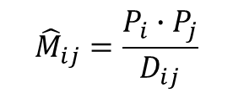

$${\hat{M}}_{ij}=\frac{P_{i}∙P_{j}}{D_{ij}}$$
$${\hat{M}}_{ij}$$
i
j

Slide 9
$${\hat{M}}_{ij}=\frac{P_{i}∙P_{j}}{D_{ij}}$$
k
i
j

Slide 10
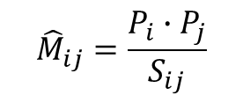
$${\hat{M}}_{ij}=\frac{P_{i}∙P_{j}}{S_{ij}}$$
k
k
Intervening Opportunities
i
j
k

Slide 11
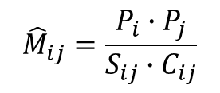
$${\hat{M}}_{ij}=\frac{P_{i}∙P_{j}}{S_{ij}∙C_{ij}}$$
k
k
k
Intervening Opportunities
i
j
Competing Migrants
k
k
k

Slide 12
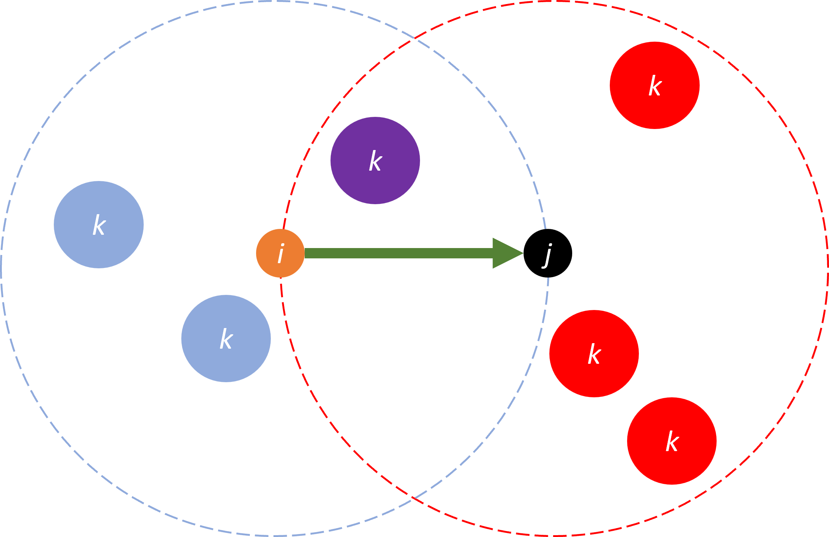
Does the radiation model outperform regression-based spatial interaction models?
METHODS: Additional spatial variables
Origin-based
Intervening Opportunities (IO) | S_{ij} | (Stouffer, 1940)
IO + origin population | S_{ij} + P_{i} | None
Distance-weighted IO | T_{ij} | None
*
New and existing variants of Stouffer
“Population only” variables consistent with Simini et al
Eight combinations of origin-destination variables due to collinearity
Destination-based
Competing Migrants (CM) | C_{ij} | (Stouffer, 1960)
CM + destination population | C_{ij} + P_{j} | None
Distance-weighted CM | L_{ij} | (Guldmann, 1999)
Competing Destinations | A_{ij} | (Fotheringham, 1983)
*

Slide 13
Does the radiation model outperform regression-based spatial interaction models?
METHODS: Regression models
Approach | Estimation | Reference
Ordinary Least Squares | Least squared error | Simini et al (2012)
Poisson | Maximum Likelihood | Silva and Tenreyro (2006)
Zero-inflated Poisson | Maximum Likelihood | None
Zero-inflated Negative binomial | Maximum Likelihood | None
Zero-inflation
Designed to handle “excess” zeros
Two-part model:
What is the probability that the value is zero? (Complimentary log-log)
Given that probability, what is the expected value? (Poisson or NB)

Slide 14

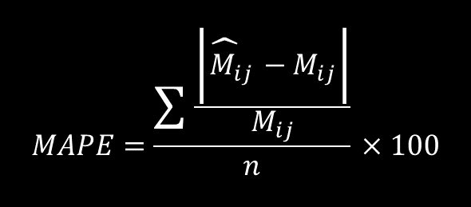
Does the radiation model outperform regression-based spatial interaction models?
METHODS: Accuracy
96 models
Data sources (3)
Model types (4)
Spatial variables combinations (8)
Divide data into training and test components (80/20)
When M_{ij} > 0: Mean absolute percentage error (MAPE)
When M_{ij} = 0: Mean error (ME)
MAPE is undefined
$$MAPE=\frac{\sum{\frac{\left|{\hat{M}}_{ij}−M_{ij}\right|}{M_{ij}}}}{n}×100$$
$$ME=\frac{\sum{{\hat{M}}_{ij}−M_{ij}}}{n}$$

Slide 15
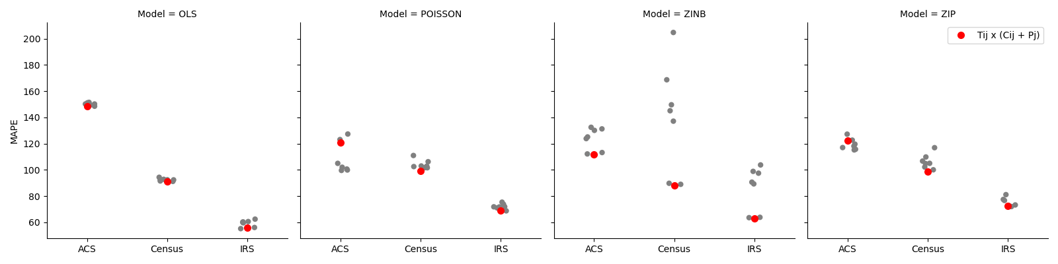
Does the radiation model outperform regression-based spatial interaction models?
The combination of T_{ij} and (C_{ij} + P_{j}) was the best overall
Figure 8. Mean absolute percent error (MAPE) of all models by data source when M > 0 (ACS and Census) and M ≥ 20 (IRS). Looking across other variable combinations (gray dots), models, and accuracy metrics, T_{ij} + (C_{ij} + P_{j}) performed well most consistently.

Slide 16
Research Question #1: Conclusions
The radiation model does not out-perform regression models
Final alternate model selection:
T_{ij} and (C_{ij} + P_{j}) deterrence variables
Zero-inflated negative binomial
Exclude OLS, this is best remaining MAPE
Excellent when M_{ij} = 0 (like the other MLE methods)
1990 Census
Race/age crosstabs are needed for next research question
IRS lacks any demographic information
Census models outperformed ACS models in most cases

Slide 17
Research Question #2
Does incorporating the homophily principle improve migration modeling?

Slide 18
Migration and the Homophily Principle “Similarity breeds connection”
Members of our social network tend to be like us
Race and ethnicity
Age
Religion
Education
Friends and family give information about receiving areas (Ritchey, 1976)
People find jobs through personal referrals (Montgomery, 1991)
Individual/local social capital influences migration decisions (Hotchkiss & Rupasingha, 2020; Kan, 2007)
Examples of homophily in domestic migration:
Black\African-American (McHugh, 1988; Cebula, 1973; Pack, 1973)
Hispanic, Black\African-American, Asian (Frey and Liaw, 2005)

Slide 19
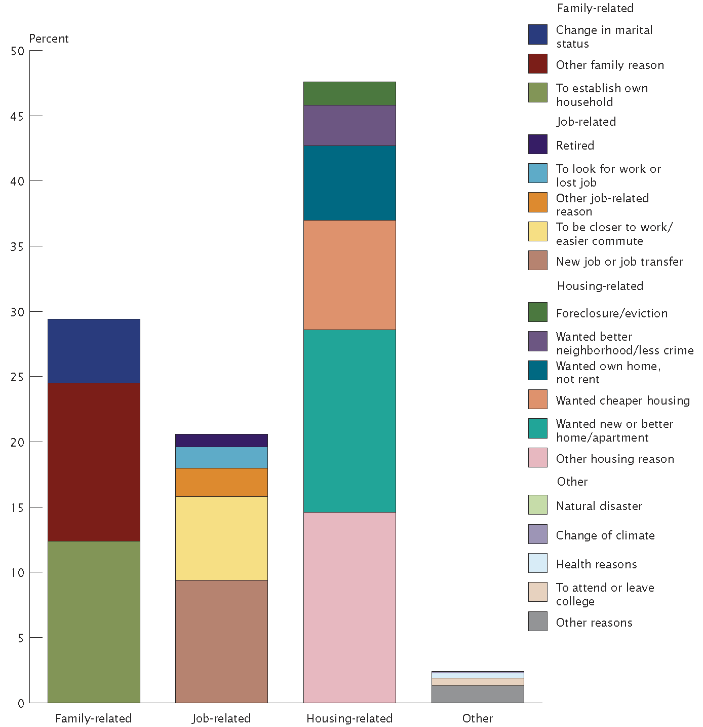
“The Dominance of Economic Explanations for Migration” Spring et al. 2016
The abundance of quantitative measures
Consensus about how individuals and households respond to economic factors
Immigration issues of the 1980s and 1990s
Major migration events (e.g., the Great Migration) in response to macro-level economic imbalances

Slide 20
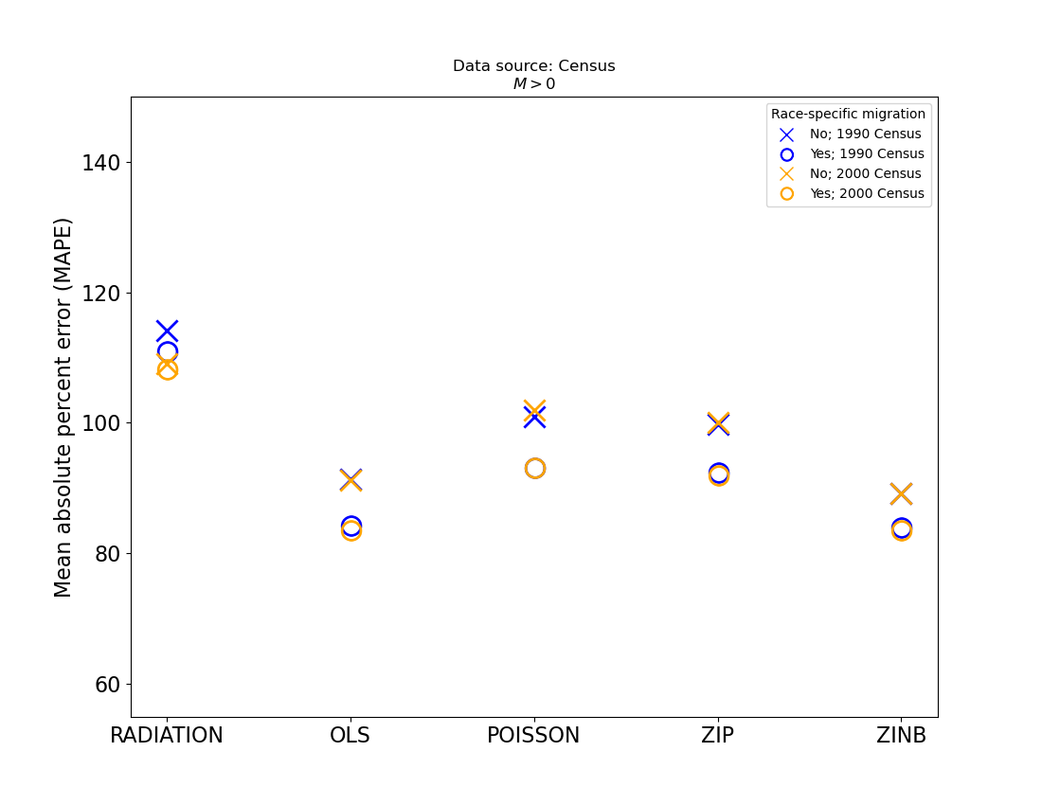
Race Homophily
Partitioning migration flows by race improves all models when M_{ij} > 0.

Slide 21
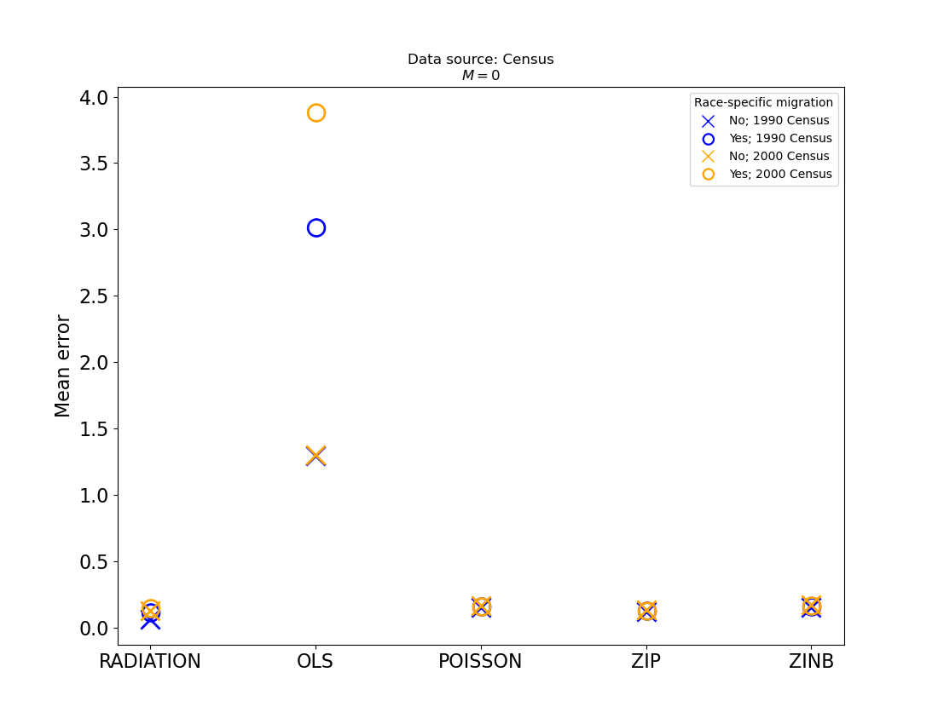
Race Homophily
Model performance stays generally the same (i.e., very good) when M_{ij} = 0
The OLS model does worse, likely due to even more zeros in the training and testing data

Slide 22
Age Homophily, Urban Amenities, Labor Markets
Age homophily
Destination population (P_{j}) is an aggregate value, weighted by age group-to-age group correlation values
Urban amenities: Census Bureau Metropolitan Statistical Areas (MSA)
Dummy variable (urban, not-urban)
Well known urban preference (or not) for certain age groups
Urban preference for certain race groups (e.g., Black/African American)
Labor market effects: BEA Economic Areas
Dummy variable (intra- or inter-labor market)
Differentiates “adjustment moves”
Also adds an additional continuous variable (Pj*) defined as ΣP_{j} which captures social network opportunities elsewhere in the labor market

Slide 23
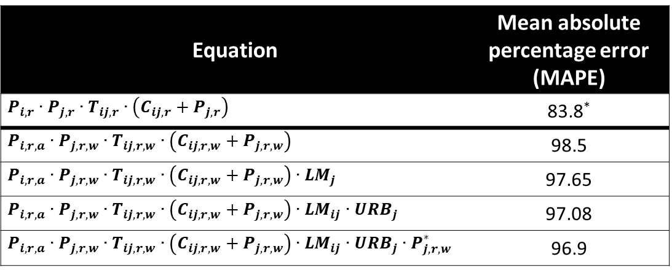
Age Homophily, Urban Amenities, Labor Markets
Equation | Mean absolute percentage error (MAPE)
$$P_{i, r}∙P_{j, r}∙T_{ij, r}∙\left(C_{ij,r}+P_{j,r}\right)$$ | 83.8*
$$P_{i, r, a}∙P_{j, r,w}∙T_{ij, r, w}∙\left(C_{ij,r,w}+P_{j,r,w}\right)$$ | 98.5
$$P_{i, r, a}∙P_{j, r,w}∙T_{ij, r, w}∙\left(C_{ij,r,w}+P_{j,r,w}\right)∙{LM}_{j}$$ | 97.65
$$P_{i, r, a}∙P_{j, r,w}∙T_{ij, r, w}∙\left(C_{ij,r,w}+P_{j,r,w}\right)∙{LM}_{ij}∙{URB}_{j}$$ | 97.08
$$P_{i, r, a}∙P_{j, r,w}∙T_{ij, r, w}∙\left(C_{ij,r,w}+P_{j,r,w}\right)∙{LM}_{ij}∙{URB}_{j}∙P_{j,r,w}^{∗}$$ | 96.9
Further partitioning migration models by age increases the error
Additional variables nominally improve model performance
LM = same labor market (dummy)
URB = urban destination
P* = population of destination labor market, less j

Slide 24
Research Question #2: Conclusions
Race homophily in migration data is supported by regression results
Relates a widely accepted sociological theory with migration patterns
Introducing age homophily degrades model performance
More life course variables needed (e.g., college/university, retirement)

Slide 25
Research Question #3
When used for projections, does a demographic model that uses a best-of-breed migration model compare favorably to other population projection approaches?

Slide 26
Subnational Population Projections
Source | Year published | # of projections | Spatial resolution | Temporal attributes | Thematic attributes | Launch year
U.S. Census Bureau | 1997 | 2 | States | Semi-decadal through 2025 | Total population | 1995
U.S. Census Bureau | 2005 | 1 | States | Annual through 2030 | Age & gender | 2004
U.S. EPA | 2009 | 6 | Counties | Decadal through 2100 | Total population | 2000
Mckee et al. | 2015 | 1 | 30 arc-second | 2030 and 2050 only | Total population | 2010
U.S. EPA | 2017 | 6 | Counties | Decadal through 2100 | Total population | 2010
Gao | 2017 | 5 | 1 km | Decadal through 2100 | Urban and rural | 2000
University of Virginia | 2017 | 1 | States | Decadal through 2040 | Age and race | 2017
Urban Institute | 2017 | 27 | States | Semi-decadal through 2040 | Age and race | 2010
USFS | 2019 | 5 | Counties | Semi-decadal through 2070 | Per Capita Income | 2010
Hauer | 2019 | 5 | Counties | Semi-decadal through 2100 | Age, sex, and race | 2010
Jiang et al. | 2020 | 5 | States | Decadal through 2100 | Urban and rural | 2010

Slide 27
A new population projection
Components of change
Fertility and Mortality
CDC (county rates)
Wittgenstein Centre for Demography (national changes)
Immigration
Wittgenstein (national changes)
Census (race & ethnicity proportions)
ACS (county proportions)
Migration: Zero-inflated negative binomial with bias correction
U.S. Census Bureau intercensal estimates
Assessing accuracy
MAPE from Smith et al.

Slide 28
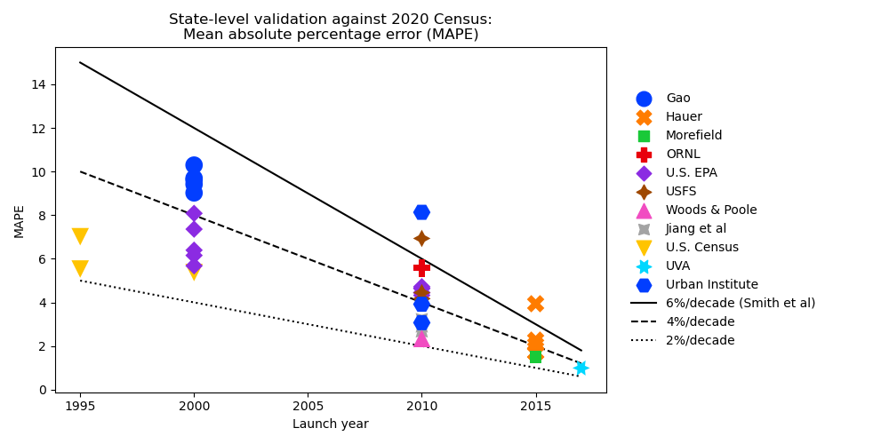
Accuracy of state-level projections for 2020
Notes:
Reduce to 12% max

Slide 29
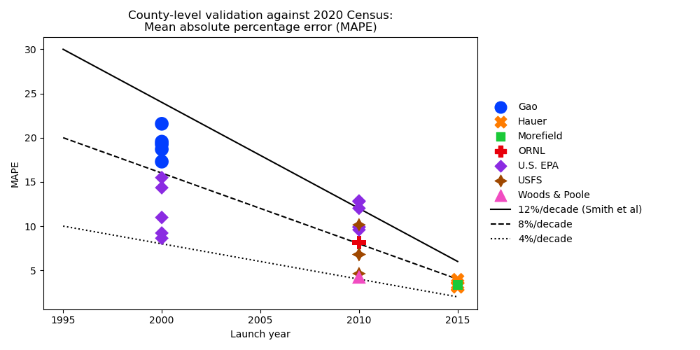
Accuracy of county level projections for 2020
Notes:
Reduce to 25% max

Slide 30
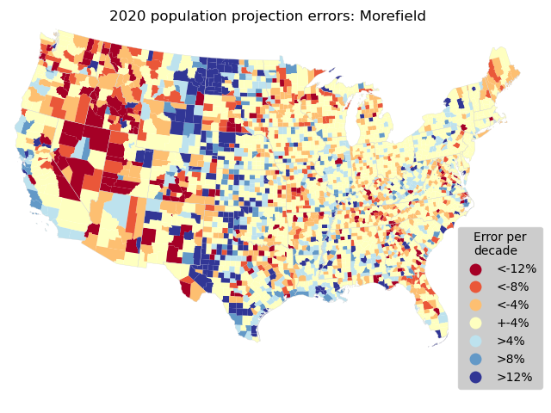
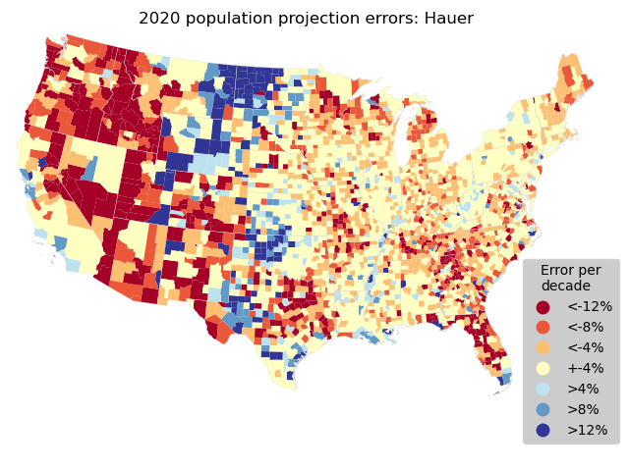

Slide 31
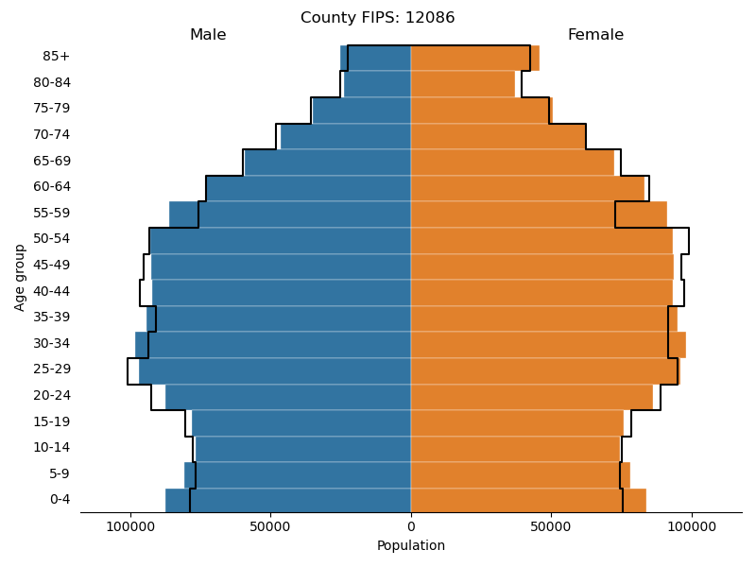
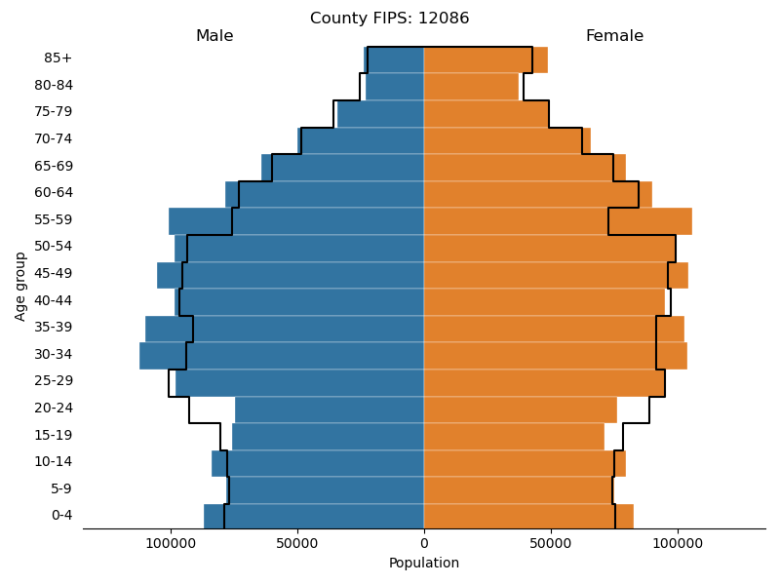
Miami-Dade County, FL
2020
Morefield
Hauer

Slide 32
Research Question #3: Conclusions
A new population projection competitive at state and county
Relatively simple
Public data
Novel migration approach with a theoretical basis
Interchangeable components for scenario exploration
Update to “typical” errors suggested by Smith et al
State → county doubles errors
National-level accuracy is one criteria for model selection
Accuracy is scale dependent
Demographic attributes
Spatial resolution

Slide 33
Limitations of this work
Not an exhaustive analysis of the homophily principle and migration
1990 Census and credibility
Migration is a complex phenomenon; MAPE values ~80%
Economic drivers
Other (dis)amenities

Slide 34
Additional research & next steps
Replace 1990 Census data
Synthesize ACS migration data
Access raw ACS data at data centers
Incorporate 2017 Census Population Projection
New immigration scenarios
Add dummy variable for colleges & universities
Add retirement amenities
Adjust at-risk migration population (P_{i}) for group quarters

Slide 35
Thank you!

Slide 36
Potential publications
Significance of/differences between data sources
Demonstrate zero-inflated regression and homophily
Population projection accuracy assessment

Slide 37
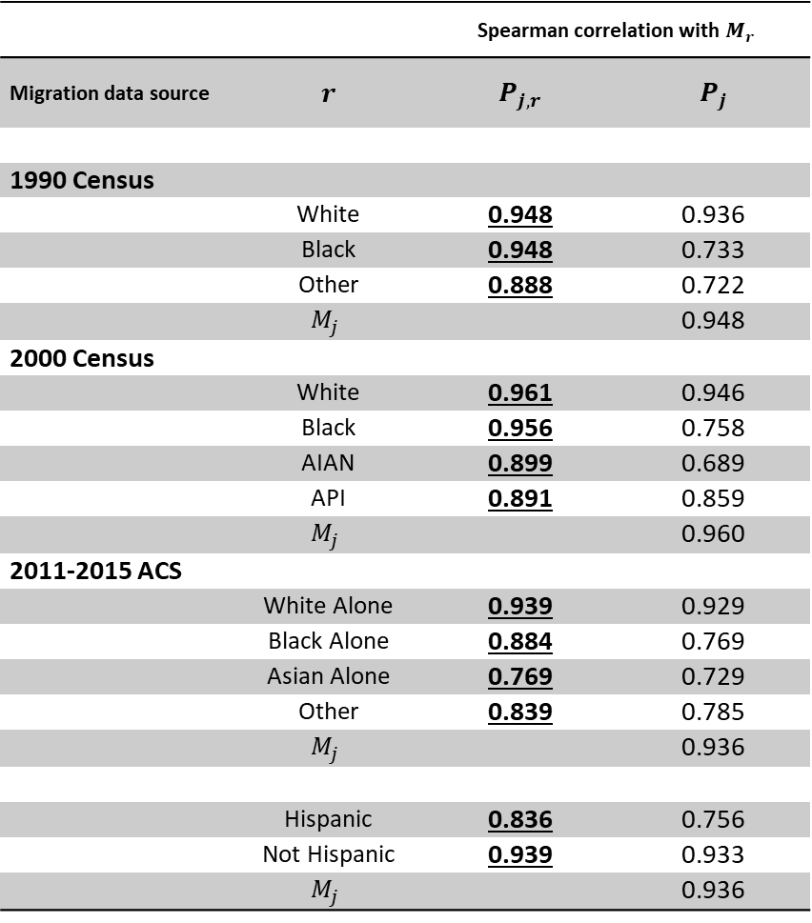
Race homophily in migration data
 |  | Spearman correlation with $M_{r}$
Migration data source | $$r$$ | $$P_{j, r}$$ | $$P_{j}$$
1990 Census
 | White | 0.948 | 0.936
 | Black | 0.948 | 0.733
 | Other | 0.888 | 0.722
 | $$M_{j}$$ |  | 0.948
2000 Census
 | White | 0.961 | 0.946
 | Black | 0.956 | 0.758
 | AIAN | 0.899 | 0.689
 | API | 0.891 | 0.859
 | $$M_{j}$$ |  | 0.960
2011-2015 ACS
 | White Alone | 0.939 | 0.929
 | Black Alone | 0.884 | 0.769
 | Asian Alone | 0.769 | 0.729
 | Other | 0.839 | 0.785
 | $$M_{j}$$ |  | 0.936
 | Hispanic | 0.836 | 0.756
 | Not Hispanic | 0.939 | 0.933
 | $$M_{j}$$ |  | 0.936
Correlations
Incoming migrants of a given race
M_{r}
Population at the destination
P_{j}
P_{j, r}
Conclusion: Partitioning migration by race should improve modeling

Slide 38
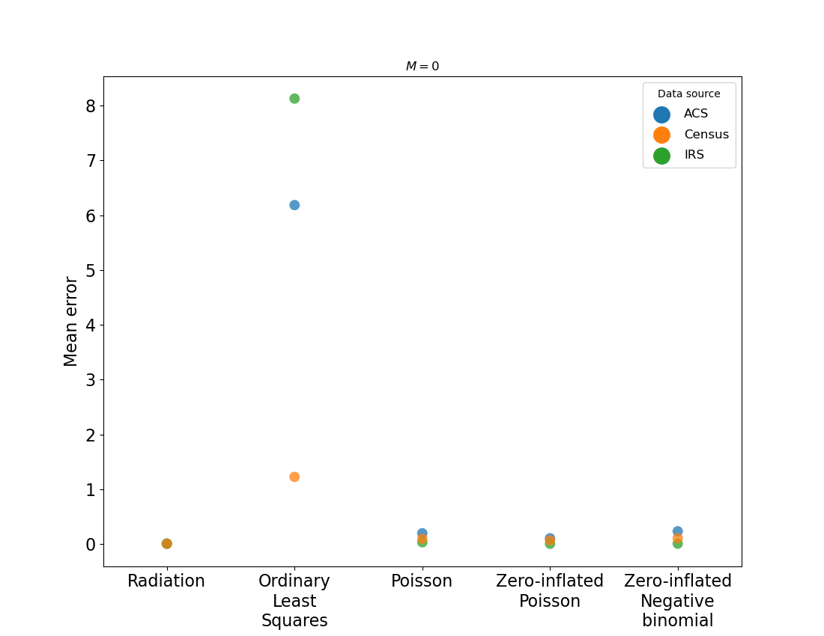
Does the radiation model outperform regression-based spatial interaction models?
Regression models shown here use T_{ij} and (C_{ij} + P_{j}) deterrence variables.
MLE models are vastly superior at reproducing M_{ij} = 0.
OLS models struggle to predict zero; this is significant given the large proportion of zeros in migration data.

Slide 39
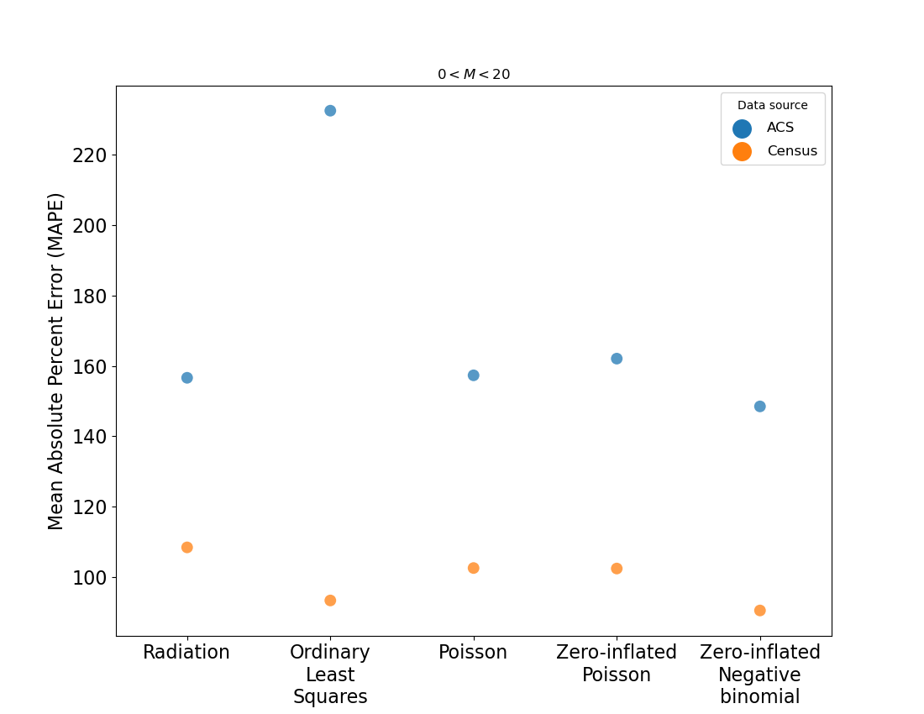
Does the radiation model outperform regression-based spatial interaction models?
MAPE values roughly double when M_{ij} ˂ 20
The radiation model is on par with MLE models
Methodological differences between Census and ACS likely account for differences
ZINB is about 12% better than ZIP

Slide 40
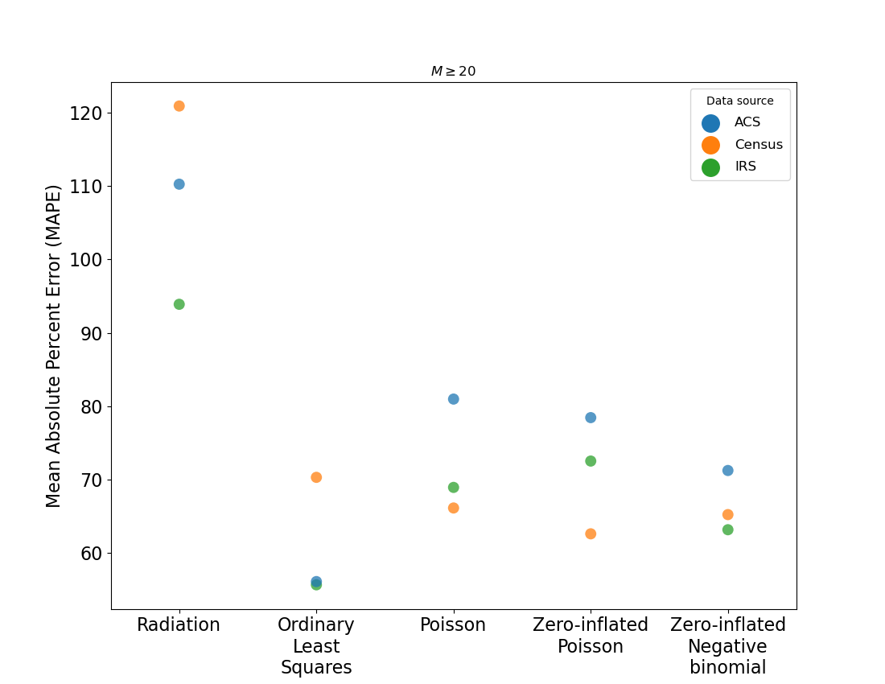
Does the radiation model outperform regression-based spatial interaction models?
Regression models shown here use T_{ij} and (C_{ij} + P_{j}) deterrence variables
When M_{ij} ≥ 20, the radiation model is outperformed by all model/data source combinations

Slide 41
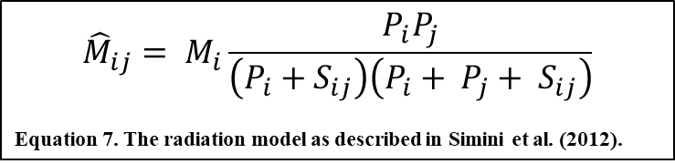
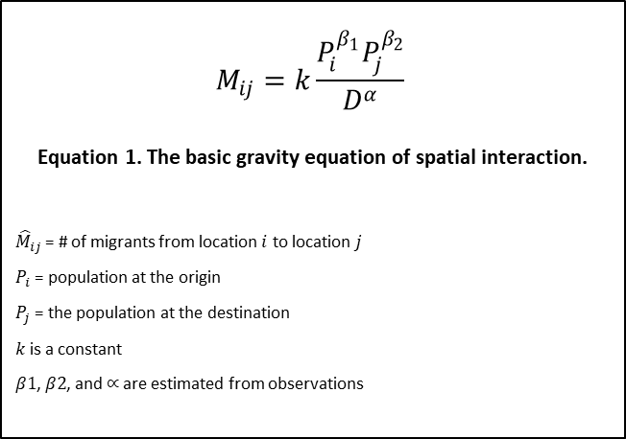
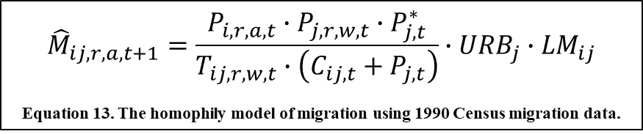
$$M_{ij}=k\frac{P_{i}^{β_{1}}P_{j}^{β_{2}}}{D^{α}}$$
$$\text{Equation}\text{ 1. }\text{The} \text{basic} \text{gravity} \text{equation} \text{of} \text{spatial} \text{interaction}\text{.}$$
${\hat{M}}_{ij}$ = # of migrants from location $i$ to location $j$
$P_{i}$ = population at the origin
$P_{j}$ = the population at the destination
$k$ is a constant
$β1$, $β2$, and $∝$ are estimated from observations
$${\hat{M}}_{ij, r, a,t+1}=\frac{P_{i,r,a,t}∙P_{j,r,w,t}∙P_{j,t}^{∗}}{T_{ij,r,w,t}∙\left(C_{ij,t}+P_{j,t}\right)}∙{URB}_{j}∙{LM}_{ij}$$
Equation 13. The homophily model of migration using 1990 Census migration data.
$${\hat{M}}_{ij}= M_{i}\frac{P_{i}P_{j}}{\left(P_{i}+S_{ij}\right)\left(P_{i}+ P_{j}+ S_{ij}\right)}$$
Equation 7. The radiation model as described in Simini et al. (2012).

Slide 42
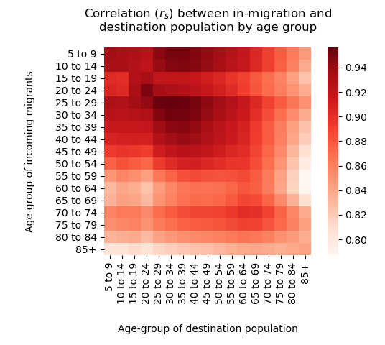
Figure 15. Correlation (r_{s}) between in-migration and destination population by age group in 1990 Census migration data.

Slide 43
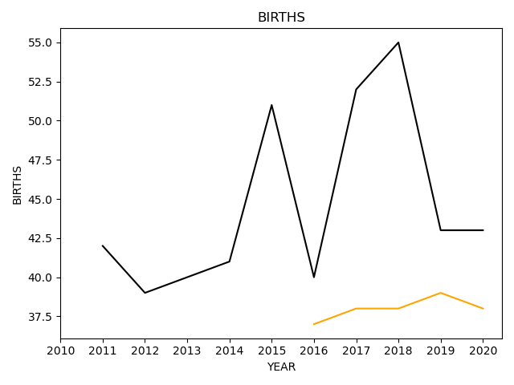
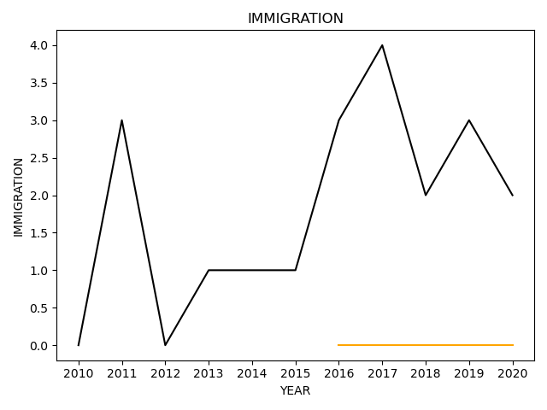
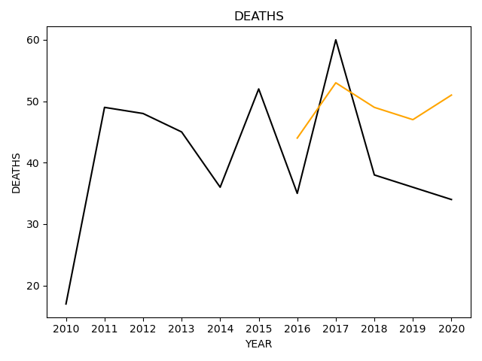
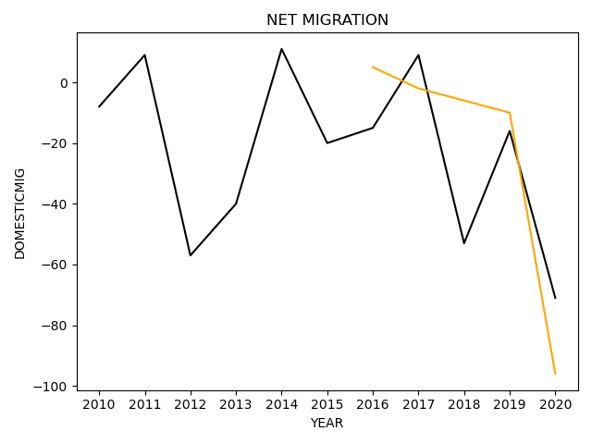
Mercer County, MO
2020 Population: 3,558
2020 Projected: 3,558

Slide 44
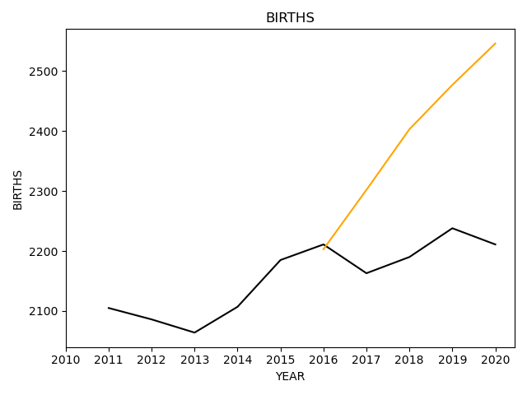
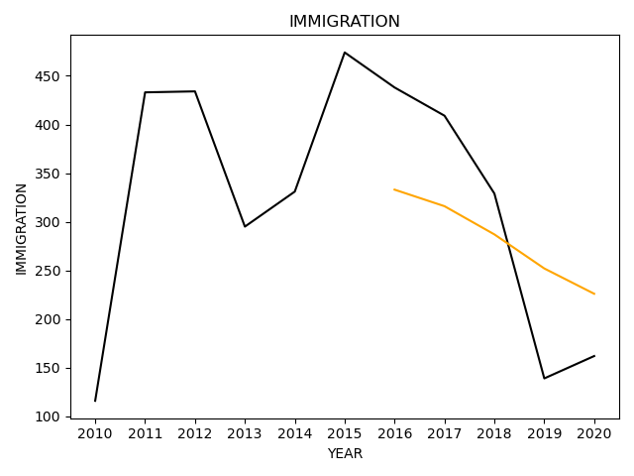
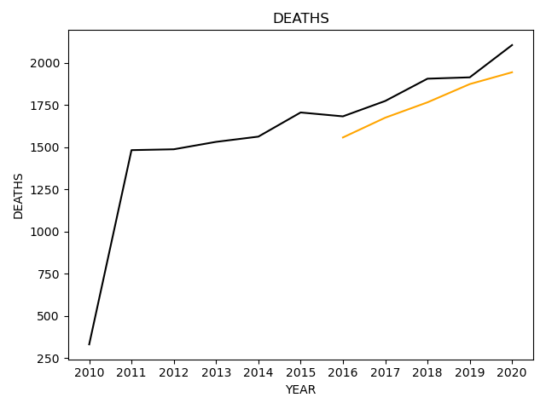
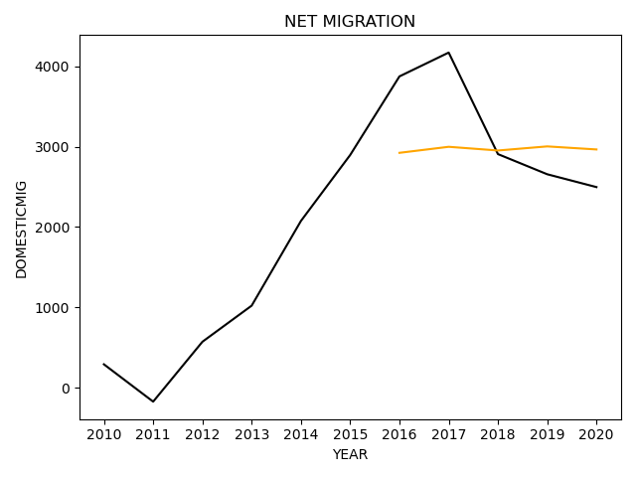
Clay County, FL
2020 Population: 221,770
2020 Projected: 221,782

