Slide 1
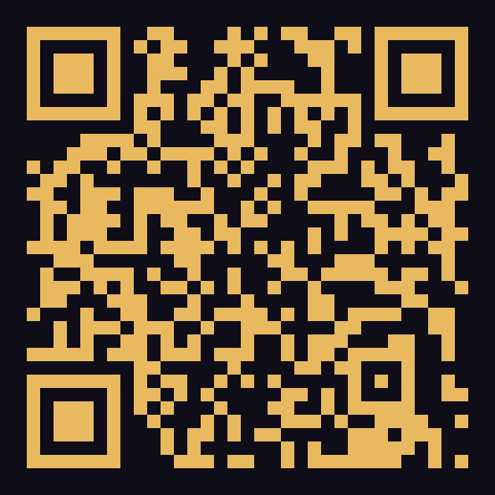
RCCG LP63 YAYA · YAYA PROVINCE HEADQUARTERS
Website &
Mobile App
How to use them
SCAN TO OPEN
A simple, guided walkthrough of everything the website and the app can do for you and your family — from reels and sermons to giving and prayer.
rccglp63yaya.org.ng
Presented in church · Sunday service
Notes:
Welcome and thank the church for the time.
Introduce the session in one line: "Today we are going to learn how to use our church
website and our church app so that nobody misses what God is doing among us."
Keep this short - the goal is a friendly, practical demo, not a technical talk.
If there is a projector and internet, have the website open in a browser tab ready.

Slide 2
TODAY'S SESSION
What we will cover
Four short parts — about 20 minutes, then your questions.
01
02
03
04
Why we built this
The website
The mobile app
Your next steps
One church family, connected every day — not only on Sunday.
A guided tour of rccglp63yaya.org.ng, page by page.
The CHURCH MEDIA app: reels, Bible, sermons, prayer, alerts.
Three simple things to do before you leave today.
RCCG LP63 YAYA · Website & Mobile App Guide
02
Notes:
Set expectations: four short parts, then questions at the end.
Tell them nothing here requires a login, and nothing here costs money to use.

Slide 3
PART 1
Why this matters
Technology is only a tool — the goal is that nobody is left out of the family.
🔗
🎧
🙏
🔔
Stay connected
Never miss the Word
Pray & give anywhere
Always informed
• Church life continues after Sunday.
• See what God is doing all week long.
• Catch up on any sermon you missed.
• Listen again and share with a friend.
• Send a prayer request from home.
• Give your tithe and offering securely.
• Events, changes and announcements.
• Push alerts straight to your phone.
“However far, however near — there's a seat for you.”
RCCG LP63 YAYA · Website & Mobile App Guide
03
Notes:
Emphasise that this is about the people, not the software.
Speak to the families, the youth, the elderly, and those who travel or are unwell -
the website and app let them stay part of the church from anywhere.

Slide 4
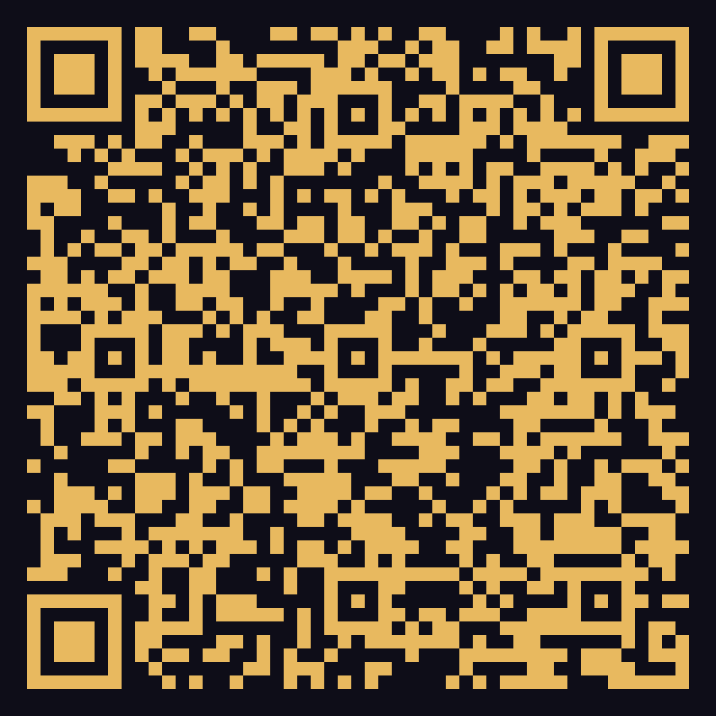
START HERE
Two ways to meet us
Both show the same church content. Use whichever suits you — or both.
1. THE WEBSITE
2. THE MOBILE APP
rccglp63yaya.org.ng
CHURCH MEDIA
• Works on any phone, tablet or computer.
• Nothing to install — just open and use.
• Best for reading, watching and giving online.
• No login needed for anything public.
• Free on Google Play — install once.
• Reels, offline Bible and audio Bible.
• Push notifications for new content.
• Works best for daily use on your phone.
RCCG LP63 YAYA · Website & Mobile App Guide
04
Notes:
Make it very practical: the website needs no installation, so anyone can start today.
The app is free on Google Play and gives extra things the website cannot do -
the offline Bible and push notifications.
Point out the two QR codes on screen and say: "Scan either one right now if you like."

Slide 5
PART 2 · THE WEBSITE
Getting to the website — 3 steps
Nothing to download. Done in under a minute.
1
Open your browser
Chrome, Safari, Opera, Edge — whichever is on your phone or computer.
2
Type the address
Type rccglp63yaya.org.ng in the address bar at the top, then press Go.
3
Save it for later
Tap the menu ⋮ and choose “Add to Home screen”. It becomes a one-tap icon.
Tip: the same trick works for the prayer wall and the giving page.
RCCG LP63 YAYA · Website & Mobile App Guide
05
Notes:
Walk through this slowly - some members have never typed a web address.
Say the address out loud twice: "r-c-c-g-l-p-6-3-y-a-y-a dot org dot n-g".
The "Add to Home screen" tip is the most valuable thing on this slide -
show it live on your own phone if you can.

Slide 6
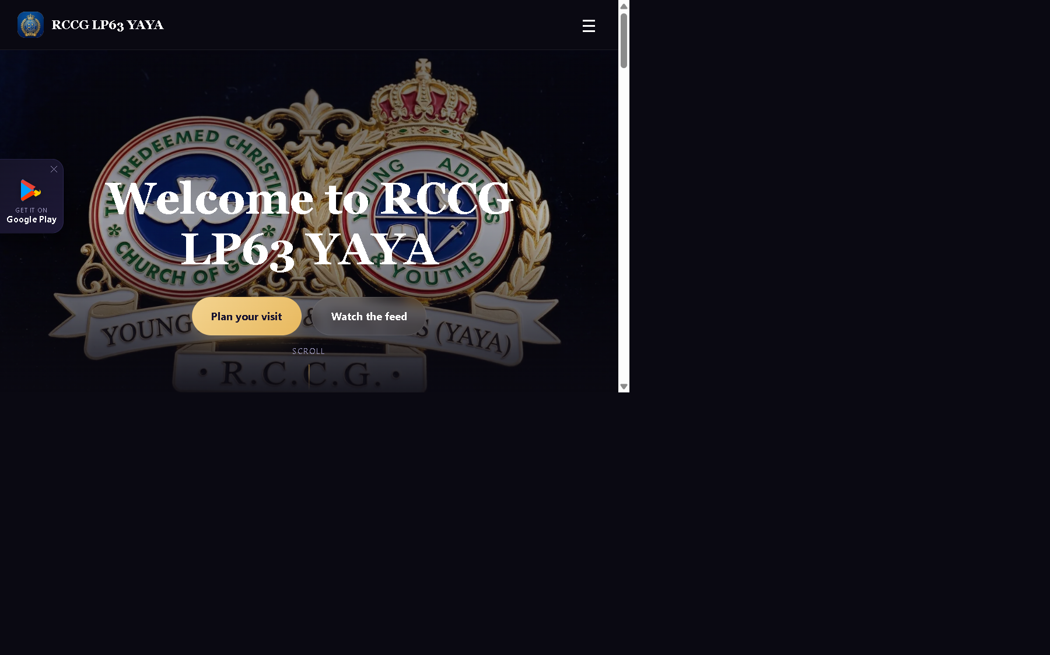
PART 2 · THE WEBSITE
The home page at a glance
Everything important is one scroll away.
Welcome banner
Our welcome message, with buttons to plan a visit or watch the feed.
From Our Feed
The newest photos and short reels — swipe through them.
What's Happening
Upcoming events with date, time and venue.
Latest Sermons
The most recent messages, ready to play.
Service Times
Sunday worship, Digging Deep and Faith Clinic.
Get in Touch / Give
Contact us or give your tithe and offering in two taps.
RCCG LP63 YAYA · Website & Mobile App Guide
06
Notes:
If you have internet, open the real website here and scroll it live - it is far more
convincing than a picture.
Point at each section as you name it. Tell them: "If you only remember one thing,
remember that everything starts from this page."

Slide 7
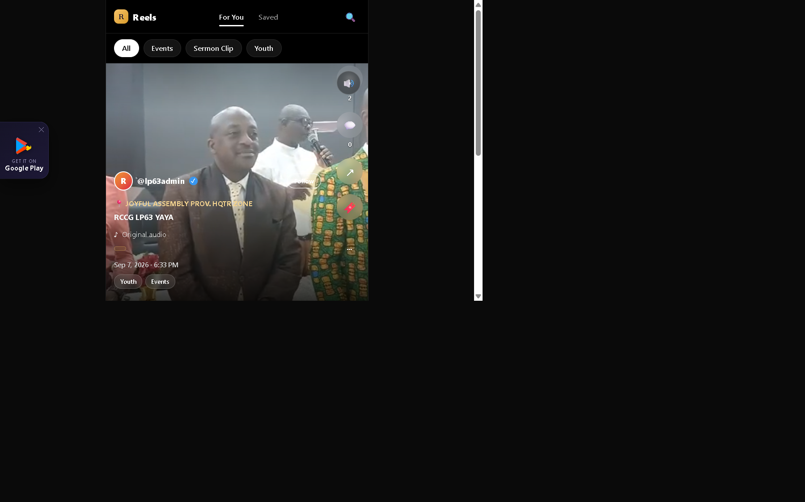
PART 2 · THE WEBSITE
Media Feed & Reels
The life of the church — photos and short videos.
What it is
• A scrolling feed of photos and vertical video “reels”.
• Moments from worship, youth nights, outreaches and events.
How to use it
• Tap Feed in the top menu.
• Scroll down to browse, or tap a reel to open it full screen.
• Like, comment and save the ones that bless you.
• Use the category chips to filter what you see.
rccglp63yaya.org.ng
RCCG LP63 YAYA · Website & Mobile App Guide
07
Notes:
This is the most engaging part for the youth - appeal to them directly here.
Explain that reels are vertical short videos, like the ones they already watch,
but with content from their own church.
Encourage them: "When you see something good, share it - that is how we reach others."

Slide 8
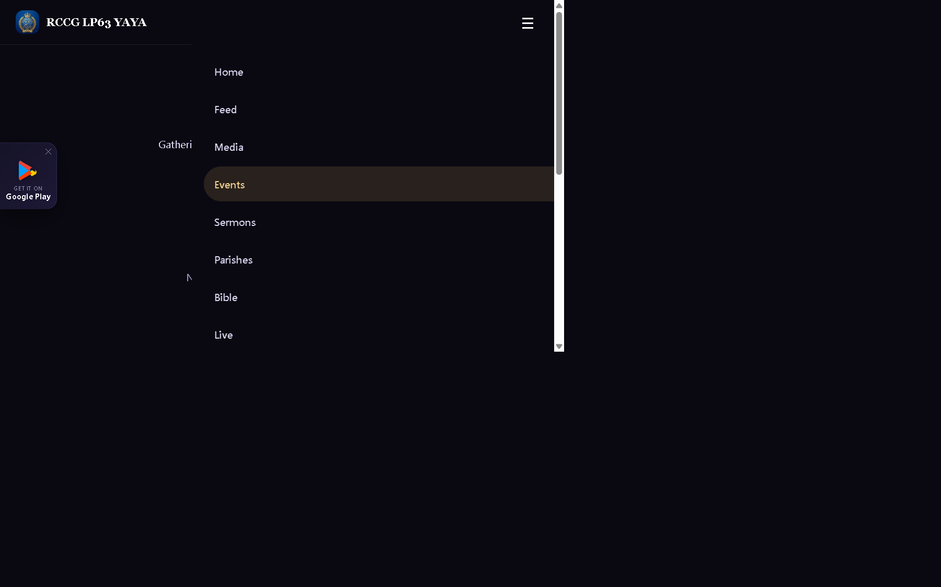
PART 2 · THE WEBSITE
Events — what's happening
The church calendar, always up to date.
Every programme in one place
• Upcoming events with date, time and venue.
• Tap any event to open its full details and flyer.
• Check here before you travel — times can change.
Who should use it
• Everyone — especially units, workers and the youth.
• Share an event link with a friend who is not yet with us.
rccglp63yaya.org.ng
RCCG LP63 YAYA · Website & Mobile App Guide
08
Notes:
Tell them plainly: "If you are not sure whether an event is holding, check the website."
Encourage unit leaders to make sure their programmes are published so the whole
church can see them.

Slide 9
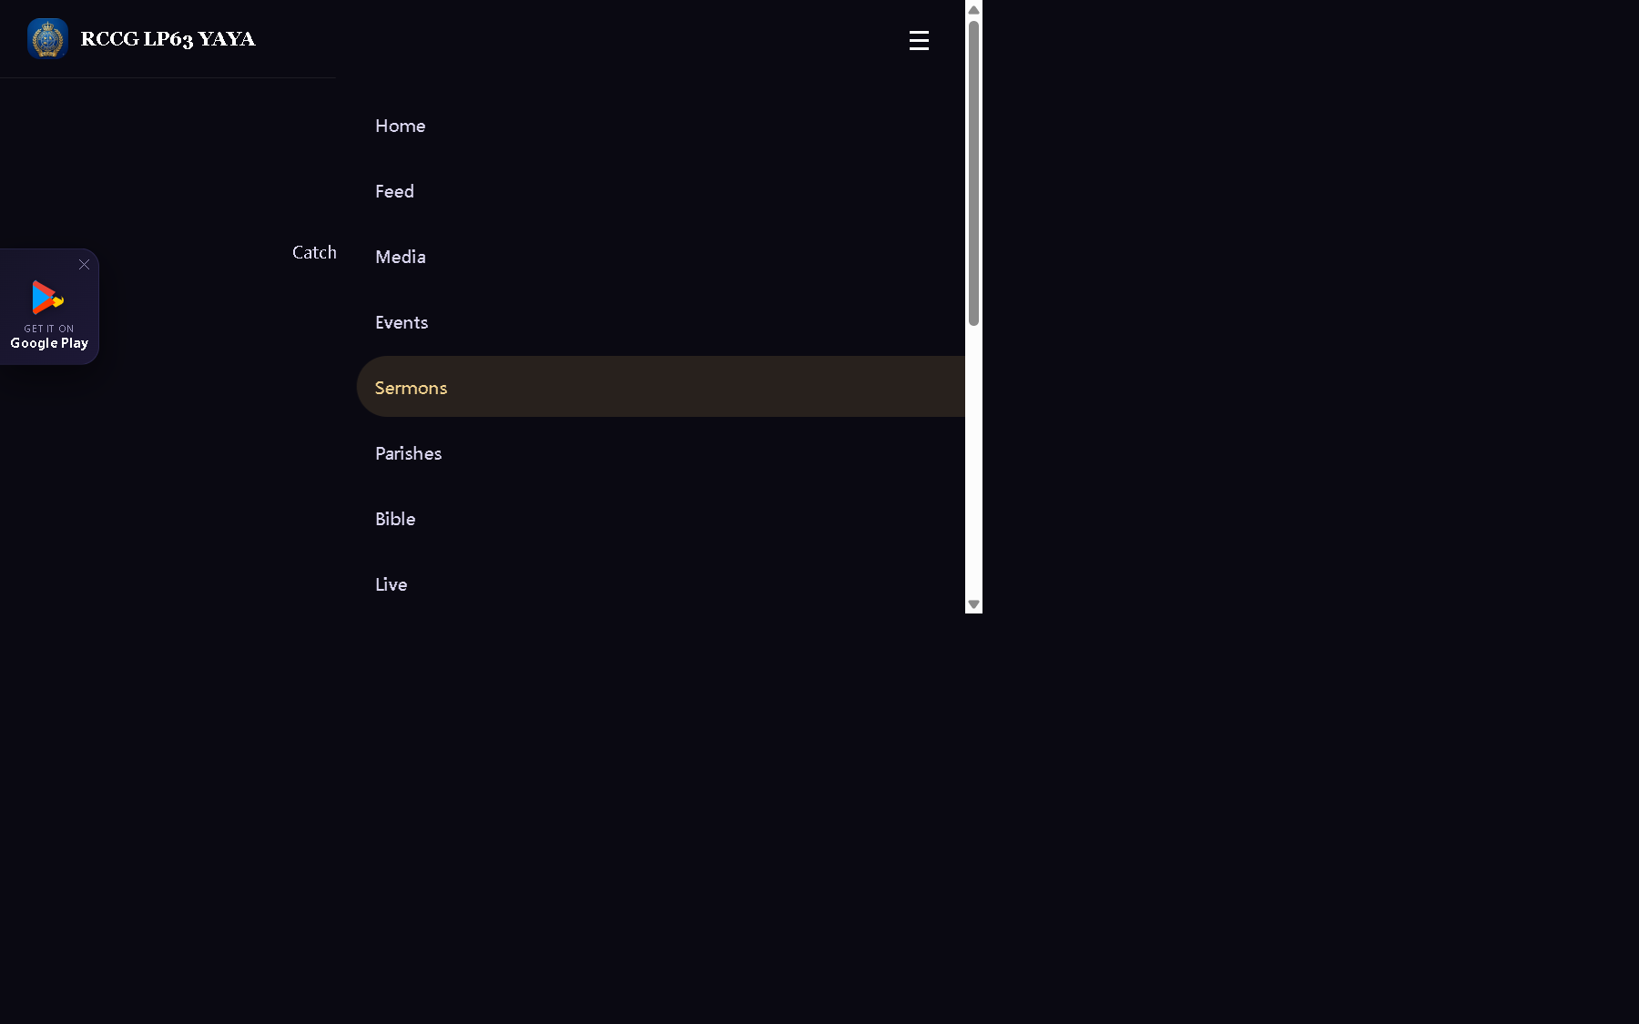
PART 2 · THE WEBSITE
Sermons — the Word, on demand
Missed a service? It is waiting for you here.
What you will find
• Audio and video messages from our services.
• The speaker, the date and the scripture reference.
• Tap a sermon to play it or read its details.
Why it helps
• Re-listen to what God said and take notes.
• Send a message to someone going through a hard time.
• Perfect for those who were absent, travelling or unwell.
rccglp63yaya.org.ng
RCCG LP63 YAYA · Website & Mobile App Guide
09
Notes:
Testimony opportunity: if someone was blessed by a message they heard again online,
let them say one sentence here.
Remind them that the same sermons are also inside the app.

Slide 10
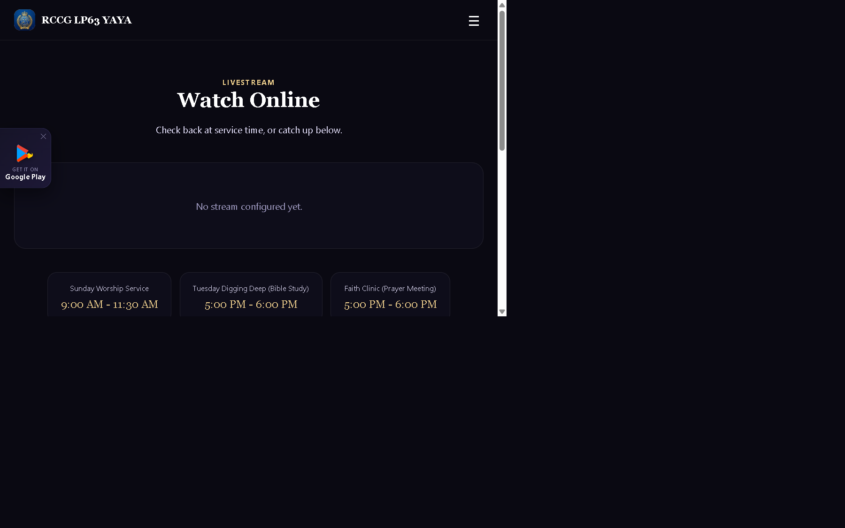
PART 2 · THE WEBSITE
Watch Live
Join the service from wherever you are.
When we are live
• Open the website and tap “Watch Live Now” on the home page.
• The button is shown automatically the moment the stream starts.
• Use the Live page any time to see service times.
Catching up later
• If you missed it, the message is added to Sermons and Media.
• Invite family abroad to join the Sunday service online.
rccglp63yaya.org.ng
RCCG LP63 YAYA · Website & Mobile App Guide
10
Notes:
This is a big one for our members abroad and for those who are sick or nursing a baby.
Mention that the stream works on a normal phone internet connection.
Ask the media team to be sure the live flag is switched on before service.

Slide 11
PART 2 · THE WEBSITE
Bible & Search
Read the Word, then find anything on the site.
📖
🔍
Bible
Search
• Open Bible from the main menu.
• Read the Scriptures right in your browser.
• Jump to any book, chapter or verse.
• No sign-up, no cost — open and read.
• Look for anything on the website.
• Find a sermon, an event or a post by keyword.
• Great when you remember a word but not the title.
• Reach it from the footer link on any page.
RCCG LP63 YAYA · Website & Mobile App Guide
11
Notes:
The Bible here is for quick reading on any device.
For daily reading and listening, the app is better because the Bible works without
internet and can read aloud to you - that is on the app slides coming next.

Slide 12
PART 2 · THE WEBSITE
Prayer Wall
We pray for one another — from anywhere in the world.
🙏
❤️
Submit a request
Pray for others
• Open Prayer from the menu or the footer.
• Type your request and send it in.
• Choose to keep it private if it is personal.
• You do not need an account to send one.
• Read the requests others have shared.
• Stand in agreement with the church family.
• Use it with your unit, family or prayer group.
• Prayer requests are monitored by the prayer team.
RCCG LP63 YAYA · Website & Mobile App Guide
12
Notes:
Invite someone to type a request today as a demonstration.
Remind them that private requests are seen by the pastoral/prayer team only.
This is a strong point for those who find it hard to speak out in person.

Slide 13
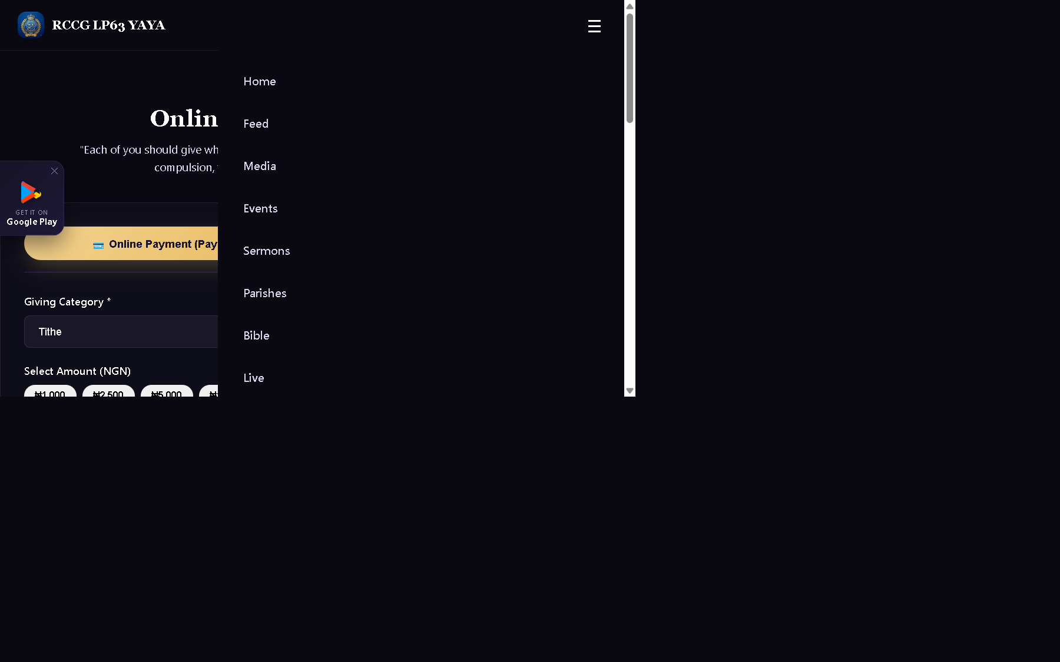
PART 2 · THE WEBSITE
Giving Online
Tithes, offerings and pledges — safely and securely.
How to give
• Tap “Give” in the menu or “Give Online” on the home page.
• Choose what you are giving — tithe, offering, pledge or project.
• Pay by card or bank transfer through our secure payment channel.
• You receive a confirmation for your records.
Please note
• Give only through the official links on our website or app.
• Never send money to a personal account that is not ours.
rccglp63yaya.org.ng
RCCG LP63 YAYA · Website & Mobile App Guide
13
Notes:
Be clear and reassuring: this is the same church account, just a safer and easier way
to give. Mention that records are kept properly by the finance team.
Strongly warn against fraudsters who ask for money into personal accounts.

Slide 14
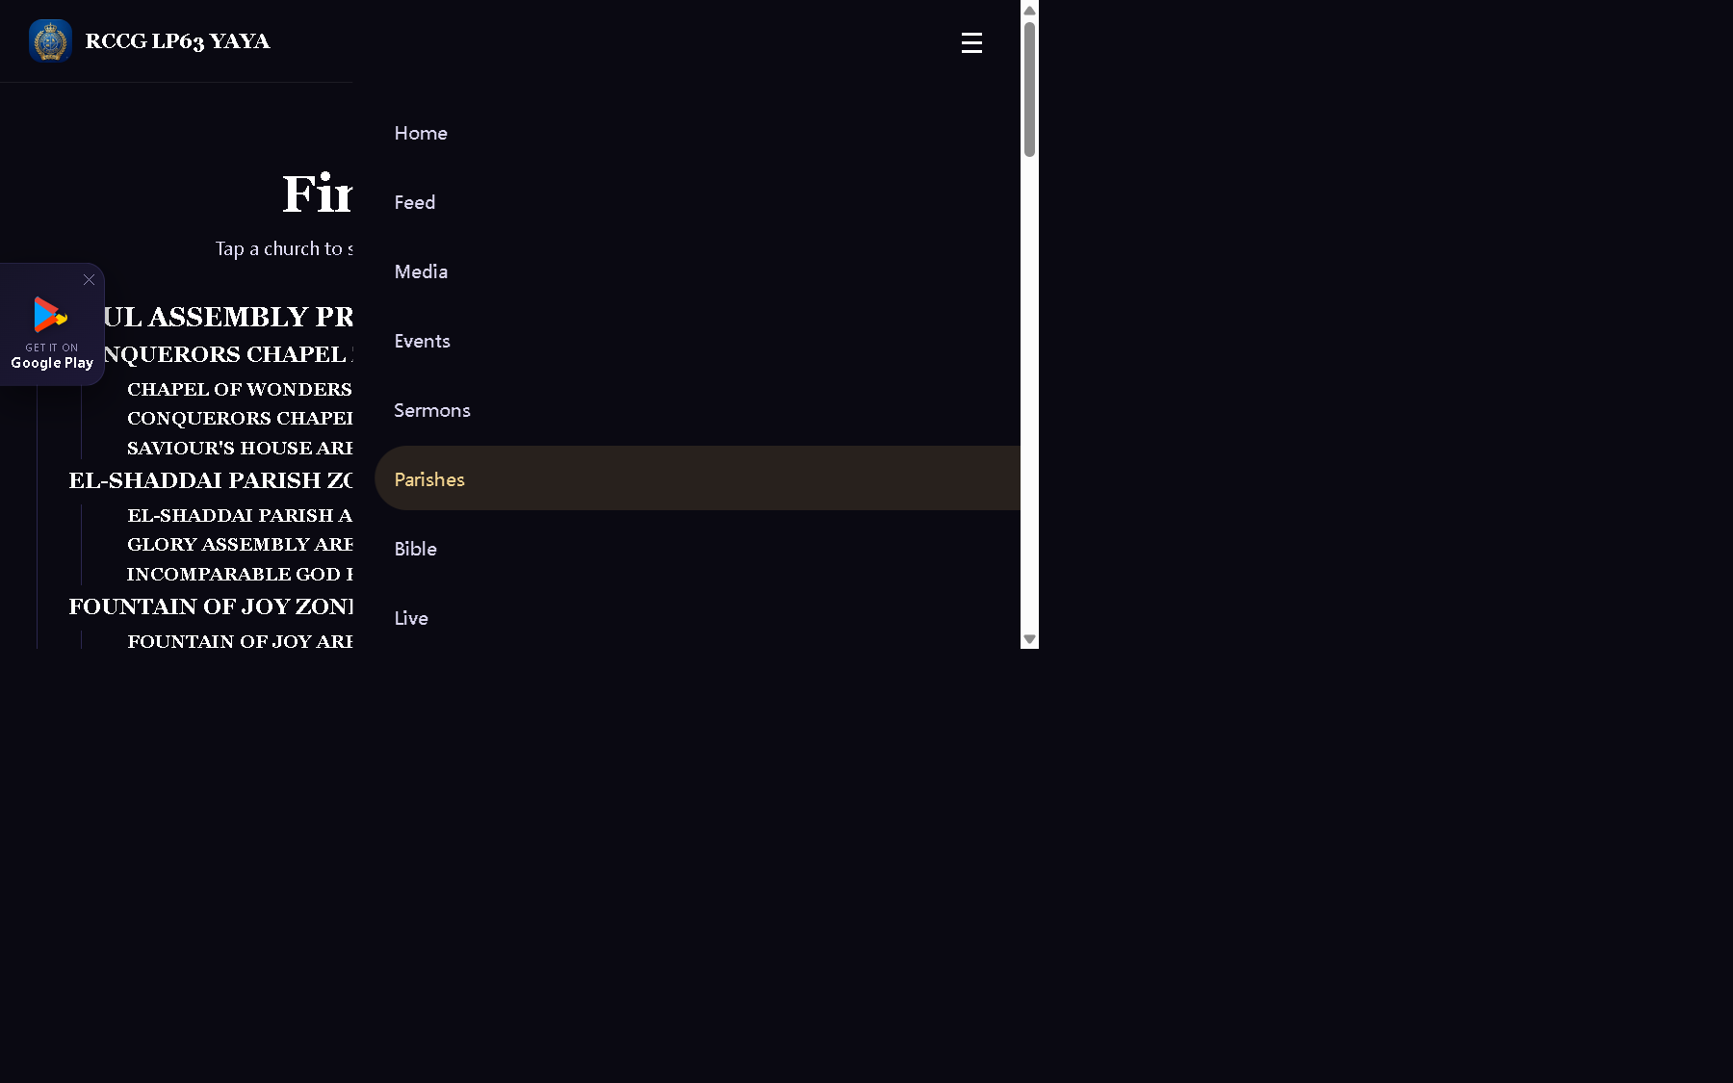
PART 2 · THE WEBSITE
Find your parish
Our network: Province → Zone → Area → Parish.
Browse the network
• Open “Parishes” in the main menu.
• Browse from province down to area and parish level.
• Select a parish to see its details.
• Ideal for members who relocate or travel.
Good for
• Finding the nearest parish when you travel.
• Inviting someone who lives far from us to their local parish.
• Workers who need to see how our network is arranged.
rccglp63yaya.org.ng
RCCG LP63 YAYA · Website & Mobile App Guide
14
Notes:
Use this to help anyone who travels often or has family elsewhere.
Explain the structure simply: province, then zone, then area, then parish -
so they know where they belong and where they can fellowship.

Slide 15
PART 2 · THE WEBSITE
About, Contact & Updates
Who we are, how to reach us, and how to hear first.
ℹ️
📞
✉️
About Us
Contact
Newsletter
• Our history and message.
• What we believe and where we are going.
• A good page to send a first-time visitor.
• Reached from the About menu.
• Our phone numbers and email.
• Reach the church office directly.
• Ask a question or plan a visit.
• Perfect for first-time guests.
• Enter your email in the footer box.
• Get updates and announcements by email.
• One click to join — no app needed.
• Great for parents and workers.
RCCG LP63 YAYA · Website & Mobile App Guide
15
Notes:
Show the contact details out loud - someone may want to note them down.
Encourage the congregation to help a first-time visitor by sharing the website.
Mention the newsletter as an option for those who prefer email over the app.

Slide 16
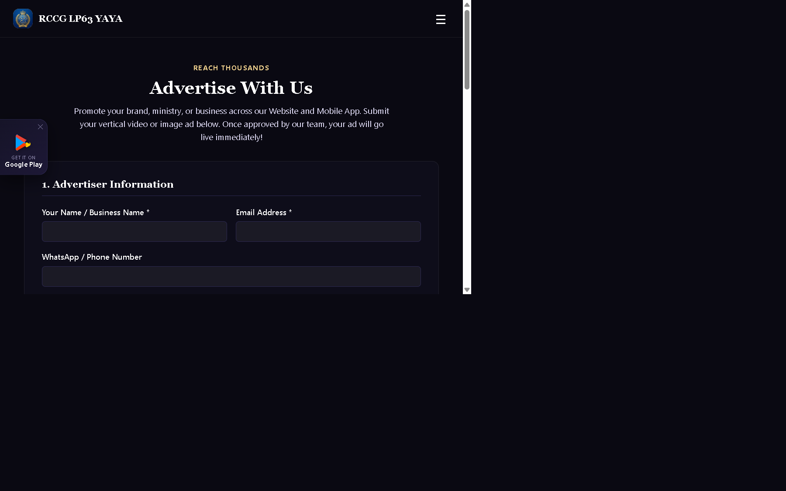
PART 2 · THE WEBSITE
Advertise with us
A door for businesses and ministries in our church family.
For business owners and ministries
• Show your product, brand or ministry to our church audience.
• Choose to appear on the website, in the app, or both.
• Send a vertical (9:16) image or short video advert.
• Free trial slots are available — a paid premium option exists.
Already advertising?
• Use the Publisher Portal to track views and clicks.
• Request an access link with your email address.
rccglp63yaya.org.ng
RCCG LP63 YAYA · Website & Mobile App Guide
16
Notes:
This slide may not apply to everyone - keep it brief.
Speak directly to entrepreneurs, traders and ministry leaders in the house.
Remind them that adverts must be approved by the church before they go live.

Slide 17
PART 3 · THE MOBILE APP
Getting the app — 4 steps
Free on Google Play. Takes two minutes.
1
Open the Play Store
2
Find the app
On your Android phone, tap the Google Play Store app.
Search “CHURCH MEDIA”, or scan the QR code on this slide.
3
Tap Install
4
Allow notifications
It is 100% free. Wait for it to finish, then tap Open.
Say “Allow” so you receive our announcements.
Scan to install
Search “CHURCH MEDIA”
RCCG LP63 YAYA · Website & Mobile App Guide
17
Notes:
Demo this on your own phone and pass it round if possible.
Say clearly: the app is free, and it is the same church - not a third-party company.
If someone has an iPhone, tell them the website works fully on iPhone and the app is
currently on Google Play for Android.

Slide 18
PART 3 · THE MOBILE APP
Inside the app — five tabs
The bar at the bottom of the app takes you everywhere.
CHURCH
MEDIA
RCCG LP63 YAYA
Home
Service times, latest sermons and quick shortcuts.
Feed
Full-screen reels and photos — swipe to browse.
Latest sermons
Bible
Read and listen, even without internet.
Upcoming events
Sermons
The full message archive on audio and video.
More
Events, Live, Prayer, About, Contact, Give and Search.
Home
Feed
Bible
Sermons
More
RCCG LP63 YAYA · Website & Mobile App Guide
18
Notes:
Say it simply: "Five buttons at the bottom - that is the whole app."
Home first, then Feed for reels, Bible for the Word, Sermons for messages,
and More for everything else.
Tell them: "If you ever feel lost, just tap Home."

Slide 19
PART 3 · THE APP
Reels & Media Feed
Church moments in the format young people already love.
🎬
❤️
🏷️
Watch
React
Filter
• Swipe up and down for the next reel.
• Full-screen, vertical, fast.
• Pinned reels appear first.
• Photos and videos together.
• Like the reels that bless you.
• Save them to find later.
• Comment and reply, Instagram-style.
• See what others are saying.
• Use categories to sort content.
• Worship, sermon clips, youth and events.
• Great for youth and young adults.
• New content appears automatically.
RCCG LP63 YAYA · Website & Mobile App Guide
19
Notes:
This is the feature that will excite the youth the most.
Invite a young person to demonstrate on their phone for 30 seconds if you can.
Encourage them to follow the church and share reels with their friends.

Slide 20
PART 3 · THE APP
Bible — read and listen, even offline
The strongest reason to install the app.
📶
🔊
🌍
🔎
Offline
Listen
Versions
Search
• KJV and BBE read fully offline.
• No data, no airtime needed.
• Perfect in church or while travelling.
• Always available on your phone.
• Audio Bible reads to you.
• The verse being read is highlighted.
• Speed: 0.75x, 1x, 1.25x, 1.5x.
• Auto-scroll follows the reading.
• NIV, NLT and NKJV online.
• Multi-language support.
• Switch version in one tap.
• Ideal for study and devotion.
• Search any verse instantly.
• The page scrolls straight to it.
• No more flipping endlessly.
• Use it during service.
RCCG LP63 YAYA · Website & Mobile App Guide
20
Notes:
Challenge the church: "Let us read the Bible every day this week."
The offline KJV is a real blessing for those who cannot afford data every day.
Show the audio Bible on your own phone - let them hear it read a verse aloud.

Slide 21
PART 3 · THE APP
Sermons, Events & Live
Everything you would come to church for — in your pocket.
🎧
🗓️
📺
Sermons
Events
Live
• Full sermon archive on audio and video.
• Speaker, date and scripture included.
• Replay and share any message.
• Build your own daily listening habit.
• Upcoming programmes with full details.
• Tap an event for the venue and time.
• Plan ahead with your family.
• Never hear about an event too late.
• Watch the service live from the app.
• Ideal when you cannot attend.
• Share with family far away.
• Catch up later in Sermons.
RCCG LP63 YAYA · Website & Mobile App Guide
21
Notes:
Connect this to real people: the student away at school, the nursing mother,
the traveller, the one who is unwell.
Say: "Church is not only a building - it is a family, and this keeps you in the family."

Slide 22
PART 3 · THE APP
Prayer, Giving & Notifications
Stay connected in the moments that matter.
🙏
💛
🔔
Prayer Wall
Give
Notifications
• Send a prayer request from your phone.
• Public or private - your choice.
• Pray for others on the wall.
• Open from More → Prayer Wall.
• Tithes, offerings and pledges.
• Secure payment in a few taps.
• Open from More → Give.
• Confirmation for your records.
• Alerts for new posts and events.
• Announcements reach you first.
• Tap an alert to open the content.
• Turn them on in your phone settings.
RCCG LP63 YAYA · Website & Mobile App Guide
22
Notes:
The notification point is important - many people install the app but never allow
notifications, then wonder why they hear nothing.
Ask them to check it today: Phone Settings → Apps → CHURCH MEDIA → Notifications → Allow.

Slide 23
QUICK REFERENCE
“Where do I go for…?”
Keep this slide — it answers almost every question.
I want to… | On the website | In the app
Watch short videos & reels | Feed | Feed tab
Read the Bible offline | Bible (online only) | Bible tab — KJV/BBE offline
Read or listen to the Bible | Bible | Bible tab — with audio
Hear a past sermon | Sermons | Sermons tab
See upcoming programmes | Events | More → Events
Watch the service live | Live | More → Live
Send a prayer request | Prayer | More → Prayer Wall
Give my tithe or offering | Give | More → Give
Contact the church | Contact | More → Contact
RCCG LP63 YAYA · Website & Mobile App Guide
23
Notes:
Give them a moment to photograph this slide.
Say: "Everything on this table is free and needs no login, except giving where you
choose your own payment details."

Slide 24
YOUR NEXT STEPS
Three things to do this week
Small habits that keep you connected to the family.
1
Save the website
SCAN & GO
Open rccglp63yaya.org.ng and add it to your home screen.
2
Install the app
Search “CHURCH MEDIA” on Google Play and tap Install.
Website
The app
3
Turn on notifications — and invite someone
Scan one now and follow along with us this morning.
Allow alerts, then share the website with one person who was not here today.
RCCG LP63 YAYA · Website & Mobile App Guide
24
Notes:
End with a clear, simple ask - three actions, nothing more.
If the church has a projector and internet, ask everyone who can to scan the QR code now
and install the app before they leave the hall.

Slide 25
Thank you
Questions & answers
“However far, however near — there's a seat for you.”
rccglp63yaya.org.ng · CHURCH MEDIA on Google Play
admin@rccglp63yaya.org.ng
+234 817 812 4518 · +234 806 067 5824 · +234 811 987 1010
Sunday Worship 9:00–11:30 AM · Digging Deep (Tue) 5:00–6:00 PM · Faith Clinic 5:00–6:00 PM
Notes:
Open the floor for questions. Have the website open on a phone or laptop so you can
answer live - that is the most powerful moment of the whole session.
If nobody asks, ask them: "Who has already installed the app? Please raise your hand."
Close with prayer.

